Slide 1

West Virginia Internet2 Consortium

Slide 2
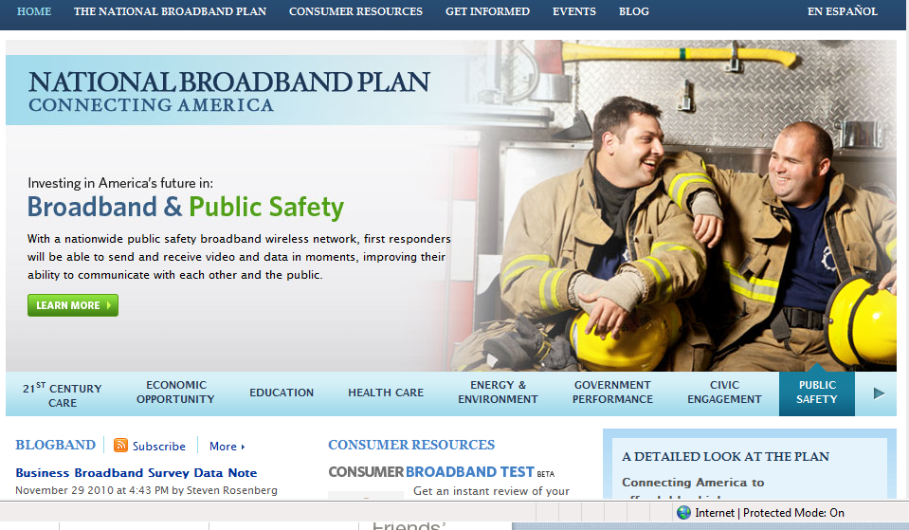







E-Opportunity

Slide 3
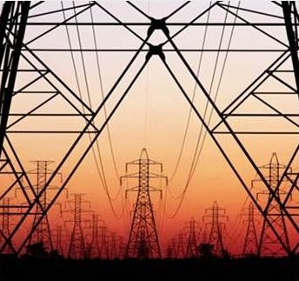


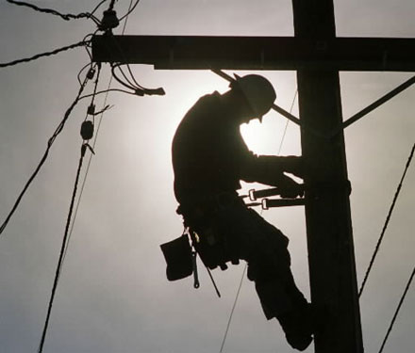

The New Utility

Slide 4


Did You Know?
Over 50,000 schools, libraries, museums, zoos, aquariums, and other cultural organizations across the US are connected with each other and thousands of institutions around the world via the next-generation Internet?
…Rice has from its inception been dedicated to three missions: educating and preparing outstanding students for diverse careers and lives; contributing to the advancement of knowledge across a wide range of fields; and being of service to our city, our state, our nation, and our world…
Research Education Service

Slide 5
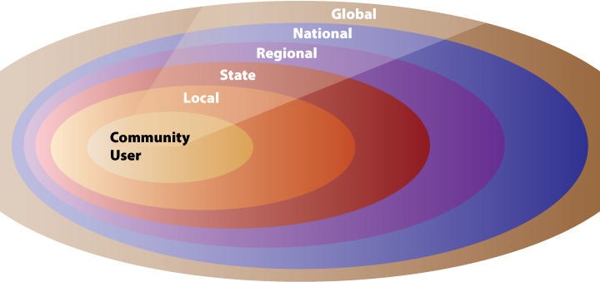
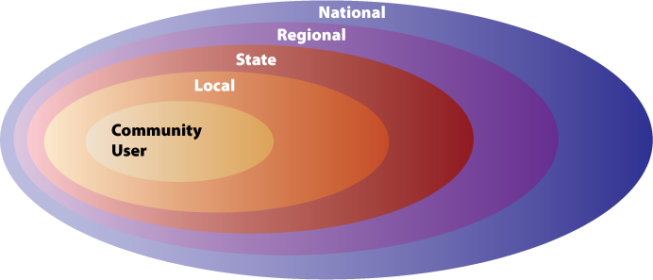
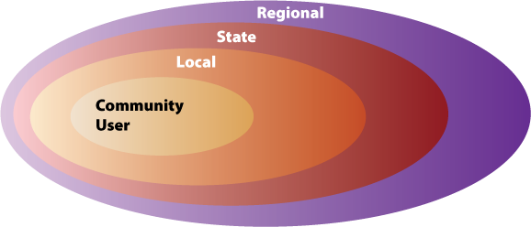
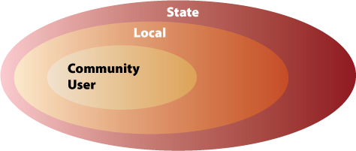
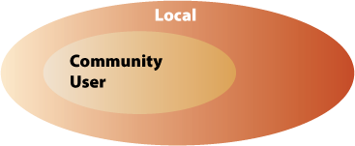


An ecosystem built on partnerships
Courtesy of H. David Lambert, President of Internet2

Slide 6



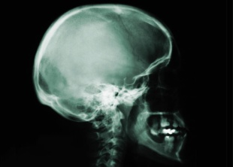



An Asset for the Community
An Asset for the Community
Universities
Universities
Researchers
Researchers
Regional Networks
Regional Networks
K-12
K-12
Industry
Industry
International
International
Notes:
So, advanced networking is increasingly an asset for the entire community. As the next round of advanced networking capabilities are deployed, coordination among and leadership by all networks will be an important part of making them broadly available.

Slide 7

The Need for Speed
6 Seconds
56 kbps
ISDN
DSL/
Cable
T1
168 Hours
74 Hours
25 Hours
6.4 Hours
Time Required to Download 2-hour Course Lecture DVD

Slide 8
SEGP Video

Slide 9
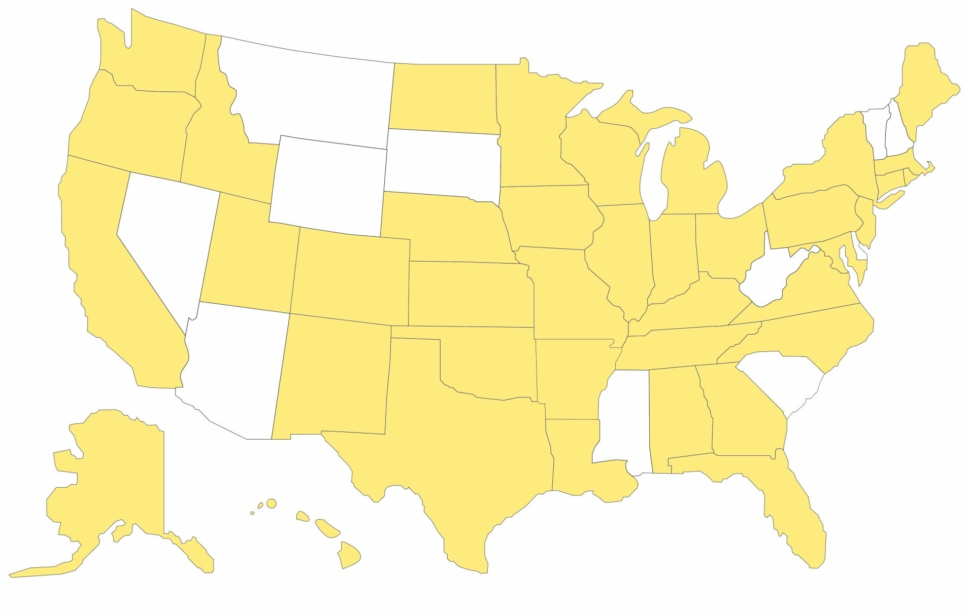
States with Educational Internet2 Networks
Now 40 via Marshall Universities NSF EPSCoR Grant
Notes:
$3B stimulus package for NSF
On top of ~$7B FY09 annual budget
General NSF priorities
“$2B+ in unfunded excellence”
Focus on in-house proposals, standard research grants of 2-5 year duration; increase success rate to 30%
Young investigators; CAREER, transformative, excellence
OCI: $80M stimulus funds
Jumpstart new activities in software, LWD, applications
Career awards, GRF, PetaApps, STCI
OIA: MRI-R2 and ARI-R2 special opportunities for campus investments in CI: $200M each

Slide 10
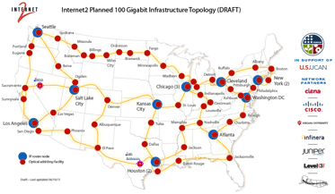
Internet2 Planned 100 Gigabit Infrastructure

Slide 11
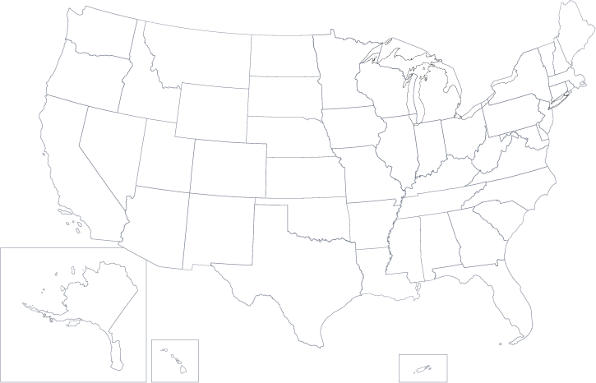
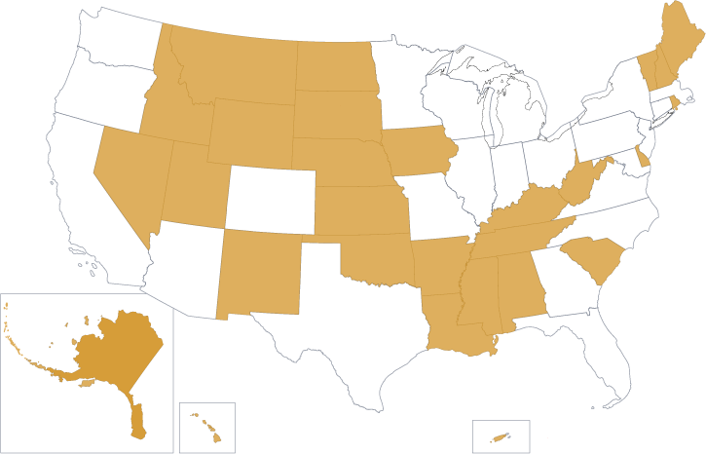

U.S. UCAN: Benefits to EPSCoR States
EPSCoR states
U.S. UCAN footprint
Courtesy of H. David Lambert, President of Internet2

Slide 12

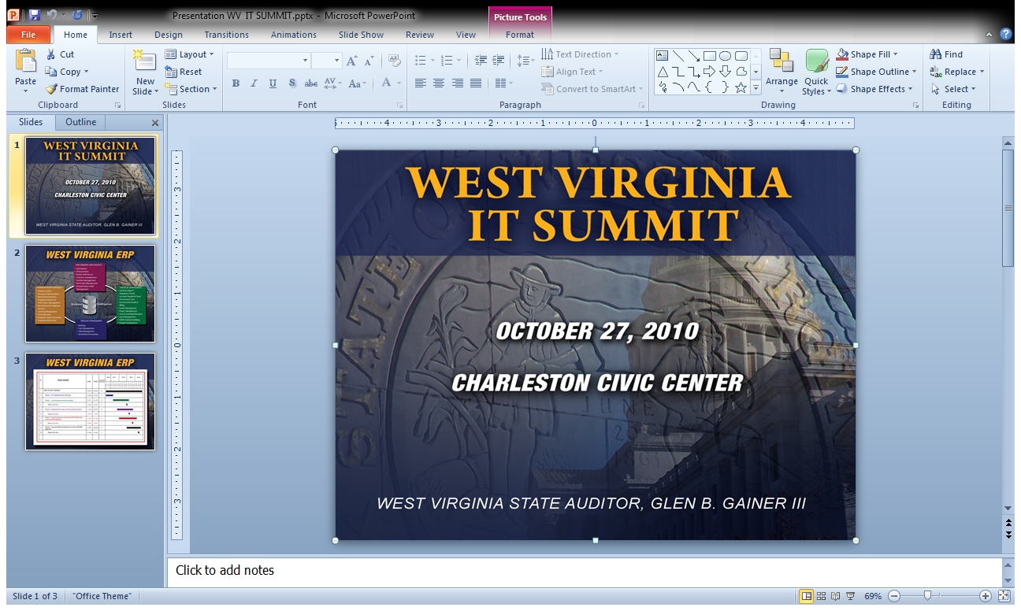

BTOP Award
WV Statewide Broadband Infrastructure Project
$126,323,296

Slide 13
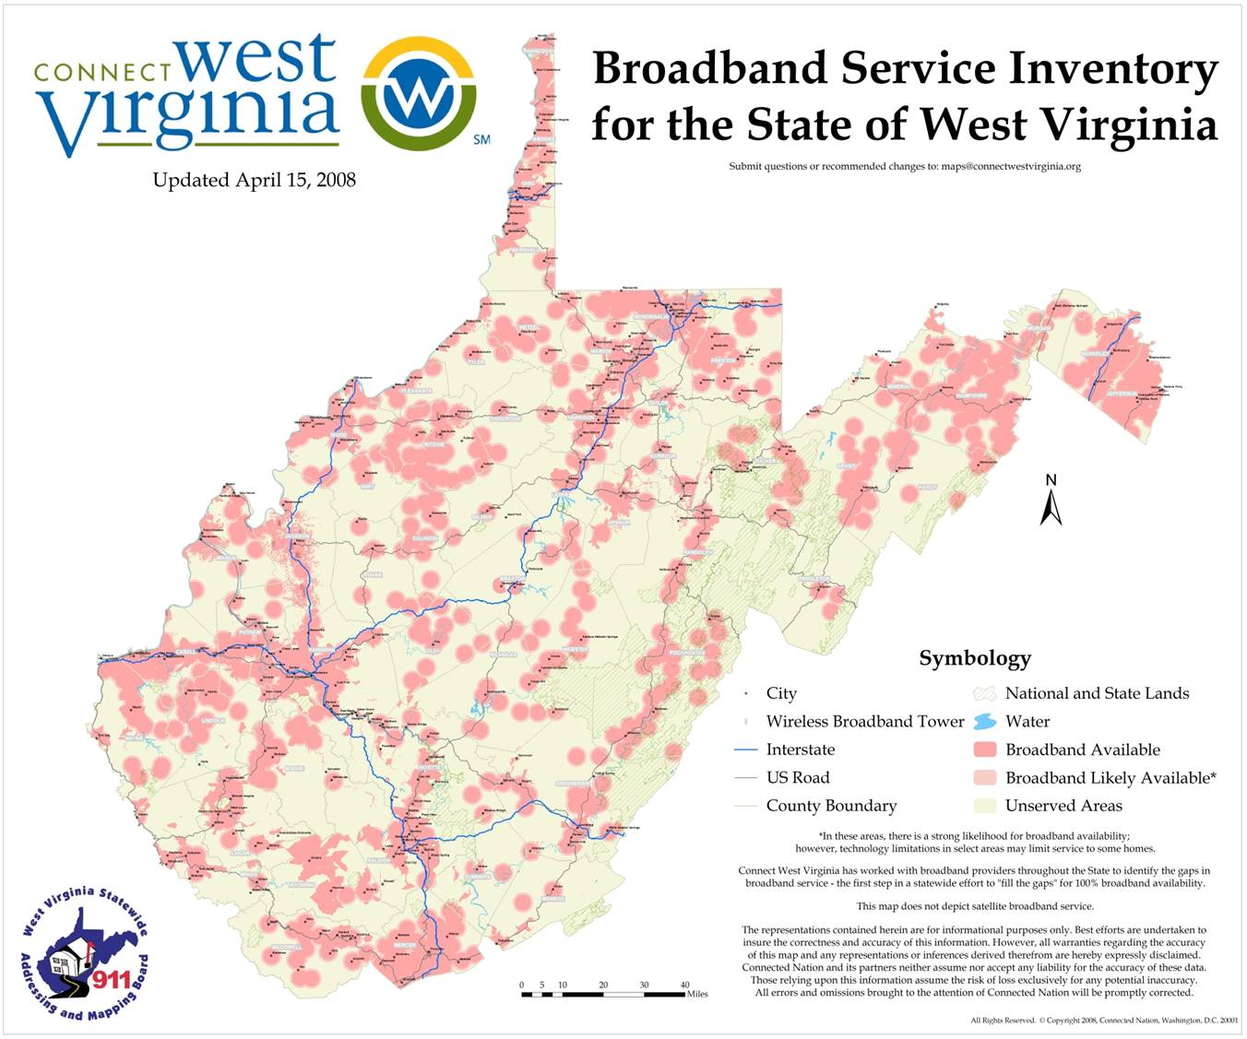

Slide 14

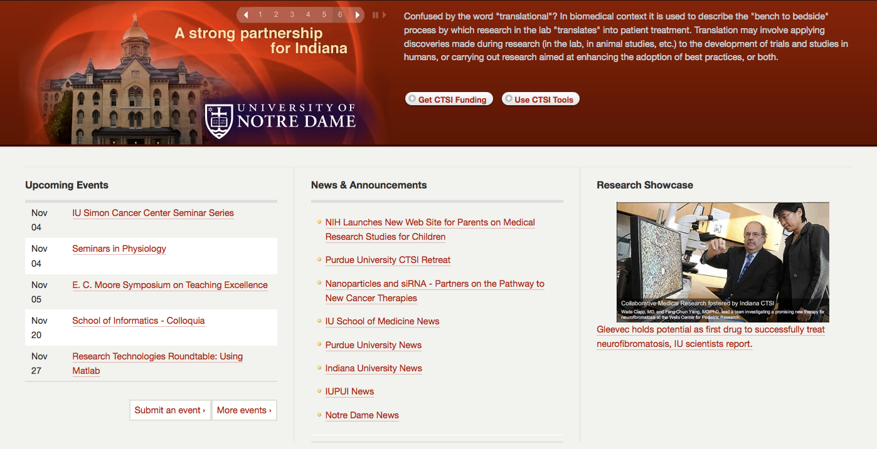
Access to Specialty Portals
Indiana Clinical and Translational Sciences Institute

Slide 15
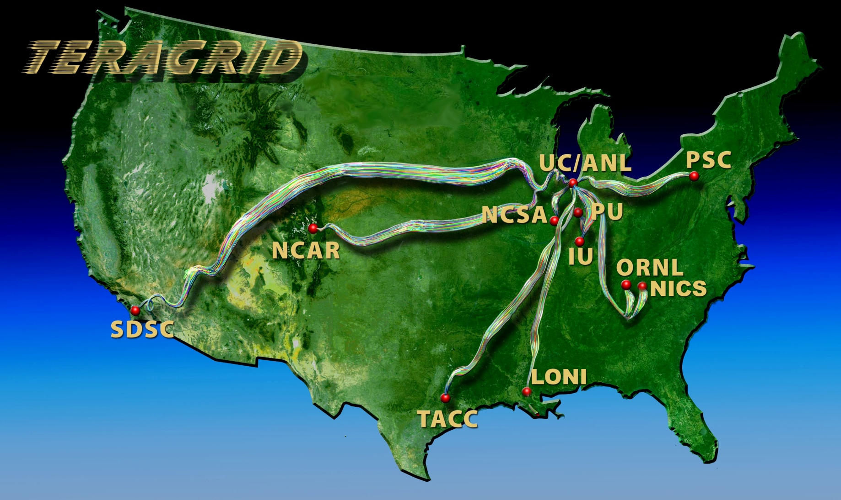
GRIDS

Slide 16
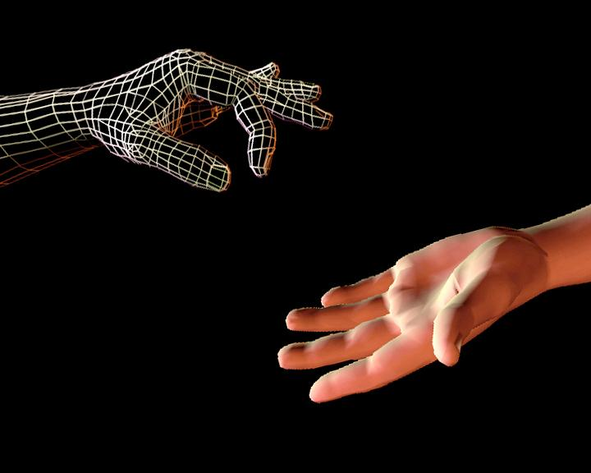
Internet2 Health Science Initiative
Includes clinical practice,
medical and related biological
research, education, and
medical awareness
in the Public.
Notes:
Smithsonian Photo by Laurie Minor-Penland.

Slide 17

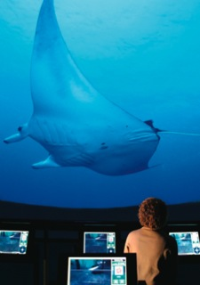
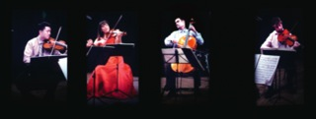
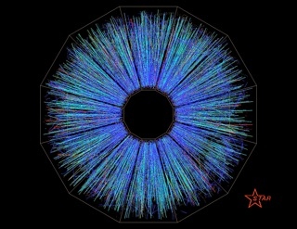
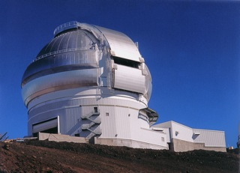
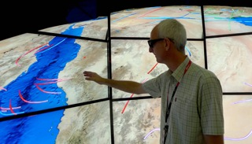
Diverse Applications
Notes:
Jane cerates a computer model based on the collected data to project future scienarios
17

Slide 18
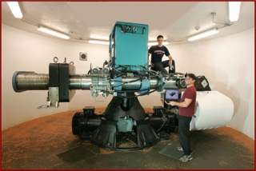
Remote Instrumentation
Notes:
Jane cerates a computer model based on the collected data to project future scenarios
18

Slide 19
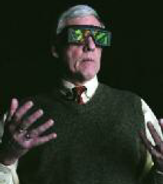

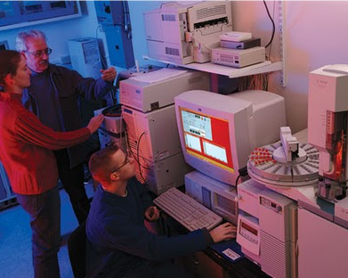

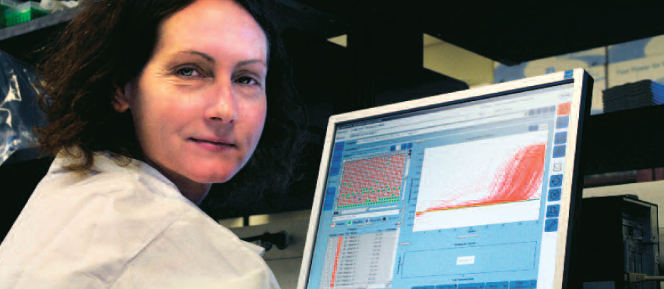
Distributed Research

Slide 20


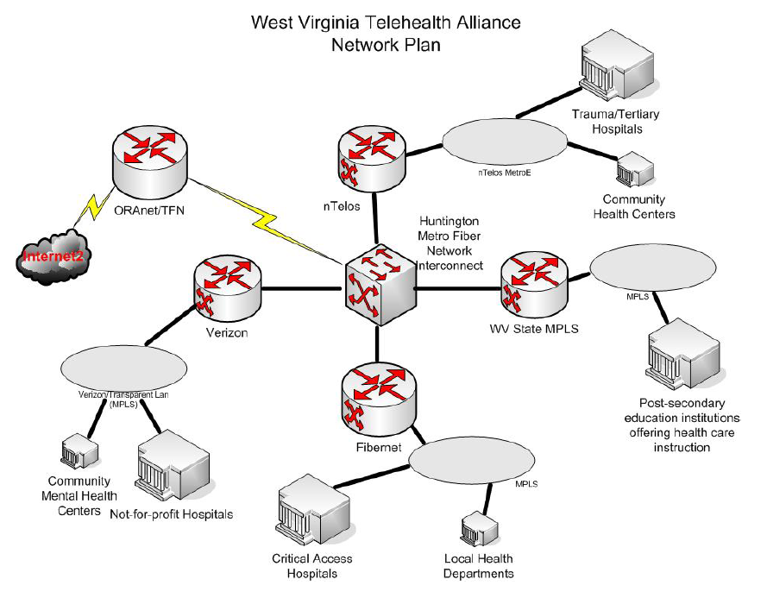
$8.4 Million FCC + 1.3 M in State and Private Funds
OARNet
Notes:
The West Virginia Telehealth Alliance (WVTA) is a non-profit organization dedicated to advancing telehealth use and telemedicine capabilities throughout the Mountain State. Participants in the alliance include hospitals, rural health care centers, medical schools (WVU, Marshall, CAMC, W.Va. School of Osteopathic Medicine), doctors, mental health centers, local health departments, senior groups, consumers as well as AFL-CIO and the West Virginia Chamber of Commerce, and major telecommunications companies.

Slide 21
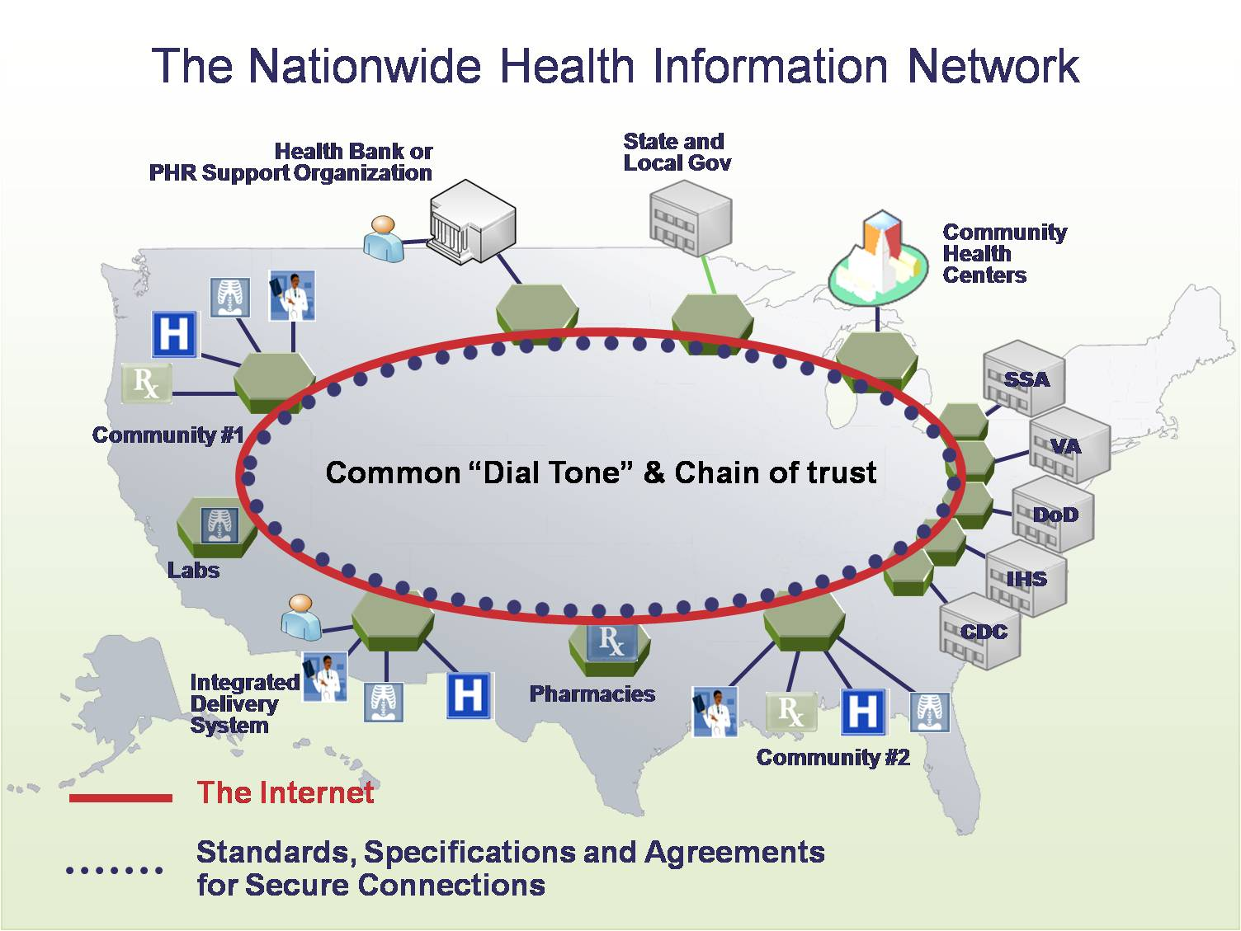

Slide 22
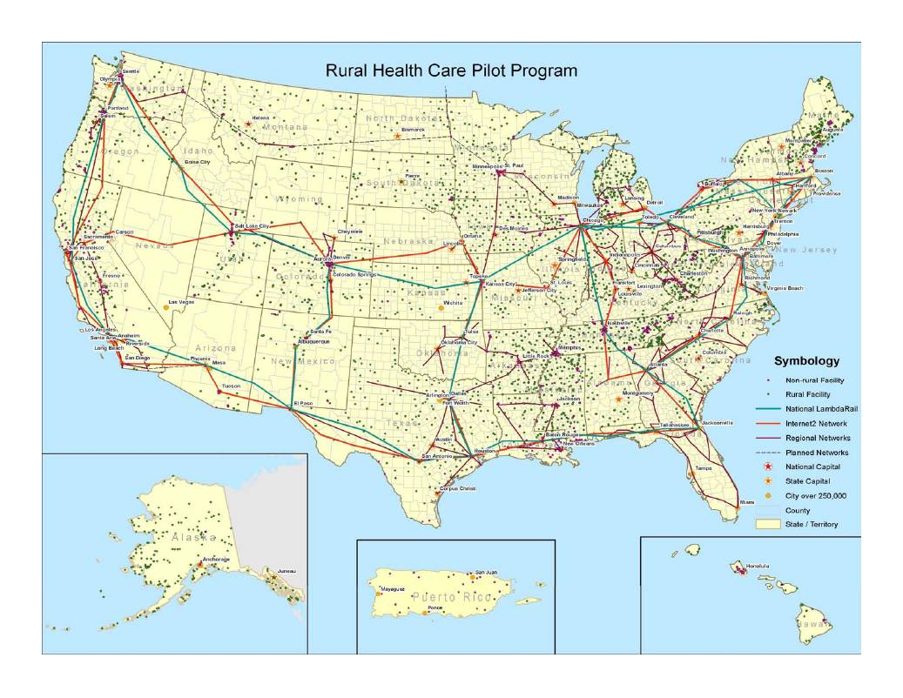

Slide 23
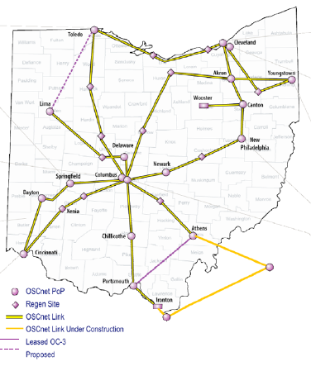

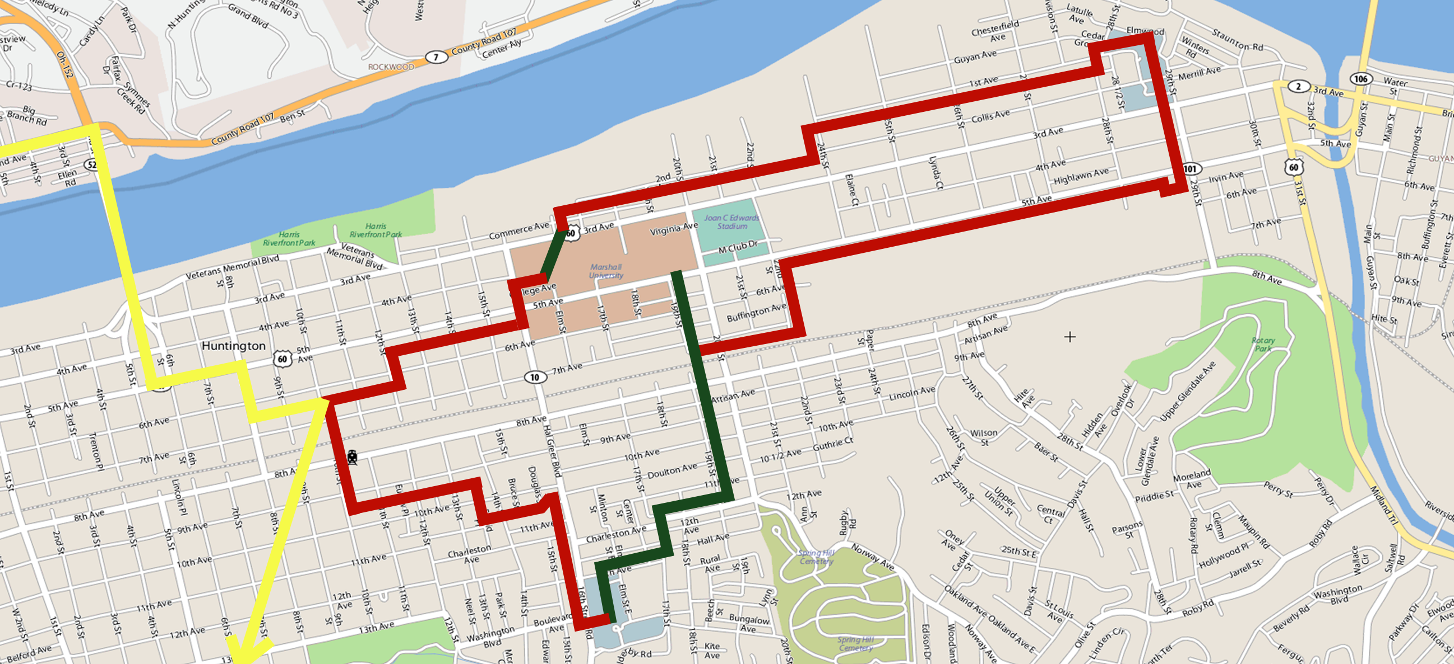




OARNet
FCC Rural Health
WV TeleHealth Alliance
Huntington Metro Fiber

Slide 24

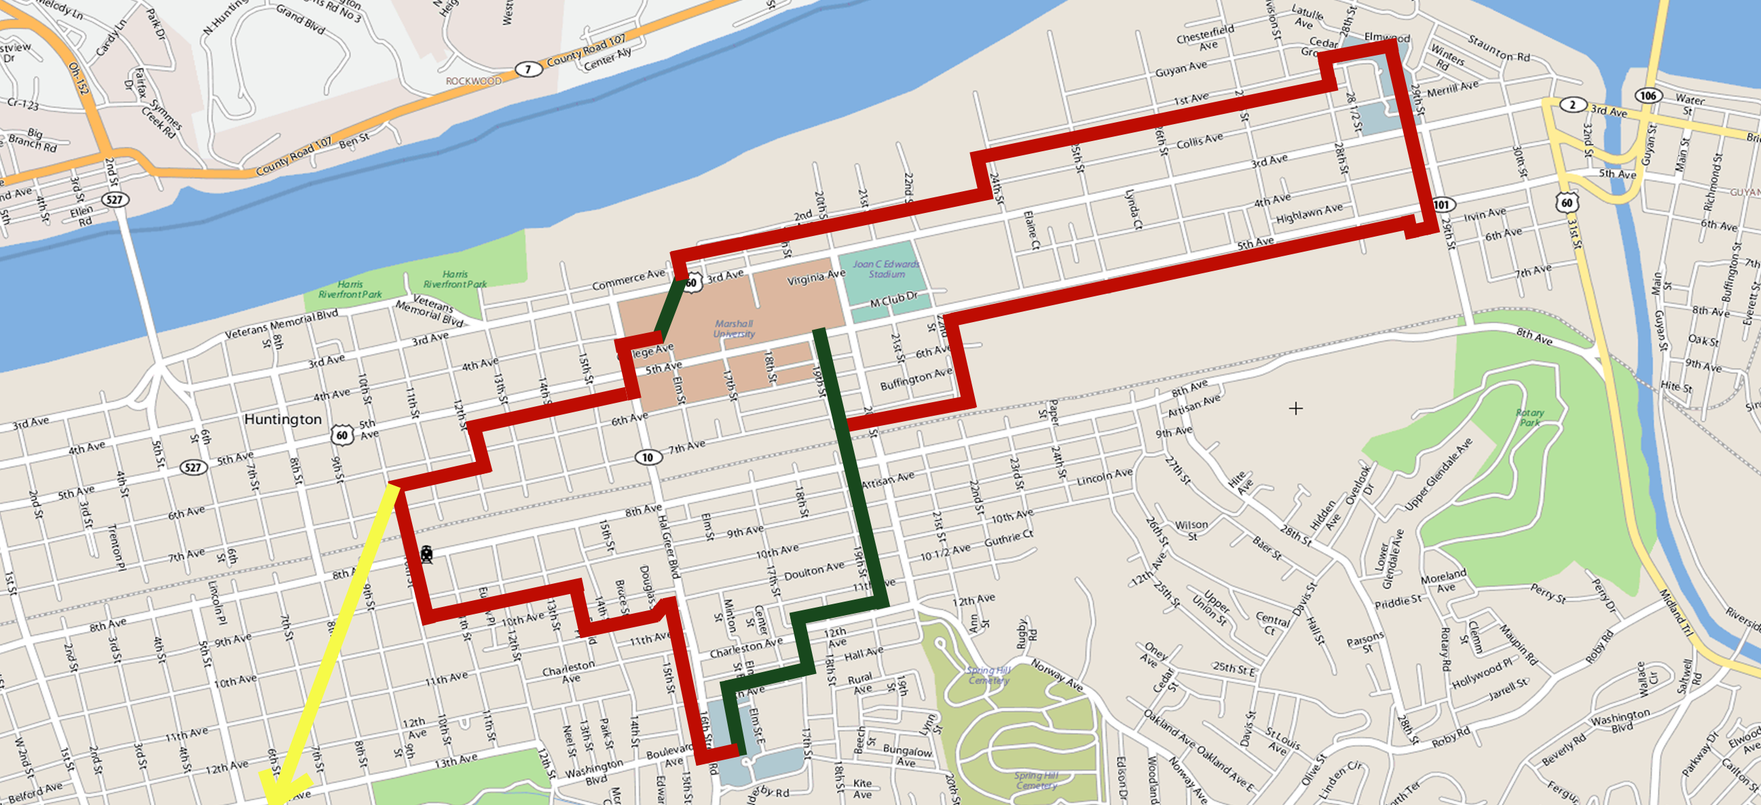

Huntington Metro
Fiber Build Project
Fiber Routes
To Columbus
To Ravenswood
– New Fiber
– Existing MU Fiber
– OARnet/Internet2

Slide 25
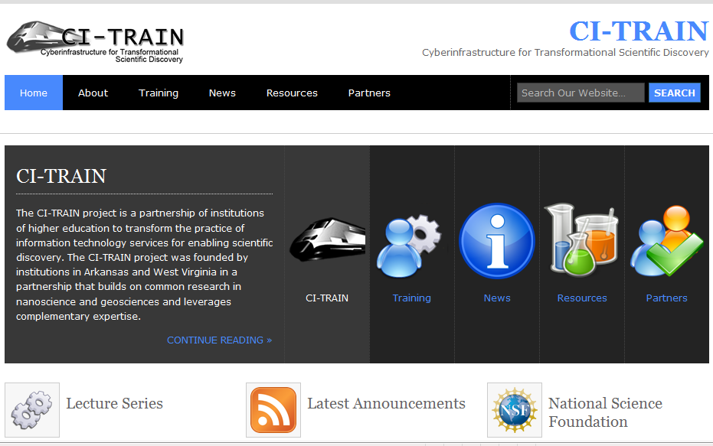
CI-TRAIN

Slide 26
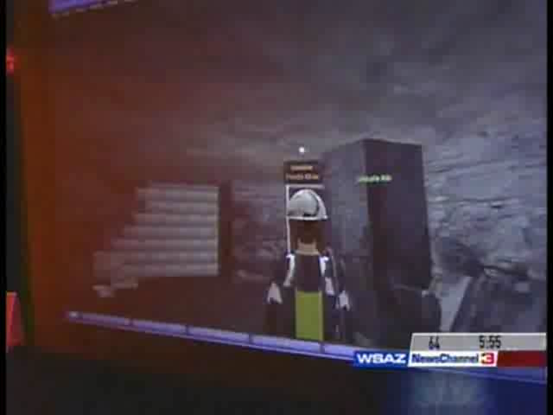
Model Simulation
Notes:
Jane uses visualization to see what the models predict.

Slide 27
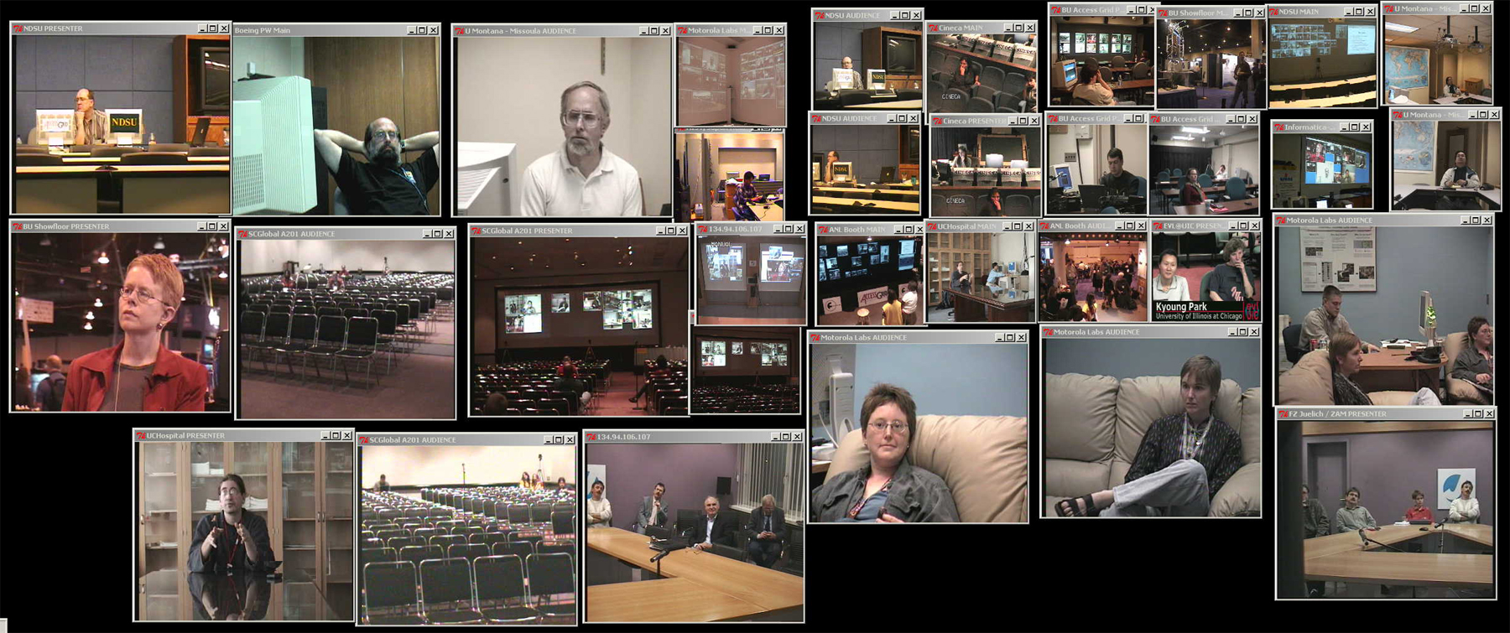
Global Collaboration
Notes:
Jane collaborates with her colleagues about her findings

Slide 28
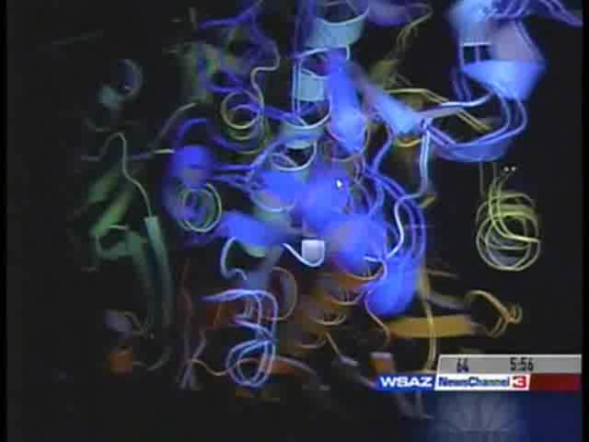
Advanced Visualization
Notes:
Jane uses visualization to see what the models predict.

Slide 29
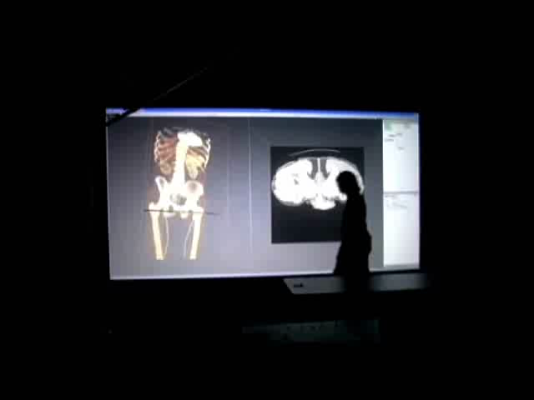
Advanced Visualization
Notes:
Jane uses visualization to see what the models predict.

Slide 30
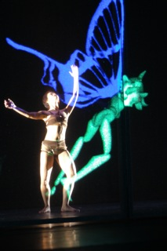
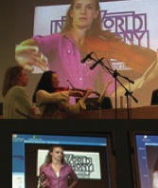
Performing Arts
Notes:
Jane cerates a computer model based on the collected data to project future scenarios
30

Slide 31

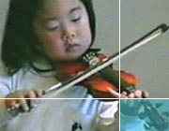
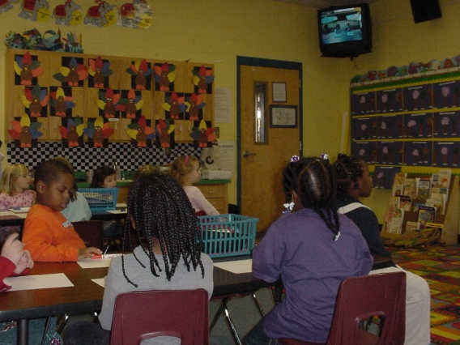
Internet2 K20 Initiative
Connect and engage K12, museums, libraries, science and cultural centers, aquariums, community colleges, universities, etc.
Increase opportunities for joint funding, collaborations, student recruitment, enhanced teaching & learning, incubating global citizens

