Slide 1
Appalachia online: DIGITAL PROJECTS AT MARSHALL UNIVERSITY AND BEYOND
Robert H. Ellison, Marshall University
with thanks to
Thom Walker, Independent Researcher
Notes:
Good morning, and welcome to our session on “Appalachia Online.” I’m Robert Ellison, and I teach English and direct the Center for Sermon Studies at Marshall University.
I want to start by mentioning a change to the program and talking about our format. I’m sorry to say that Thom Walker is not able to be with us today. He was the person who introduced me to this topic and did so much to help get it where it is today. He also provided me with excellent material for the first part of my talk, and I want to publicly give him the credit he deserves.
Our format today may be a bit unusual. We have 75 minutes, but I have only about 15-20 minutes’ worth of material. That was by design; we wanted to leave at lot of time not just for discussion about our work, but for our chance to hear from you about digital projects you’re working on, projects you’re thinking about starting, questions you might have about this whole digitization thing, and so on. That’s where the “roundtable” comes in!
I also invite interaction during the presentation, so feel free to speak up if you have a question or whatever. So let’s get started!

Slide 2
The rev. m. homer cummings papers at marshall university
Notes:
As stated in the program, Thom was going to talk about the Rev. M. Homer Cummings Papers at Marshall. I’ll start there, talking about
who Cummings was, how his papers came to Marshall, what his family wanted the library to do with them, and the nuts-and-bolts of how we’re getting the materials online.
Then I’ll say a few words about how this fits into a larger effort, noted in the program as “The Tri-State Sermons Project.”
So here we go!

Slide 3
The man
Life 1890: Born in Pickaway, WV 1907: Licensed to preach 1909: Graduated from Trevecca College 1910: Began 1st pastorate 1918: Served in Camp Meade, MD 1959: Retired to Huntington 1978: Passed away in Huntington | Family Wife: Mary Louise Cummings (1888-1968) Sons Melville Homer (surgeon, 1920-2001) John Hugh (minister, 1923-2000) 8 grandchildren 30+ great-grandchildren
Notes:
So let me start with who Cummings was. This is a very brief biographical overview; more details about his career will be on the next slide.

Slide 4
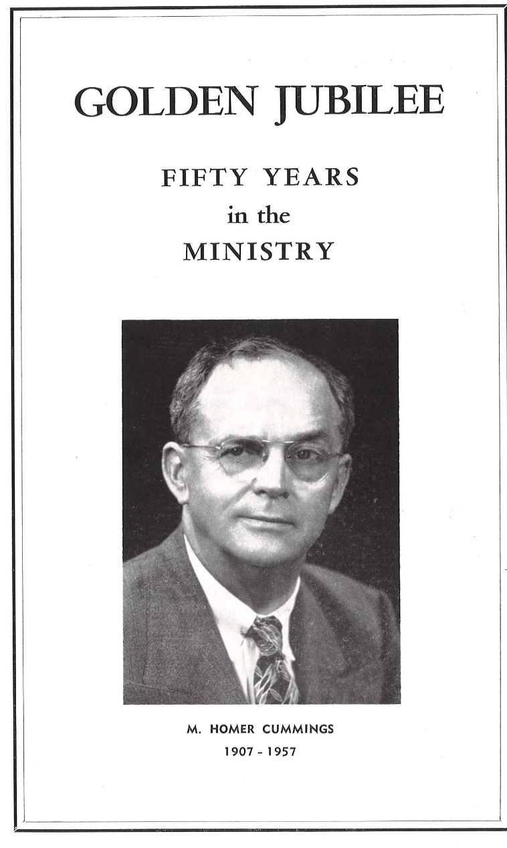
The preacher
1910-1912: Boomer 1912-1913: Clay 1913-1915: Ripley 1915-1916: Proctor 1916-1918: Fulton, Wheeling 1919-1923: Glen White | 1923-1927: Ceredo 1927-1939: Fayetteville 1939-1942: Williamstown 1942-1945: Ravenswood 1945-1957: Coalwood 1947-1957: Glasgow
Notes:
Cummings wore many hats, but I’m pretty sure he would describe himself primarily as a preacher. The program for the celebration of his Golden Jubilee in 1957 listed all the churches he’d served over those 50 years.
As w saw on the previous slide, he remained in Glasgow for 2 more years and retired to Huntington in 1959.

Slide 5
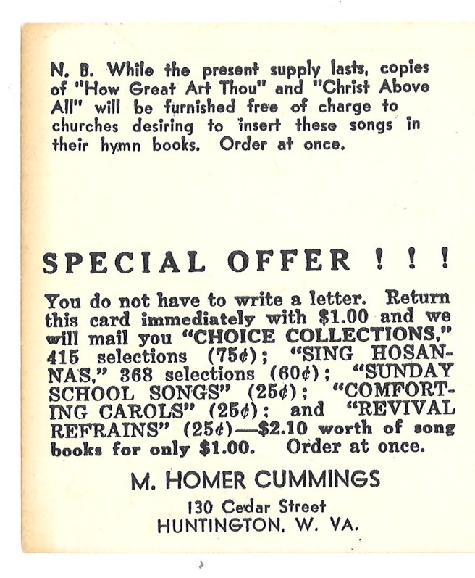
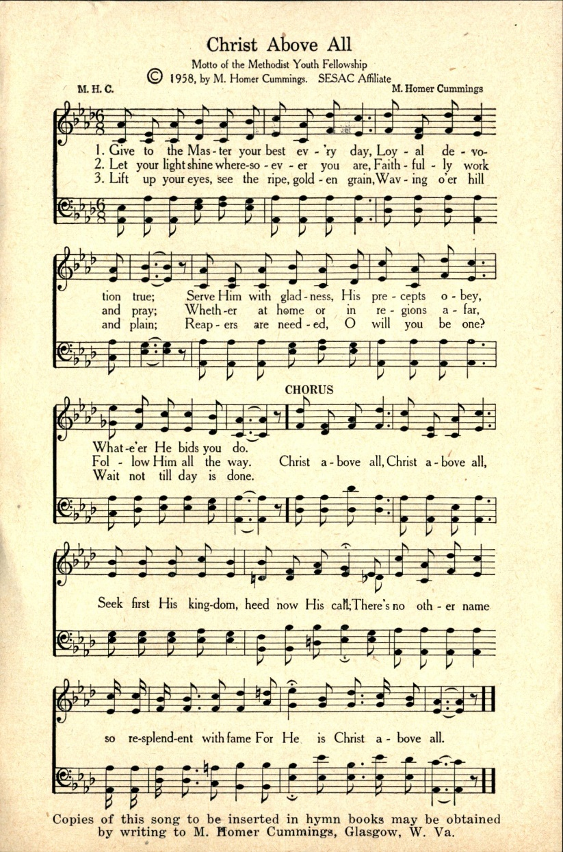
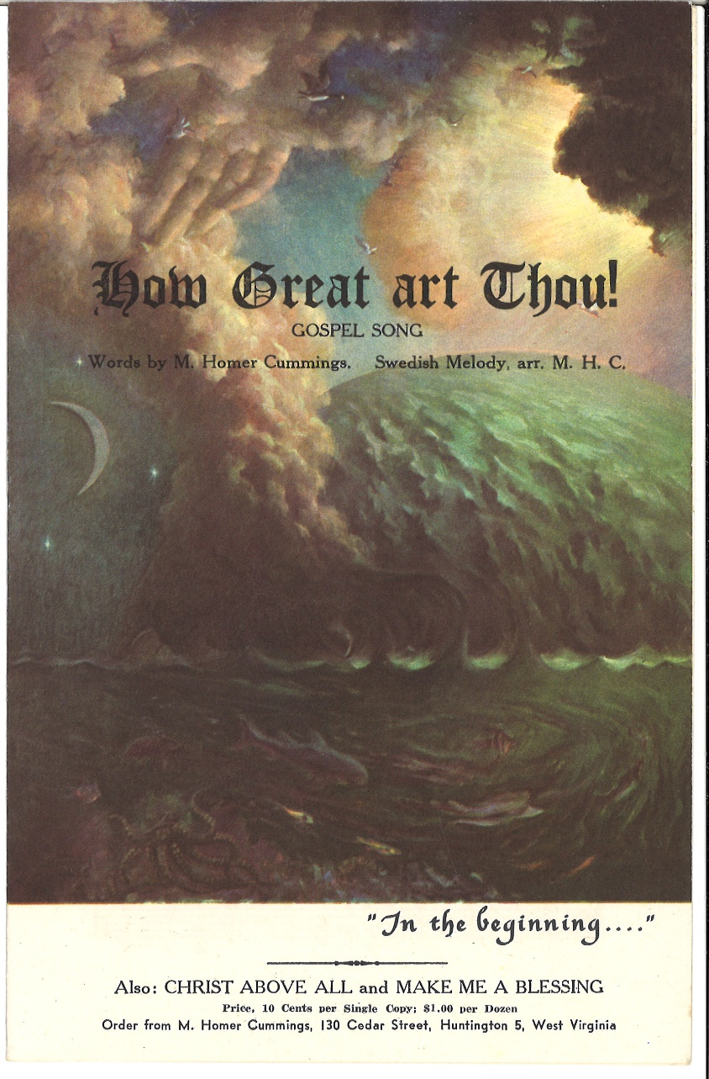
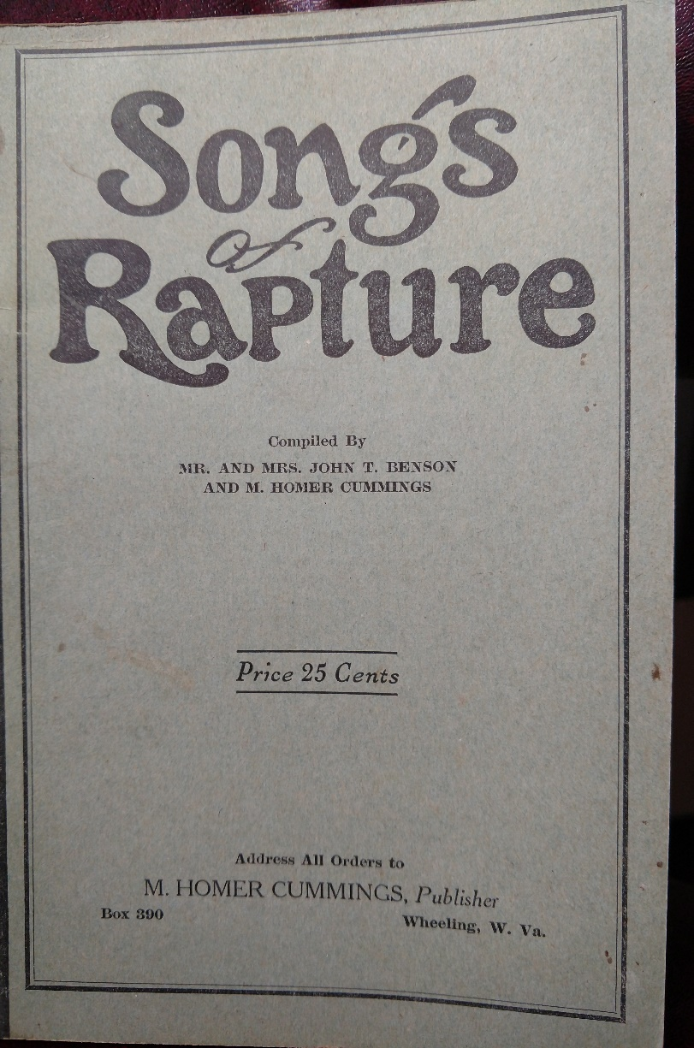
The hymn writer
Notes:
Cummings’ second hat was that of hymn writer. Some of the materials I’ve run across credit him with composing several hundred pieces; the ones I’ve actually put my hands on total about 130.
These were printed in several different ways. Sometimes they’d be postcard-sized, with special offers or promotional messages on the back.
Other times, they’d be printed the size of hymnal pages, or gathered into little booklets he offered for sale.
Finally, there were times he’d be the publisher rather than the composer, compiling hymns others had written and offering them for sale as well.

Slide 6
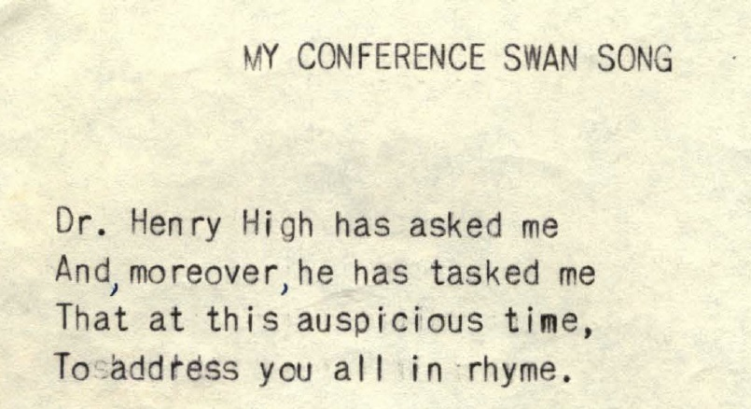
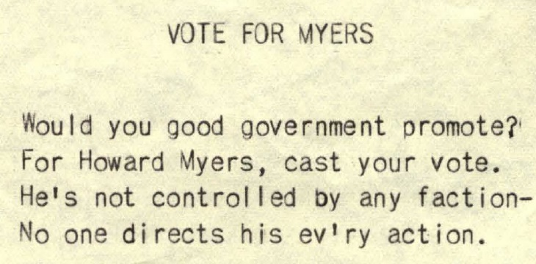
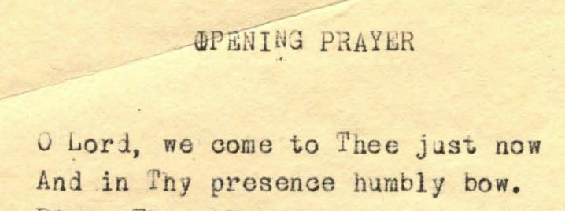
The poet
Notes:
Next, Cummings was a poet. As we’d expect from a minister, some of his poems were on religious topics, or reflections on his years in the ministry.
His poems could get political at times, which we may or may not expect from a minister!
And on the lighter side, he wrote a lot of “corner couplets” and short pieces under the name “Josh Hayseed.” These would be published in the local paper, and later published all together in book or pamphlet form.

Slide 7
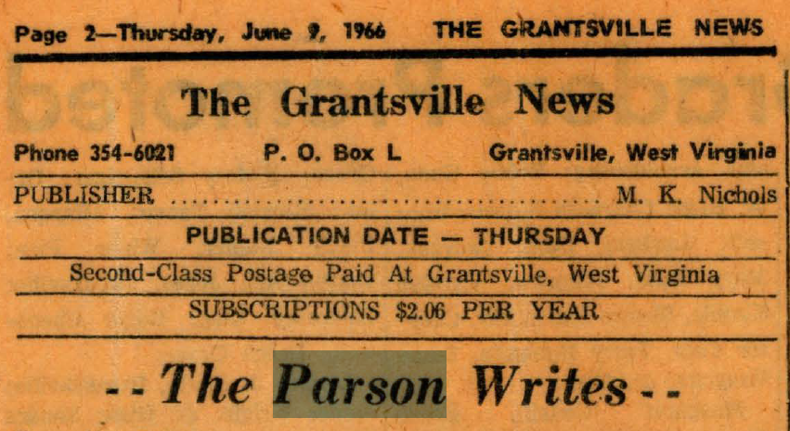
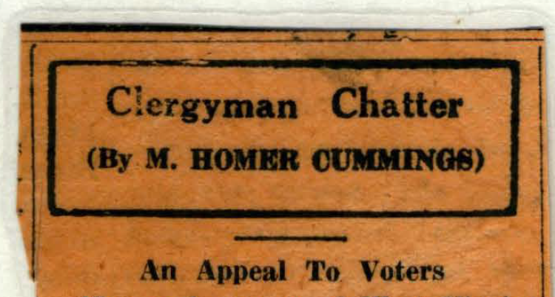
The columnist
Notes:
And I wasn’t sure where to put this in order of importance, but he also wrote a fair number of newspaper columns published under several different headlines. “Our Weekly Visit” appeared in the Grantsville News; others were published in the Huntington Herald-Dispatch.

Slide 8
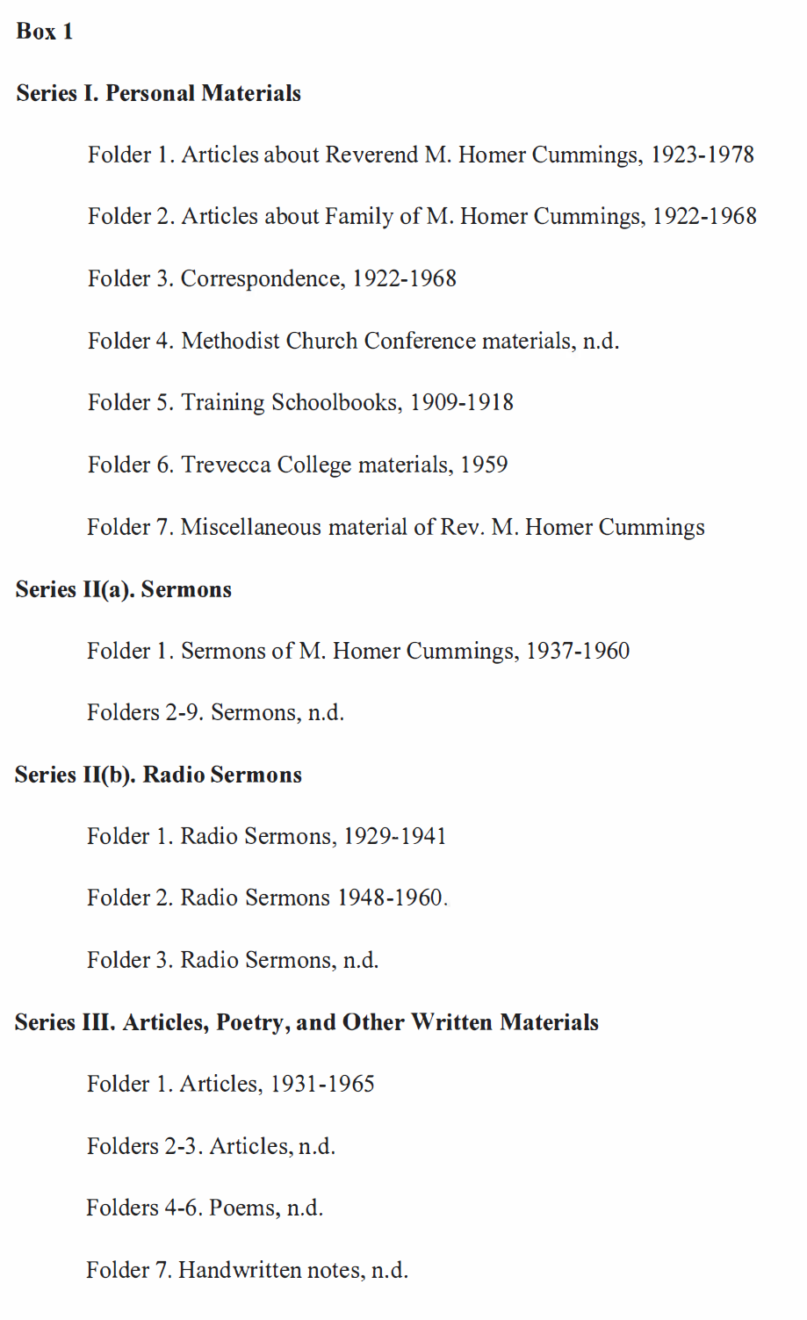
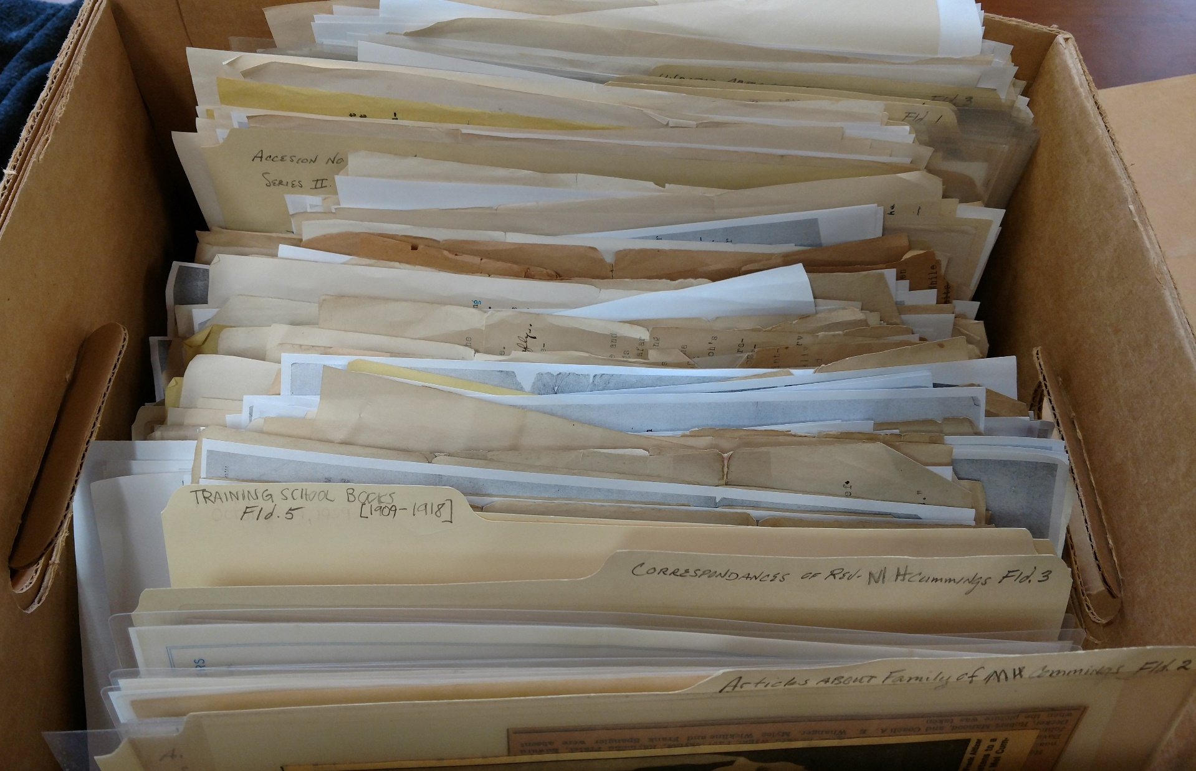
The collection
Notes:
Now I’d like to describe the collection that was given to Marshall back in 2014.
This banker’s box with about 400 documents is the only part of the collection that has been processed and cataloged. This is a page from the “Register” prepared by the Special Collections staff, indicating how it’s been organized into 4 “Series,” each with several file folders.

Slide 9
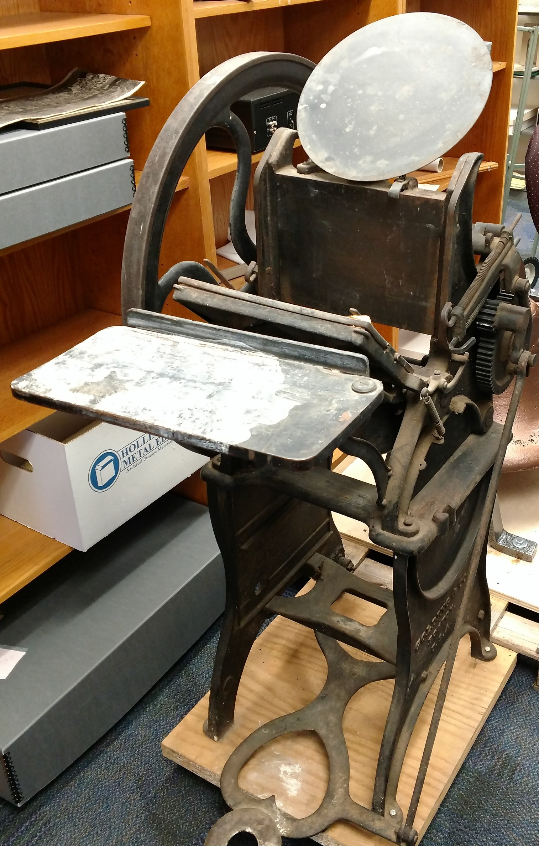
The collection
Notes:
There was also a cardboard box of papers that no one had gone through until I started this project. This is where I found the 130 or so individual hymns and little booklets I mentioned earlier. We were also given the printing press on which many of these were published, which I think is pretty cool.

Slide 10
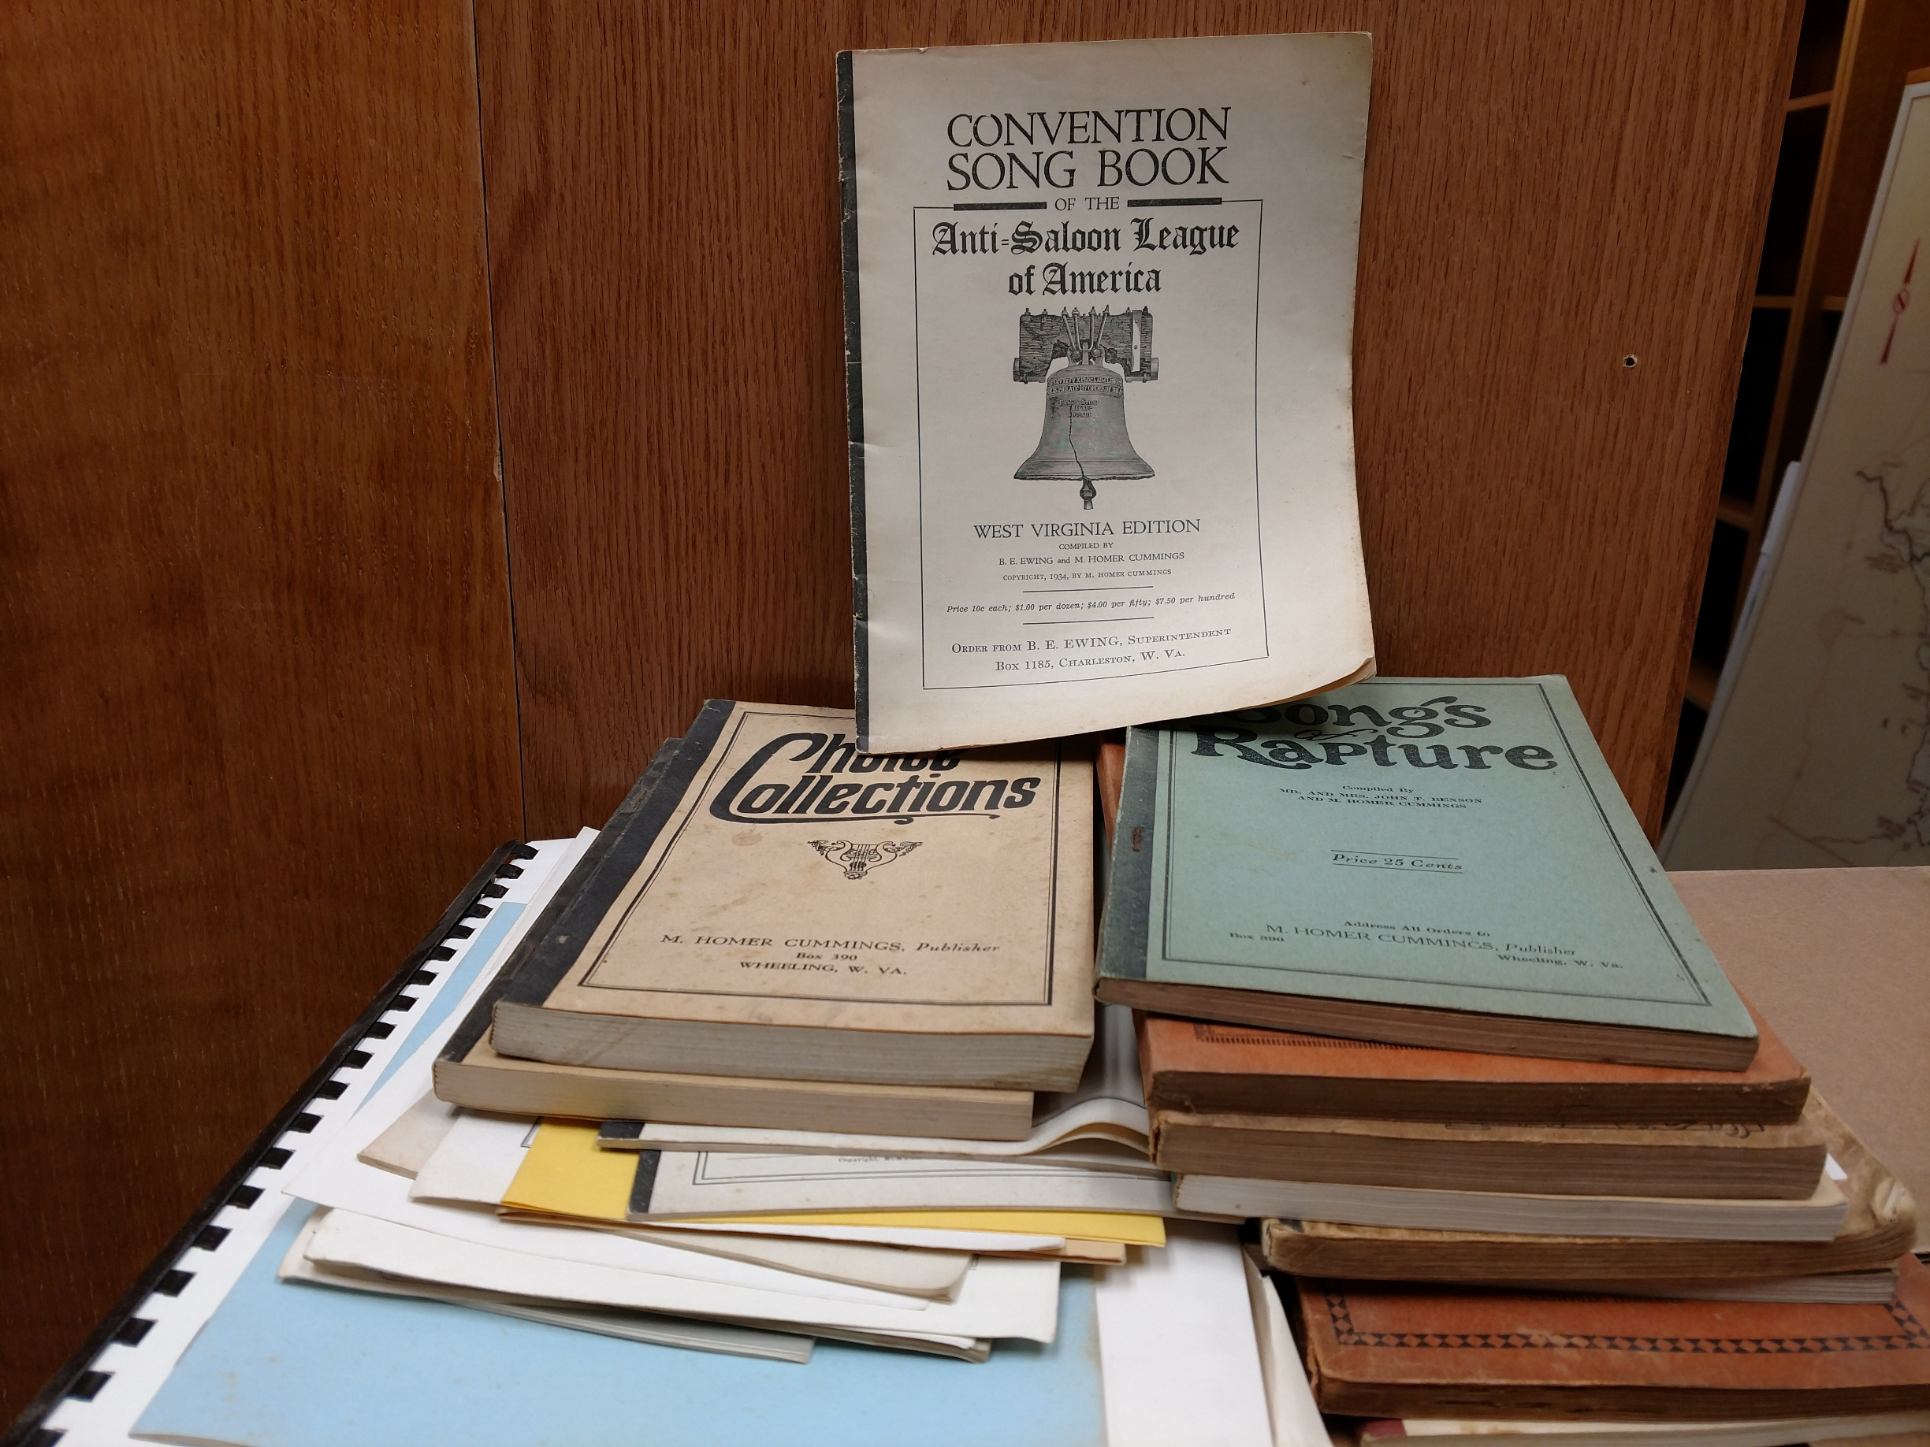
The collection
Notes:
And this is the rest of the collection, sitting back in our big archive storage room waiting for something to be done with it.
I went through these boxes for the first time last week. There’s some additional stuff by Cummings; there are about 30 items in this photo: single pieces by Cummings, booklets of hymns written entirely by him, and collections of others’ work he compiled and sold.
The one on the top is my favorite. Cummings was not shy about his anti-alcohol views, so it makes sense that he would help put together a songbook for the Anti-Saloon League of America.

Slide 11
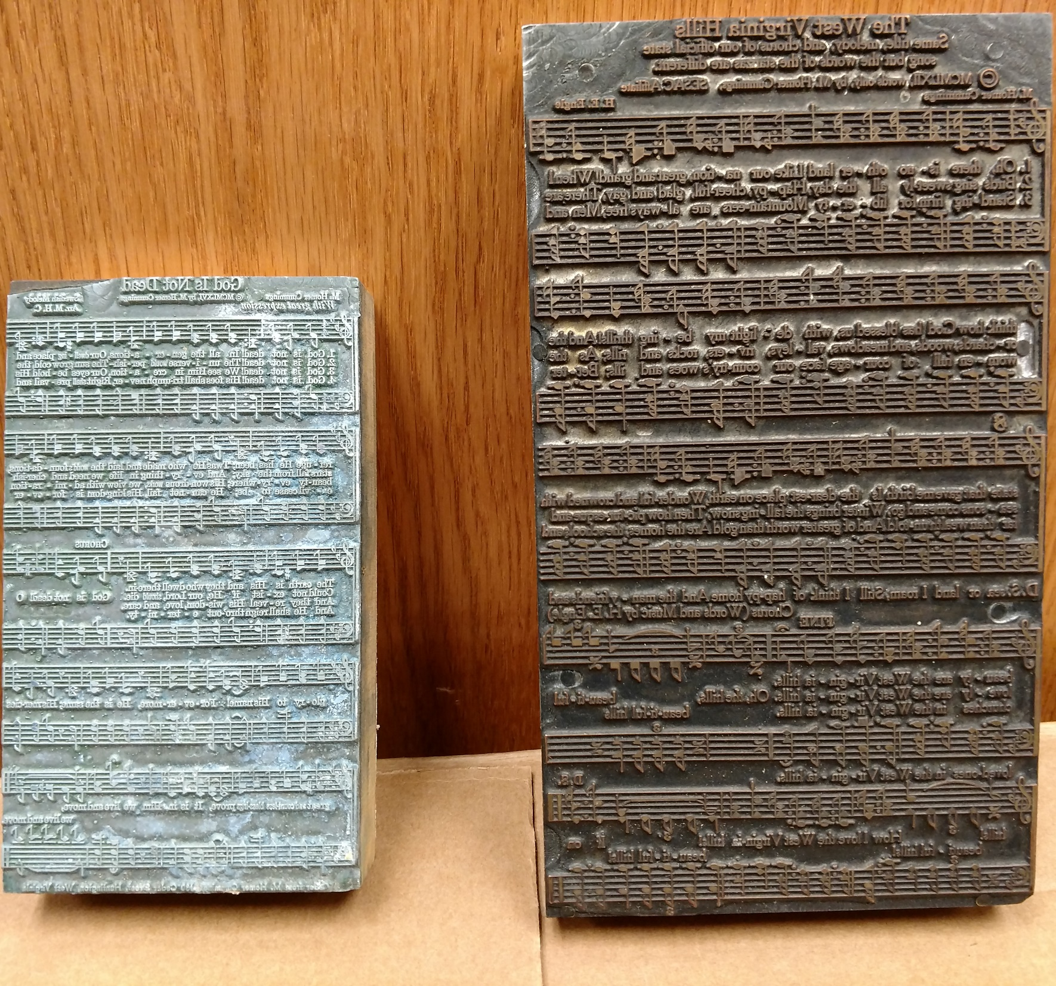
The collection
Notes:
Also by Cummings, we have 33 plates used in the printing press and about 45 wire recordings of his music. We can’t do much with them; I think we have a machine that can read them, but they’re very fragile and would probably break if we tried.

Slide 12
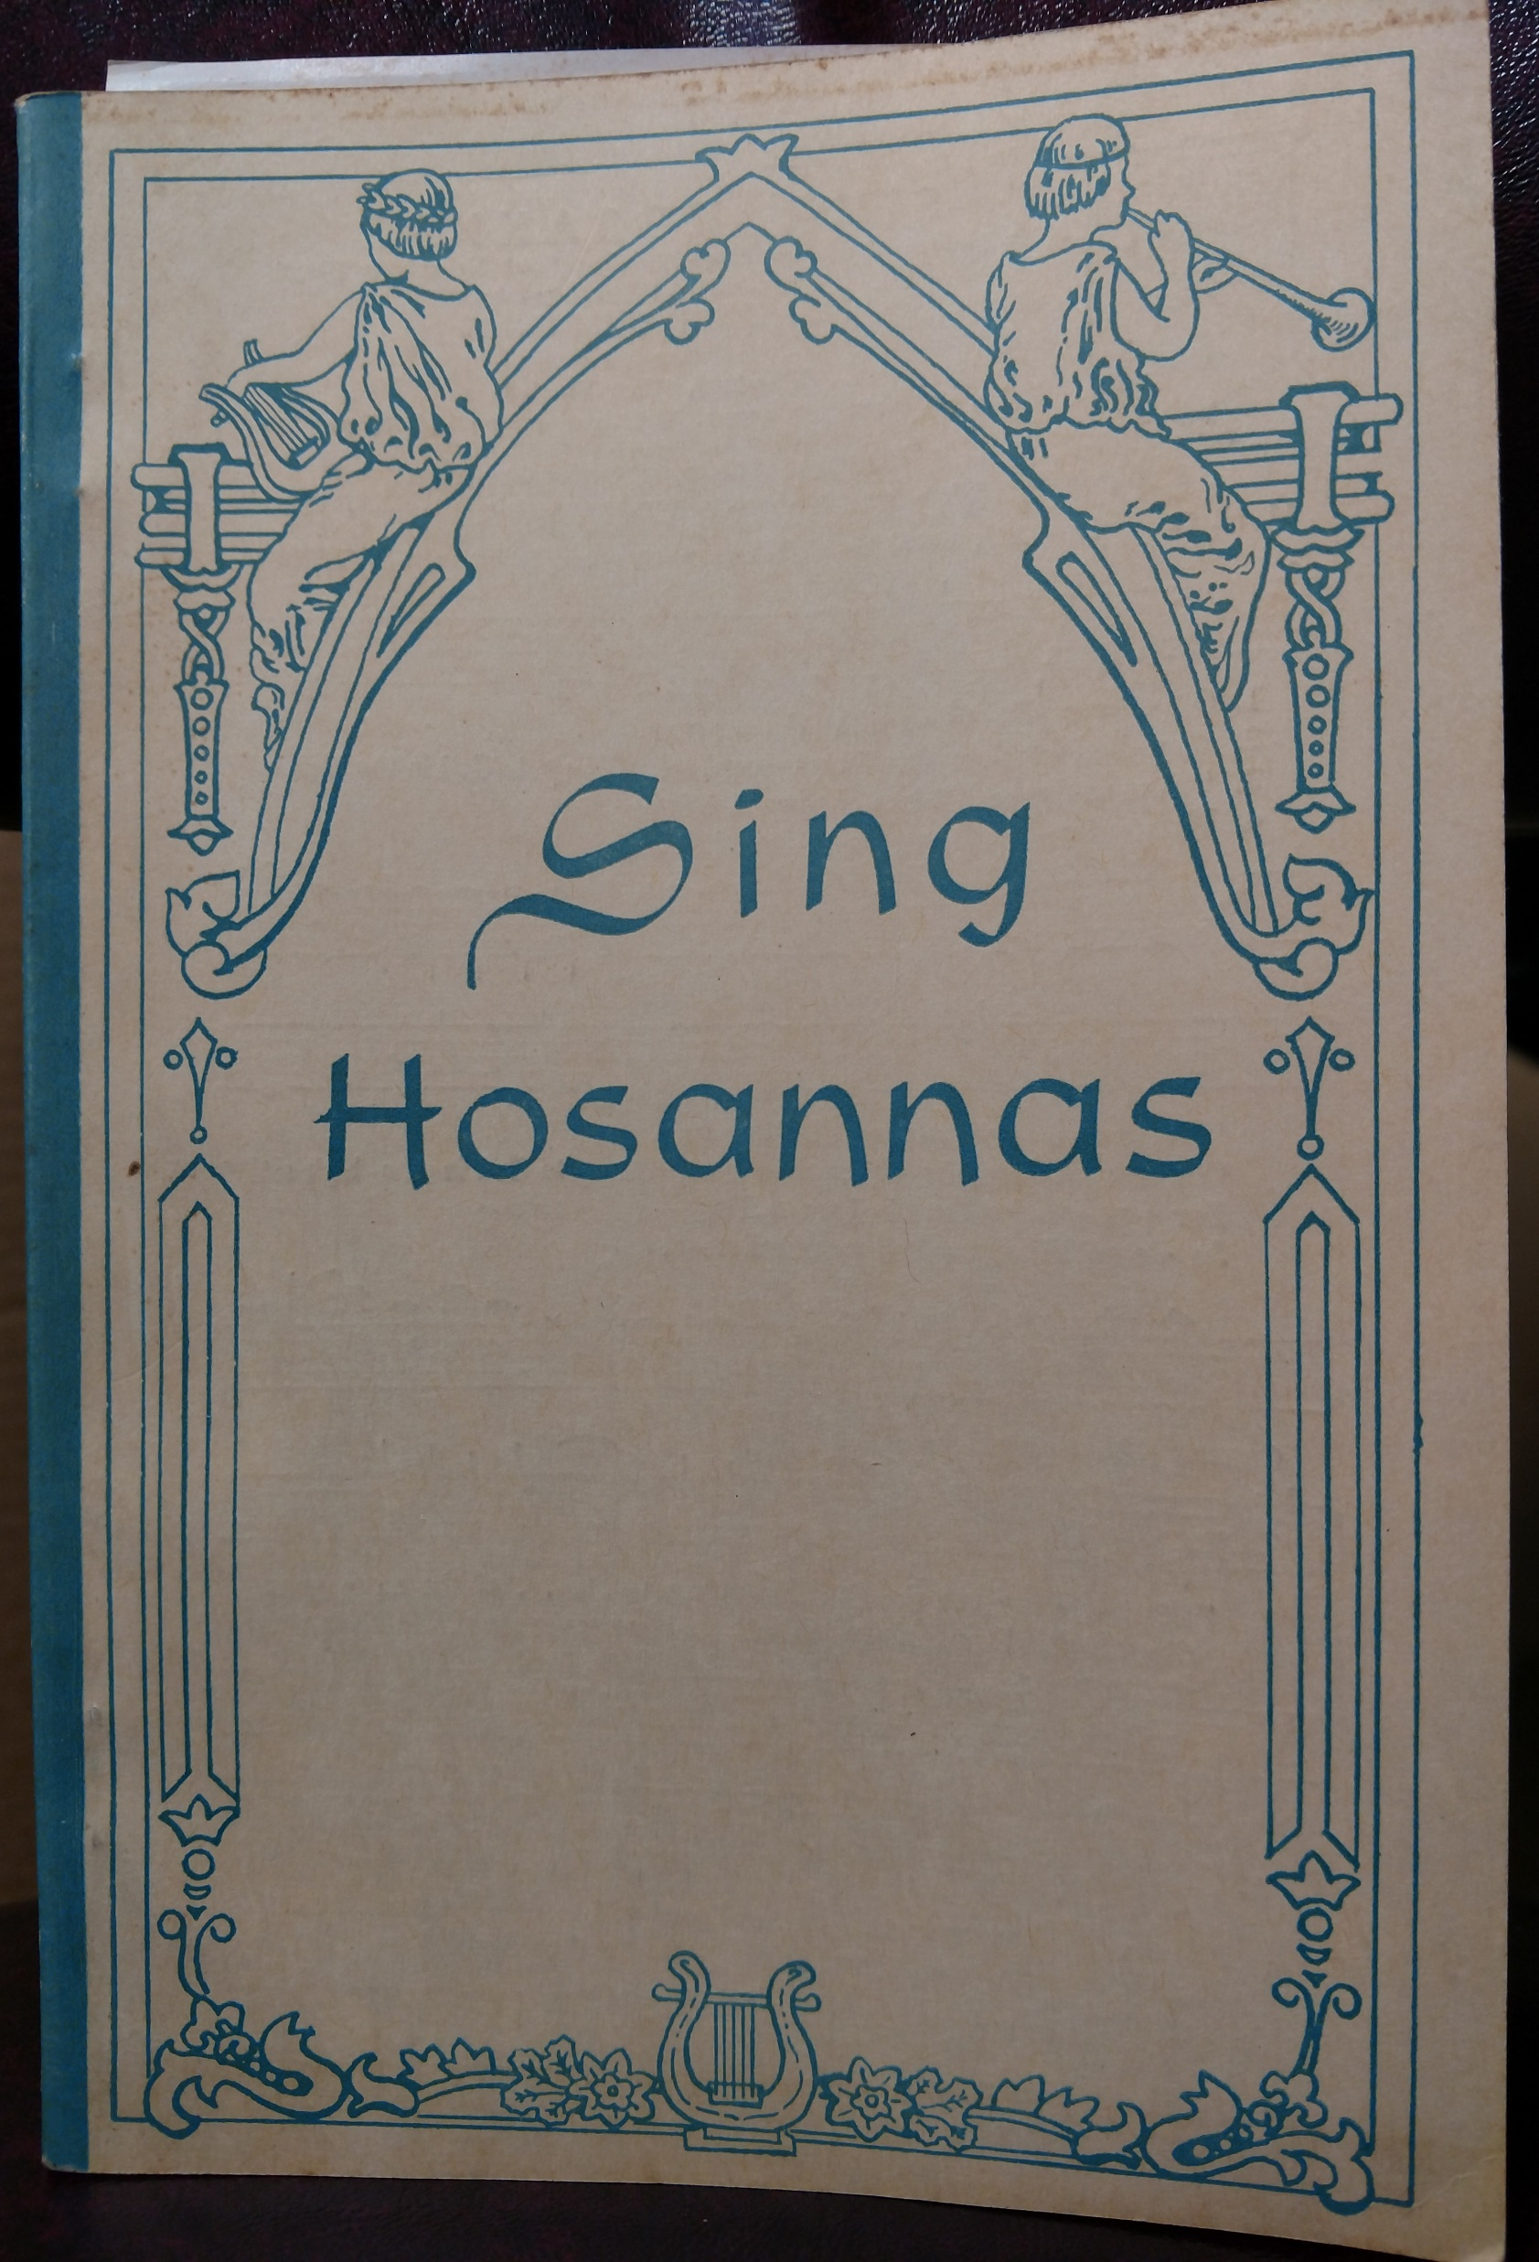
The collection
Notes:
Finally, there are items that Cummings did not have a hand in creating but were part of the library he assembled.
There are about 110 phonograph records of religious and classical music. I chose this photo because the record was made by the Rodeheaver Record Company, with whom Cummings had many business dealings.
There are also over 400 hymnals! That’s the grand total; I found these just last week, so I haven’t had the chance to sort through the duplicates and see how many unique titles there are. That’s pretty low on my priority list, but I hope to get it done eventually.

Slide 13
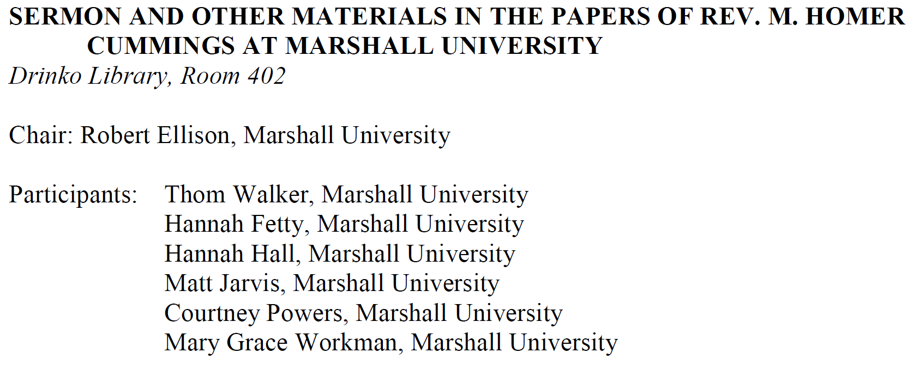
Student projects
Notes:
So that’s the collection. What are we doing with it?
In August 2018, Thom and I visited with Melville Homer Cummings III, the grandson who gave us the collection. We asked him why he’d given it to Marshall, and what he hoped we would do with it. He said he thought his grandfather “made a great contribution to West Virginia,” and he just didn’t “wanna see [the collection] die.”
We think we’re honoring his wishes. The process actually started in the fall of 2017, when I taught an honors class in the sermon. Rather than having the students write the “traditional” term paper, they chose a Cummings folder to scan and did a project on some aspect of the collection.
Some did write papers, on the structure and style of his sermons, the anti-alcohol views expressed in his newspaper columns. Others worked more outside the box. One did an oral interpretation of one of Cummings’ poem, and others shot videos using a sermon as a voice-over. Students whose schedules permitted also talked about their work in the first Conference on Sermon Studies, held on Marshall’s campus in October 2017.

Slide 14
Choosing a platform
Notes:
Now we’re working to get the collection online, so even more people can have access to the materials. I’ll talk now about the techy side of that process.
The first thing we had to do was decide where the project was going to live. After talking with the librarians, we decided to go with MDS. It’s already being used to post faculty research, host conferences, and publish journals, and we thought it would work well for this project too. It won’t work for everything (some of my colleagues are working on a mapping project that will need to be hosted elsewhere), but it’s a good fit for us.
There are several reasons it’s a good fit:
The infrastructure is already in place, so we don’t have to reinvent the wheel
We get excellent tech support from the vendor
We can run analytics, which will be very helpful in documenting how many people are using the collection.

Slide 15
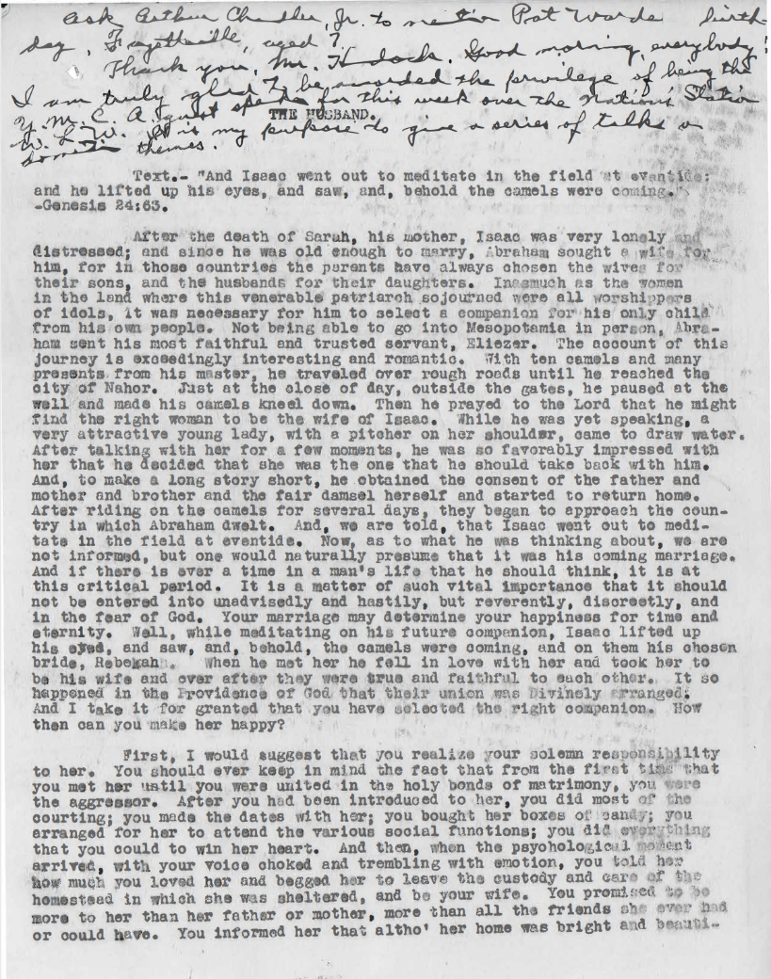
Scanning specifications
Notes:
Then we had to decide how we wanted the scans to look. The easy part was committing to providing high-quality, searchable PDFs. The hard part was figuring out how to get there. This took a lot of trial and error; I found myself spending way more time in Special Collections than I’d planned!
When it came to the sermons, we noticed that many of the pages were a bit yellowed, either because of age or the paper was originally that way, and we thought that color scans were a bit easier on the eyes. They’re also much bigger files, but we could compensate for that by saving the final versions as reduced-size PDFs. That cut the size down by about half. Most of the PDFs of everything in a given folder were 20 or 30MB; the reduced versions are 12-15, which will make them much easier to download.

Slide 16
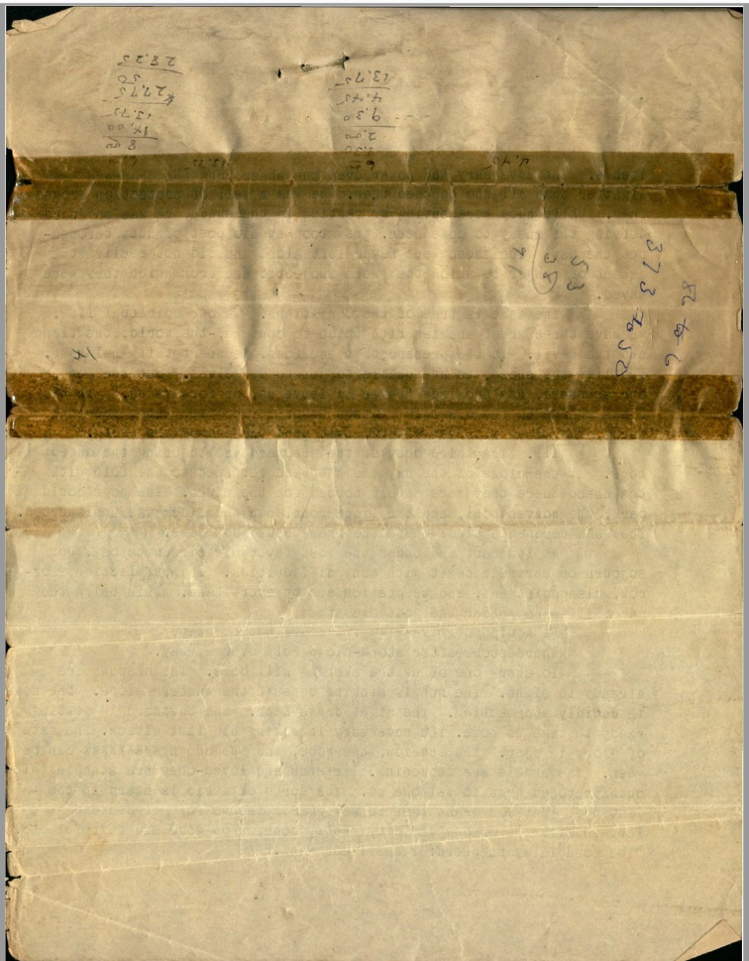
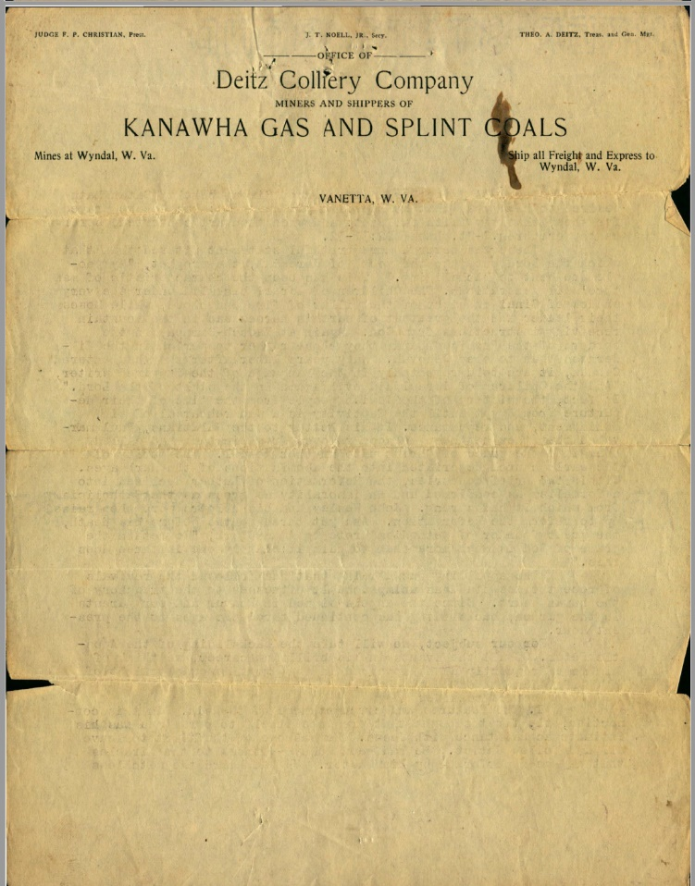
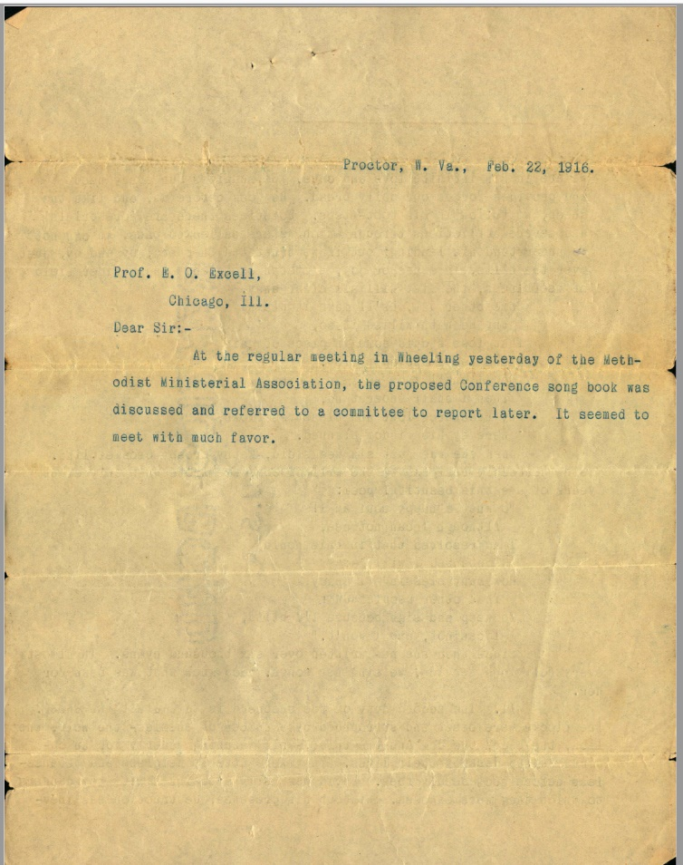
Scanning specifications
Notes:
We also decided that if there was anything at all on the back side of a page, we would scan that as well. Cummings’ grandson told us he liked to reuse paper, which is likely because he lived through the Great Depression, and we wanted that to be illustrated here.
Sometimes, the material there seems fairly inconsequential, such as the numbers in the scan on the left. In other cases, however, it may be more significant. Most of the sermons are not dated, but the letterhead he used or the drafts of letters he typed could provide some indication of when they were composed.

Slide 17
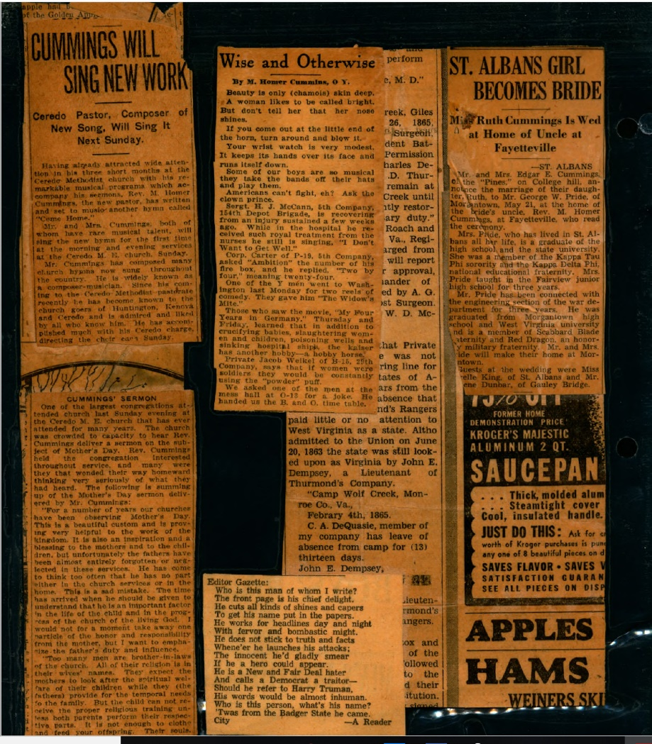
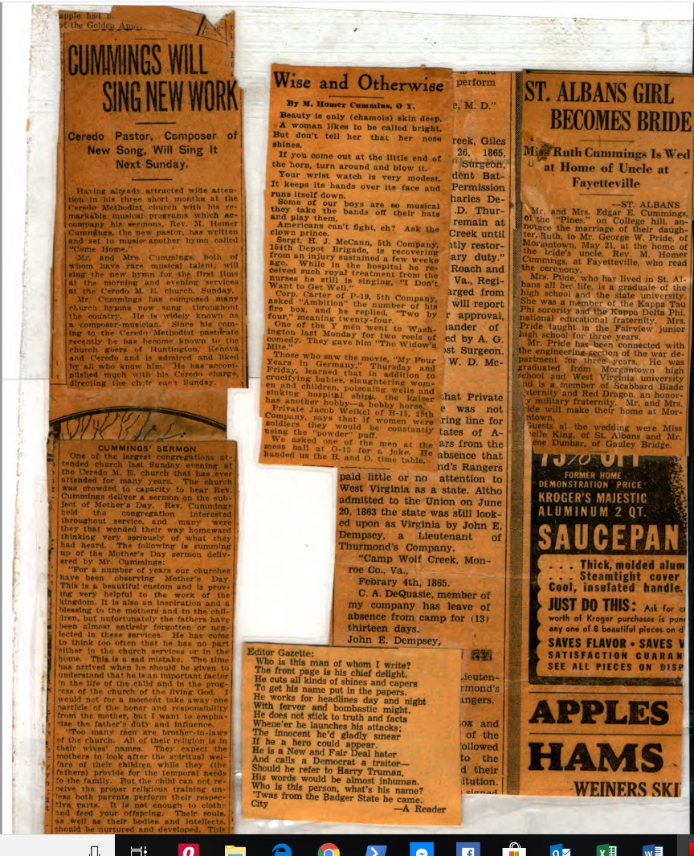
Scanning specifications
Notes:
We ran into a different situation with the clippings of newspaper articles by and about Cummings. They’d all been laminated, which is good for preserving family memories but presents challenges to librarians.
One issue is that it was sometimes hard for the scanner to capture a full page; things were often cut off on the side or bottom and had to be rescanned.
We discovered that putting a blank sheet of paper behind it helped. Then we realized that it looked better too, so I enlisted one of our DH interns to go back and redo them all. I’m really pleased with how they turned out!

Slide 18
Single sermons
Notes:
There are also two things we decided not to do, or at least not to do right now.
First, we decided not to upload PDFs of individual sermons. We think that it will suffice—for the moment at least—to upload everything in a file folder as a single PDF, which users can scroll through or search to find the texts they want.

Slide 19
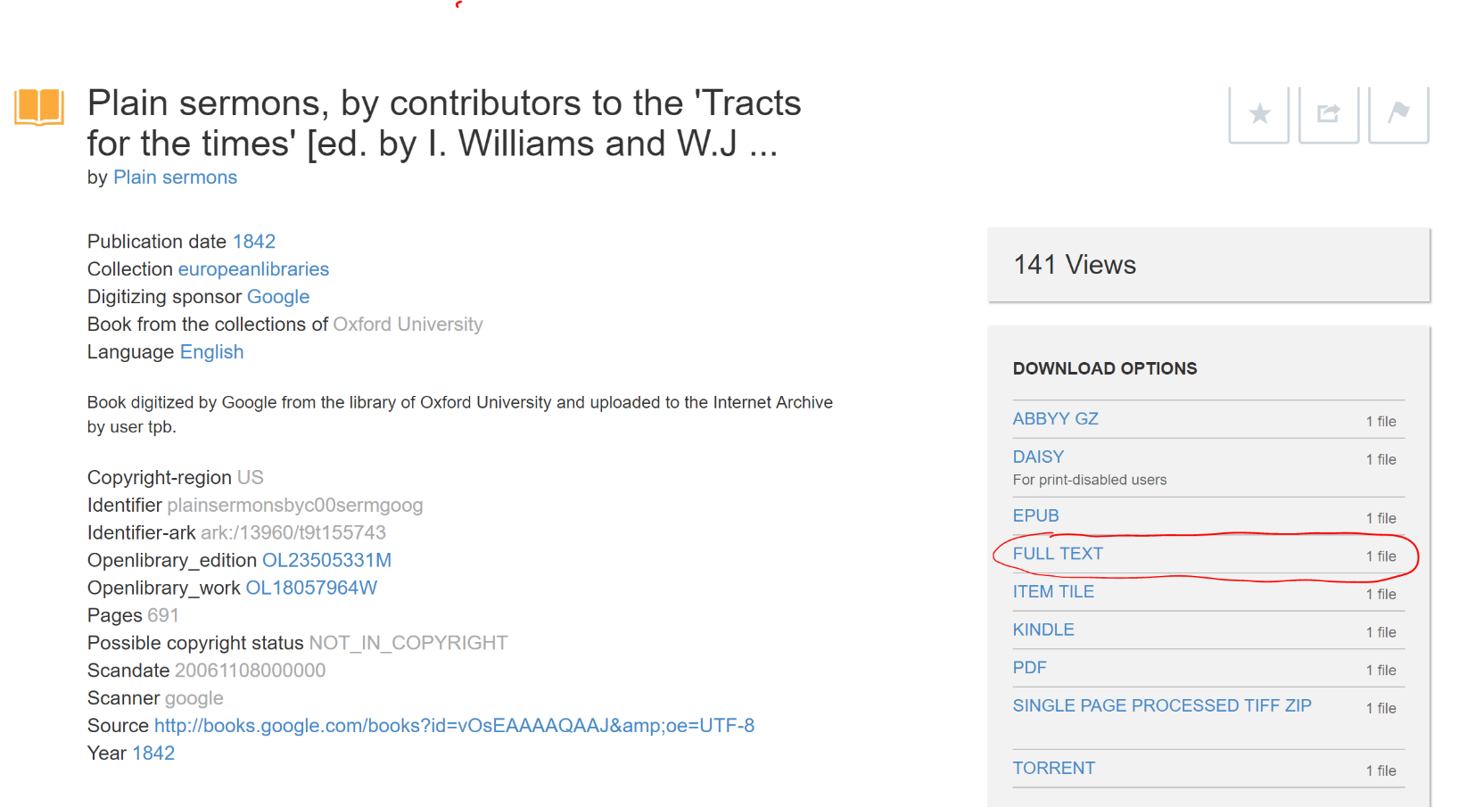
ocr
Images from archive.org and Adobe Spark
Notes:
We also decided not to provide plain-text versions of the documents.
Plain text can open the door to interesting computational-analysis work.
The Internet Archive makes such files available, and I learned how to work with them when I attended a DH workshop at the University of Victoria last summer.

Slide 20
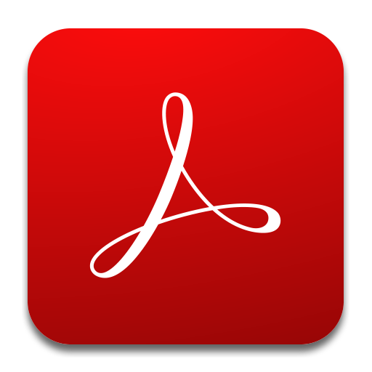
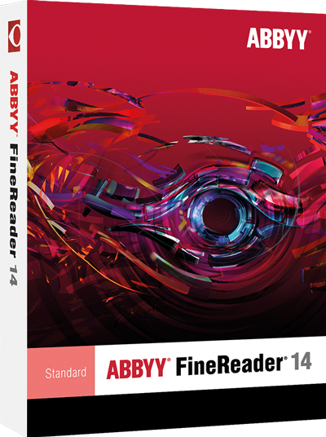
ocr
Images from product websites. Left to right: Omnipage, Adobe, Abbyy, Google Drive, Readiris
Notes:
It should also be fairly easy to make them available here. Plain text can be generated for free via Adobe, and, as it turns out, with Google Drive as well (something I didn’t know until recently, when our new hire in DH told me about it).
If you have money to spend, there are programs you can purchase as well.
My understanding is that ABBYY is kind of the industry standard along these lines. It carries a one-time price of about $200; other programs, such as Omipage and ReadIris, can be purchased for between $50 and $500.

Slide 21
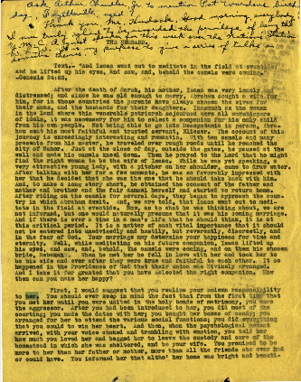
ocr
Notes:
After consulting with librarians and our DH hire, though, I decided to put that on the back burner as well. We’re already providing searchable PDFs, and we suspect there may not be much demand for anything beyond that. If it turns out that the demand is actually there, I can work with researchers to help them get what they need.
If I do eventually decide to go that route, I’ll download the free trial versions of the programs on the previous slides and pick the one(s) that seem to work best for me. I suspect that none of them will generate perfectly clean results, but I can provide the least-dirty text I can.
I won’t clean anything up myself, partly because it will take a lot of time, and partly because I suspect researchers would want to do it themselves, to be sure they have good inputs and will therefore get the best outputs.

Slide 22
THE CURRENT STATE OF THE PROJECT https://mds.marshall.edu/cummings_papers/
Notes:
So this is what it looks like now. We might go to the actual site a little later on, but here are some screen shots for now. All of the materials have been uploaded, and I’ve written a little summary of what’s in each document.

Slide 23
THE CURRENT STATE OF THE PROJECT https://mds.marshall.edu/cummings_papers/
Notes:
When you click on one of the links, a screen will come up with the summary and some metadata, and a button you can click to download the file.

Slide 24
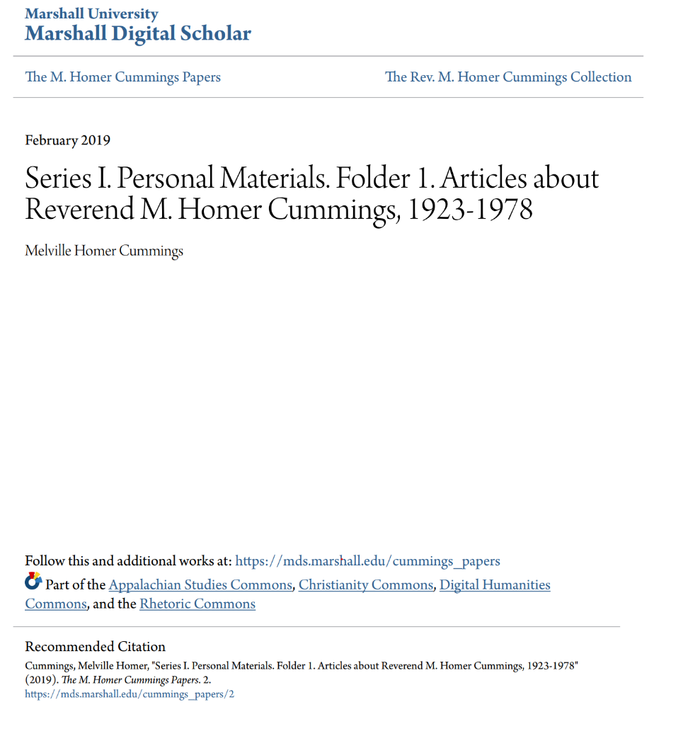
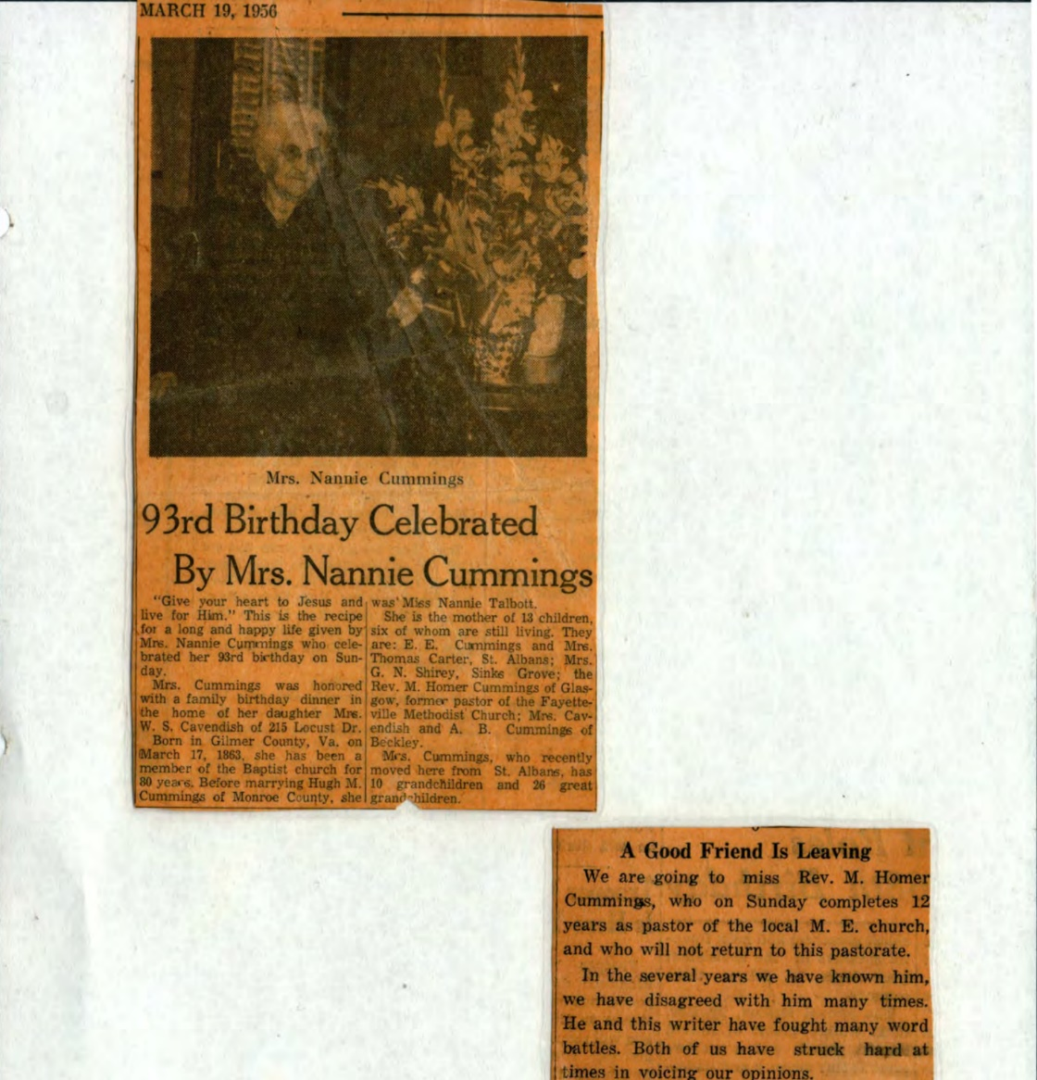
THE CURRENT STATE OF THE PROJECT https://mds.marshall.edu/cummings_papers/
Notes:
When you download the file, you’ll see an automatically-generated cover page, followed by the PDF itself.

Slide 25
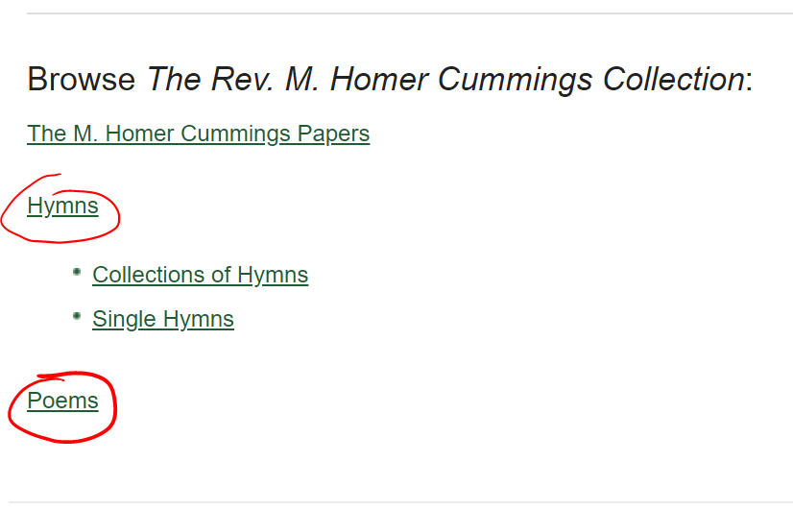
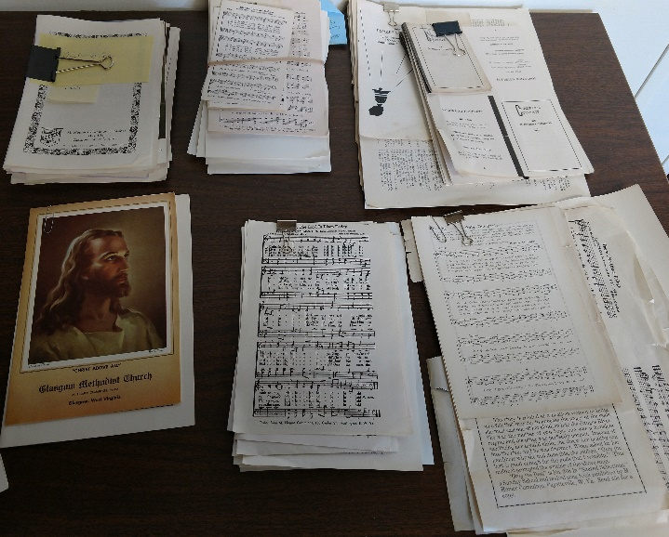
Where we go from here
Notes:
Everything in the bankers box is up and how I want it, but there’s more to be done. We have a space in MDS for Cummings’ hymns and poems, so they need to be scanned and uploaded as well.

Slide 26
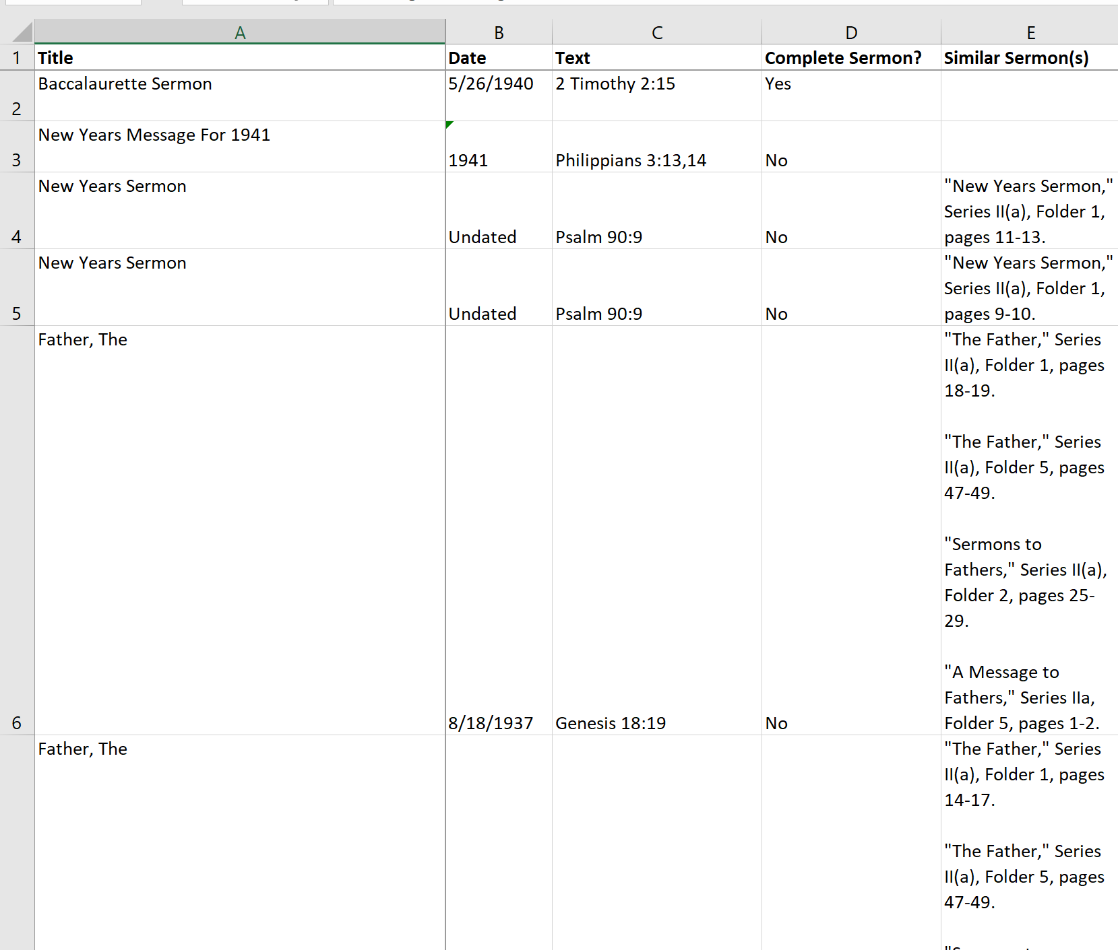
Where we go from here
Notes:
But that’s not the end of the project! One of our core convictions is that putting the scans online (and possibly providing the plain text) was just a means to an end, not an end in itself. We also wanted to make supplementary materials available to help make the project as robust and user-friendly as possible.
So I’ll be working on a series of “finding aids,” Excel spreadsheets that users can download, search, sort, and so on. I’ll have separate ones for the sermons and the hymns, and an overall scripture index for the whole collection, so we can find instances where Cummings wrote sermons and hymns on the same verses.
All of them will have hyperlinks, for easy access to the items themselves. As I said before, we will not upload individual sermons or hymns—at least not yet—so the link will go to the folder and provide the page number, and users can search or scroll from there.

Slide 27
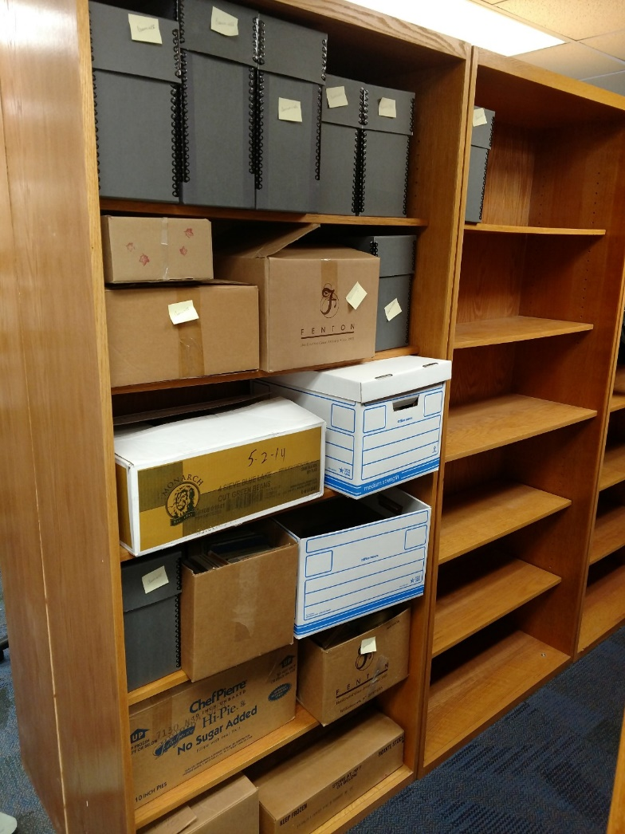
Where we go from here
Notes:
I’ll also catalog the hymnals and recordings that were not by Cummings himself. We won’t upload the materials themselves, but it would be helpful to have a complete list of the items in Cummings’ library, or at least that part of his library that was given to the school.
And last week, when I was in the library taking inventory of those boxes, the head of Special Collections said we could create accession numbers and such and get the information into the library system. That will close the loop and make the Cummings collection complete.

Slide 28
The tri-state sermons project
Image from missiontristate.com
Notes:
Even then, we won’t be done! My title in the program is “The Tri-State Sermons Project”; let me say a few words about that as well.

Slide 29
Library catalog
Notes:
Marshall’s library system has about a dozen single sermons or collections cataloged under “Special Collections/West Virginia.” I would like to digitize those too.

Slide 30
mds
Notes:
And we’re set up to do just that!
The Cummings collection is actually just a subdivision of a broader Center for Sermon Studies area of MDS. There is plenty of room to grow; as we’re ready to add new materials, we’ll simply add a link to this page and go to work.

Slide 31
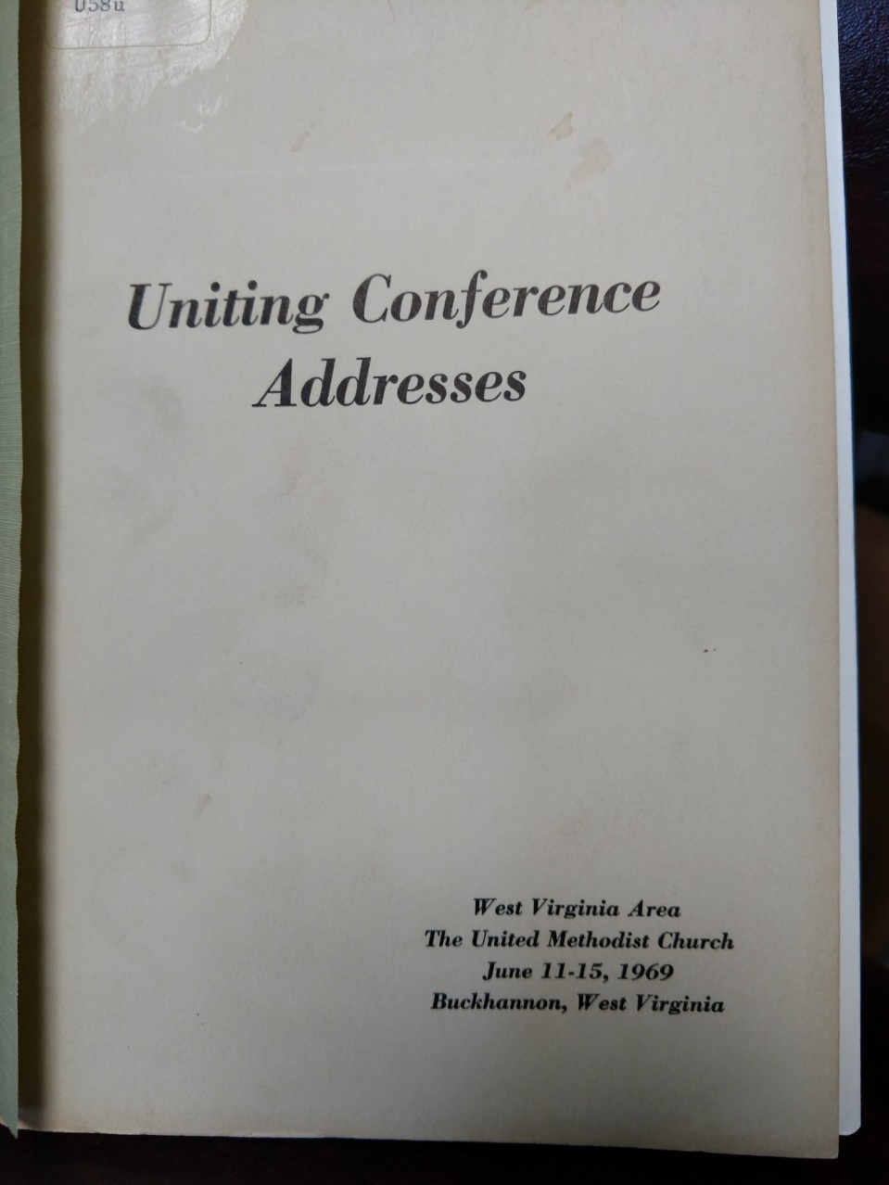
Special collections
Notes:
Let me give a few examples of what we have.
To continue work with Methodist preachers, we have The West Virginia Pulpit, which has sermons by 27 ministers working throughout the state in the late 1800s. It turns out that this is already in the Internet Archive, so we can just link to it instead of scanning it ourselves.
There’s also a small collection entitled Uniting Conference Addresses, containing about 6 sermons delivered at a meeting of the West Virginia Area of the United Methodist Church in 1969. Some of the preachers may still be living or recently deceased, so there may be copyright issues to consider, but I’ll see if I can get permission to digitize it.

Slide 32
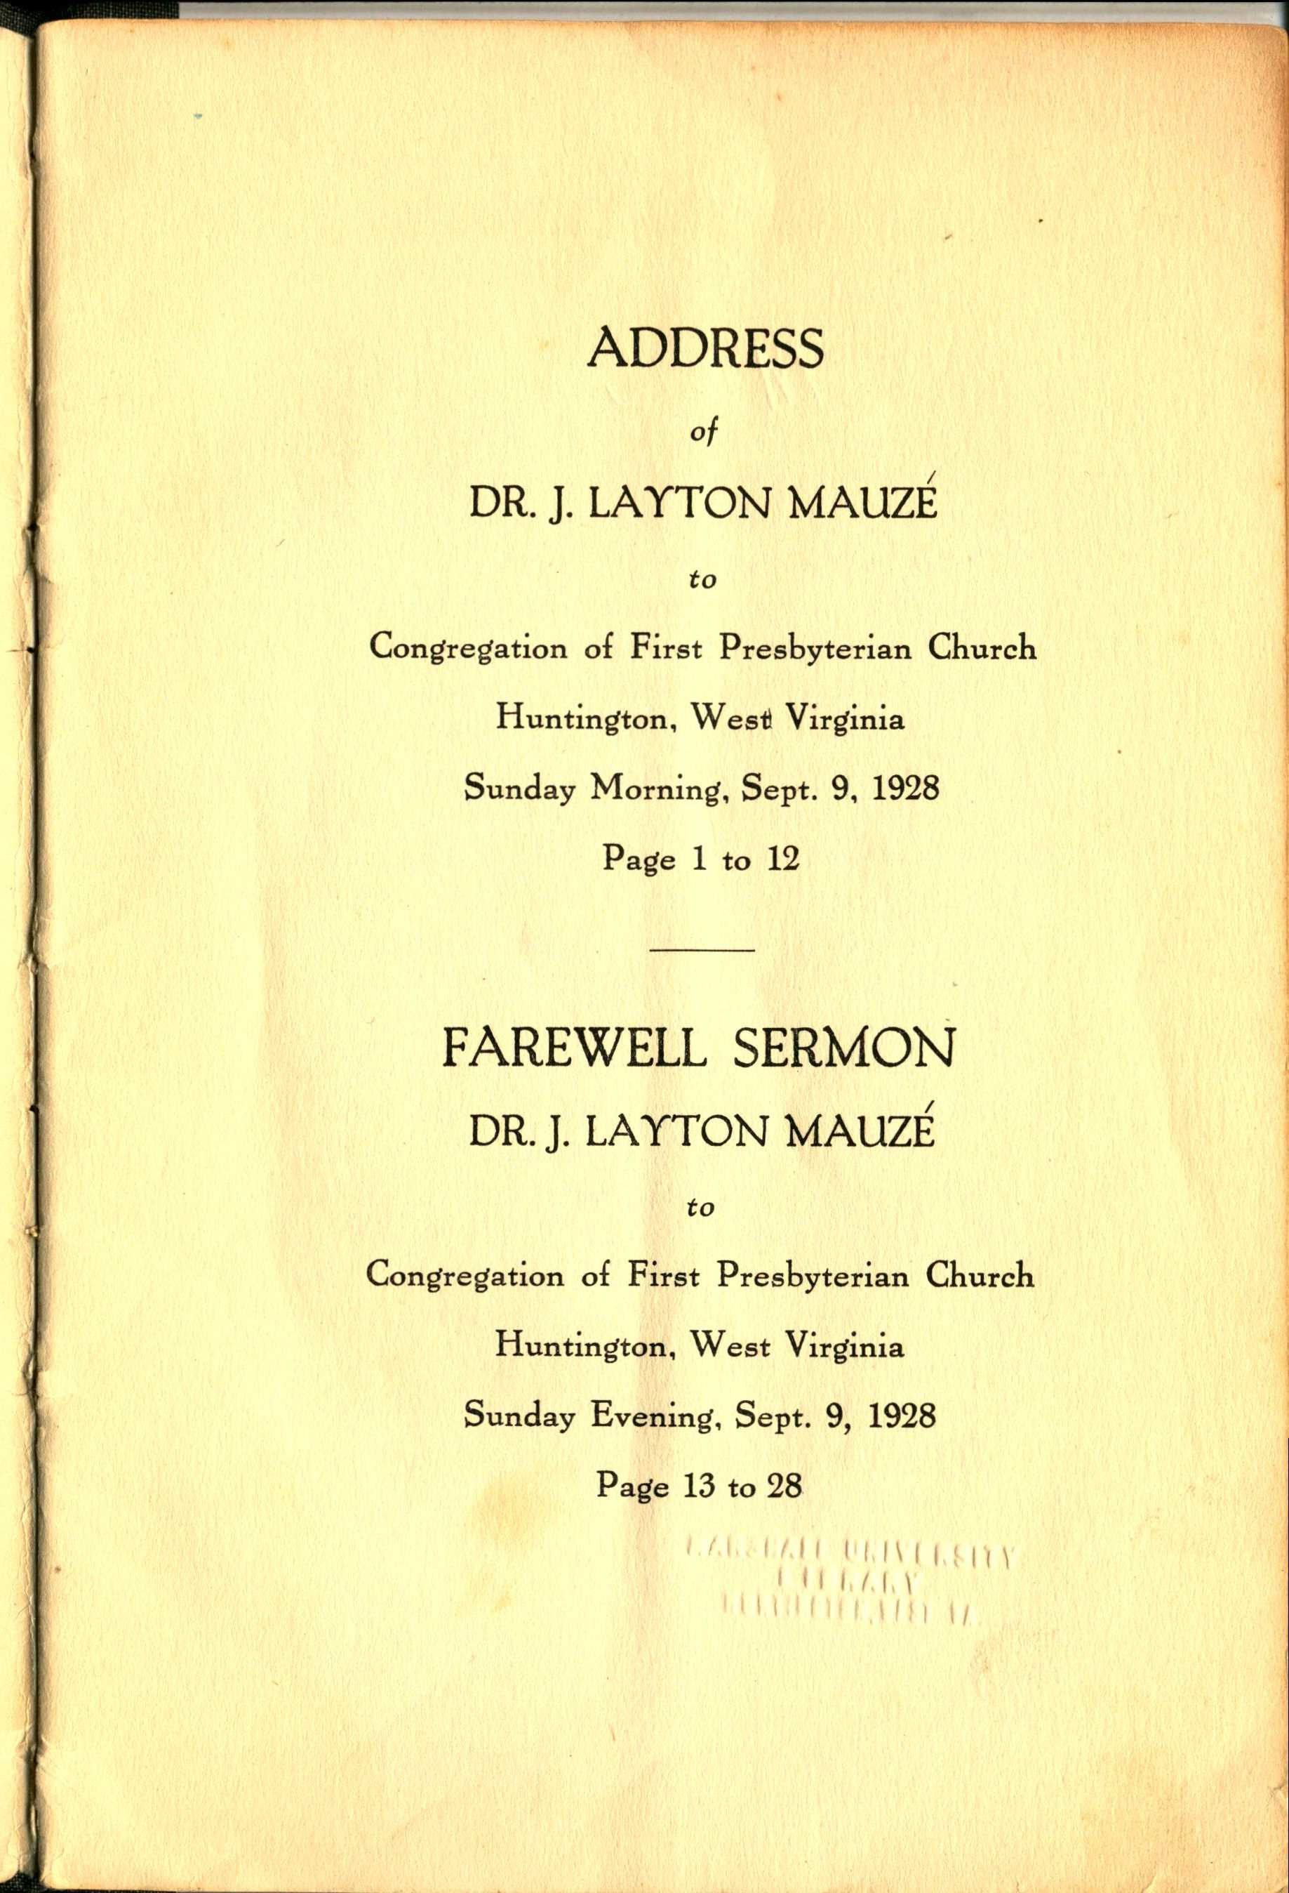
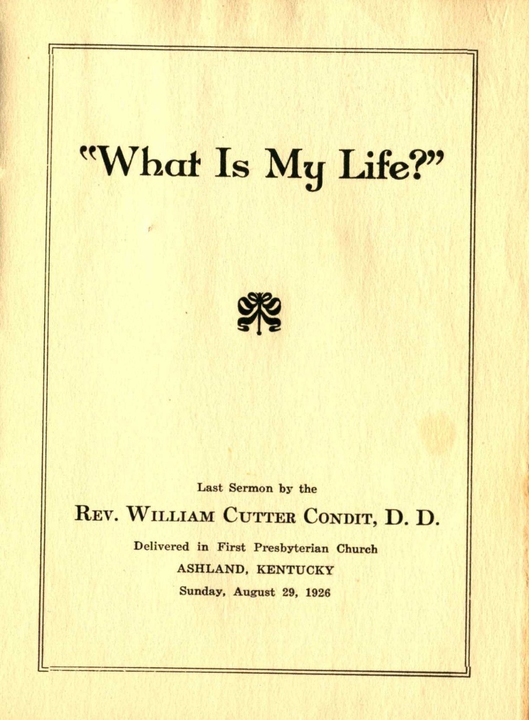
Special collections
Notes:
Branching into other denominations, we have sermons preached in Presbyterian churches in Huntington and in Ashland, Kentucky, in the 1920s.

Slide 33
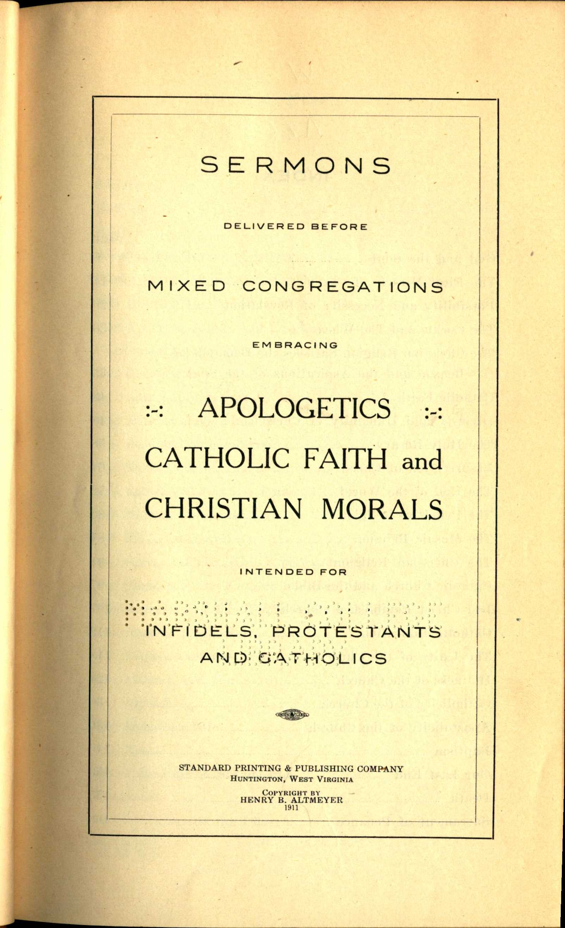
Special collections
Notes:
Finally, we have two volumes of sermons by Henry Altmeyer, who was the priest of St. Joseph’s Catholic Church in Huntington from 1899-1930; here’s a picture of the church from the back of one of those collections.
Catholic preaching has been underrepresented in the journal I edit and the conferences I’ve organized, so I’m pleased we’ll be able to include these volumes in the project.

Slide 34
Blake library
Notes:
One of the separate divisions within Special Collections is the Rosanna Blake Library of Confederate History, which some would say is one of the largest and best collections of Civil-War era materials.
The curator of this collection has identified nearly 50 sermons, pamphlets, and similar texts that I’d also like to work with. Most of them were preached and published in Georgia, Virginia, and the Carolinas, so they take us beyond the boundaries of the tri-state, but they’re part of Marshall’s holdings and definitely pertain to sermon studies, so they have a place in MDS as well.

Slide 35
The tri-state sermons project
Image from missiontristate.com
Notes:
In all these cases, we’ll use the same specs and standards we’re using with Cummings. I’ll also create similar finding aids, to individual volumes of sermons such as The West Virginia Pulpit; to larger subsets such as the two Altmeyer books and the texts in the Blake Library; and to the entire Center for Sermon Studies project.
There are fewer items than in the Cummings collection, and fewer issues to consider because we don’t have to worry about lamination and so on.
There’s still plenty here to keep me busy for a while. I’ve applied for an award that will allow me to focus on this full-time next spring. I’m also fortunate that I’m going up for tenure this fall, after which I’ll have the freedom to focus on projects like this rather than more “traditional” research and publication.

Slide 36
The tri-state sermons project
Image from missiontristate.com
Notes:
The project won’t be peer-reviewed, but I’m working with others to be sure it’s done in accordance with the “best practices” of librarianship and IT. I also envision it leading to a publication, as I plan to write it up for the journal published by the ASA.
My hope is that when it’s all done, we’ll have a valuable contribution to the library, the Center for Sermon Studies, and Marshall’s Digital Humanities program.

Slide 37
Appalachia online: DIGITAL PROJECTS AT MARSHALL UNIVERSITY AND BEYOND
Notes:
Now I’d like to open the floor for questions and a discussion of the last two words of our session title: “and beyond.” If you are working on a digital project, or just thinking about starting one, we’d love to hear from you!

