Slide 1
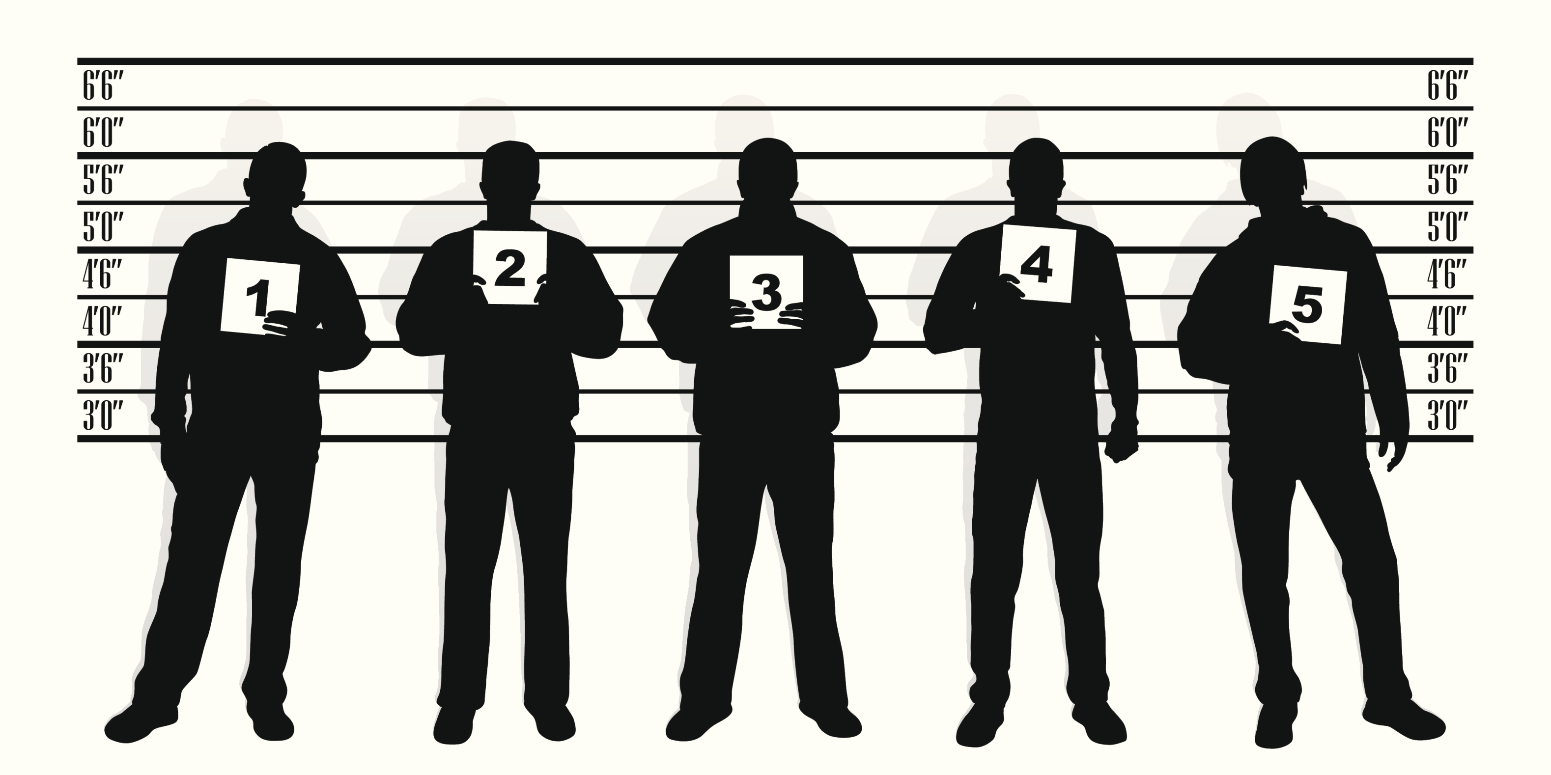
The Effect of Lineup Structure on Individual Identification
Ryan Patrick | Dr. Chris LeGrow | Marshall University
Purpose
Hypotheses
Results
The primary purpose of the research is to examine the effect of police photo lineup structure (Simultaneous, 3x3, Photo Lineup vs. Sequential, 1x9, Photo Lineup) on the accuracy of college students’ perpetrator identifications. Secondary purposes of this research are to examine whether (a) “cross-race bias” (i.e. lower likelihood of misidentifying someone of one’s own ethnicity than someone of another ethnicity) exists in college students’ perpetrator identifications, and (b) is there an evident gender bias (i.e. do genders have better, or worse, accuracy when identifying within their own gender rather than across genders).
H1- (a) Sequential lineups will yield a superior level of accuracy compared to simultaneous lineups. (b)Simultaneous lineups will yield a superior level of accuracy compared to sequential lineups. (c) Lineup structure will not affect participant’s ability to identify the perpetrator.
H2- (a) Participants will have superior accuracy when identifying perpetrators within their own ethnicity. (b) Participants will have inferior accuracy when identifying perpetrators within their own ethnicity. (c) Participant’s ethnic identity will not affect their identification accuracy.
H3- (a) Participants will have superior accuracy when identifying within their own gender identity. (b) Participants will have inferior accuracy when identifying within their own gender. (c) Participant’s gender will not affect identification accuracy.
H1- Data analysis shows there to be no significant difference (.434) in sequential lineup accuracy (2.257) and simultaneous lineup accuracy (2.046). Based on this analysis we are unable to accept the hypotheses H1a or H1b. Hypotheses H1c is supported by the data and thus we can accept H1c.
H2- Due to a lack of ethnic diversity in the study we are unable to compare accuracy to ethnic identity as the data would not effectively represent the population. Thus we can not accept nor reject H2a, H2b, or H2c.
H3- A univariate ANOVA test of overall participant accuracy was done in addition to independent sample t-tests of first, second, and overall accuracy in regard to gender. The ANOVA data showed there to be no significant difference (.402) in accuracy within gender. Independent samples t-tests showed no significant differences in any of the tested categories (first choice accuracy in male and female lineups, second choice accuracy in male and female lineups, and overall accuracy in male and female lineups). Based on the aforementioned data, we are unable to accept H3a and H3b, but H3c is supported.
Rationale
To date, research has revealed the sequential photo lineup typically achieves a higher ratio of accurate identifications to mistaken identifications compared to the simultaneous photo lineup (Kornell, 2014; Steblay, et al., 2001; Wells, et al., 2014; Wells, Steblay, & Dysart, 2015). Research has also shown a “cross-race bias” (i.e., a lower likelihood of misidentifying someone of one’s own race than someone of another race) is often found in the identification of perpetrators from both human and photo lineups used by the police (Behrman, Bruce, & Davey, 2001; Jackiw, et al., 2008; Russell, 2012; Wells & Olson, 2001; White, 2012). Little research, however, has examined the interaction of police photo lineup structure and witness/perpetrator race. The present study will examine the effect of: (a) photo lineup structure (Simultaneous vs. Sequential Photo Lineup), and (b) witness/perpetrator race (Someone of One’s Own Race vs. Someone of Another Race) and (c) the interaction of photo lineup structure x witness/perpetrator race on college students’ perpetrator identification accuracy across 9 simulated police photo lineups.
Procedure
For inclusion in this study participants had to be Marshall University students and at least 18 years of age. A survey with 18 lineups was administered to 113 participants (79 female, 34 male) through the Marshall University SONA site for psychology research. Participants began by answering demographic questions including: Age, gender identity, ethnic identity. On the same page participants were asked to select a lineup structure to complete. Participants selected either lineup A (simultaneous 3x3) or lineup B (sequential 1x9). There were 57 participants for lineup A and 56 for lineup B. From there participants completed their selected lineup. Participants were asked to read the provided description of a subject (found from the FBI website) and answer chose the individual they thought fit the description was best, their confidence in that choice, their second choice, and an open-ended question about why they chose their answer. Participants were allowed to omit any answer if they chose, omission of more than one lineup sequence resulted in exclusion of data in analysis phase.
Conclusion
The original goal of this research was to see how precisely participants could read a description and match that description to the correct individual’s photo (we went with police lineups as they most common and descriptive of these experiments). One of the factors we hypothesized would have in an influence is the structure, if participants were presented with all the photos at once instead of having to scroll and look at pictures individually, there might be accuracy differences. Accuracy was not statistically effected. When looking at the open ended questions, participants seemed to have focused on one main area when making their choice (i.e. hair, nose, emotional presentation, etc.).
This study, like all other, has its limitations. We lacked ethnic diversity from our participants. We also wanted to keep the distributed survey somewhat brief to limit the rate of withdrawal. We did have a good sample size for our method of distribution, but, this sample doesn't’t represent the general population as 85% of our participants identified as white/caucasian.
Printed references are available upon request.

