Slide 1
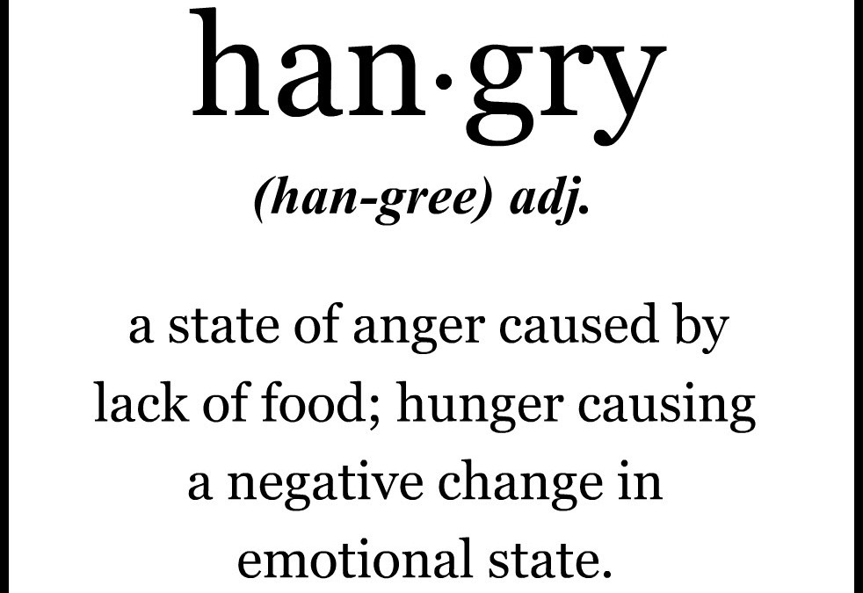
The Influence of Hunger on Perceived Mood
Ryan Patrick | Dr. Christopher LeGrow | Marshall University
Purpose
Hypotheses
Procedure Continued
Clinical Description
The following experiment was devised to determine whether or not there is any supporting evidence for the hanger phenomenon. From birth we are generally raised on a schedule, when we go to sleep, wake up, eat, work and so on. Dinner seems to be the most stable of timing when it comes to meals, and with that came the research question. Do individuals become increasingly angry and/or irritable when they are hungry but a meal is inaccessible?
H1- relative to 5 minutes after a meal, 1 hour before a meal there will be a significant difference in; (a) tension, (b) anger, (c) depression, (d) confusion, (e) fatigue, and (f) vigor, resulting in a significant (g) total mood disturbance (TMD).
H2- relative to 1 hour before a meal, 15 minutes before a meal there will be a significant difference in; (a) tension, (b) anger, (c) depression, (d) confusion, (e) fatigue, and (f) vigor, resulting in a significant (g) total mood disturbance (TMD).
H3- relative to 5 minutes after a meal, 15 minutes before a meal there will be a significant difference in; (a) tension, (b) anger, (c) depression, (d) confusion, (e) fatigue, and (f) vigor, resulting in a significant (g) total mood disturbance (TMD).
H4- relative to 5 minutes after a meal, regardless of time before a meal there will be no significant difference in; (a) tension, (b) anger, (c) depression, (d) confusion, (e) fatigue, and (f) vigor, resulting in a significant (g) total mood disturbance (TMD).
Using these subcategories will allow us to devise a total mood disturbance in which tension, anger, depression, confusion, and fatigue are added together and vigor is subtracted from that total. This allows us to see how much the data really changes over the three times.
Results
Rationale
H1- Data analysis shows a significant difference in tension, anger, depression, fatigue, vigor, and an overall TMD, at 1 hour before a meal compared to 5 minutes after. Thus we are able to accept all parts of H1.
H2- Data analysis shows no significant change in any of the six grouped categories between the scenarios of 1 hour and 15 minutes before a meal. Thus we can not accept any of H2.
H3- Data analysis shows a significant difference in all six categories at 15 minutes before a meal compared to 5 minutes after. Thus we are able to accept all parts of H3.
H4- Due to a significant difference in all parts of H1 and H3 we can not accept any aspect of H4.
In a study by Martin and Seneviratne, they examined the relationship between hunger and headaches. The study found that in the group that was designated to fast had significantly higher intensity of headaches than those of the group of participants who were not designated to fast (Martin & Seneviratne, 1997). Studies on the effect types of foods play on mood emotion and performance is documented in a study by Hopf. In said study research shows that females report an increase in drowsiness after a carbohydrate meal, whereas males reported greater calmness (Hopf, 2011). In a study out of the University of Minnesota, research shows during a stage of semi-starvation men experienced significant decreases in strength and stamina, body temperature, heartrate and sex drive. Participants also noted that in the state of semi-starvation they experienced increased fatigue, irritability, depression and anxiety (Baker & Keramidas, 2013). Gesellschaft, in a study of hunger and decision making and risk, states that hunger can affect more than individual’s moods, but also their willingness to take risks. In humans, hungry subjects were shown to take more financial risks than those of satisfied individuals (Gesellschaft, 2013).
Procedure
To test these hypotheses, a questionnaire was taken in an online format in which 40 participants (11 males and 29 females) were asked to answer the questionnaire as accurately to how they believe they would feel 1 hour before a meal, 15 minutes before a meal, and, 5 minutes after a meal. The survey participants will be asked to complete is divided into two parts. In Part A of the survey, participants will provide some demographic information (e.g. age, gender) and information about their typical appetite level and mood state. In Part B of the survey, participants will be asked to imagine two separate scenarios in which they are really hungry and have been told that their dinner is cooking and will not be ready to eat for 1 hour, and the second scenario at 15 minutes before. The final scenario presented was for participants to imagine it was 5 minutes after a meal and how they believe they would feel if they had just eaten. With these scenarios in mind, participants will rate what they perceive their mood state would likely be under these circumstances. Participants will use the POMS (Profile of Mood States) in order to provide their ratings of their perceived mood states. When using the POMS, participants will provide a 0 (Not at all) - 4 (Extremely) rating for each of 65 adjectives commonly used to describe an individual's mood state. Data will be assessed in a categorical fashion, dividing the survey of 65 adjectives into 6 sub categories; tension, anger, depression, confusion, fatigue, and vigor.
Average Response per Subsection | 1 Hour Before a Meal | 15 Minutes Before a Meal | 5 Minutes After a Meal
Tension | 12.732 | 12.293 | 5.244
Depression | 15.000 | 14.122 | 4.463
Anger | 16.463 | 15.366 | 2.927
Fatigue | 10.610 | 9.293 | 5.634
Confusion | 8.171 | 8.341 | 4.073
Vigor | 7.537 | 6.927 | 13.024
Total Mood Disturbance | 55.439 | 52.488 | 9.317
Conclusions
This study shows that there is merit to the phenomenon know as “hanger.” Further research could examine this connection in a way that stimulates a hunger response (i.e. presenting food or food smells; controlling the time of testing to before a meal). This study, as performed, does have its limitations though. The sample size is somewhat small and was only testing current Marshall University students. Also, the sample was not representative of the population, more than twice as many females than males participated.
Printed sources are available upon request.

