Slide 1
Public Library Usage Among College Students
Brianna L. Shelton
Marshall University
College of Liberal Arts
Undergraduate Research & Creativity Conference
April 19, 2018

Slide 2
Why libraries?
I used them frequently as a child & even as a college student
Place of employment for two years
I wanted to know if I was the only one who preferred them

Slide 3
Cabell County Public Library | Drinko Library
Technology Checkout: None | Technology Checkout: Laptops, webcams, DVD drives, calculators, cameras, laser pointers, HDMI cables, calculators, and headphones
Patron Services: Printing, copy machines, faxing, scanning, notary services, meeting room rental, information & referral, blind & handicapped services, literacy services, genealogy, academic, & job databases | Patron Services: Printing, copy machines, scanning, study room rental, interlibrary loan, ez-borrow, textbook loan program, academic databases
Collection: Adult fiction, nonfiction, local history, DVDS, CD’s, CD-books, playaways, juvenile and young adult fiction and nonfiction, books for blind and handicapped persons | Collection: Scholarly journals, dissertations, theses, academic books, DVD’s, bound periodicals

Slide 4
Research Question
Do college students use public libraries in addition to or instead of the academic ones provided to them on campus?
Why or why not?

Slide 5
Theory
Non-traditional students use public libraries (Antell, 2004; Stone & Collins, 2012).
Millennials are credited with saving public libraries (Geiger, 2017; Morris, 2017; Peet, 2014).
Other students include foreign exchange, first generation, & low income students (Asher & Case, 2008; Soria et al, 2015).

Slide 6
What does it mean?
Are all college students engaging with public libraries?
Does living in Appalachia make a difference?
Is it the libraries in their hometown, or the ones located near Marshall’s campus?
Do modern changes in a public library’s collection influence their decision? (Zickuhur et al, 2013).

Slide 7
Qualitative Methodology
Qualtrics survey
Shared on Facebook & sent out to all Marshall students
Open ended questions, demographics
Text entry
Attitudes and perceptions

Slide 8
Qualitative Questions
Do you think that college students use the public library?
What programming would entice you to visit a public library?
What services would entice you to visit a public library?
Do you think that public libraries are a dying industry?

Slide 9
Qualitative Questions
Why are public libraries important?
What is your age?
What is your gender identity?
Do you consider yourself a traditional college student?

Slide 10
Qualitative Data
263 responses, 255 could be used
47% of respondents answered positively or said they knew peers who visited a public library
62% said that public libraries were a dying industry
Over half of respondents said libraries were important for elders, children, & those with low incomes

Slide 11
Qualitative Analysis
Most students favored public libraries, even if they were not users themselves
Libraries needed for those without internet access
Graduate students were more likely to visit public libraries, other variables in literature did not come up

Slide 12
Qualitative Analysis
Movie Showings
Book Clubs
Informational Speakers
Author Events/Signings
Local History Materials/Events
New/Popular/Rare/Reference Books
Wine/Beer/Food Tasting
Kid/Family Friendly Events
Access to Video Games/Game Nights
Art/Craft Clubs
Better Computers/Software
Skill Classes
Giveaways/Prizes
Writing Programs/Workshops
Most of these programs are already in place at public libraries
Does this mean that public libraries should advertise to students better?

Slide 13
Quantitative Methodology
Capstone survey
Administered in introductory sociology & anthropology classes
Demographics, how often, Likert scale
Included questions on an array of topics

Slide 14
Quantitative Questions
How often do you | Often | Some | Rare | Never
Get help from librarians at Marshall | Often | Some | Rare | Never
Visited a public library before I came to college | Often | Some | Rare | Never
Visited a public library since I came to Marshall | Often | Some | Rare | Never

Slide 15
Quantitative Questions
Circle your level of agreement for each statement: | Strongly agree | Agree | Disagree | Strongly disagree
Public libraries are no longer useful in internet age | SA | A | D | SD
I prefer e-books to physical copies of books | SA | A | D | SD
Public libraries offer more than books to patrons | SA | A | D | SD

Slide 16
Quantitative Data
312 responses
51% said they visited a public library before coming to MU
49% have visited a public library since coming to MU
27% ask for help from librarians at MU

Slide 17
Quantitative Data
Respondents who scored above the midpoint on the following scales were less likely to use public libraries/regard them favorably
Conservative Scale
Mankind if supposed to exercise dominion over the earth.
America is letting in too many immigrants.
Sometimes it’s okay for a species to die off for people to have jobs.
I support the coal companies doing what they need to for job creation.
The government is spending too much on the environment

Slide 18
Quantitative Data
Respondents who scored above the midpoint on the following scales were less likely to use public libraries/regard them favorably
Jock Scale
Do outdoor activities
Play amateur sports
Engage in sport fan activity (tailgate, game parties around the TV)

Slide 19
Quantitative Data
Respondents who scored above the midpoint on the following scales were less likely to use public libraries/regard them favorably
Partier Scale
Go out to a bar/dance club
Attend or host a private party at someone’s house/apartment
Drink alcoholic beverages

Slide 20
Quantitative Data
Respondents who engaged in the following behaviors were more likely to visit public libraries/view them favorably
Attends to news frequently
Uses tutoring services provided by MU
Food insecurity
Involvement in Extracurricular Activities
Ask for help from MU librarians

Slide 21
Limitations & Future Research
All of the sample are enrolled at a 4 year university
Could focus on students at community/technical schools
7 Qualtrics respondents confused public libraries with Drinko
Students from rural areas cited faster internet access as a reason they used the public library

Slide 22
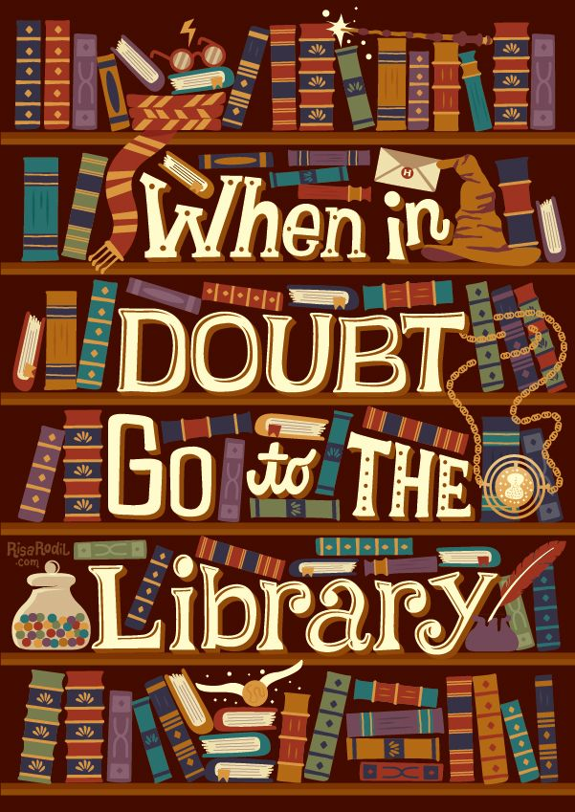
Works Cited
Antell K. (2004). Why Do College Students Use Public Libraries? Reference & User
Services Quarterly [serial online]. 43(3), 227-236.
Asher, C., & Case, E. (2008). A Generation in Transition: A Study of the Usage and Attitudes Toward Public Libraries by Generation 1.5 Composition Students. References & User Services Quarterly [serial online]. 47(3), 274-279.
Geiger, A. (2017). Millennials are the most likely generation of Americans to use public
Libraries
Guion, D. (2014). Academic Libraries and How They Differ from Public Libraries
Marshall University Libraries. (2015). Retrieved from http://www.marshall.edu/library/services/default.asp.
Morris, D. Z. (2017). Millennials Use Public Libraries More Than Other Generations.
Peet, L. (2014). Research: Pew: Millennials and Libraries. Library Journal, 139(17), 19.
Soria, K. M., Fransen, J., & Nackerud, S. (2017). Beyond Books: The Extended Academic
Benefits of Library Use for First-Year College Students. College and Research Libraries, 78(1), 8-22.
Special Services. (2015). Retrieved from www.cabell.lib.wv.us
Stone, G., & Collins, E. (2012). Library Usage and Demographic Characteristics of
Undergraduate Students in a UK University. Performance Measurement & Metrics,
14(1), 25-35.
Zickuhr, K., Rainie, L., & Purcell, K. (2013). Library Services in the Digital Age

