Slide 1
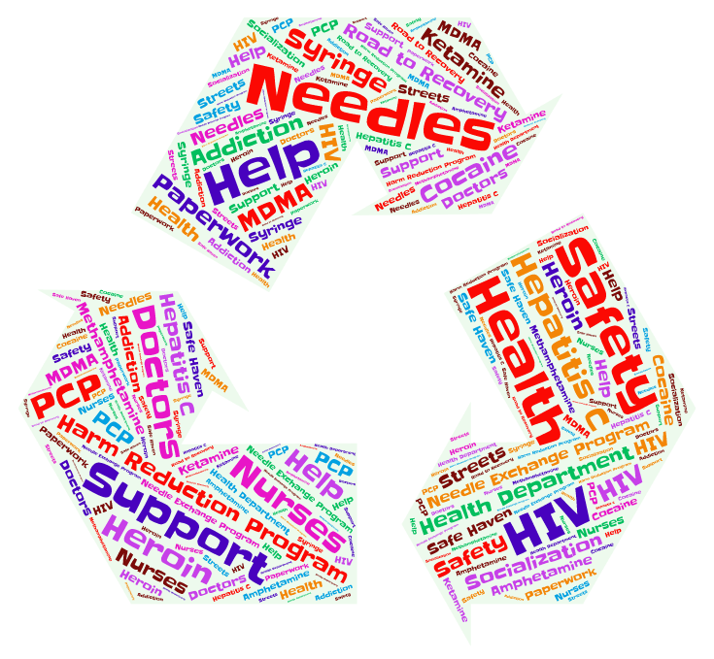
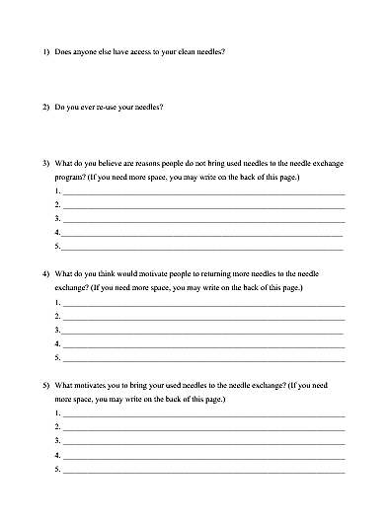
Needle Exchange Programs:
Barriers to Needle Return
Stephanie Spaulding & Brittany Canady, Ph.D.
Marshall University
Abstract
Implications
The first NEP (needle exchange program) was in Amsterdam, Netherlands in 1984, followed four years later by the first U.S. NEP in 1988 in Tacoma, Washington (The Center for Innovative Public Policies, 2012).
NEPs have been shown to reduce risk of disease, and prior studies suggest that individuals who participate in such programs are more likely to enter recovery from opioid addiction, making them an important public health intervention.
The worldwide average for needle return in NEPs is around 90% (Ksobiech, 2004). With the needle return rate in Huntington being around 60%-70%, it is below national average by 20%-30%. Charleston is closer to the worldwide average at around 80%. It is unclear why so many needles are not being returned. Reducing the number of used needles in the community can reduce incidence of HIV, Hepatitis C, and the number of drug users who inject.
The current project reviews the literature related to needle exchange programs and discusses a study currently underway to investigate barriers for needle return, so interventions can be developed to encourage higher needle return rates for these important harm reduction programs in the future.
We expect to identify barriers to needle return in key communities affected by the opioid epidemic. Based on this information, interventions and/or programmatic changes will be explored to attempt to increase the likelihood of needle return. It will also help by laying the groundwork for future studies.
Literature Review
Questions for Research
What is the Needle Exchange?
The needle exchange is a popular type of harm reduction intervention that seeks to reduce risky settings. NEPs provide clean needles in exchange for used ones to minimize the reuse of contaminated needles. Many NEPs also provide other prevention and safety materials and services such as cotton and alcohol swabs, wound care and safe injecting practices education, as well as referral to substance treatment programs for those who are ready to quit injecting (Davis et al., 2017).
The first NEP was in Amsterdam, Netherlands in 1984. Four years later, the first needle exchange was located in 1988 in Tacoma, Washington (The Center for Innovative Public Policies, 2012).
The worldwide average for needle return in needle exchange programs is around 90% (Ksobiech, 2004).
Support for the Needle Exchange Programs:
NEPs reduce the amount of times contaminated needles are re-used (Satcher, 2000).
Some programs offer HIV testing and counseling, offer medical examinations and help, as well as help for those who are seeking treatment (The Center for Innovative Public Policies, 2012).
The needle exchange on average costs about $160,000 to run each year (about $20 per user per year (ACLU, n.d.).
The needle exchange helps avert HIV and Hepatitis C infections, depending on the location they also offer testing. There are approximately 20% of AIDS cases and 55% and rising cases of Hepatitis C which can be pointed to injection drug use, which shoes the viability of NEPs as a tool to fight against HIV/AIDS (Harm Reduction Organization, n.d).
On average the cost for lifetime treatment for an HIV infection is estimated at $379,668 in 2010 dollars using the cost of averting one infection. Therefore, prevention interventions are seen as cost-saving (CDC, 2017).
In a study on a one-for-one needle exchange program, the amount of needles on the community streets after the program started stayed around the baseline count or decreased, and very few program needles were found among the discarded needles. (Doherty et al., 2000).
Needle exchange programs do not seem to be associated with increase in crime rates. (Marx et al., 2000).
Common concerns with harm reduction programs:
Contaminated needles can spread HIV and Hepatitis C (Palmateer, 2010).
Needles given out by the program that are not returned could end up in unsafe places such as the streets (Doherty, 2000).
Communities over time are seeing an increased number of used needles throughout the community such as in the parks, on the streets, and outside of buildings. Programs are having trouble getting all of the needles returned to the program. Therefore, communities are blaming the programs and wanting to shut them down (Ksobiech, 2004).
Recently, this has been the case in Charleston, WV, where the needle exchange program was closed in March 2018, despite maintaining an average return rate of around 80% of needles (personal communication, 2018). Return rates for the NEP in Huntington, WV, have generally ranged from 60-70% of needles provided.
Proposed Method
Participants:
Participants will be approximately 200-300 individuals recruited from both the Kanawha-Charleston Health Department and the Cabell-Huntington Health Department. All participants must be 18 years of age or older and participating in the needle exchange program.
Measures:
The first group of questions will consist of non-identifying demographic information (e.g., age, gender).
The second group of questions will include five open-ended questions with blanks to write in related to clean usage of needles and motivation to return the needles to the Harm Reduction Programs. These questions were developed for the purpose of this study following consultation with health department staff.
Procedure:
This is an anonymous survey. Participants will be recruited when they present to the health department to participate in the needle exchange. They will be provided with the questionnaires to complete and return to a locked dropbox while they are at the health department. A small incentive (coffee and donut) will be provided to encourage participation.
References
American Civil Liberties Union, Needle Exchange Programs Promote Public Safety. (n.d.). Retrieved March 08, 2018, from https://www.aclu.org/fact- sheet/needle- exchange-programs-promote-public-safety
Centers for Disease Control and Prevention, HIV/AIDS. (2017, March 08). Retrieved March 08, 2018, from https://www.cdc.gov/hiv/programresources/guidance /costeffectiveness/index.html#
Davis, S. M., Daily, S., Kristjansson, A. L., Kelley, G. A., Zullig, K., Baus, A., & ... Fisher, M. (2017). Needle exchange programs for the prevention of hepatitis C virus infection in people who inject drugs: a systematic review with meta-analysis. Harm Reduction Journal, 141-15. doi:10.1186/s12954-017-0156-z
Doherty, M. C., Junge, B., Rathouz, P., Garfein, R. S., Riley, E., & Vlahov, D. (2000). The Effect of a Needle Exchange Program on Numbers of Discarded Needles: A 2- Year Follow-Up. American Journal Of Public Health, 90(6), 936-939
Harm Reduction Organization, Cost-Effectiveness of Syringe Exchange Programs. (n.d.). Retrieved March 8, 2018, from http://harmreduction.org /wpcontent /uploads/2012/01/CostEffectivenessofSyringeExchangePrograms.pdf
Ksobiech, K. (2004). Return Rates for Needle Exchange Programs: A Common Criticism Answered. Harm Reduction Journal, 1, 2. http://doi.org/10.1186/1477-7517-1-2
Marx, M. A., Crape, B., Brookmeyer, R. S., Junge, B., Latkin, C., Vlahov, D., & Strathdee, S. A. (2000). Trends in Crime and the Introduction of a Needle Exchange Program. American Journal Of Public Health, 90(12), 1933-1936
Palmateer, N., Kimber, J., Hickman, M., Hutchinson, S., Rhodes, T., & Goldberg, D. (2010). Evidence for the effectiveness of sterile injecting equipment provision in preventing hepatitis C and human immunodeficiency virus transmission among injecting drug users: a review of reviews. Addiction, 105(5), 844-859. doi:10.1111/j.1360-0443.2009.02888.x
Philbin MM, FuJie Z (2014) Exploring Stakeholder Perceptions of Facilitators and Barriers to Using Needle Exchange Programs in Yunnan Province, China. PLoS ONE, 9(2): e86873. doi:10.1371/journal.pone.0086873
Satcher, D. (2000, March 17). Evidence-based findings on the efficacy of syringe exchange programs: An analysis of the scientific research completed since April 1998. Retrieved April 8, 2018, from http://harmreduction.org/wpcontent/uploads/2012/01 /EvidenceBasedFindingsOnEfficacyofSEPs.pdf
The Center for Innovative Public Policies. (2012, January). Needle Exchange Programs: Considerations for Criminal Justice. Retrieved from http://harmreduction.org/wp-content/uploads/2012/01/NEPcriminaljusticeCIPP.pdf

