Slide 1
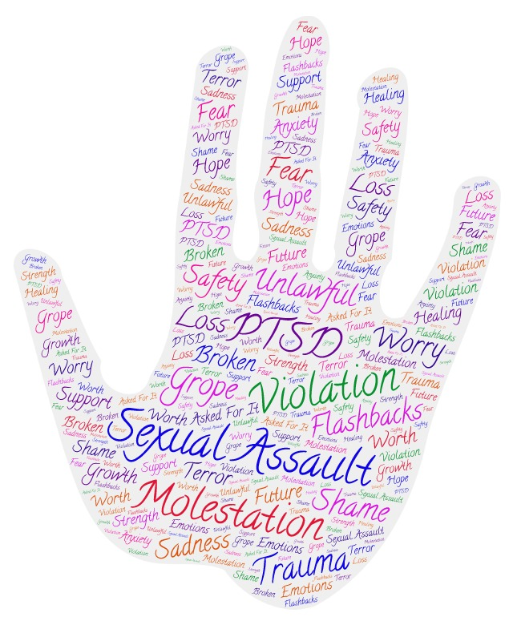
Sexual Assault and PTSD
Stephanie Spaulding
Marshall University
.
What is Sexual Assault?
“Every 98 seconds another American is sexually assaulted. (RAINN, n.d. p.2)”
According to the United States Department of Justice, “Sexual assault is any type of sexual contact or behavior that occurs without the explicit consent of the recipient. Falling under the definition of sexual assault are sexual activities as forced sexual intercourse, forcible sodomy, child molestation, incest, fondling, and attempted rape (n.d., p. 1).”
Reactions
Implications
Implications include paying more attention to: repeated sexual victimization, cortisol levels, trust, and sexual minority status.
The ramifications of this research include: the knowledge for providing better coping strategies, the need for providing education to the survivors as well as the general public on sexual assault, identifying which populations are not receiving adequate treatment, targeting the expected reactions, examining the role of gender, focusing on the short and long-term barriers, and acknowledging there are resources for recovery.
“In regard to social reactions to sexual assault disclosure, most participants in this sample reported experiencing (at least “rarely”) victim-blaming reactions (n=114; 55%), being treated differently (n=133; 64.3%), experiencing others’ attempts to distract from the assault (n=189; 90.9%), experiencing others’ attempts to take control of the situation (n= 175; 84.1%), and others’ egocentric reactions (n=41; 80.3%) (DeCou, Cole, Lynch, Wong, & Matthews, 2017, p. 169).”
“Only two participants (1.1%) from the present sample indicated they experienced no negative social reactions to sexual assault disclosure (DeCou, Cole, Lynch, Wong, & Matthews, 2017, p. 169).”
What is PTSD?
According to Barlow, Durand, & Hofmann (2016), “Posttraumatic Stress Disorder is an enduring, distressing emotional disorder that follows exposure to severe helplessness or a fear-inducing threat. The victim re-experiences the trauma, avoids stimuli associated with it, and develops a numbing of responsiveness and an increased vigilance and arousal (p. G-8).”
Co-morbid Conditions
Predictors of PTSD
Drug and Alcohol Use
“Child Sexual Assault (CSA) was associated with greater PTSD symptoms & greater problem drinking symptoms in woman of Adult Sexual Assault (ASA) (Najdowski, & Ullman, 2009, p. 966).”
“The results suggest that PTSD only influences prospective problem drinking, and vice versa, in women who experience further sexual victimization (Najdowski, & Ullman, 2009, p. 967).”
Suicide Attempts
“Adolescents reporting a history of sexual assault were approximately six times more likely to have attempted suicide in the past year when compared with adolescents reporting no history of sexual assault (Tomasula, Anderson, Littleton, & Riley-Tillman, 2012, p. 114-115).”
“Thus, students with sexual assault histories were more likely to be medically serious suicide attempters than nonvictims (Tomasula, Anderson, Littleton, & Riley-Tillman, 2012, p. 115).”
“The greater history of the trauma (revictimization and child sexual abuse) was connected with more PTSD and depression symptoms (Sigurvinsdottir, & Ullman, 2016, p. 918).”
“Both depression and PTSD symptoms were significantly higher for bisexual women than for heterosexual women (Sigurvinsdottir & Ullman, 2016, p. 917).”
“Cortisol levels taken at the ER and prior assault can predict PTSD symptoms and the slope of PTSD symptoms as well as depression (Walsh et al., 2013, p. 2525).”
Without a prior history of assault
Higher ER cortisol was associated with a swifter decline in symptoms over the course of the study.
Prior assault history
There was a greater initial PTSD and depression symptoms.
They had a steeper decline in PTSD and depression symptoms over time relative to non-assault victims.
Future Research
We should look at longitudinal studies of survivors to see the more long-term effects of the sexual assault and PTSD that results.
There needs to be more research involving males and transgenders as well as those who are bisexual, lesbian, gay, and queer as there isn’t as much data research targeted on these populations.
References available upon request.

