Slide 1
HER Huntington
Carper, A., Hess, A., Lobo, K., Rider, A., Sorrell, R., & Williams, D.

Slide 2
Homelessness
Rates of homelessness have decreased in recent years (US Dept. of Housing and Development, 2017).
But, there were still an estimated 205 sheltered, and an unknown number of unsheltered, individuals in Cabell County in 2015 (WV Dept. of Health and Human Resources, 2016).
Additionally, these numbers may be drastically underreported because only visible individuals are counted (US National Library of Medicine, 2016).

Slide 3
Effects of Homelessness
Difficulty finding a job
Greater chance of having a mental disorder
Greater chance of having long term physical health issues
Greater chance of drug use and abuse
Impact of homelessness. (2011). Homelessness. Retrieved March 7, 2011 from https://www.homeless.org.uk/facts/understanding-homelessness/impact-of-homelessness

Slide 4
Difficulty Finding a Job
In order to combat homelessness, individuals need a reliable source of income, but in WV, the unemployment rate is 5.4% (Bureau of Labor Statistics, 2018).
As of March 23, 2018, WV ranks 48th in employment just before New Mexico and Alaska.
Barriers associated with employment and homelessness are low education level, limited work experience, and lack of access to transportation and technology (The National Coalition for the Homeless, 2014).

Slide 5
Homelessness & Domestic Violence
Among mothers with children experiencing homelessness, more than 80% had previously experienced domestic violence.
38% of all domestic violence victims become homeless at some point in their lives.
In just one day in 2016, over 41,000 adults and children fled domestic violence.

Slide 6
CONTACT
We worked closely with CONTACT Rape Crisis Center to provide the women at Harmony House who have experienced rape and domestic violence with education and support.
CONTACT is a local organization that
Provides advocacy and support for victims of sexual assault and domestic violence
Provides prevention education to the community

Slide 7
“Harmony House affirms the right of all people to adequate food, clothing, shelter and healthcare.”
Resume & Application Assistance
Job Placement
Counseling
Advocacy
Transportation
Donation Center
Apartment Living Quarters
627 4th Avenue
Huntington, WV 25701
(304)523-2764

Slide 8
Fliers For Our Event

Slide 9
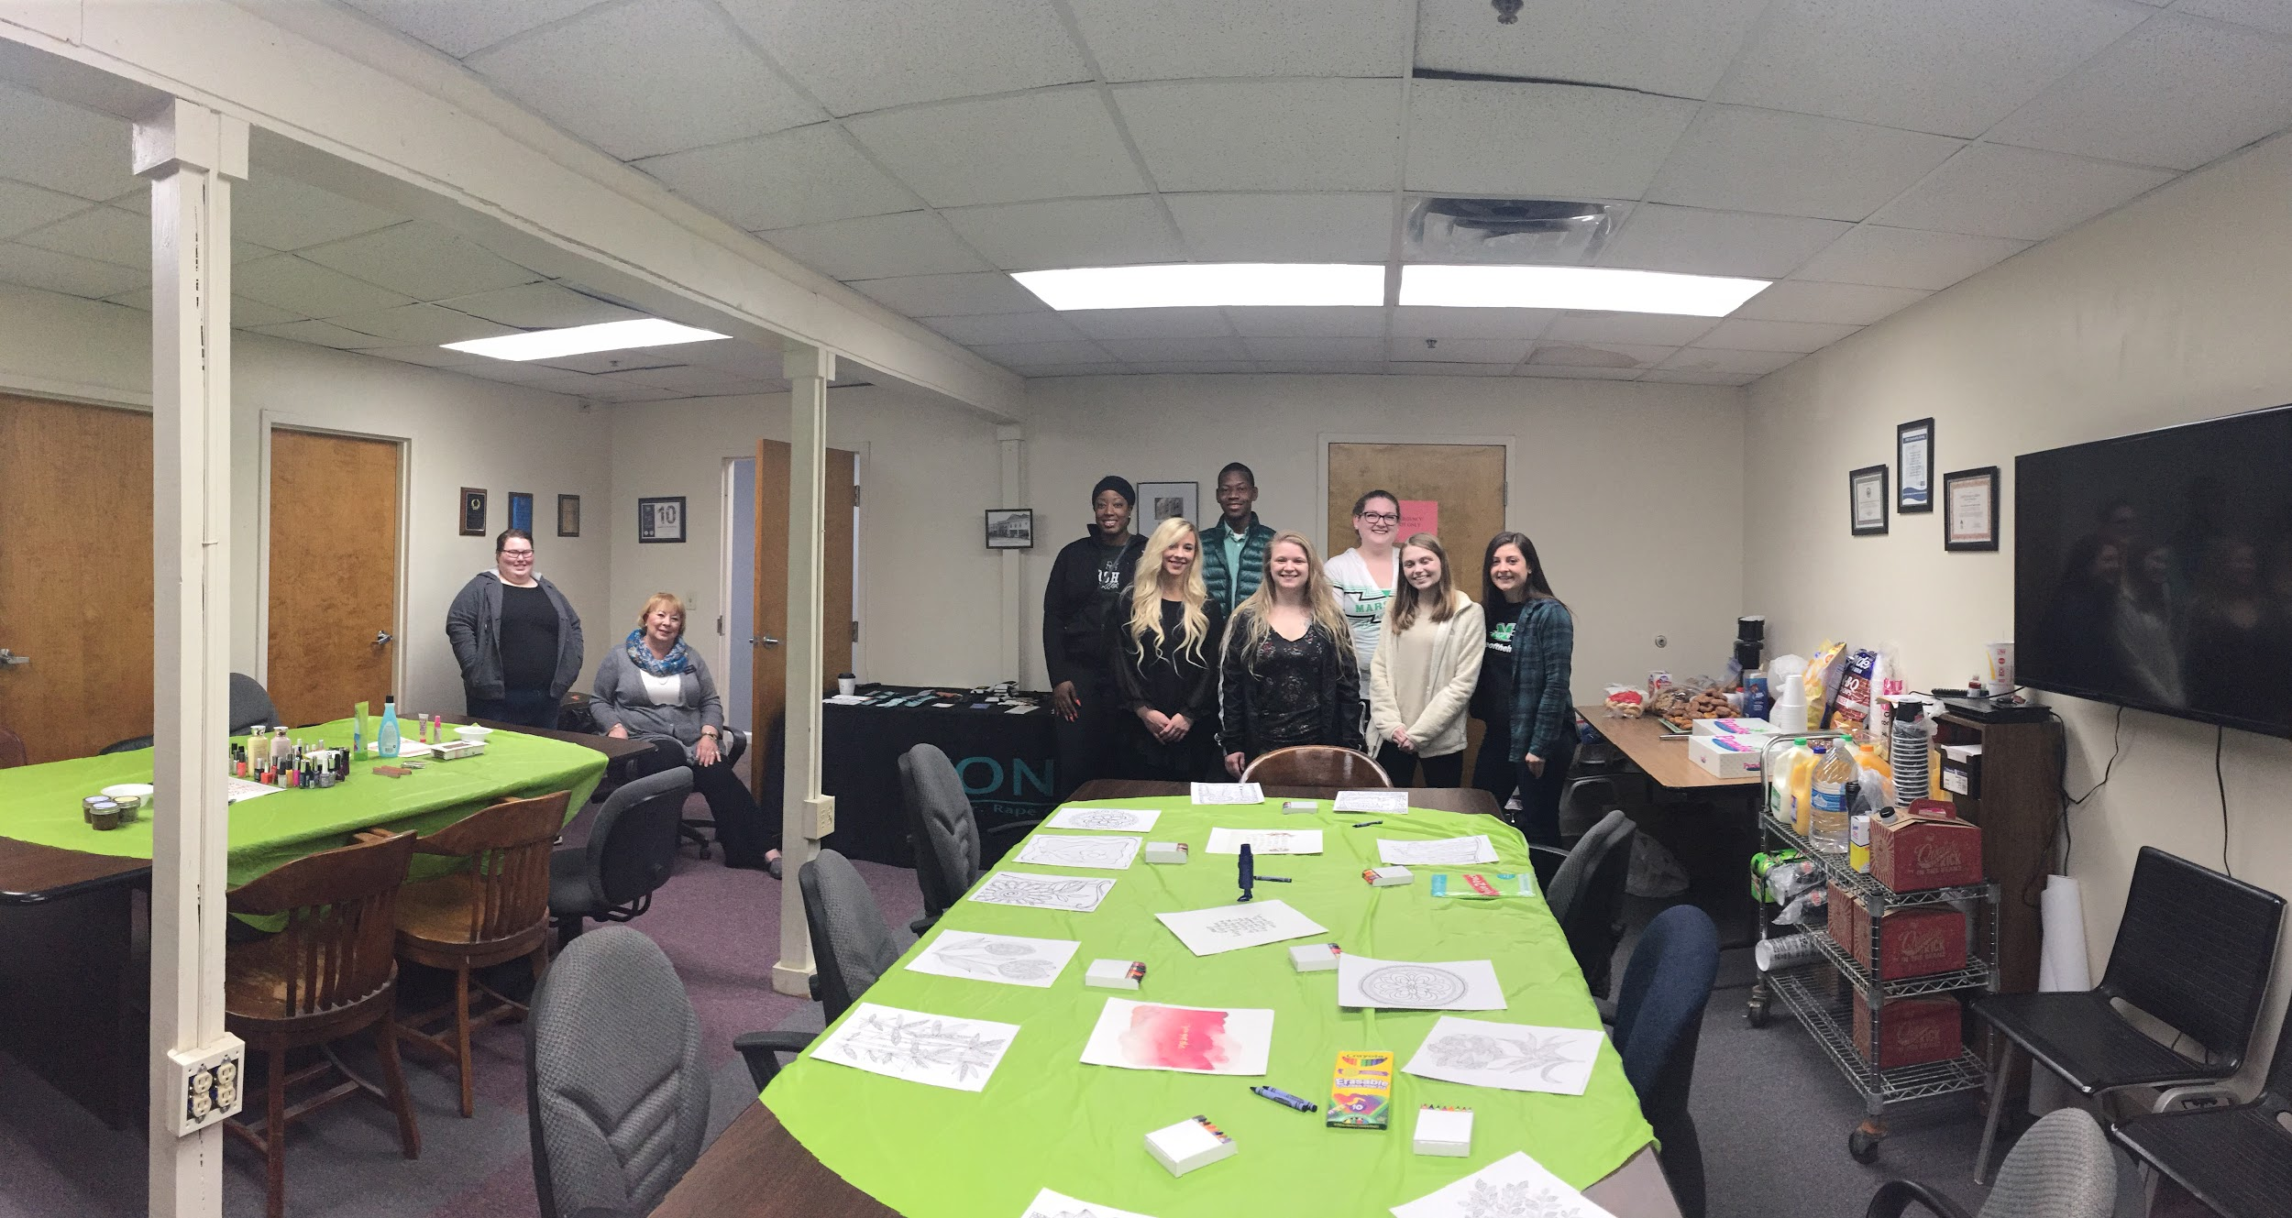
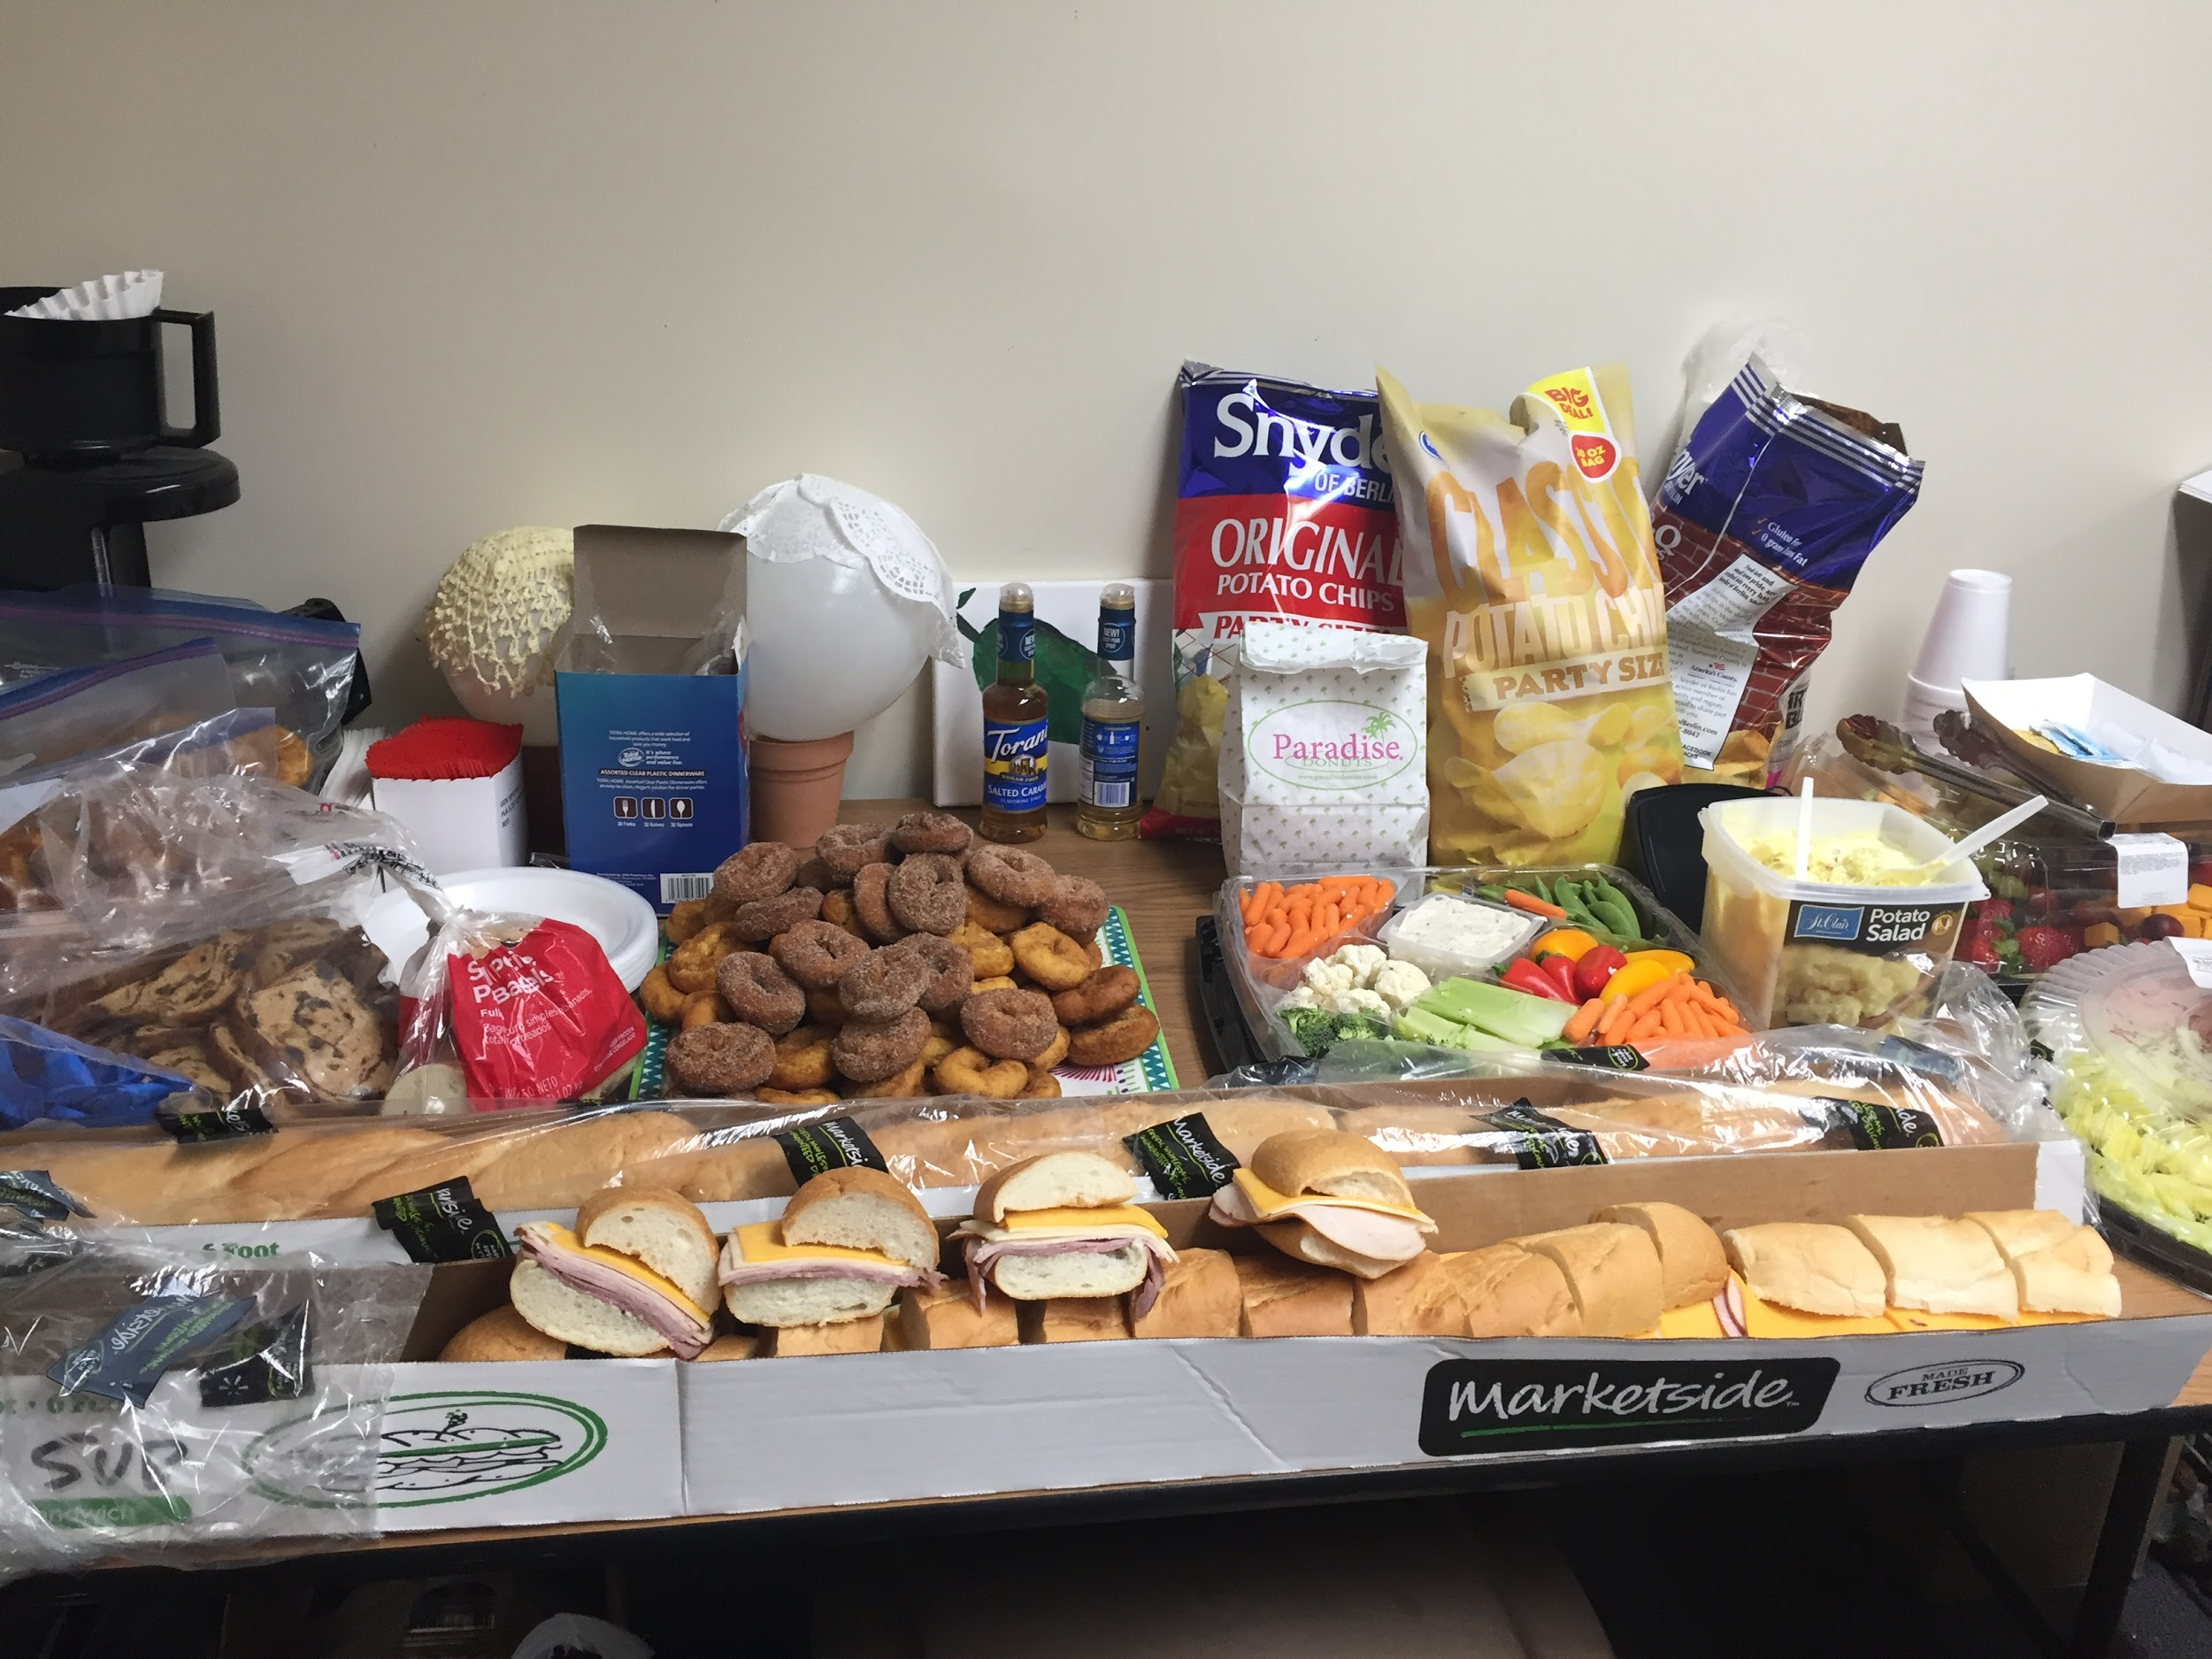
Women’s Brunch and Beauty

Slide 10
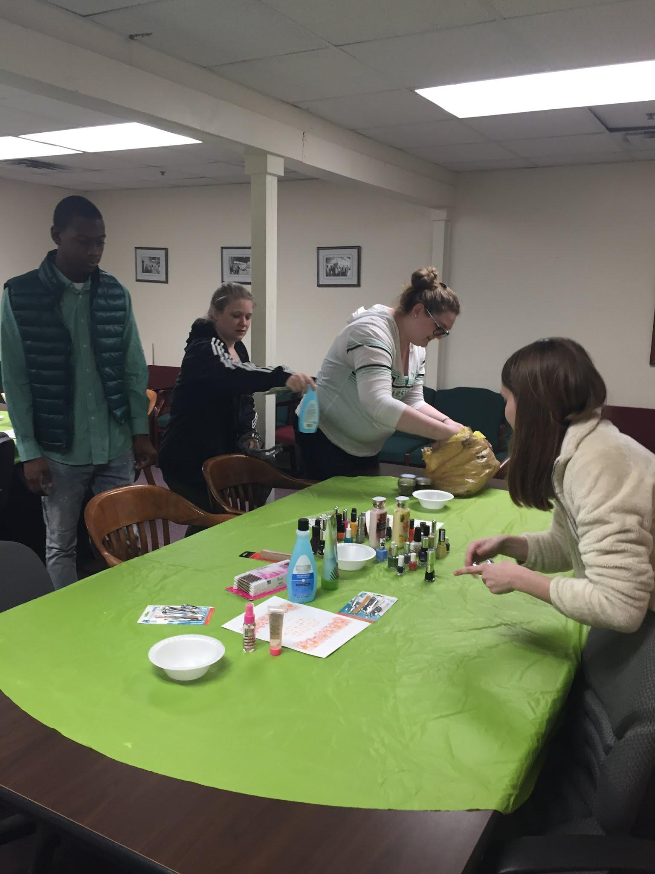
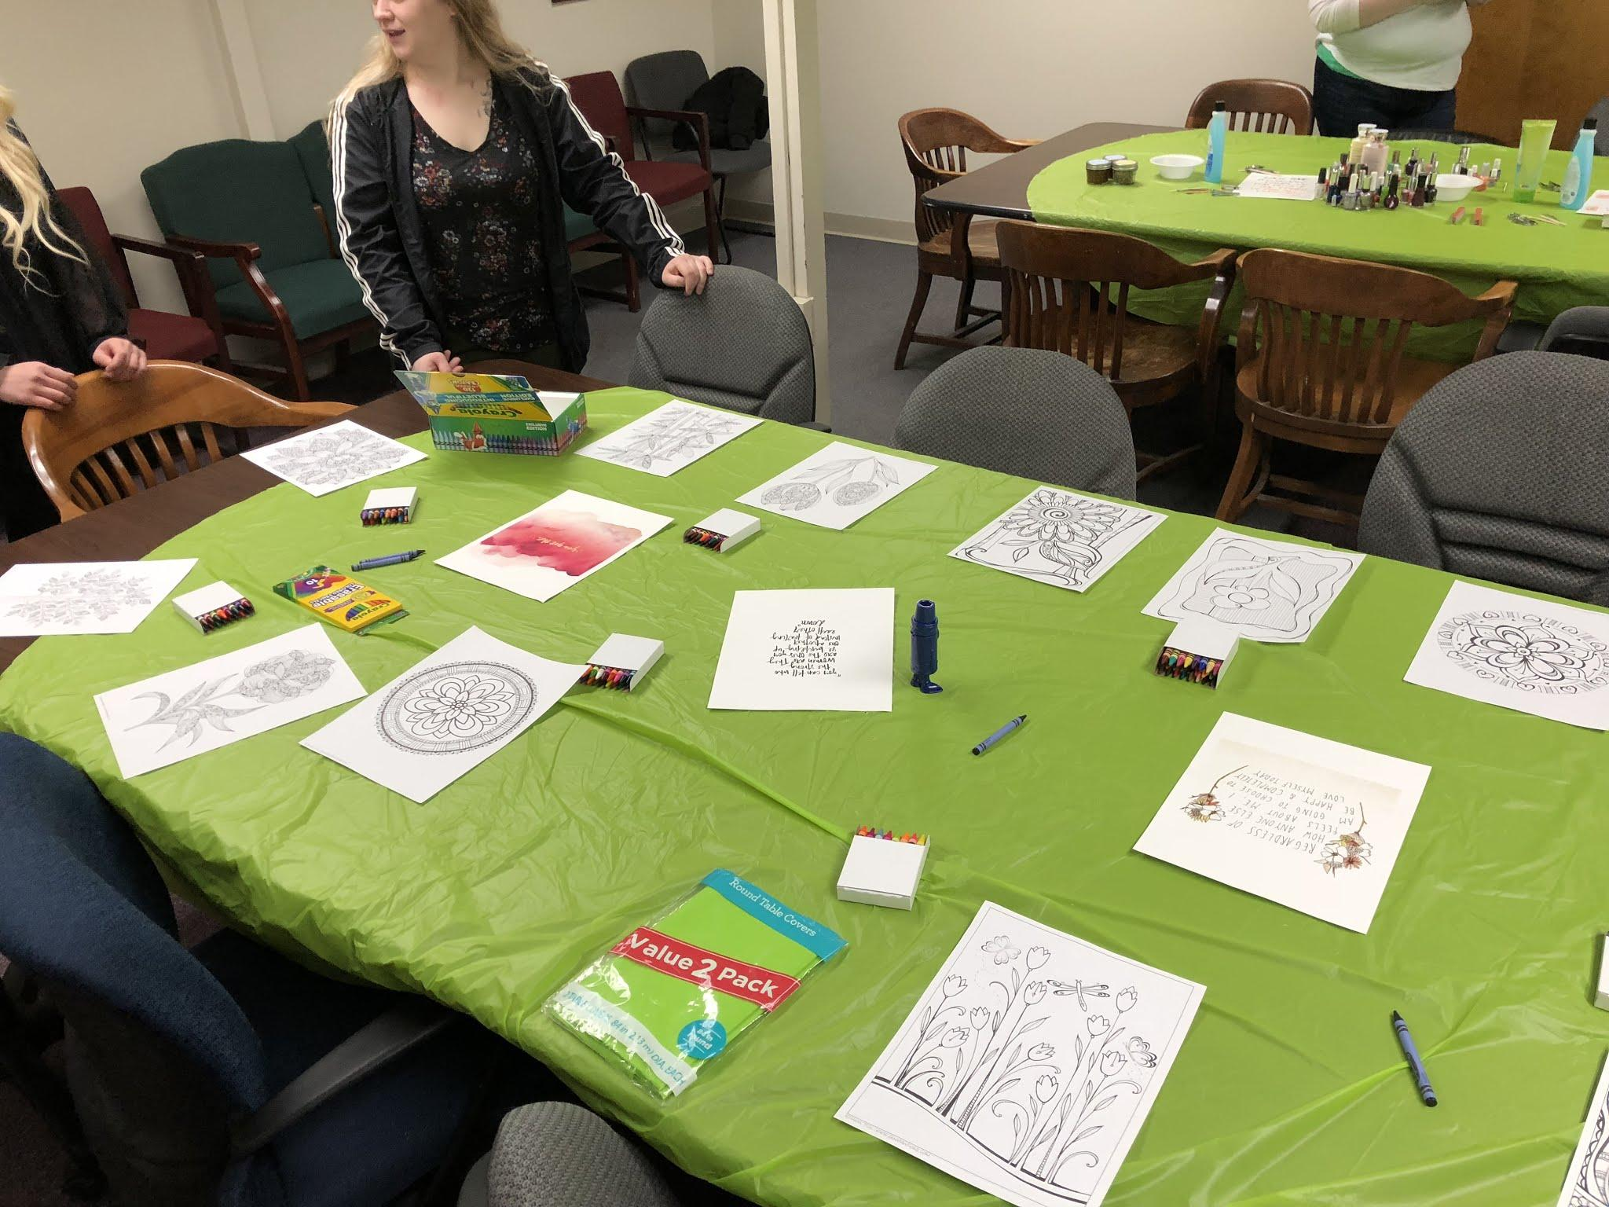
Women’s Brunch and Beauty

Slide 11
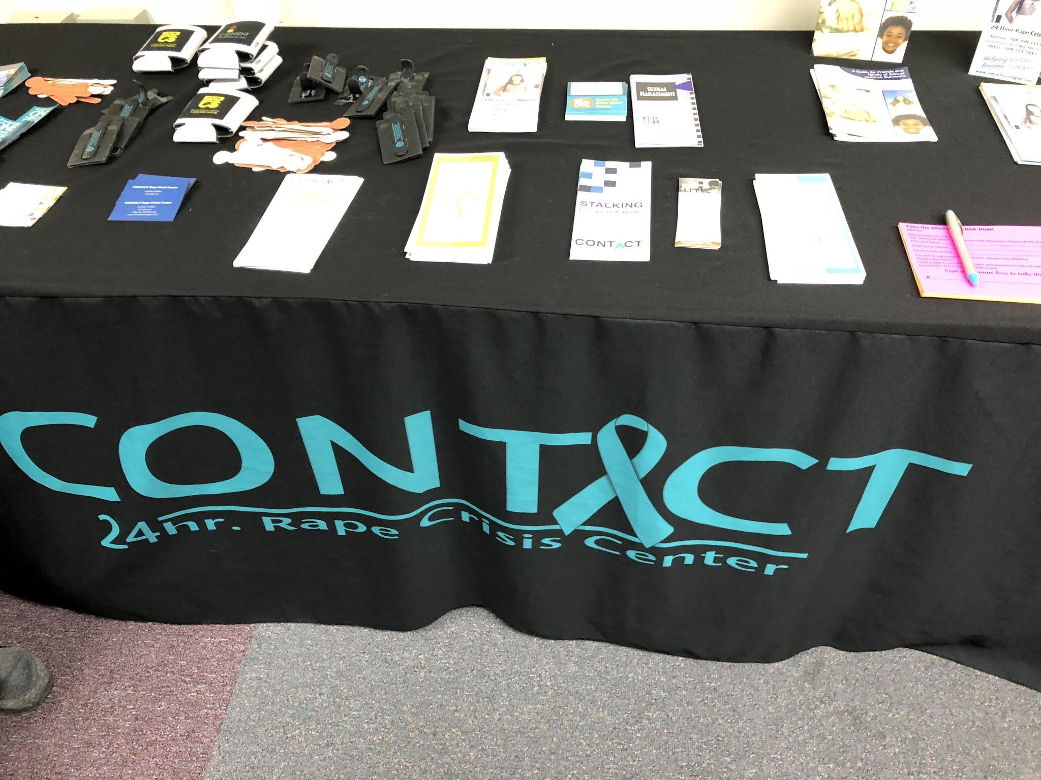
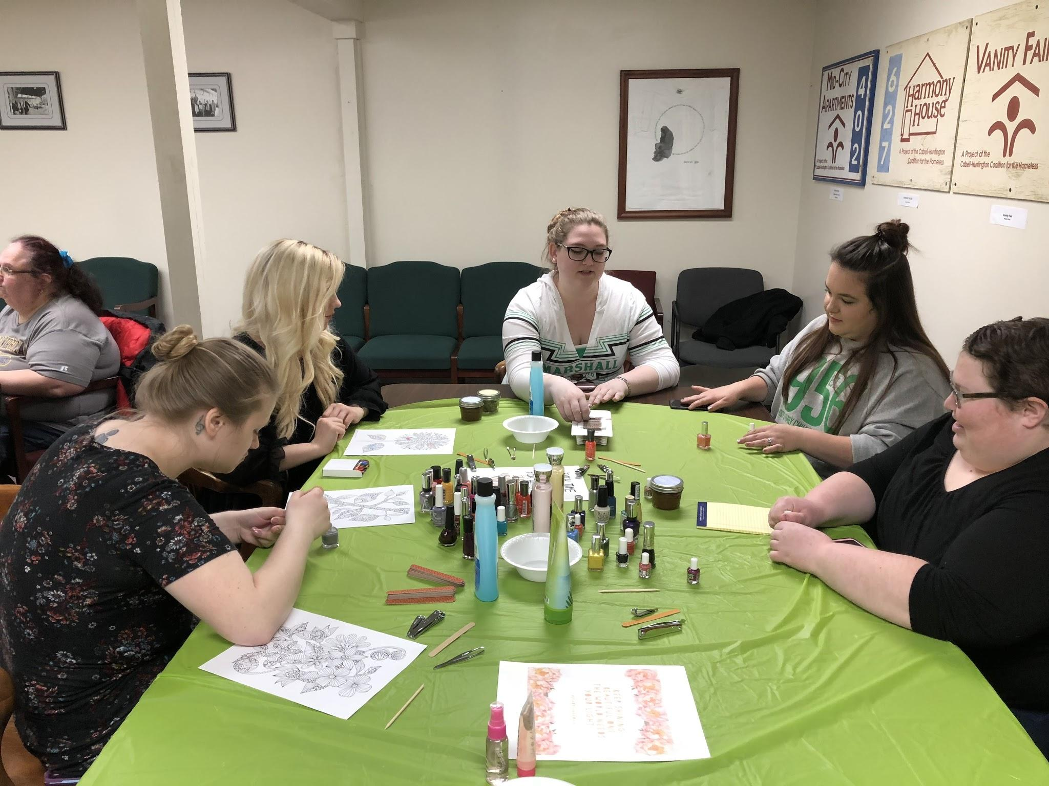
Women’s Brunch and Beauty

Slide 12
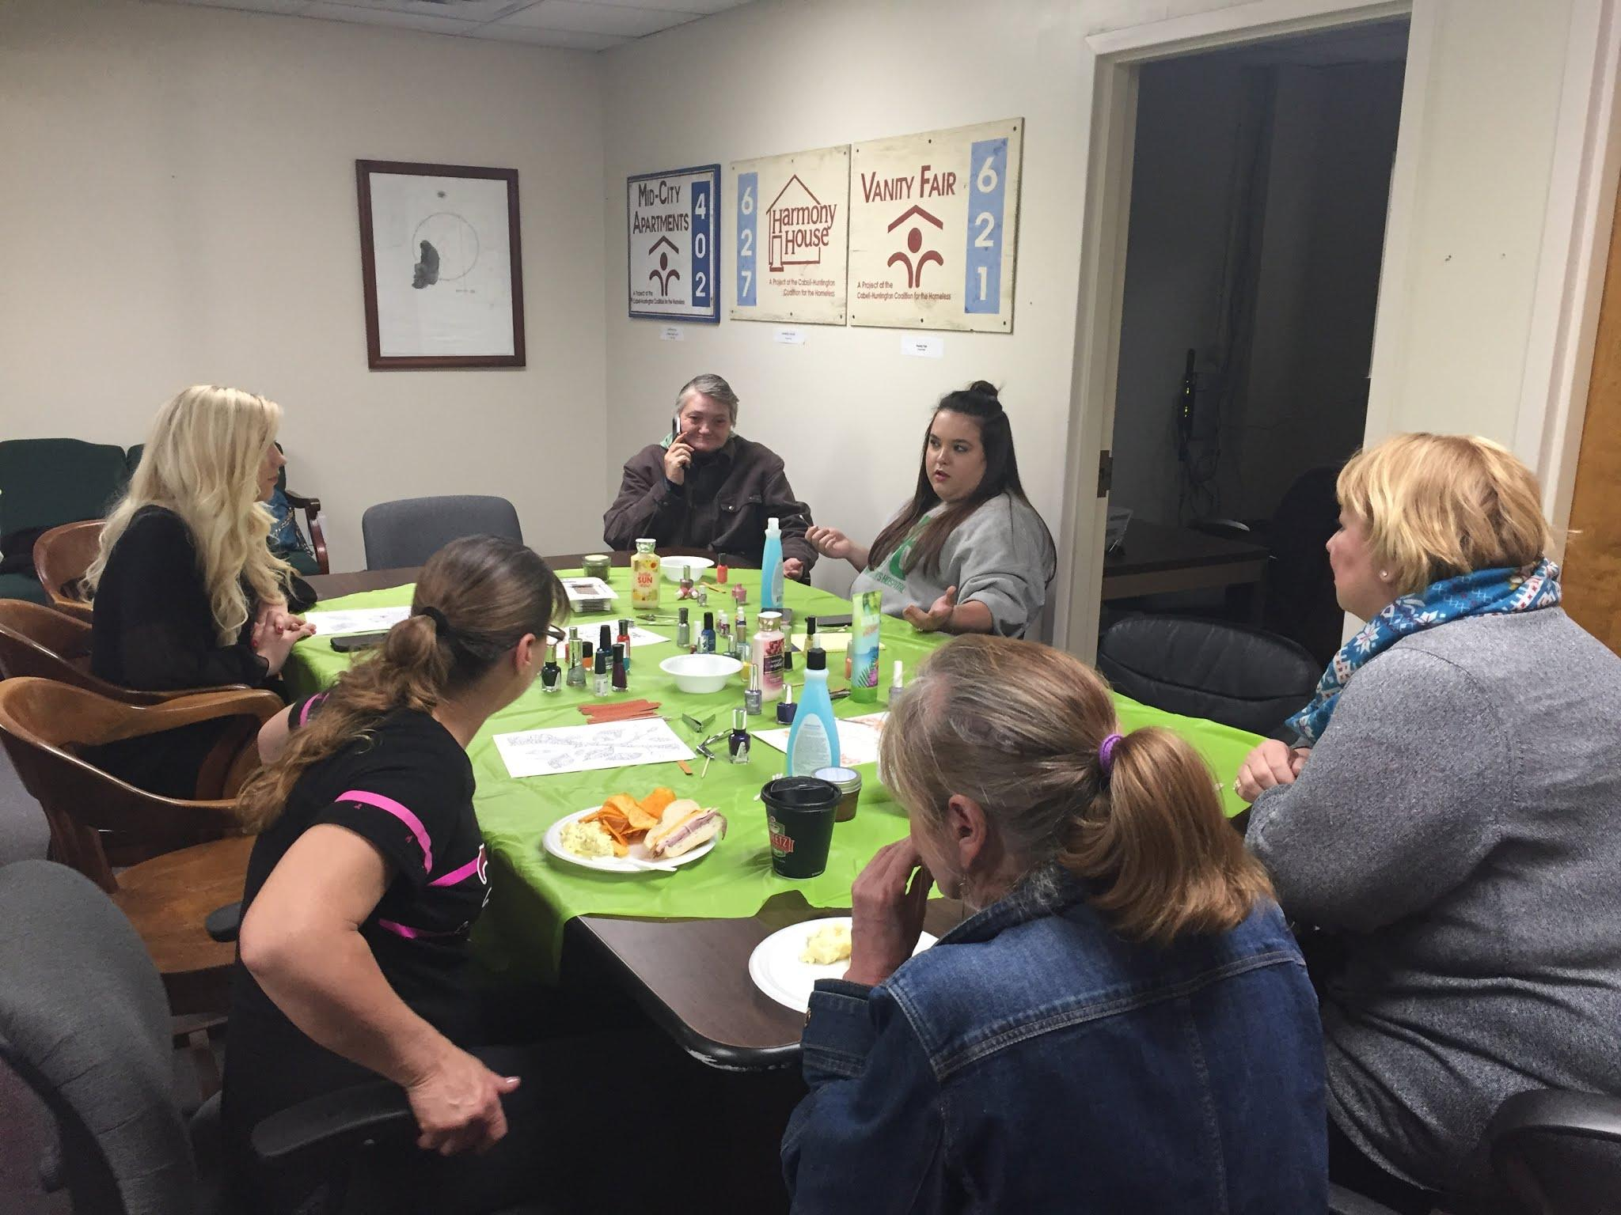
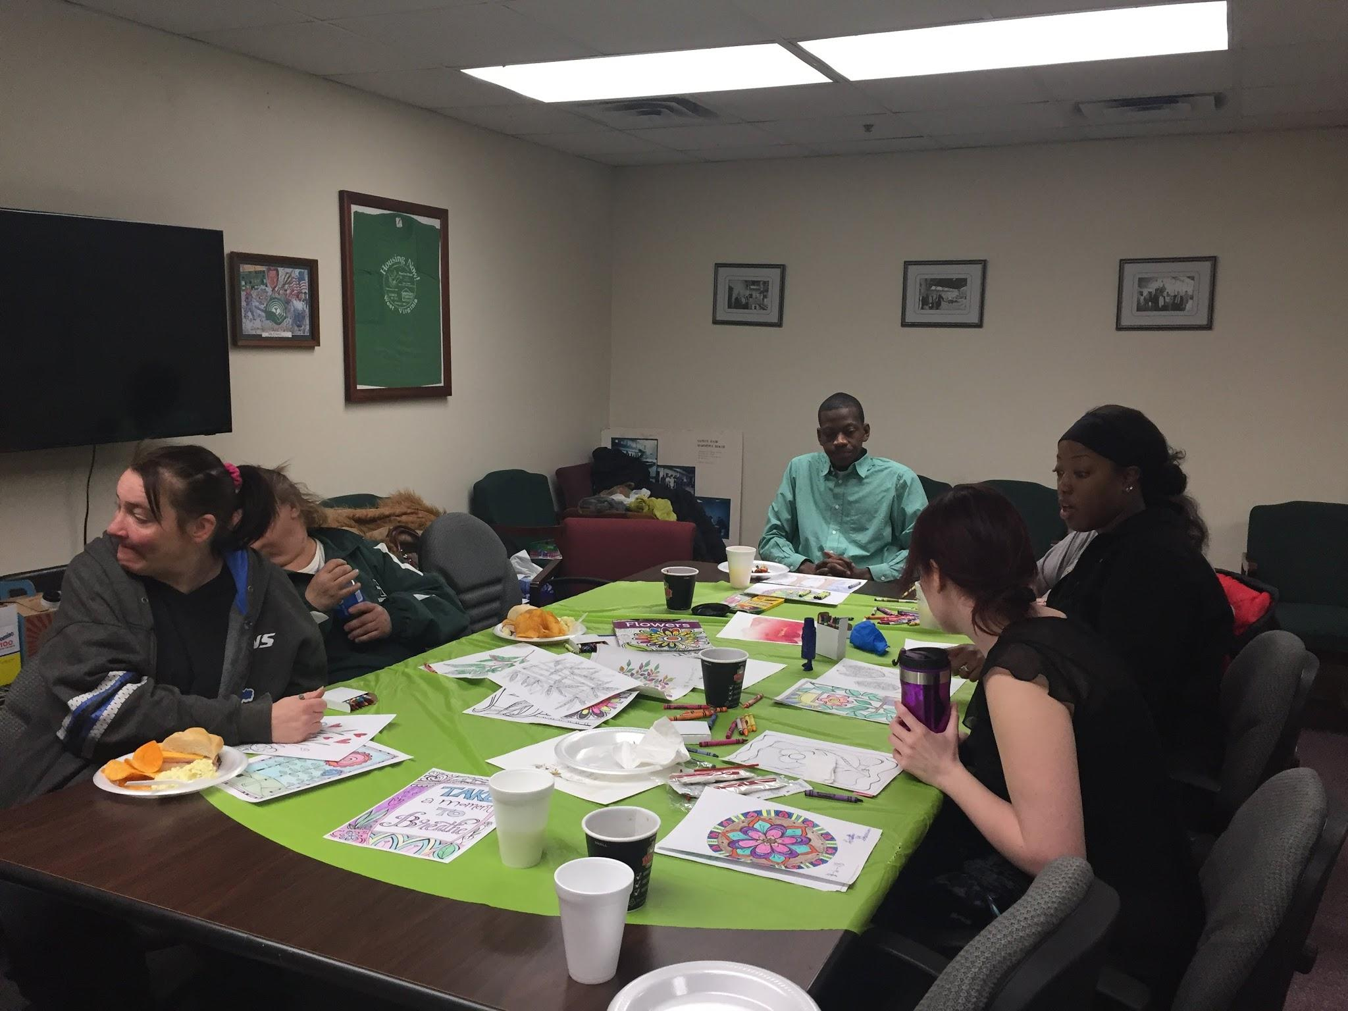
Women’s Brunch and Beauty

Slide 13
Future Involvement
Gain trust and relationships with more individuals at Harmony House by attending other activities on location
Work alongside Dr. Marianna Linz’s Chat and Create on Tuesdays
Help create a women’s support group led by Marshall University Psy.D. students and faculty, along with Psi Chi and Psychology Club
Monthly or quarterly group meetings may provide new resources, training, self-care techniques, and any other needs voiced by Harmony House clients

Slide 14
References
Aratani, Y. (2009). Homeless Children and Youth, Causes and Consequences. New York, NY: National Center for Children in Poverty.
Baker, C., Cook, S., & Norris, F. (2003). Domestic Violence and Housing Problems: A Contextual Analysis of Women’s Help-Seeking, Received Informal Support, and Formal System Response. Violence Against Women 9(7), 754-783.
Bureau of Labor Statistics. (2018). West Virginia. Bureau of Labor Statistics. Retrieved Apr. 15, 2018, from www.bls.gov
Impact of homelessness. (2011). Homelessness. Retrieved March 7, 2011 from www.homeless.org
National Coalition for the Homeless. (2014). Employment and Income. National Homeless. Retrieved Feb. 21, 2018 from www.nationalhomeless.org
National Network to End Domestic Violence (2017). 11th Annual Domestic Violence Counts Report: 24-Hour Census of Domestic Violence Shelters and Services. Washington, DC.
U.S. Department of Housing and Development. (2017). The 2017 Annual Homeless Assessment Report (AHAR) to Congress. Housing and Urban Development Exchange. Retrieved Feb. 27, 2018 from www.hudexchange
U.S. National Library of Medicine. (2016). The Dilemma in Family Homelessness. U.S. National Library of Medicine. Retrieved on March 7, 2018 from www.ncbi.gov
WV Department of Health and Human Resources. (2016). Behavioral Health Epidemiological County Profile. Department of Health and Human Resources. Retrieved Feb. 2018 from www.dhhr.wv.gov

