Slide 1


Free Formal For Now,
Lifestyle Education Forever
Sierra Thornton
Lauren Thompson
Casey Dauberman
Faculty Advisor: Dawn Goel, Ph. D.
Katelynn Gatens
Stephanie Hansell
Marki Lewis
Christian Moore
Sarfina Seretharan
Notes:
Casey Dauberman, Katelynn Gatens, Stephanie Hansell, Marki Lewis, Christian Moore, Sarfina Seretharan, Sierra Thornton
Faculty Advisor: Dawn Goel, Ph. D.

Slide 2

The Cost of Prom
According to USA Today, the average teen spent more than $600 on prom in 2017. This includes
ticket
after prom
transportation
accommodations
flowers
photographs
formal attire
Notes:
Stats on prom formal costs, how it affects disadvantaged youth.

Slide 3

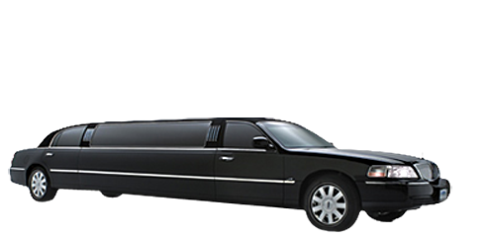
Main Project Points
Provide free prom and formal attire for teens
Offering an educational program to address issues related to safe-dating practices
Help build confidence and self esteem
Notes:
What our goals were, how we collected donations (including food), obstacles, history of project

Slide 4
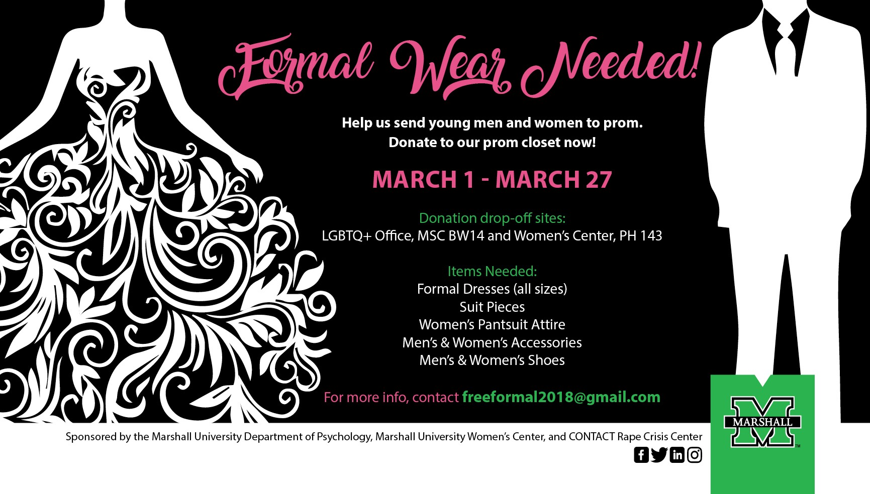
Preparation
Notes:
Talk about the drive

Slide 5





Obstacles
When preparing for the event we ran into several different obstacles that called for some creative thinking.
Notes:
School Strike → Unable to communicate with schools → Lack of donations in the beginning

Slide 6
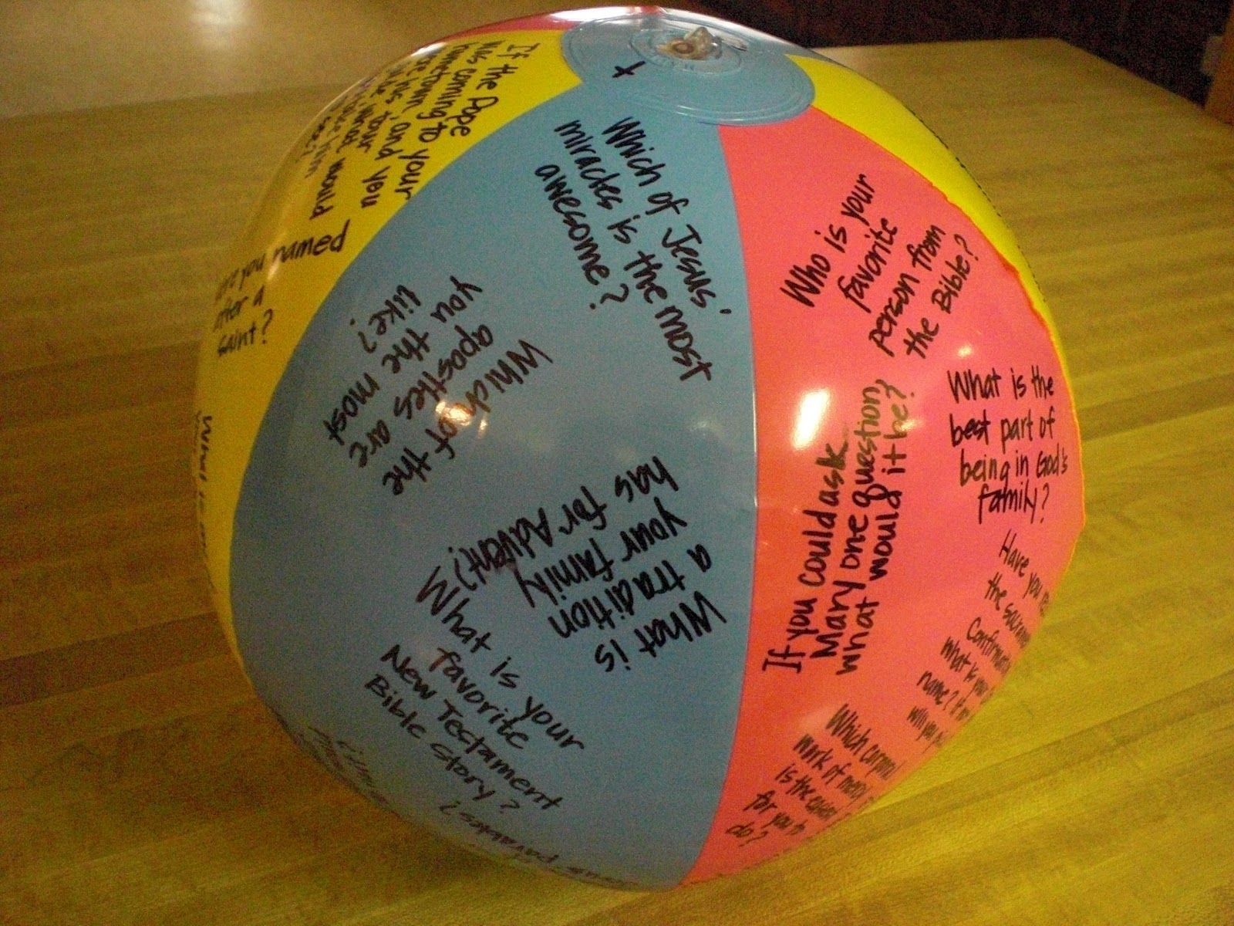

Preview day
Notes:
Include info on Contact’s involvement and the info night

Slide 7
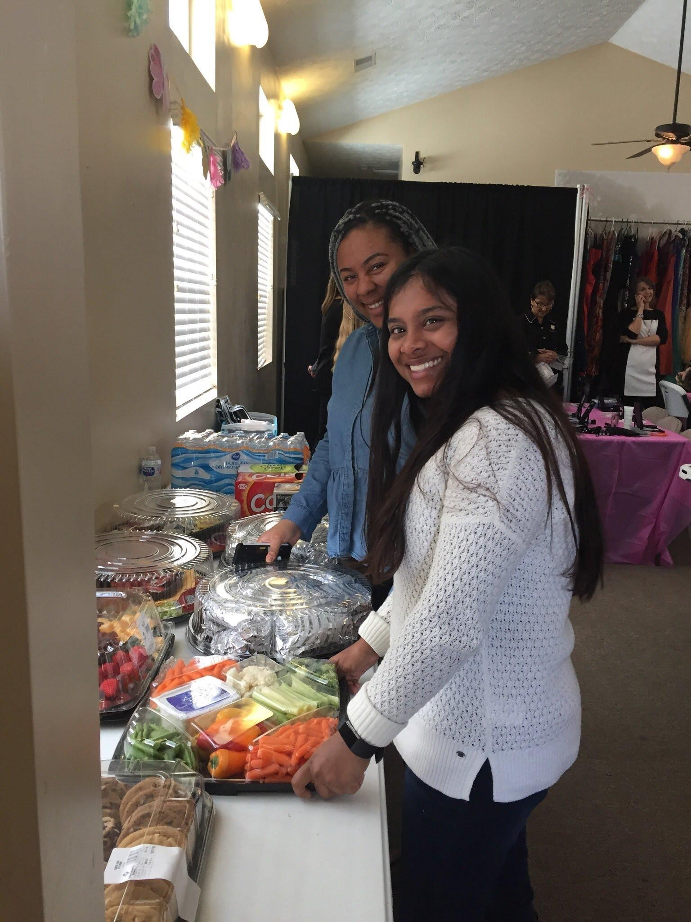
Golden Girl
A non-profit home for girls ages 12-18 that have been severely sexually abused, neglected, and abandoned. They also have an independent living complex and program to help girls who turn 18 graduate from college and help them live healthy and successful lives.
Notes:
Explain what Golden Girls is, how we got involved, what we planned to do for the girls. Loosely explain event
Not all were able to attend prom and/or did not plan on attending but we still wanted to give them a day to pamper them and help increase their self esteem.

Slide 8
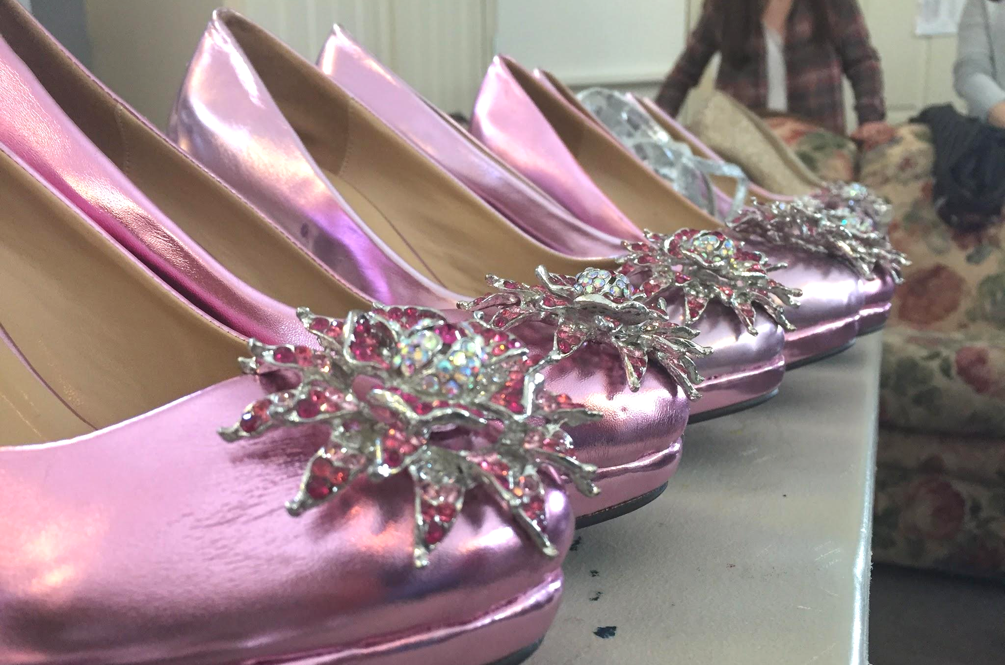
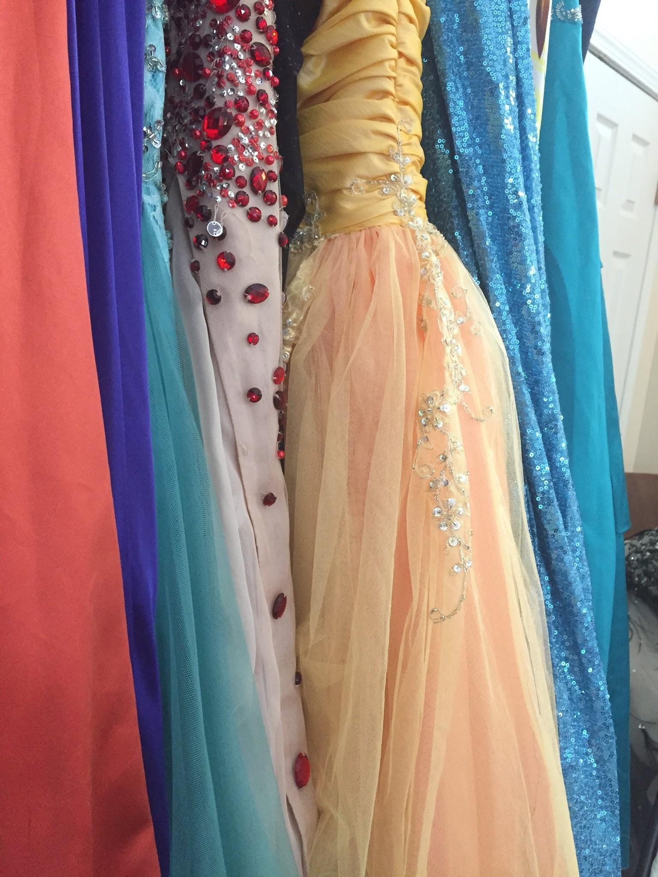
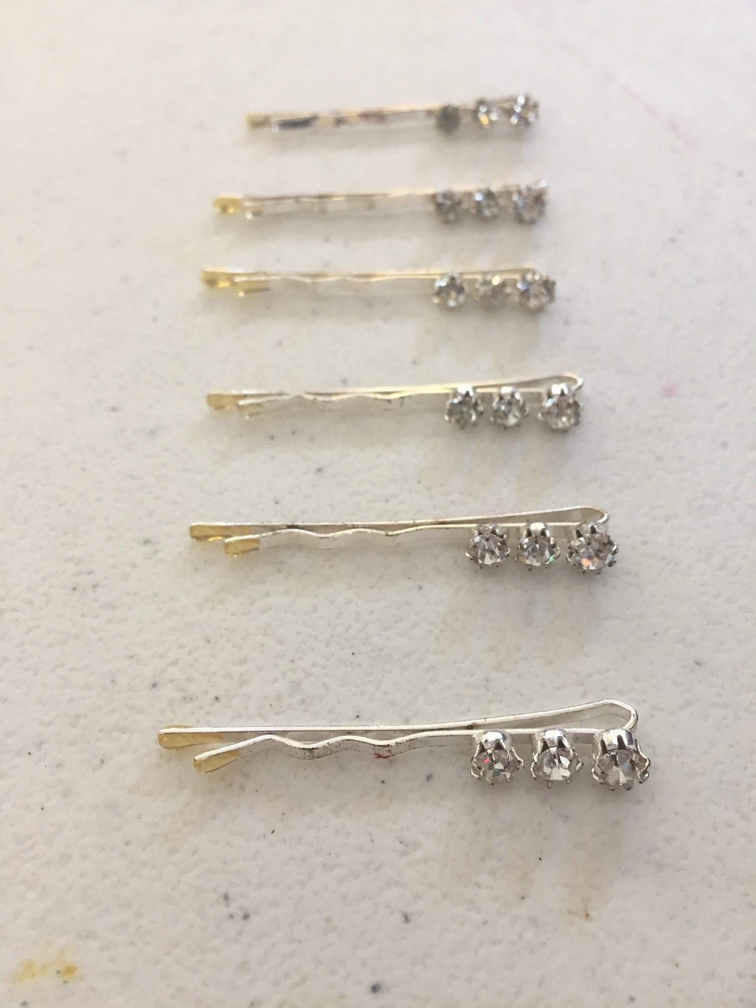


The Event
Shoes
Dresses
Accessories
Notes:
Further/fully explain day of event
They didn’t think that they would be able to to keep the dresses
Set up of Golden Girls
Amount of dresses, shoes, accessories, etc donated
Sheetz food donations
Huntington High’s Women’s Golf Team and Mary Kay
The reaction of girls when they said “yes to the dress”
All girls left with a dress, if not two.
We also brought hope into Golden Girls

Slide 9

Volunteer, Mentor, and Foster
Volunteer: 15 hours, basic volunteer work
Mentor: Background checks, other precautions, more freedom
Foster: In house foster program
Our training: 4/26
Notes:
Explain Golden Girls Program and how we plan to get involved as well as how others can get involved
15 hours of basic volunteer work. Organizing, and working events.
After 15 hrs. Fingerprints and background checks to ensure safety for the girls.
Once a specialized volunteer, may call and take girls off campus. Become a mentor to one if connection is formed.
If connection continues to grow, you can register to become a foster parent for them with their in house foster care system.

Slide 10
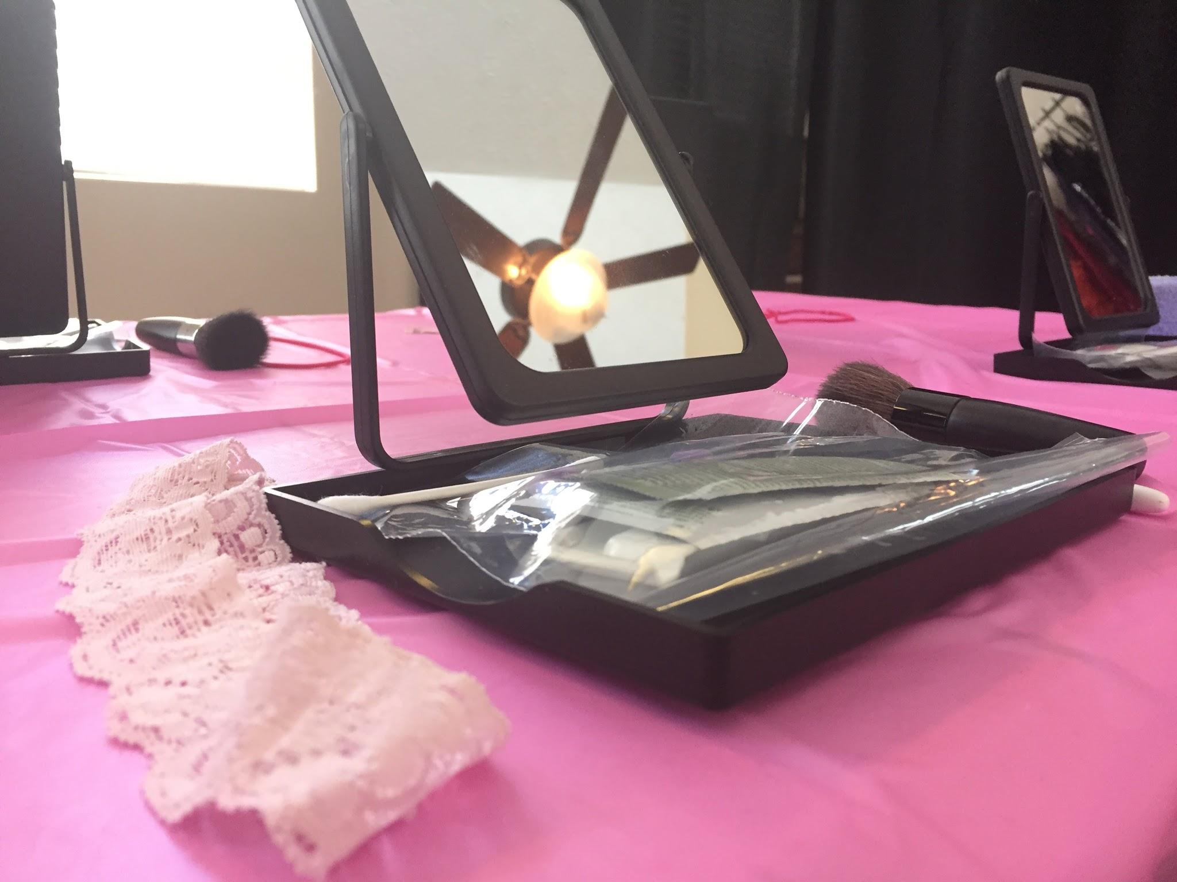

Further Outreach
Golden Girls get ready for prom, May 12th
Return with Mary Kay to help with hair, makeup, last-minute preparations
Continue project annually t
Outreach Program
Notes:
Explain how project will be continued through Psi Chi and Psych Dept. *Outreach program every year to help the community (Explain what these are as well)
Invited to do annual event (continue after graduation)
Educational program w CONTACT, another community partner, or our own people & actual free formal event

