Slide 1
Substance Abuse Awareness
Philip Armstrong-Cheek, Tabitha Ferguson, Jacob Martin, Megan Perry, and Allie Robinson
Faculty Advisor: Dawn Goel Ph.D.

Slide 2
Alcohol Use Disorder in Our Community
According to West Virginia Department of Health and Human Resources, Cabell County is ranked 15th in binge drinking (WVDHHR, 2016).
The concern for binge drinking is particularly high with 25% of college students reporting academic consequences from drinking (St. Lawrence University, 2018).

Slide 3
Mission Statement
We seek to inform students of the risk factors of alcohol abuse, what signs to look for in themselves or others, and programs that are available to help them, whether it be Alcoholics Anonymous or those available through the university.

Slide 4
Community Partner
Marshall University Wellness Center
Amy Saunders, M.A.- Director of the Wellness Center
Aliyah Mickey, B.A.- (GA) Wellness Center

Slide 5
Training Opportunities
Notes:
Throughout the semester we got the opportunity to attend different trainings to help us with our project for the class.

Slide 6
Advocacy Training
Hosted by: The American Civil Liberties Union of West Virginia (ACLU WV)
Learned:
How to speak and act towards elected officials
How to improve your resume
Communication skills
Legislative agendas
How to set up a citizen lobbying meeting
How to become connected with elected officials
Notes:
Going into this training at the beginning of the semester, we didn’t know what to expect. We learned useful tips to help talk to elected officials and others higher up in the community. We talked about some of the problems in our community that would be good ideas to talk to legislature about such as the drug epidemic and how we could better our community. A couple things that I took away from the training was to just remember that elected officials are human beings and to remember to be a voice for someone who isn’t able to speak for themselves.
This training helped us get in contact with our community partner, Amy Saunders, as Jake mentioned before. It helped us be able to have the confidence to get in touch with Amy, and even though she was busy with other things going on, on campus, we didn’t give up and we remembered the reason for choosing our project.

Slide 7
SBIRT
Screening, Brief Intervention, and Referral to Treatment is an evidence based approach focused on early intervention at risk for developing a substance use disorder.
Screening is done through various tests such as AUDIT, DAST, and CRAFT to identify their level of risk (Low, Medium, High).

Slide 8
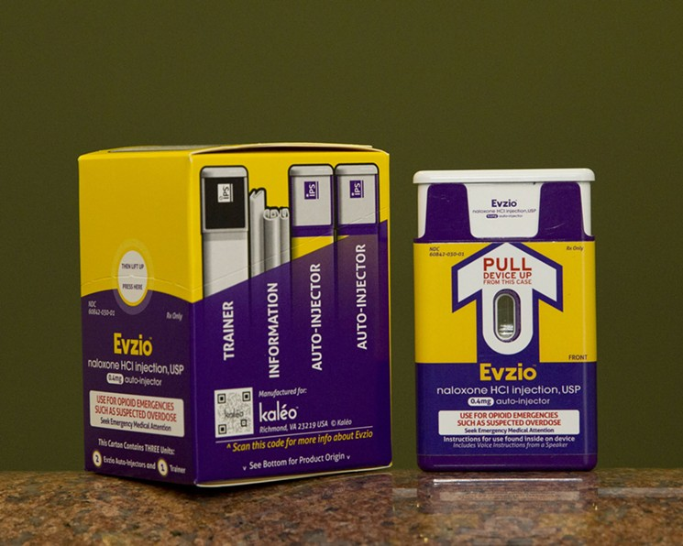
Naloxone Training
Hosted by: The Health Department
Learned:
How to give Naloxone via nasal spray and needle
How to recognize the signs of an overdose
What causes an overdose
How Naloxone works
What to do in the event of an overdose

Slide 9
Outreach

Slide 10
Pop-up Tables
3 tables total between 2 days: Towers, Freshman Dorms, and the Student Center
Flyers, pamphlets, Jeopardy, incentives, etc.
BAC levels, standard drink, myths, Amnesty Policy, counseling services, risk factors, binge drinking, alcohol poisoning, etc.

Slide 11
Continuing to Give Hope
Different expectations coming in
Trainings to put on our resumes
Contacts and connections through the university
Future GA positions
Continuation through up and coming substance abuse program on campus; SBIRT
Notes:
As we mentioned before, coming into this class we knew the issue we wanted to confront (alcohol abuse). We didn’t know all the setbacks that would come along with trying to figure out a program to set up on campus. We knew we wanted to get the information out to students about the risk factors and other comorbidities dealing with substance abuse, but our way of presenting the information changed throughout the semester and it turned out better than we could have expected. We have had so many amazing opportunities throughout this experience such as trainings that we can put on our resume, different contacts throughout the university and if some of us decide to come back for grad school, we will already have the proper training to give the presentations we originally wanted to do.Thank you

