Slide 1
Population Change in Appalachia Since 1910
Colton Snyder
Marshall University
Spring 2019

Slide 2
Introduction
Appalachian population trends over the last century have fluctuated from one extreme to the other.
Appalachia’s population has varied much more than the national average.
Each region of Appalachia has been impacted by population change differently.

Slide 3
Coal mining population boom in early 20th century
Decreased mining and manufacturing – slump in 1960’s
Millions of Appalachians travel “Hillbilly Highway”
1980’s economic improvement – past residents return home
Increase of current population

Slide 4
Questions and Objectives
What caused such a major population increase in the early 20th century?
Why did Appalachians leave in droves during the mid-20th century?
Were certain areas in Appalachia more affected than others?
What do present day Appalachian population trends show?

Slide 5
Why is this important?
By analyzing areas most affected by population change, inferences regarding that area’s economic health can be made.
Comparing Appalachian population change and other areas helps to understand the nature of modern human migration.
Past population data allows for future trend predictions.

Slide 6
Methods
Population Data 1910 – 2010 taken from US Census
Counties not in Appalachia were deleted
Divided into three regions: northern, central, and southern
Census was analyzed – totals tallied for review

Slide 7
Where is Appalachia?
Appalachian Regional Commission definition of “Appalachia”
Categorized into respective regions by color

Slide 8
Early 20th Century (1910-1940)
Mining and manufacturing in the northern and central regions
“Golden Age” of Appalachia
30% total growth

Slide 9
Mid-20th Century (1950-1970)
Mining and manufacturing decline
Central Appalachia – 24% population decrease
Northern Appalachia – 4% population increase
Southern Appalachia – 17% population increase

Slide 10
Late 20th Century/ Early 21st Century (1980-2010)
Northern Appalachia – 2% population decrease
Central Appalachia – 3% population increase
Southern Appalachia – 47% population increase

Slide 11
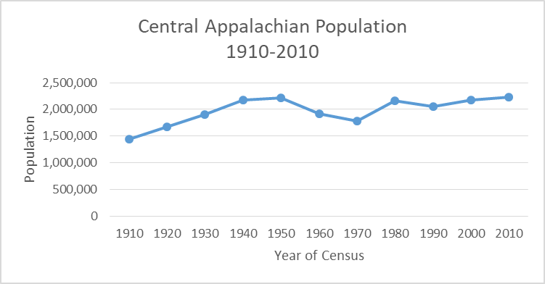
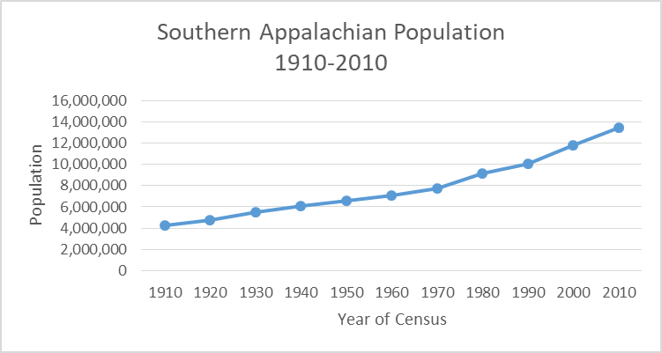
Overview of each Appalachian regions’ population during the last century.

Slide 12
Summary of Results
Population boom in the early 20th century is corroborated by census data.
Population loss in the mid-20th century was most noticeable in central Appalachia.
Southern Appalachia did not lose population in the last century.
All three regions are currently gaining population.

Slide 13
Conclusion
Population growth rates varied – northern and central Appalachia
Least afftected – southern Appalachia
Most populated in 2010 – southern Appalachia
Current population growth – urban areas
More information could be collected – race, income, education

Slide 14
References

