Slide 1
Marshall University
Institutional Repository Proposal
Ad Hoc Committee on MU Institutional Repository
Jingping Zhang (chair), University Librarian/Director of Libraries Operations
Edward Aractingi, Assistant Director of IT Infrastructure Systems
Gretchen Rae Beach, Catalog & Digital Services Librarian/Associate Professor
Nathaniel DeBruin, University Archivist and Manuscripts Librarian/Professor
Paula Kaplan, Instructional Design Specialist
Thomas Walker, Music & Digital Services Librarian/Assistant Professor
June 13, 2011

Slide 2
Ad Hoc Committee on MU
Institutional Repository
Researched other institutions to learn how they are using IRs to publish, promote, and provide access to their intellectual property
Identified a wide range of materials currently produced by Marshall University which could quickly and relatively easily be used to populate an IR
Recommend Marshall University fund a two-year pilot program to initiate MU IR with the Digital CommonsTM platform by Berkeley Electronic Press (bepressTM)

Slide 3
What is an Institutional Repository (IR)?
“An institutional repository is a digital archive of the intellectual products created by the faculty, research staff, and students of an institution and accessible to end users both within and outside of the institution, with few if any barriers to access.”
The case for institutional repositories: A SPARC position paper. Release 1.0, 2002. http://www.arl.org/sparc
“[A] University-based institutional repository is a set of services that a university offers to the members of its community for the management and dissemination of digital materials created by the institution and its community members”
Clifford A. Lynch. Institutional repositories: Essential infrastructure for scholarship in the digital age. ARL Bimonthly Report 226, February 2003.

Slide 4
Justification &
Objectives
Justification
  An institutional repository will establish the university’s research distribution strategy.
  An Institutional repository will enable the University Cabinet to better serve the university’s mission:
  “The university actively facilitates learning through the preservation, discovery, synthesis, and dissemination of knowledge.”
Objectives of an Institutional Repository (IR)
  Create global visibility for an institution's scholarly research.
  Collect content in a single location.
  Provide open access to institutional research output by self-archiving it.
  Store and preserve other institutional digital assets, including unpublished or otherwise easily lost ("grey") literature (e.g., theses or technical reports).

Slide 5
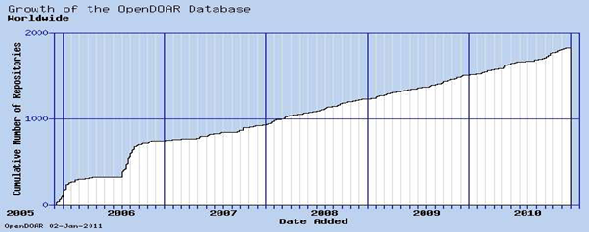
Necessity of an IR
Developing a Research Distribution Strategy
  “Dissemination of knowledge is as important to the university mission as its production.” (ARL, 2009)
  “Every university that produces research should have a publishing strategy.” (Brown, 2007)
  “This represents a shift from a passive role in research distribution to an active one.” (Shulenburger, 2007)
National and International Trends

Slide 6
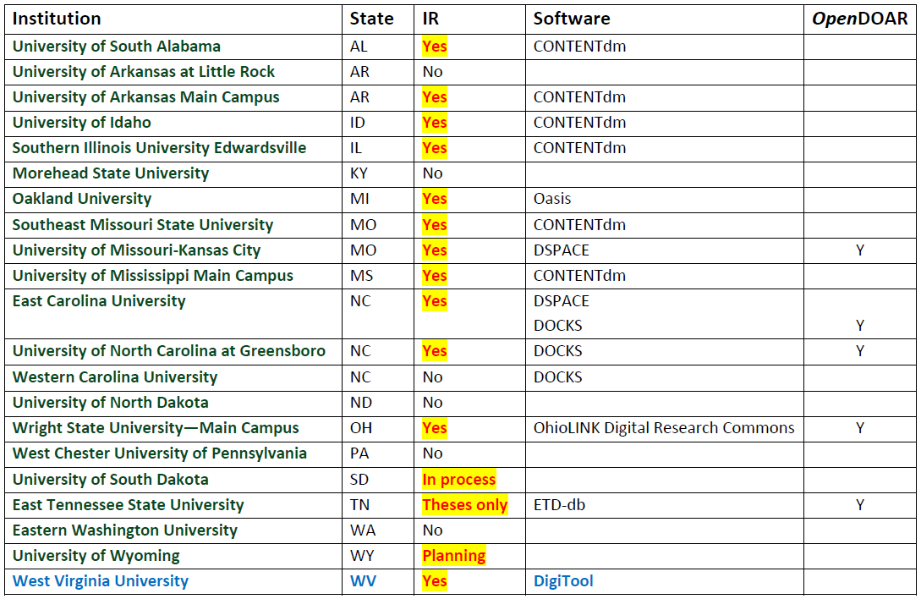
Peers and WVU

Slide 7
Status of MU
CONTENT
  Marshall University has—and continues to produce—an extensive, varied range of valuable, historic, significant, and unique content, by faculty, staff, and students.
NEEDS
ISSUES
  Improve access to existing resources
  Clear, easy process to facilitate self-publishing
  Promote MU research work to global community
  Secure management and maintenance of items
  Disparate or scattered storage locations
  Limited or no access outside MU
  Antiquated or non-existent search capability
  Long-term preservation

Slide 8
Content
Scholarly Works
  Published material
    Journal papers (post-prints)
    Book chapters
    Books
    Patents
    Conference papers
  Unpublished / “grey” material (PC, personal webpages, etc.)
    Pre-prints
    Theses and dissertations
    Undergraduate honors theses
    Working papers
    Technical reports
  Unpublished / “grey” material (continued)
    Progress/status reports
    Committee reports
    White papers
    Final research reports
    Presentations
    Posters
  Supporting material
    Data sets
    Models
    Simulations

Slide 9
Content
Continued
Faculty & Student Creative Works
  Music Scores
  Poetry
  Fiction and Creative Non-Fiction
  Art
  Dance and Music Performances
Classroom Resources
  Learning Objects
  Lectures
  Textbooks
  Syllabi
  Supplementary Course Material
Manuscripts
  Diaries
  Notebooks
  Correspondence
University Archives
  Yearbooks: Mirabilia, Chief Justice
  Newspapers: The Parthenon
  Commencement programs
  “50 Years Ago Today” with the WSAZ-TV news film: 1952-present
  Administration documents
  Newsletters: Academic Affairs, MU
  Minutes: Board of Governors meetings, Faculty Senate meetings
  MU events: Commencements, Cyber-Infrastructure Day, Week of Welcome
  Other department-produced materials
  Campus lectures
  Campus web pages

Slide 10
Locations of Content
(Example 1)
Marshall University Audio and Video
Video Archives: http://marshallu.mirocommunity.org/
We are…Marshall Today (available on the MU streaming server):
    \\mumedia\windowsmedia\muheadliners
    \\mumedia\windowsmedia\muheadliners_old
News streams:
  \\mumedia\windowsmedia\ucomm
Sound gallery:
    \\mumedia\windowsmedia\wmulfm
    \\mumedia\realmedia\wmul
Commercials & showcase:
    \\mumedia\windowsmedia\itvs\spots
    \\mumedia\windowsmedia\davemag
Faculty media: \\mumedia\windowsmedia\biotech
Marshall University Department of Music performances and recitals:
    \\mumedia\windowsmedia\musicDept
    \\mumedia\windowsmedia\music

Slide 11
Locations of Content
(Example 2)
Audio & visual materials in the Archives and Manuscript Collections (2007 inventory)
  Photographic negative images – 242,000 (12,000 glass plate, 230,000 polyester/safety film)
  Print images, artwork, and posters – 75,000 items
  Transparencies (lantern slides and 35 mm slides) – 6,500 items
  Video Tape (University Archives and WSAZ-TV news film archives, all formats) – 3,900 cassettes (approximately 4,900 hours of video)
  Motion Picture Film – 2,115 reels (approximately 1.75 million feet of film)
  Audio Tape – approximately 1,000 audio cassette and reel-to-reel tape recordings (primarily oral history recordings)

Slide 12
Solution: MU IR
The IR is specifically designed to
collect,
record,
preserve,
maintain,
promote,
and provide access
to Marshall’s scholarly and intellectual output
and make it available to the world.

Slide 13
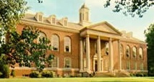


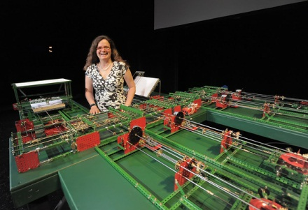
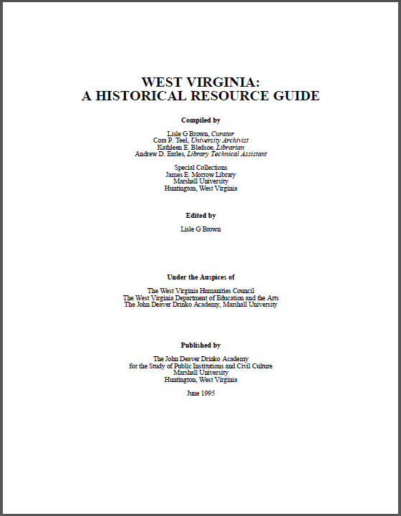
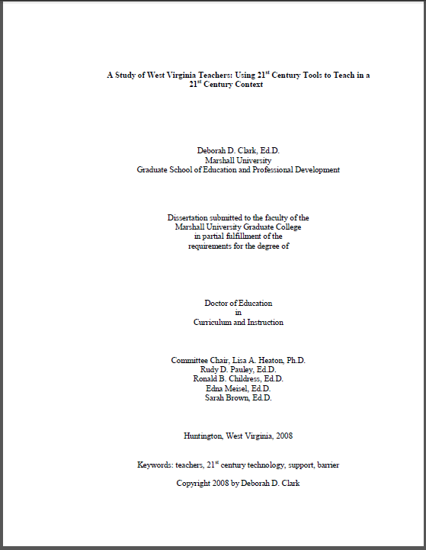

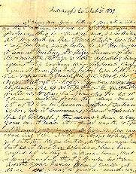
Proposed IR Content
Faculty Research and Scholarly Output
  MU Faculty Achievement Database
  http://www.marshall.edu/senate/achieve/default.asp
Theses and Dissertations
  1,500 bound volumes in Morrow Library + ETDs since 2002 http://www.marshall.edu/library/libraries/e_theses_dissertations.asp
  University Archives: 2,100 cubic feet of materials—currently non-circulating
Special Collections & Manuscripts
    800 manuscript collections varying in size from a single page to over 600 cu. ft. of materials.

Slide 14
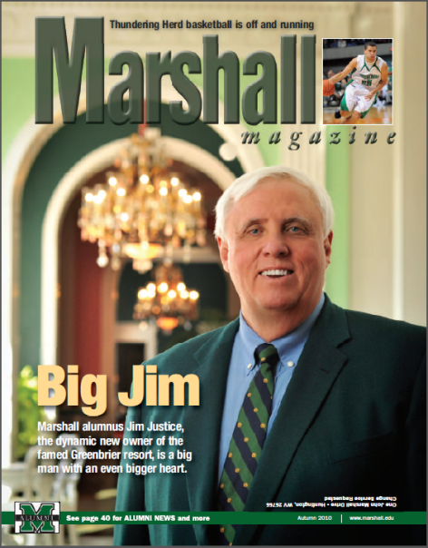
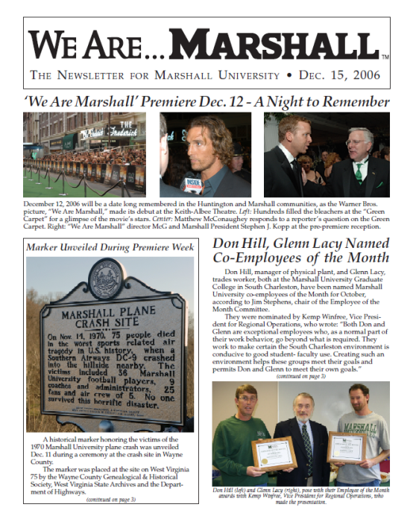
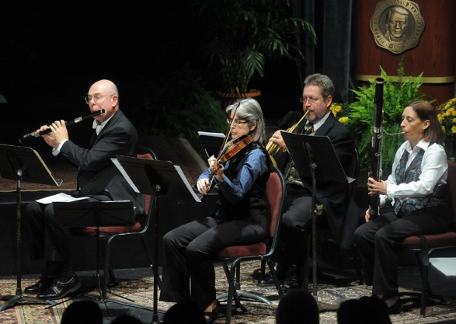
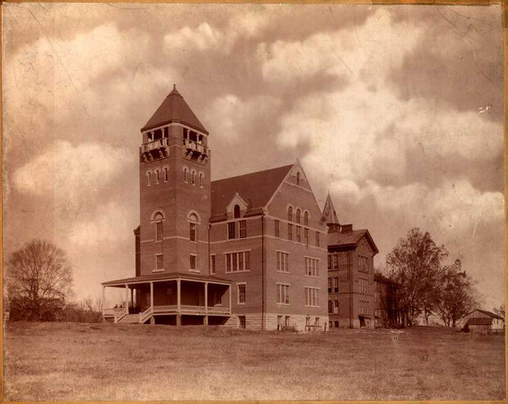
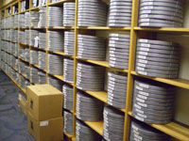
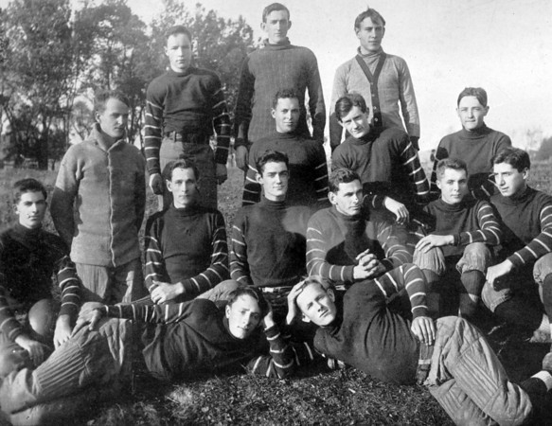
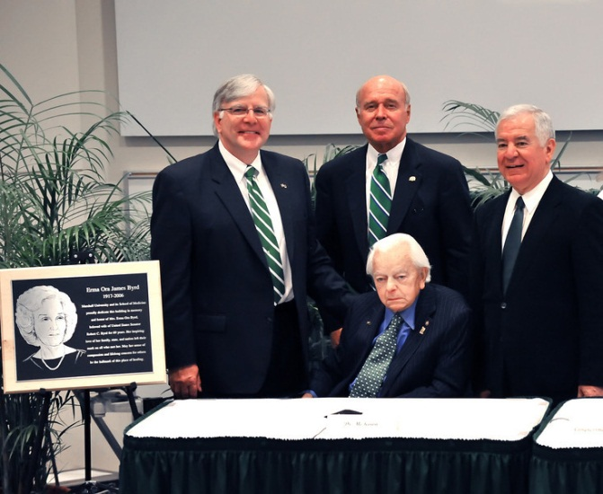
Proposed IR Content
Continued
Publications: catalogs, newsletters, brochures, yearbooks, magazines, newspapers, posters
Audio: oral histories, recitals, performances
Video and Film: 3,900 cassettes & 2,115 reels
Photos: 242,000 plates & film; countless digital

Slide 15

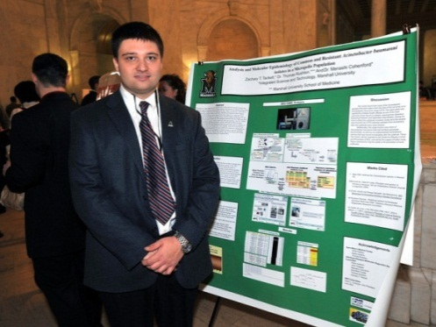

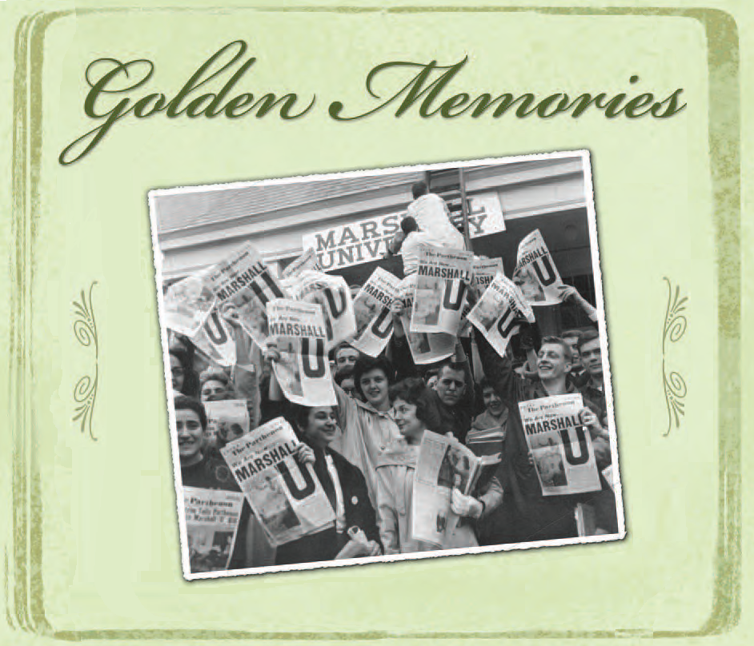
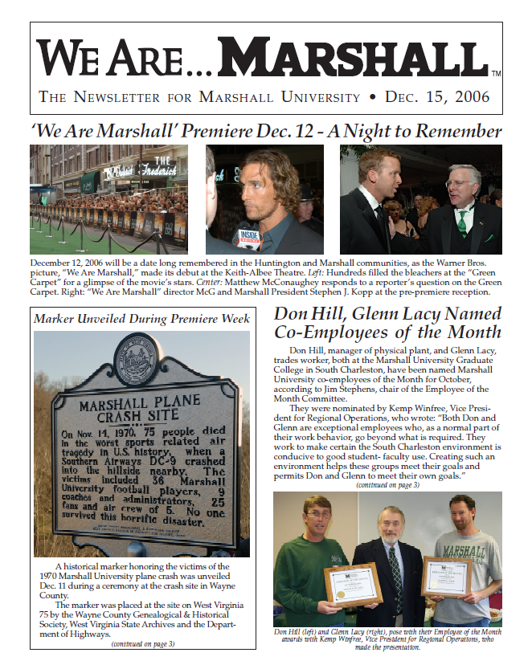



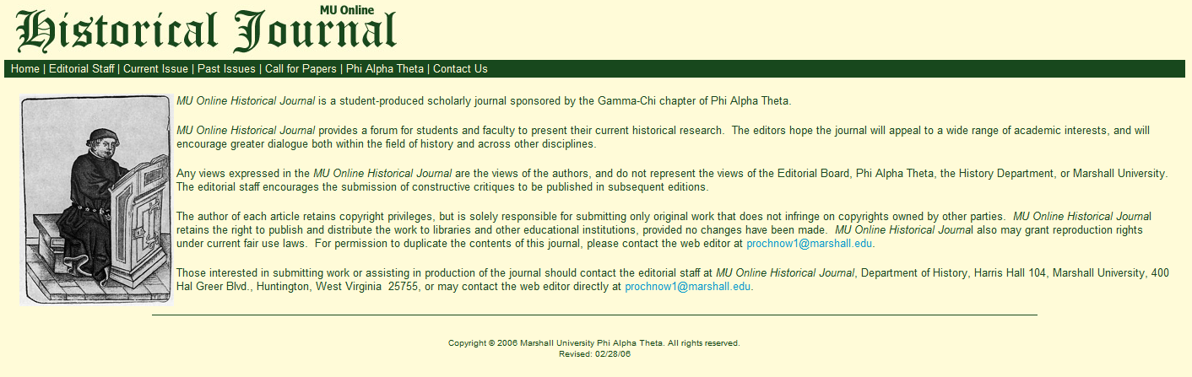

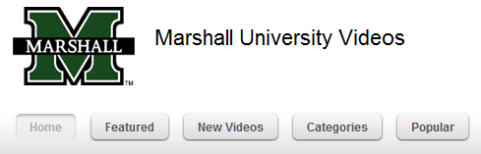
Collect

Slide 16
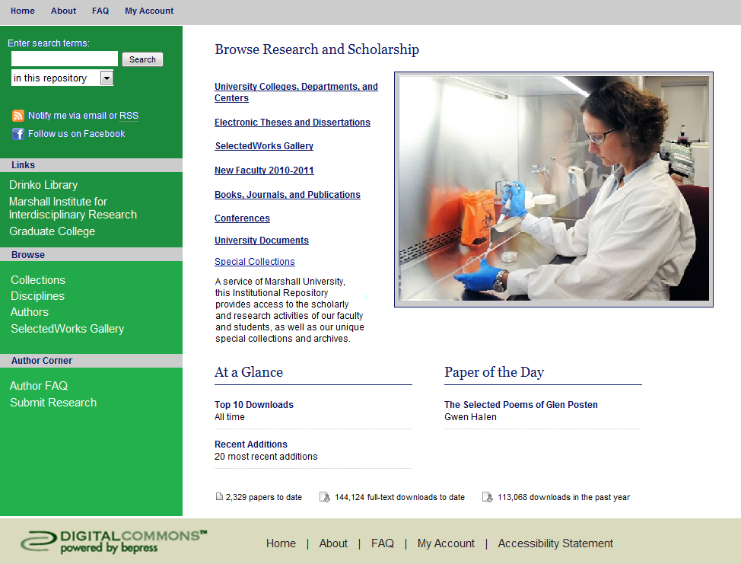
Institutional
Repository
Provide
Access
Promote
Preserve
Maintain
Promote
Record
Preserve

Slide 17
Benefits to
Marshall University
Meet the MU mission more effectively
Provide unified access and open access to MU’s scholarship
Increase the citation impact of MU’s scholarship
  Search Engine Optimization
    Indexing by the major search engines including Google, Google Scholar, and Bing.
    Indexed content includes:
        Text-based full-text objects such as PDFs, Word documents, and PowerPoint files &Text-based supplemental files
        All published metadata such as titles, subjects, author, publisher, etc.
  Align MU with other institutions which have IRs
Highlight individual achievement
Support faculty seeking innovative approaches to disseminate research
Preserve MU’s scholarship
Enhance Marshall’s visibility, status, and public value
  Perhaps—Some of the Increased Value Becomes Tangible—More Funding

Slide 18
Benefits to Faculty/Researchers
Maximize the visibility and accessibility of faculty research
Support progress toward promotion, tenure, and recognition in their field
  Each author receives a monthly email with usage statistics, for example:
    "Melville's Economy of Language"
        72 full-text downloads between 2010-12-02 and 2011-01-02
        2253 full-text downloads since date of posting (2005-06-30)
    In 2010, 74-87% of available articles were downloaded each month!
    Provide persistent linkable URLs
Share unpublished ideas and know-how’s
Easy access to faculty papers by students
Promote collaborative research
Long-term preservation of research papers
Attract research funding

Slide 19
Faculty Comment
"The reporting efficiency of Digital Commons is so attractive that I have begun linking the DC URLs to the article listings on our lab website. It just makes better sense to point to a single, well-maintained
archive than to our local folder of online PDFs."
Alan B. Bond, PhD, Research Professor School of Biological Sciences, University of Nebraska

Slide 20
Proposal
Two-Year Pilot Project
Budget
  Year 1: $25,000
  Year 2: $25,000
  Continuation: $35,000 (Renewal price cap to be at 5%)
Staff
  A team leader (from professional library faculty 0.3 FTE)
  Liaisons to the faculty participants and department or college: (from professional library faculty and Online Instructional Design Specialist, 2 FTE)
  Technical staff for configuration and interface work (from professional faculty and Instructional Design Specialist, 0.25 FTE).
  Enter contents into IR (classified staff and student assistants, 1.5-2 FTE)
Establish a formal campus-wide Institutional Repository Committee
  Faculty, IT staff, and administrators
  Oversee the creation of guidelines and policies
  Provide a final recommendation at the end of the pilot program

Slide 21
Proposal Timeline
Phase 1 (months 1 - 3)
  Purchase and implement an IR system: Digital CommonsTM from Berkeley Electronic Press (bepressTM) .
  Identify strategic partners around campus (individual faculty, departments, colleges or schools, and administrative groups).
  Identify various forms of material as content.
  Develop guidelines.

Slide 22
Proposal Timeline
(continued)
Phase 2 (months 4 - 15)
  Place initial contents into the IR system
    Selected Theses and Dissertations
    Some faculty collections: librarians serve as an essential bridge between the repository and the faculty
    Capture one conference or major campus event, e.g. Commencement
    One year of digital video collection (WSAZ-TV news film)
    Two-three years of the university yearbook
    One year of previously un-digitized and digitized The Parthenon
    One image gallery from Marshall University’s Photo Collection
    One Image gallery from Marshall University Libraries Special Collections
    One year of audio files from Marshall University’s Department of Music
  Build our first department and college collections
  Develop workflows and processes

Slide 23
Proposal Timeline
(continued)
Phase 3 (months 16 - 21)
  Continue to add content
  Open IR for public use by month 16
  Campus Conversation to introduce IR
  Evaluate content download
  Evaluate workflows and processes
Phase 4 (months 22 - 24)
  Continue to add content
  Continue to evaluate use, downloads, workflows, and processes
  Develop procedures for long term management and use
  Make recommendation for continued use of the IR

Slide 24
Ensuring Success
    Align the IR with the University’s mission
    Emphasize scholarship first, but also all the other institutional resources that can be made available
    Engage stakeholders in the project
    President, Dr. Jan Fox, Senior VP for IT/CIO & Provost
    IT Exec.
    Deans
    Department Heads
    Faculty Senate
    Faculty
    Students
    Provide superior set of services to users

Slide 25
Digital CommonsTM
Features
Fully hosted and supported platform
Content Upload
  Add content quickly with streamlined submit form
  Quick submit for articles with PubMed IDs
  Upload sound and video files, data sets, and executable files
  Import historical data with batch uploads
  Auto-convert Word, WordPerfect, and RTF documents to PDF
  Auto-create Marshall University branded PDF cover-pages, watermarking, etc., if desired
  E-Theses and Dissertations module: designed to capture and display metadata specific to ETD's
  Events Handling Module: events such as conferences, workshops, symposia, etc., can be handled within Digital Commons.

Slide 26
Digital CommonsTM
Features (continued)
Search
  Full-text searching
  Optimized for fast and accurate indexing by Google and Google Scholar (hits are highly placed in Google results lists)
  OAI compliant (facilitates inclusion of records in other search engines, e.g. WorldCat Local)
  Context sensitive searches (e.g., search this series vs. search the entire collection)
  XML gateway for inclusion in searches via meta-search applications (e.g. Summons)
Accessibility
  Persistent URL
  LDAP integration for single sign-on
  Meets Web accessibility standards
  Full-text indexed by Google and other search engines

Slide 27
Digital CommonsTM
Features (continued)
Presentation
  Each Digital Commons site is intended to be a “showcase” and thus is easy to use, searchable, and reflects well on the institution.
  A unique web page generated automatically for each article includes title, author, abstract, and citation information, with format of the citation controlled by the series administrator.
  Image Gallery capabilities with geo-location for gathering and managing image collections. Various image collections can be gathered into larger virtual collections without duplicating the images. http://digitalcollections.sit.edu/photocontest/
SelectedWorksTM
  Optional add-on, fully integrated with Digital Commons: 47% of 170 = 81
  (see example: http://works.bepress.com/features.html), including “Gallery” feature (see example: http://digitalcommons.calpoly.edu/sw_gallery.html), useful for displaying faculty associated with a community.

Slide 28
Measuring Success
SMART:
Specific, Measurable, Attainable, Realistic and Time-Bound.
Number of items collected
Number of items uploaded and accessible
Number of participants
Integration of different types of content
Data on site visits, searches, and downloads
User studies or surveys
Integration with other resources or sites
Income or funds generated from it (long term)

Slide 29
Future Challenges
& Opportunities
Continue building an infrastructure to support IR
Provide content and service to make the IR indispensable
  Continue to add benefits to MU
  Add more value for individual faculty/researchers
  Add more value for the outside world
Long term funding support and management commitment
Processes
  Development of policies
    Document types and formats
    Submission and approval policy & procedures
    Preservation policy
    Author permissions/ license terms
    Rights management
  Encouraging faculty participation
    Content submission and usage
    Addressing faculty concerns – quality, workload, etc.

Slide 30
Conclusion
An IR is necessary
to the University’s success.
An IR will improve
MU visibility
and the impact of MU intellectual output.
MU could be a real leader in academia
if we successfully implement and manage the IR.
We
look forward
to making this plan
a reality!!!

Slide 31

Questions?

Slide 32
References
The Case for Institutional Repositories: A SPARC Position Paper. Release 1.0, 2002. http://www.arl.org/sparc
Clifford A. Lynch. Institutional Repositories: Essential Infrastructure for Scholarship in the Digital Age. ARL Bimonthly Report 226, February 2003.
The Institutional Repository as a Tool for Librarians: Not Preaching to the Choir, Paul Royster, University of Nebraska-Lincoln, ALA Midwinter, Jan. 8, 2011. http://digitalcommons.unl.edu/library talks/62
From Passive to Pervasive: Changing Perceptions of the Library’s Role through Intra-Campus Partnerships, Isaac Gilman, Scholarly Communications and Research Services Librarian, Marita Kunkel, University Librarian, Pacific University (Oregon), 2010
Open Access Overview: Focusing on Open Access to Peer-reviewed Research Articles and Their Preprints, first put online June 21, 2004. Last revised November 6, 2010. http://www.earlham.edu/~peters/fos/overview.htm
Strategies for Developing an Institutional Repository, Boise State University http://works.bepress.com/michelle_armstrong/
What and the Why of Institutional repositories (IR’s), Susan Veldsman, eIFL Content Manager
Leveraging Institutional Repositories to Support Your Institution's Strategic Mission, Richard W. Clement, Dean of Libraries, Utah State University.

Slide 33
References
(continued)
The Institutional Repository in 2010... and Beyond, Online Information Conference 2009, Dec. 2, 2009
Institutional Repositories, Tout de Suite, Charles W. Bailey, Jr., Digital Scholarship, 2008
A DSpace Institutional Repository, Sue Kunda, Institutional Repositories: Disseminating, Promoting, and Preserving Scholarship, September 30, 2009.
ScholarWorks: Showcasing Faculty Research While Promoting Open Access, Michelle Armstrong, Albertsons Library, Boise State University, 2009. http://commons.pacificu.edu/cgi/viewcontent.cgi?article=1004&context=sustainableschol
Institutional Repositories: Strategies for the Present and the Future, Connie Foster, Western Kentucky University; Jean-Gabriel Bankier, President, Berkeley Electronic Press; Glen Wiley, Cornell University Library, Strategy Session, NASIG 23rd Annual Conference, June 6, 2008. http://works.bepress.com/jean_gabriel_bankier/5
Implementing an Institutional Repository, Pre-Conference 16th North Carolina Serials Conference, March 29, 2007. Carol Hixson, University Librarian, University of Regina
Digital Repositories and the Future of Preservation and Use of Scientific Knowledge, INFORMATOLOGIA, Vol.44 No.1 Ožujak 2011; http://hrcak.srce.hr/file/99976

