Slide 1
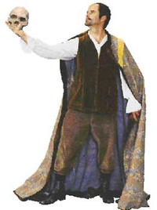
DIGITIZATION 101: To Digitize or Not to Digitize? That is the Question

Slide 2
WVLA Fall Conference
October 6, 2015
Workshop Sponsored by the WVLA Preservation Roundtable
Presented by: Nat DeBruin and Lori Thompson of Marshall University’s
Archives and Special Collections Department.
Notes:
This is a “101” class. Our goal is not to make you experts! The goal is to introduce you to the basic concepts and complexities associated with a digital project of ANY size.
There are at least 4 other stand alone workshops here… Copyright, Metadata, Outsourcing, and editing images.

Slide 3
Workshop Structure (tentative!)
1. 10:00 a.m. to 10:50 a.m. – Introduction and ‘Digitization Project Decision Making’
Break
2. 11:00 a.m. to 11:50 a.m. – Hardware, Software, and ‘Best Practices’
Lunch
3. 1:00 p.m. to 1:50 p.m. – ‘Soldier, Prepare to Digitize!’
Break
4. 2:00 p.m. to 2:50 p.m. – Hands-on Projects, Q&A Period, and Summary
Notes:
We are going to stick a funnel in your ear and pour in the information. Session 0ne and Session Three are broad and general and Session Two gets very technical. Lori and I will be watching for glazed looks and nodding heads and we may take some smaller breaks if necessary.
Please feel free to ask questions, but if they take more than about 30 seconds to answer, we will defer them to the last period Q&A session.

Slide 4
To Digitize… ?
Answer these 3 questions…
Notes:
Before you begin any digitization project – especially a large scale project – you MUST do some advance planning. Even if it is your 15th project, there will always be new issues related to software, hardware, and best practices.

Slide 5
To Digitize… ?
Question 1. What do I
want to digitize?
Notes:
We all have unique items and collections in our institutions and SOME of them are definitely worth converting to a digital form.

Slide 6
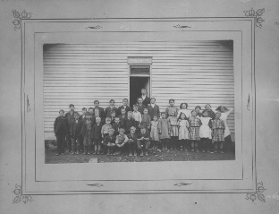
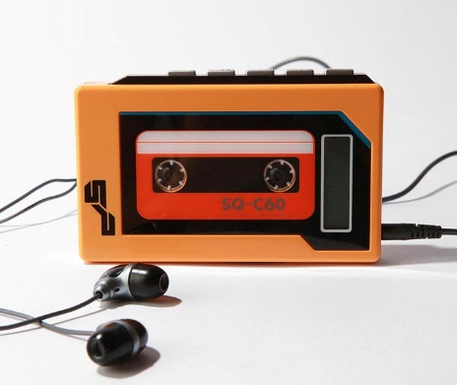
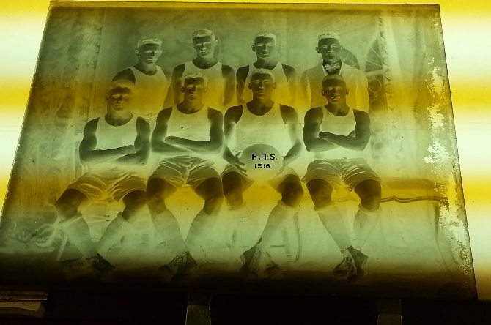
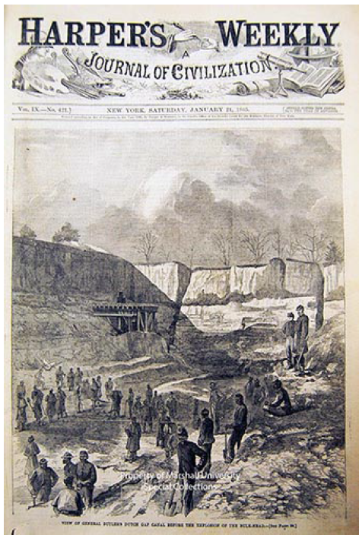
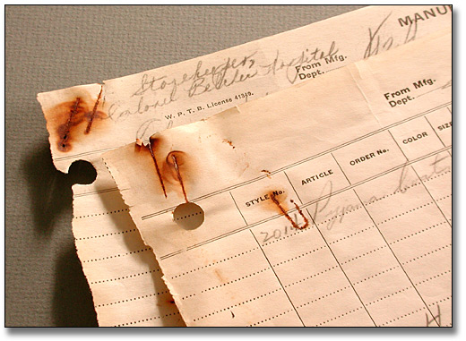
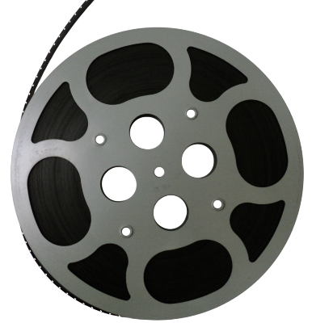
To Digitize… ?
Historic Photographs
Audio tapes/Oral Histories
Negatives/Glass Plates
Motion Pictures/Video Tapes
Manuscripts/Textual Materials
Historic Newspapers
Notes:
Most people tend to think of digitization projects in terms of just photographic images, or maybe some textual materials. But some collections can contain a variety of different formats. Ask yourself… CAN I do them all? SHOULD I do them all?

Slide 7
To Digitize… ?
Question 2. Why do I
want to digitize these
materials?

Slide 8
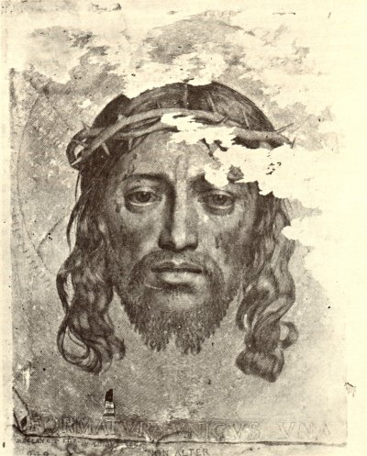
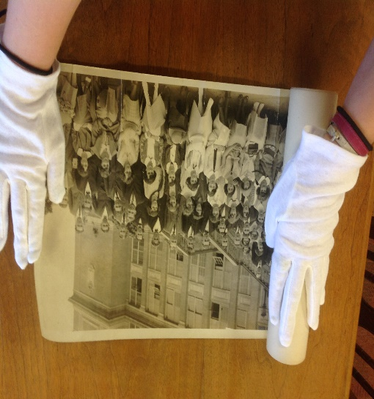
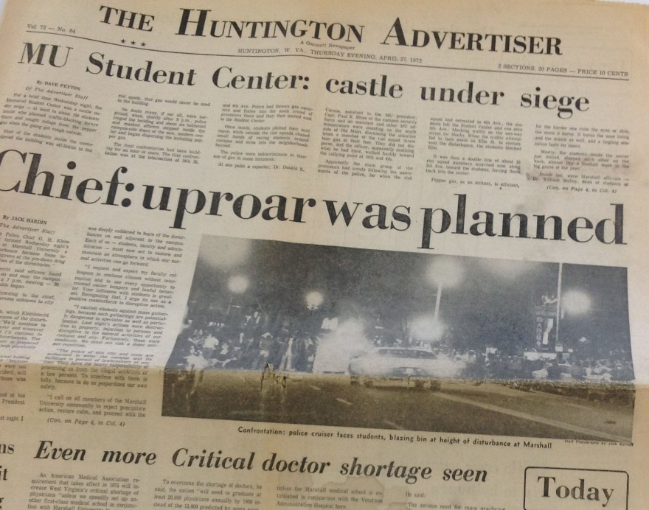
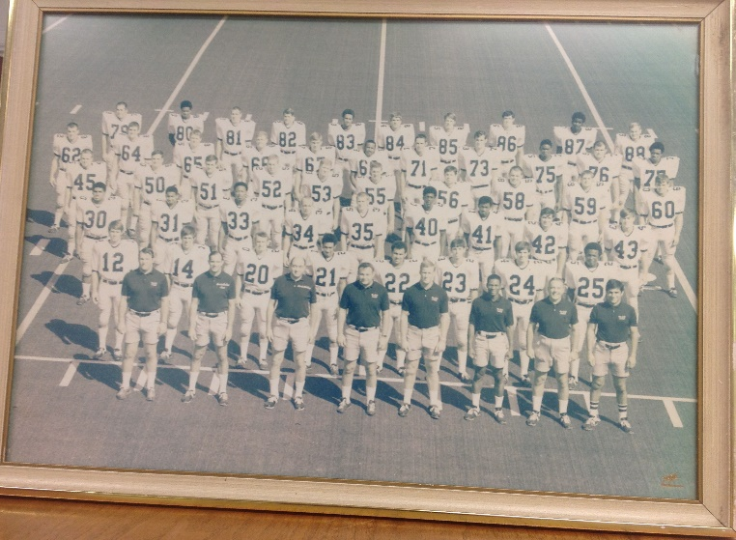
To Digitize… ?
a. Preservation – To prevent further damage or deterioration to the item(s).
http://www.abacusart.com.au/a/
Rolled photographs
Insects
Faded Color Photos
Yellowed/Brittle Newspaper

Slide 9
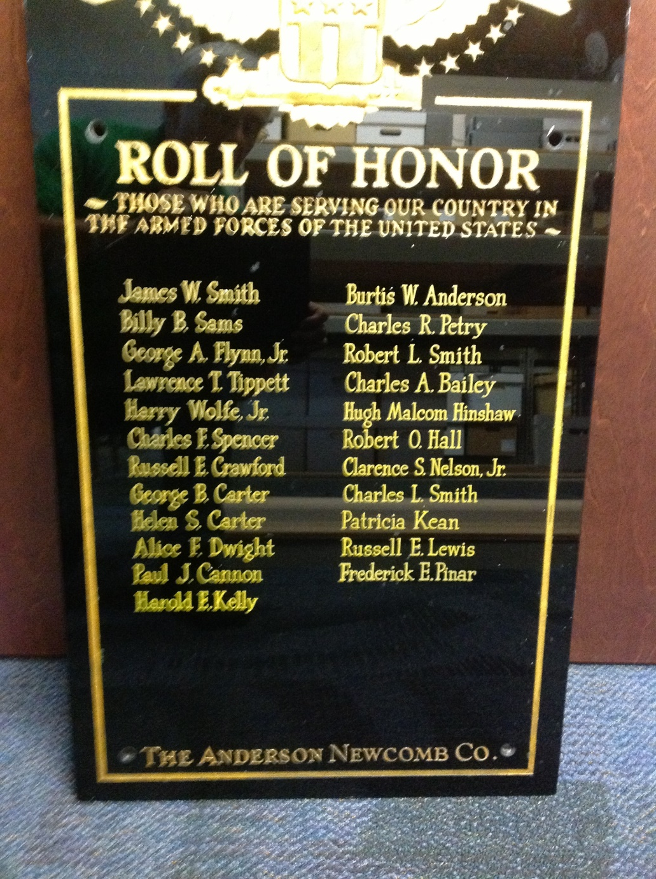
To Digitize… ?
A slightly different take on preservation…

Slide 10
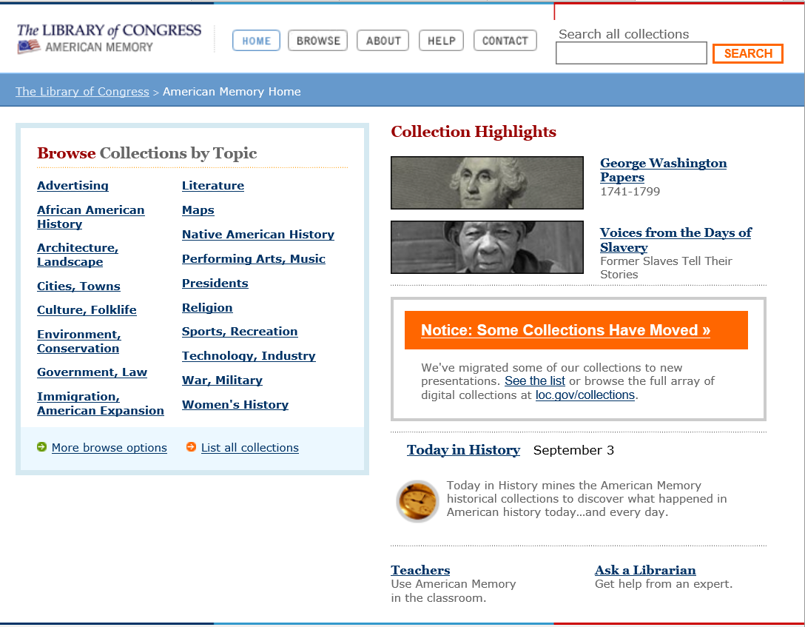
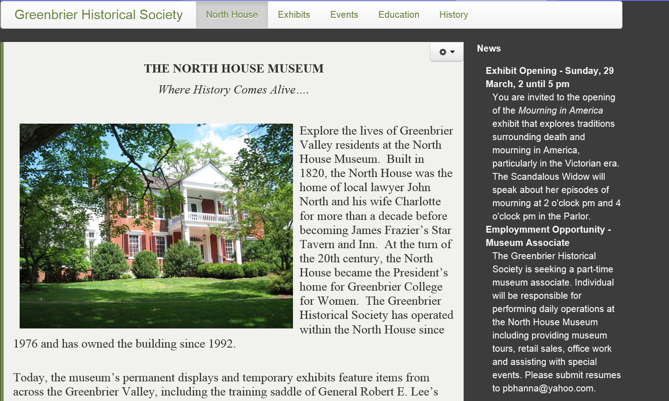
To Digitize… ?
Preservation – To prevent further damage or deterioration to the item(s).
Access – Make materials available to your patrons – locally and globally.

Slide 11
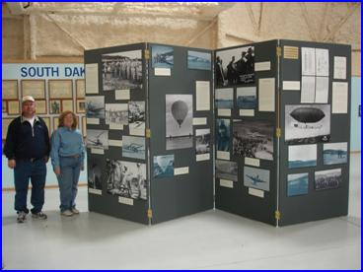
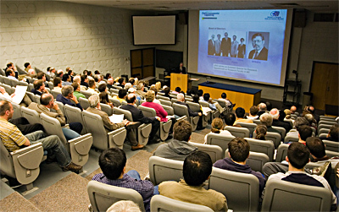
To Digitize… ?
Preservation – To prevent further damage or deterioration to the item(s).
Access – Make materials available to your patrons – locally and globally.
Marketing/Publicity/Outreach – Displays, fundraising, public presentations, etc.
Photo by: The South Dakota Pilots Association
Photo by: The University of Delaware

Slide 12
To Digitize… ?
Question 3. Do I have the
legal authority (copyright)
or permission of the owner
to digitize the materials?

Slide 13
To Digitize… ?
Copyright renewed…
120 years from the date of creation…
Published outside the U.S.…
Life of the author + 70 years…
Fair use…
Public Domain…
Orphan works…
Published without copyright notice…
the exclusive right to make copies, license, and otherwise exploit a literary, musical, or artistic work, whether printed, audio, video, etc.

Slide 14
To Digitize… ?
Copyright Basics
Copyright and Cultural Institutions
https://ecommons.cornell.edu/bitstream/handle/1813/14142/Hirtle-Copyright_final_RGB_lowres-cover1.pdf?sequence=2

Slide 15
To Digitize… ?
Copyright Basics
What types of material are covered by copyright?
Literary Works
Musical works, including any accompanying words
Dramatic works, including any accompanying music
Pantomimes and choreographic works
Pictorial, graphic, and sculptural works
Motion pictures and other audiovisual works
Sound recordings
Architectural works
This is NOT a complete list !

Slide 16
To Digitize… ?
Copyright Basics
- Exist in a tangible form
- Be a work of authorship
What are the prerequisites
for a work to be protected by copyright?
- Be original, and
- Meet the requirements
regarding the nationality
of the author

Slide 17
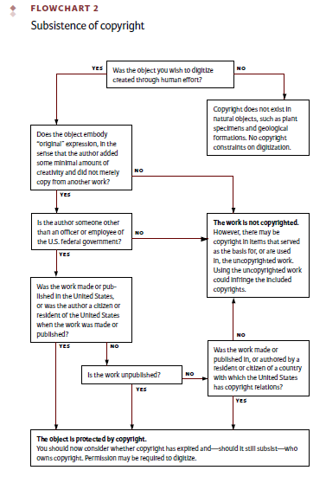
To Digitize… ?
Copyright Basics
Copyrighted? … Or not?
Originality, not aesthetic
merit is the basis of
copyright protection

Slide 18
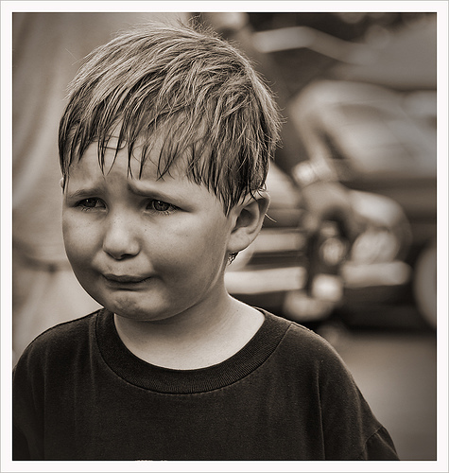
To Digitize… ?
Copyright Basics
SO… Obviously EVERYTHING is copyrighted! I will never be able to digitize anything!
https://www.flickr.com/groups/fiveflickrfavs/discuss/72157602128297809/ Accessed 9/11/2015

Slide 19
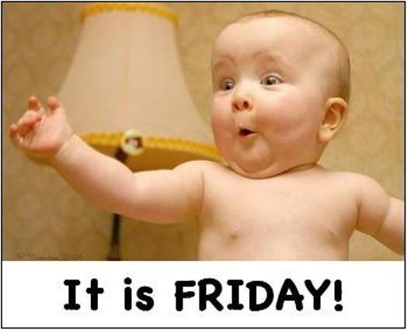
To Digitize… ?
Copyright Basics
No! There is always……
Copyright Risk Management!
http://beliefbreakout.blogspot.com/2012/06/happy-friday-everyone.html Accessed 9/11/2015

Slide 20
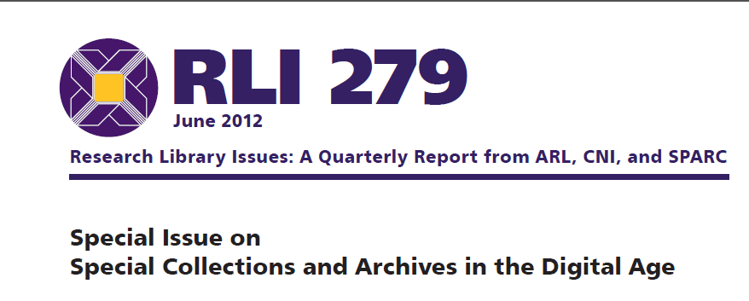
To Digitize… ?
Copyright Basics
Copyright Risk Management
1. Reduce the number of ‘risky’ items in the collection
Reduce the number of people likely to sue you over
the collection

Slide 21
To Digitize… ?
Copyright Basics
Copyright Risk Management - Strategies
1. Identify items in the collection that are in the public domain
2. Get permission from the people or organizations most likely to complain or object
Have a ‘take-down’ policy in place for any materials made subject
of a complaint
4. Recognize that many collections will be supported by a strong
‘fair-use’ argument

Slide 22
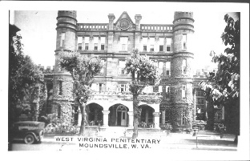
Practical Exercise One
One of our branch libraries has a wonderful collection of photographs of old buildings in the village where
the library is located. I would like to digitize these with captions and make them available on the public
computers at the library and on the web. I know who donated the photographs so I believe I can get
permission to copy them. Other items, I’m not sure about ownership and copyright….
Marshall University
Special Collections

Slide 23
Practical Exercise One
One of our branch libraries has a wonderful collection of photographs of old buildings in the village where
the library is located. I would like to digitize these with captions and make them available on the public
computers at the library and on the web. I know who donated the photographs so I believe I can get
permission to copy them. Other items, I’m not sure about ownership and copyright….
Question #1 – Who owns the copyright for the photographs?
Question #2 – Does the donor of the photos have the authority to give permission?
Question #3 – Would you publish these pictures on YOUR website?

Slide 24
To Digitize… ?
To Digitize… ?
Copyright Basics
Copyright Resources – In your Workshop Packet!

Slide 25
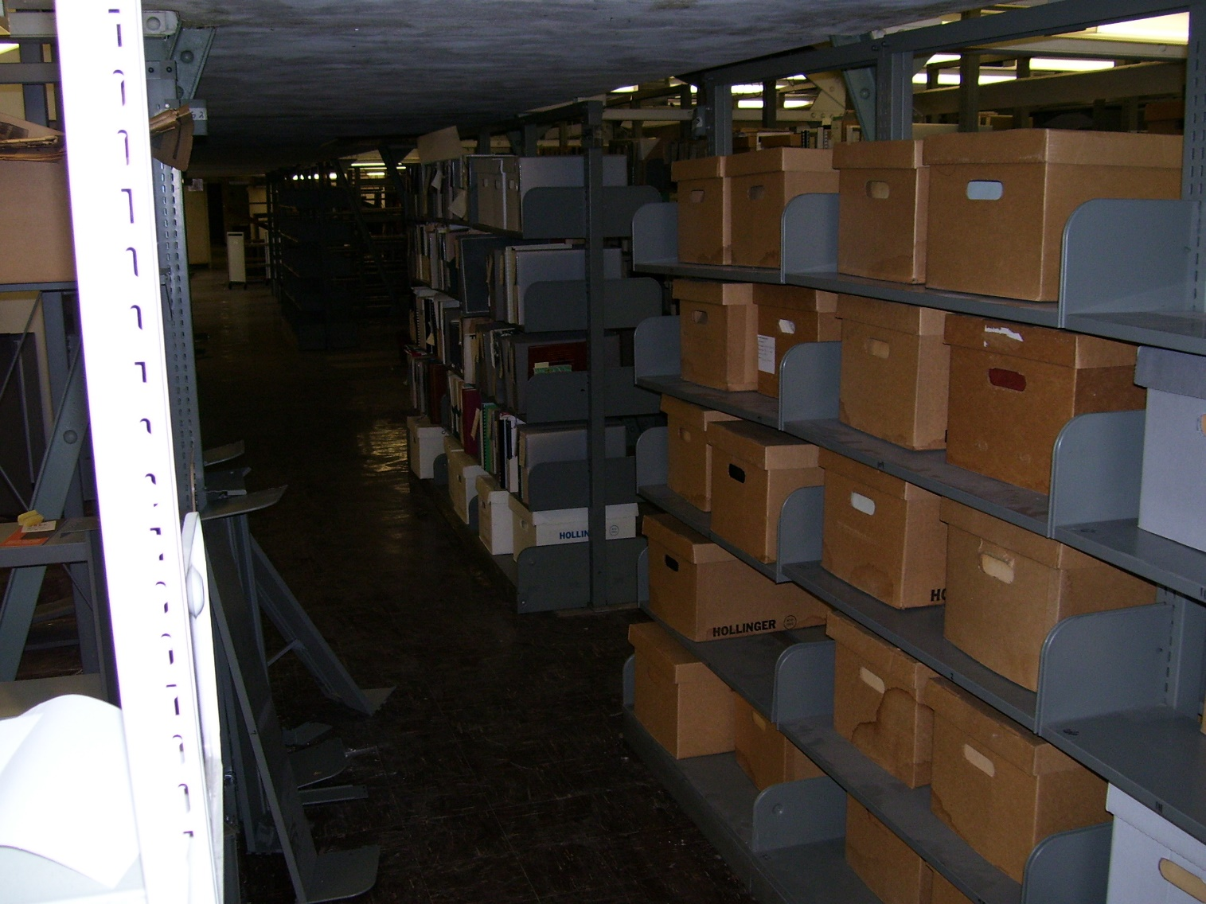
Or Not To Digitize… ?
Sheer volume of
material

Slide 26
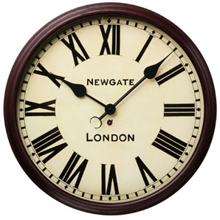
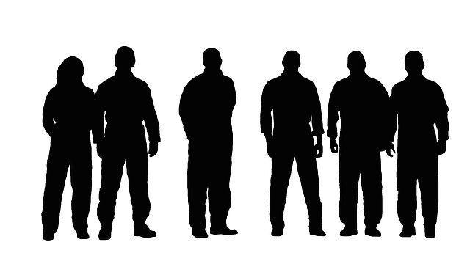
Or Not To Digitize… ?
Time
Available Resources
Funds
Storage
Staff

Slide 27
Or Not To Digitize… ?
Unable to determine copyright or unwilling to take the risk…

Slide 28
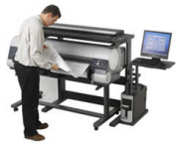
Or Not To Digitize… ?
Don’t have the resources in house? Consider outsourcing your project…
Cost effectiveness – usually requires a large amount of material.
Quality Control
Preservation of original materials

Slide 29
Or Not To Digitize… ?
The Number One reason NOT to digitize…?
To make space!
With rare exceptions, NEVER discard the original item!

Slide 30
Takest thou a break!

