Slide 1
DIGITizing sermons in the marshall university libraries Robert H. Ellison Director, Marshall Center for sermon studies
Conference on Sermon Studies
Dublin, Ireland
September 6, 2019
Notes:
Good morning! This is our 3rd Conference on Sermon Studies, and the first in which I’ve had a chance to present. In fact, I had this project in mind when I suggested that this year’s theme be “The Technologies of Preaching.” I’m pleased that so many of our papers directly address this idea—in many different ways—and I’m happy to share my piece of the puzzle with you now.
Let me start by saying something about the path my work has taken in recent years. I used to say I was a Victorianist who studies sermons; now I see myself as a sermon scholar with a background in the Victorian period.
This project is a good example of that, as most of the sermons in Marshall’s libraries are by late-19th and early 20th-century Americans, and the conference I’ve set my sights on is the one sponsored by the Appalachian Studies Association (which happens to be headquartered at Marshall). I presented on one aspect of this project last March, and I hope to present on another one next year.

Slide 2
DIGITizing sermons in the marshall university libraries Robert H. Ellison Director, MARSHALL Center for sermon studies
Conference on Sermon Studies
Dublin, Ireland
September 6, 2019
Notes:
I have been involved with academic technology for a long time, teaching online courses, editing an open access journal, and so on. I am also one of the faculty affiliated with Marshall’s new programs in the digital humanities. I team-taught an intro to digital literary studies a couple of times; this is my first venture into an online scholarly project.
Here’s what I’d like to do. I’ll start with the “sermons” part of my title, giving you a sense of the materials we have. Then, in keeping with our “technology” theme, I’ll talk a good bit about the “digitization” part: the protocols we’re using, decisions we’ve had to make along the way, and so on.

Slide 3
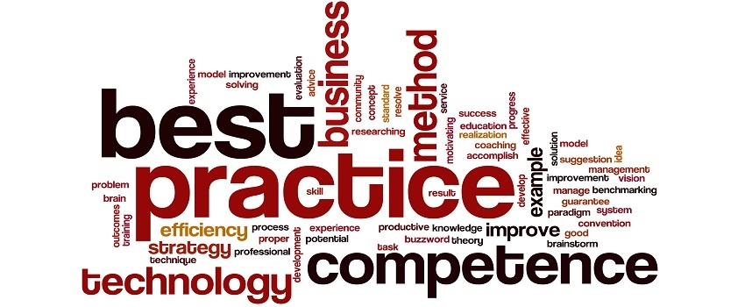
“Big Idea” #1
Cory Everington at elderresearch.com
Notes:
I’ll be going into a lot of specifics and techie details and such, but there are two “big ideas” I want to leave with you. I’ll mention one here and the other at the end.
A few months ago, I was talking with the librarian who’s my main point of contact on this project. We were kicking some ideas around, and he suggested that we bring some others into the conversation as well. His reasoning went something like this: “any of these options would be acceptable practice, but we’re looking for best practice.” Getting those other perspectives would be a good step in that direction.
That’s what I hope will happen here. Many of you are working on similar—or even bigger and better—projects, and you probably know more about some angles than I do. So I definitely invite your feedback, both here and throughout the weekend.

Slide 4
aschresources.org
Notes:
The American Society of Church History has also recently launched a “History of Christianity Teaching and Research Resource Archive.” I’ll be submitting this project for peer-review by their editorial committee, and I anticipate that their feedback will help make it both more academically rigorous and user-friendly.
So here we go!

Slide 5
The sermons
Open Stacks
Special Collections/Blake & Rare Books
Special Collections/WV
US/World
Appalachia
West Virginia
Notes:
My goal is to create an online collection of the sermons in the Marshall University Libraries. This will have several phases.
In terms of how our collections are organized, I’ll begin with Special Collections because that’s where we’re most likely to find sermons that are of local interest and/or in the public domain. We actually have “West Virginia” as a separate catalog division within Special Collections, so I’ll start there. After that, I’ll work with materials in the Rosanna Blake Library of Confederate History, and go on to our Rare Books. Finally, I’ll see what we might have in the open stacks.
The layers of geographic coverage track that pretty closely. I’ll start with sermons preached in West Virginia, or by preachers with ties to West Virginia. I’ll then branch out to the rest of Appalachia, and eventually include works from the rest of the United States and elsewhere in the world.

Slide 6
Library catalog
Open Stacks (c. 65)
Blake & Rare Books (9)
West Virginia (26)
Notes:
So let’s start with what we have. If you go to our library catalog and do a “keyword” search for “sermon*” within “Special Collections” and weed out things that aren’t actually sermons, you get 35 results: 26 in WV, 1 in Blake, and 8 in Rare Books. There are actually many more texts in Blake that haven’t yet made it into the online catalog; the curator of that collection has put together a 4-page list of sermons, tracts, and other “religious imprints,” so there’s a good amount of material to work with.
If you search for things in the open stacks, you get up to 65 primary texts that could be included in this project. The exact number will depend on when and where they were first published, whether the copyright has been renewed, and so on. It will be a long time before I get to those texts; we’ll sort all that out when the time comes.

Slide 7
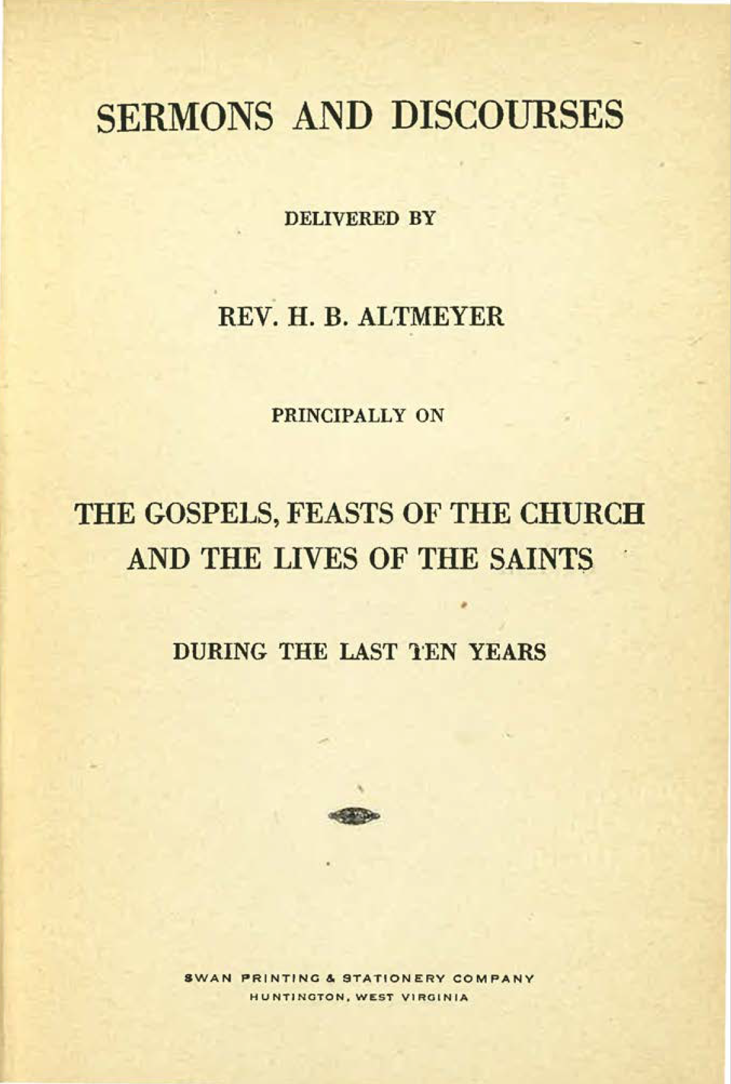
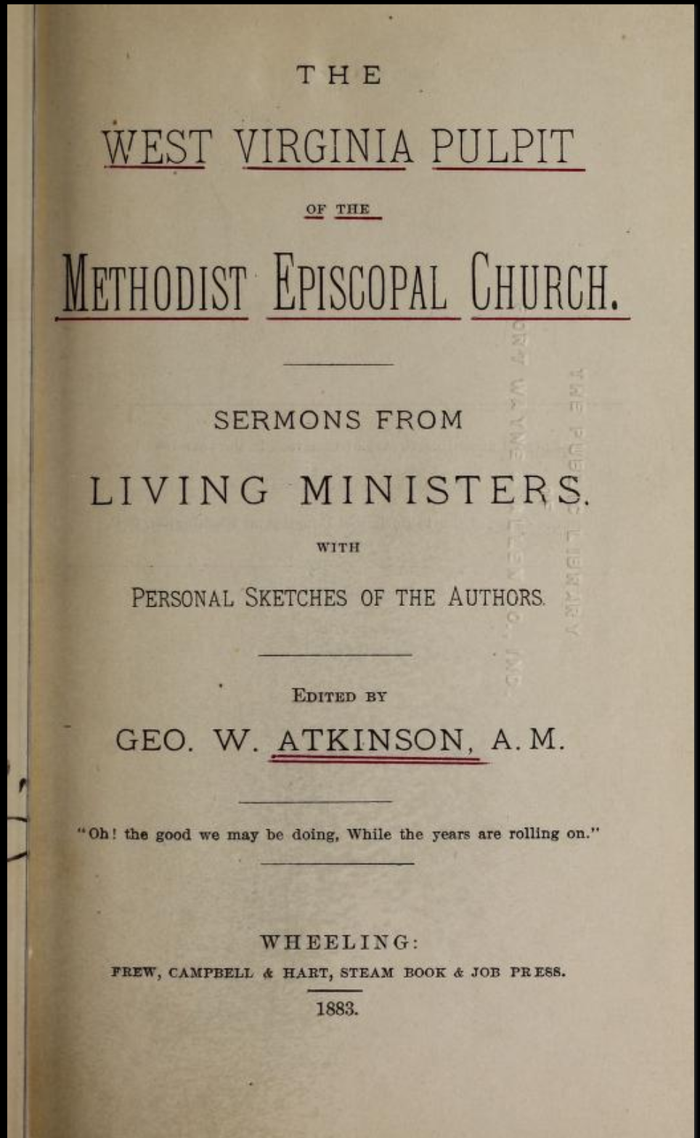
Printed texts
Notes:
Of course, not all of these materials are created equal. Some are single sermons, others are collections of sermons by one preacher, and still others are collections of sermons by multiple preachers. We’ve had to find ways to work well with all the different forms; I’ll talk more about that in a bit.

Slide 8
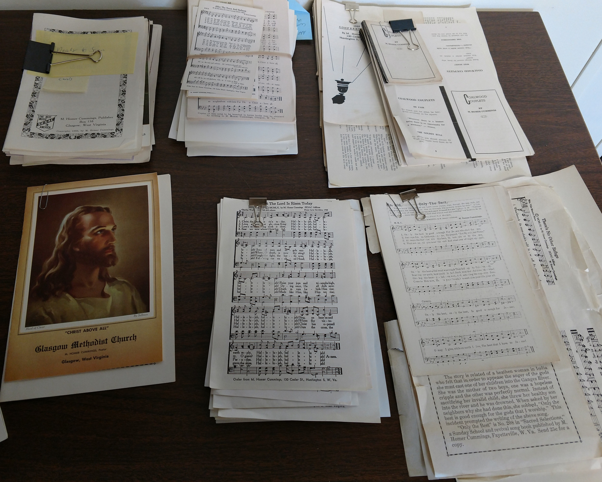
Archival material
Notes:
We also have archival material. These are pictures of the Melville Homer Cummings collection, which was given to the university in 2014. You can see items (mostly sermons and newspaper columns) that have already been sorted into file folders; other items (mostly hymns and poems Cummings wrote) that have not been processed; and about 400 hymnals (300 unique titles) from his library.
I’ve started working on this, and even uploaded scans of everything in the file box, but I’ve put it on hold until I have the time (and ideally a dedicated student assistant) to completely reorganize the physical collection, and then revise the digital collection to match it.
There may be other materials I don’t know about. We have, for example, the archives of the First Presbyterian Church of Huntington. Like the Cummings collection, some of it has been processed, but there are also 8 boxes that no one has gone through yet. There may or may not be sermons in there; I won’t know until I can block out the time to look.

Slide 9
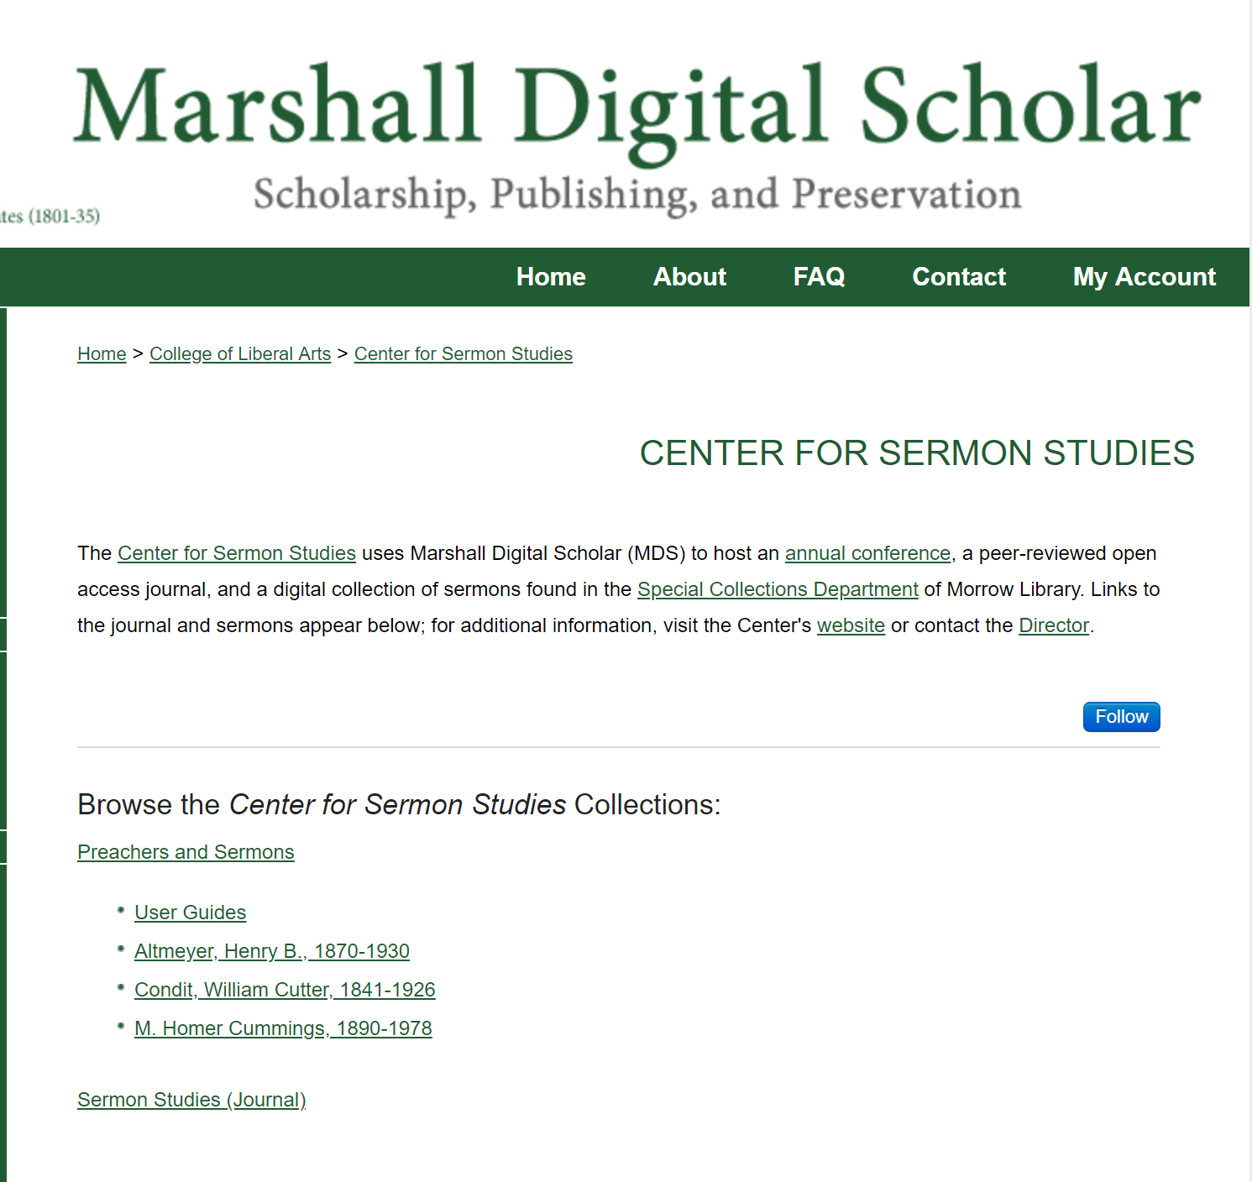
The digitizing
Notes:
So that’s what we have. Let me talk now about what we’re trying to do with it.
The platform we decided to use is Marshall Digital Scholar (MDS), our institutional repository running on the Berkeley Electronic Press/Digital Common platform. MDS is already being used to post faculty research, host conferences, and publish journals, and we thought it would work well for this project too. It won’t work for everything (some of my colleagues are working on a mapping project that will need to be hosted elsewhere), but it’s a good fit for us.
There are several reasons it’s a good fit:
The infrastructure is already in place, so we don’t have to reinvent the wheel
We get excellent tech support from the vendor
We can run analytics, which will be very helpful in documenting how many people are using the collection.

Slide 10
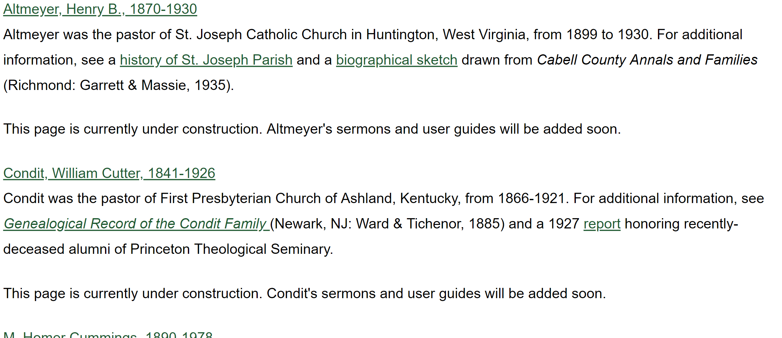
authors
Notes:
We wanted to keep the architecture as clean and “flat” as possible, so the next level down is a single, alphabetical list of preachers with
The name as it appears in the Library of Congress. If a preacher is not listed there, we’ll get as close as we can; in most cases, that will be the name and years they lived.
A very brief biographical sketch
Links out to additional information
I had interesting discussions with a librarian who’s over MDS, an archivist, and a cataloger about how to handle collections of sermons by multiple authors. On the one hand, I want a comprehensive list of preachers; on the other hand, we want to preserve “the integrity of the book,” so to speak.
So we decided to have it both ways! Each preacher in a collection will have an entry like you see here; the collection itself will have a “line item” of its own.

Slide 11
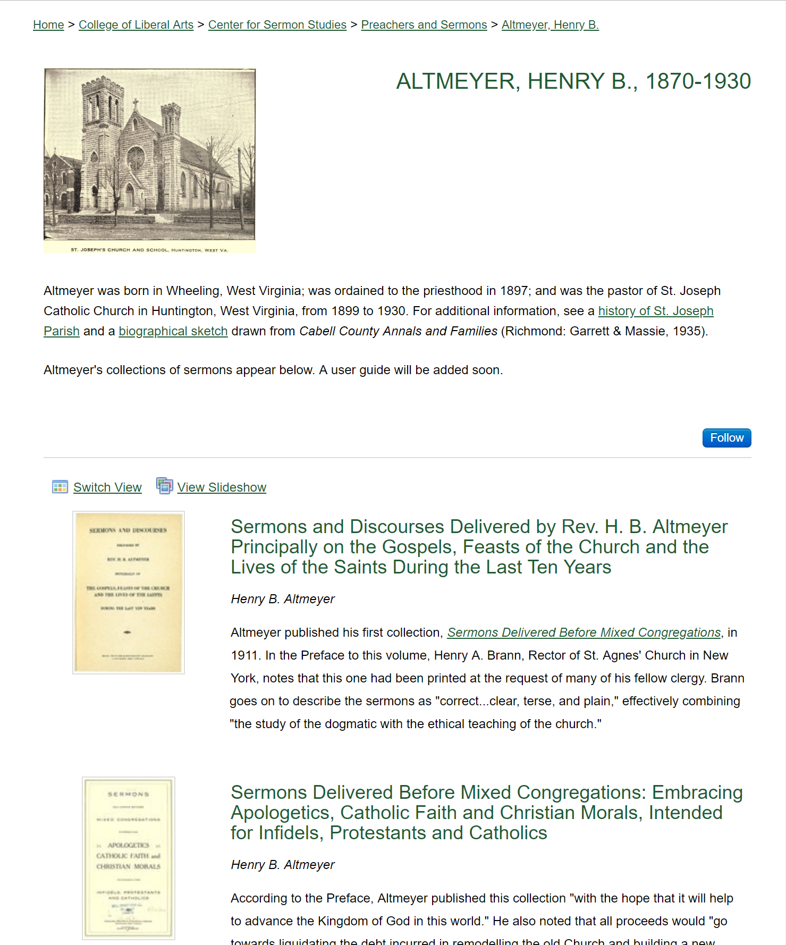
texts
Notes:
When you click on a name, you’ll see that bio sketch again, a picture if we can find one, and a list of the text(s) we have in the collection.

Slide 12
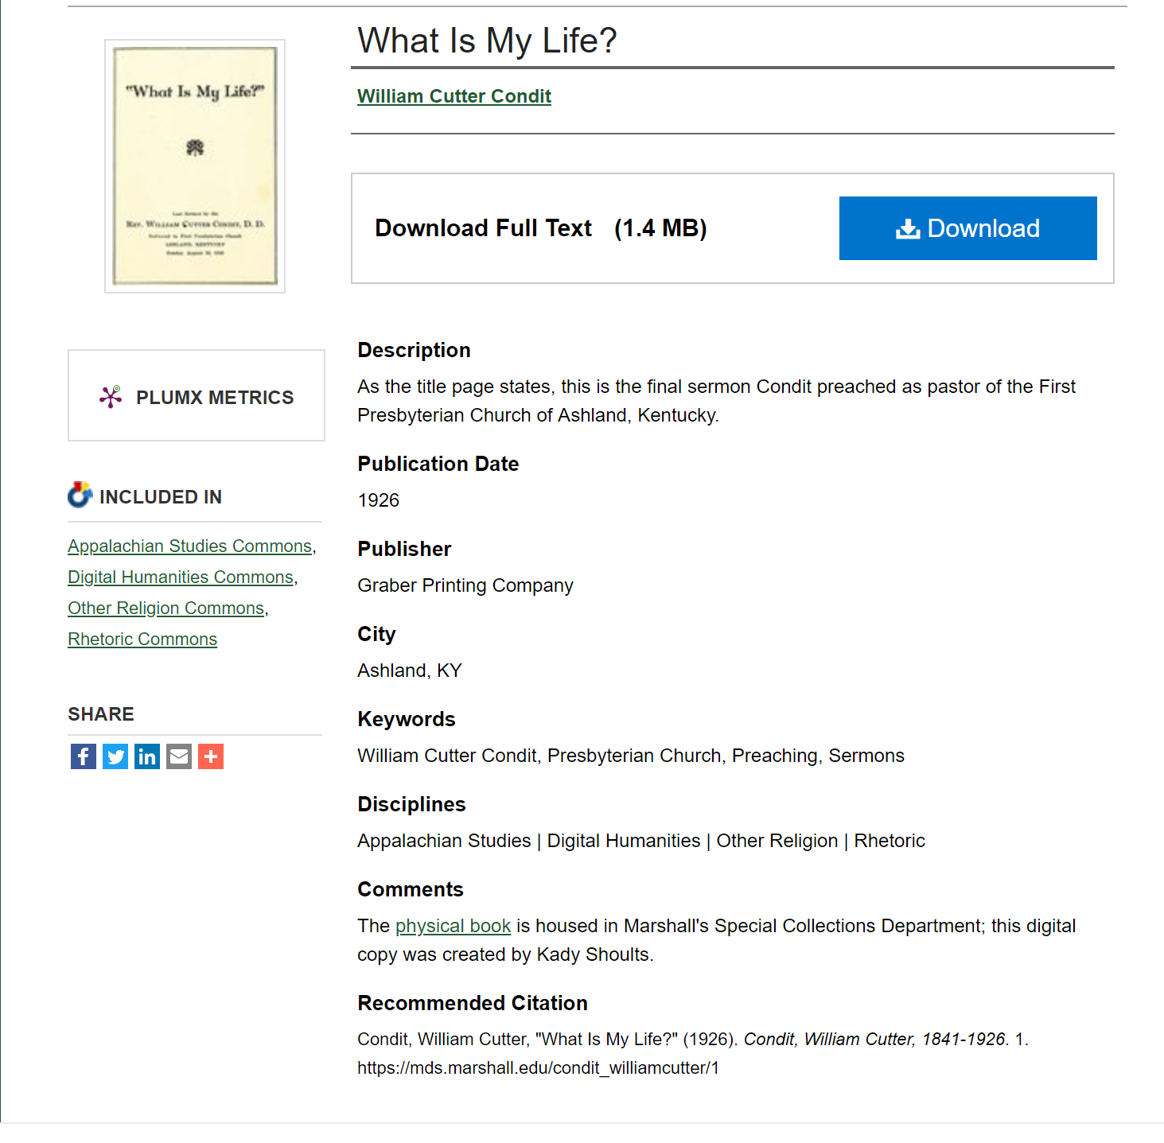
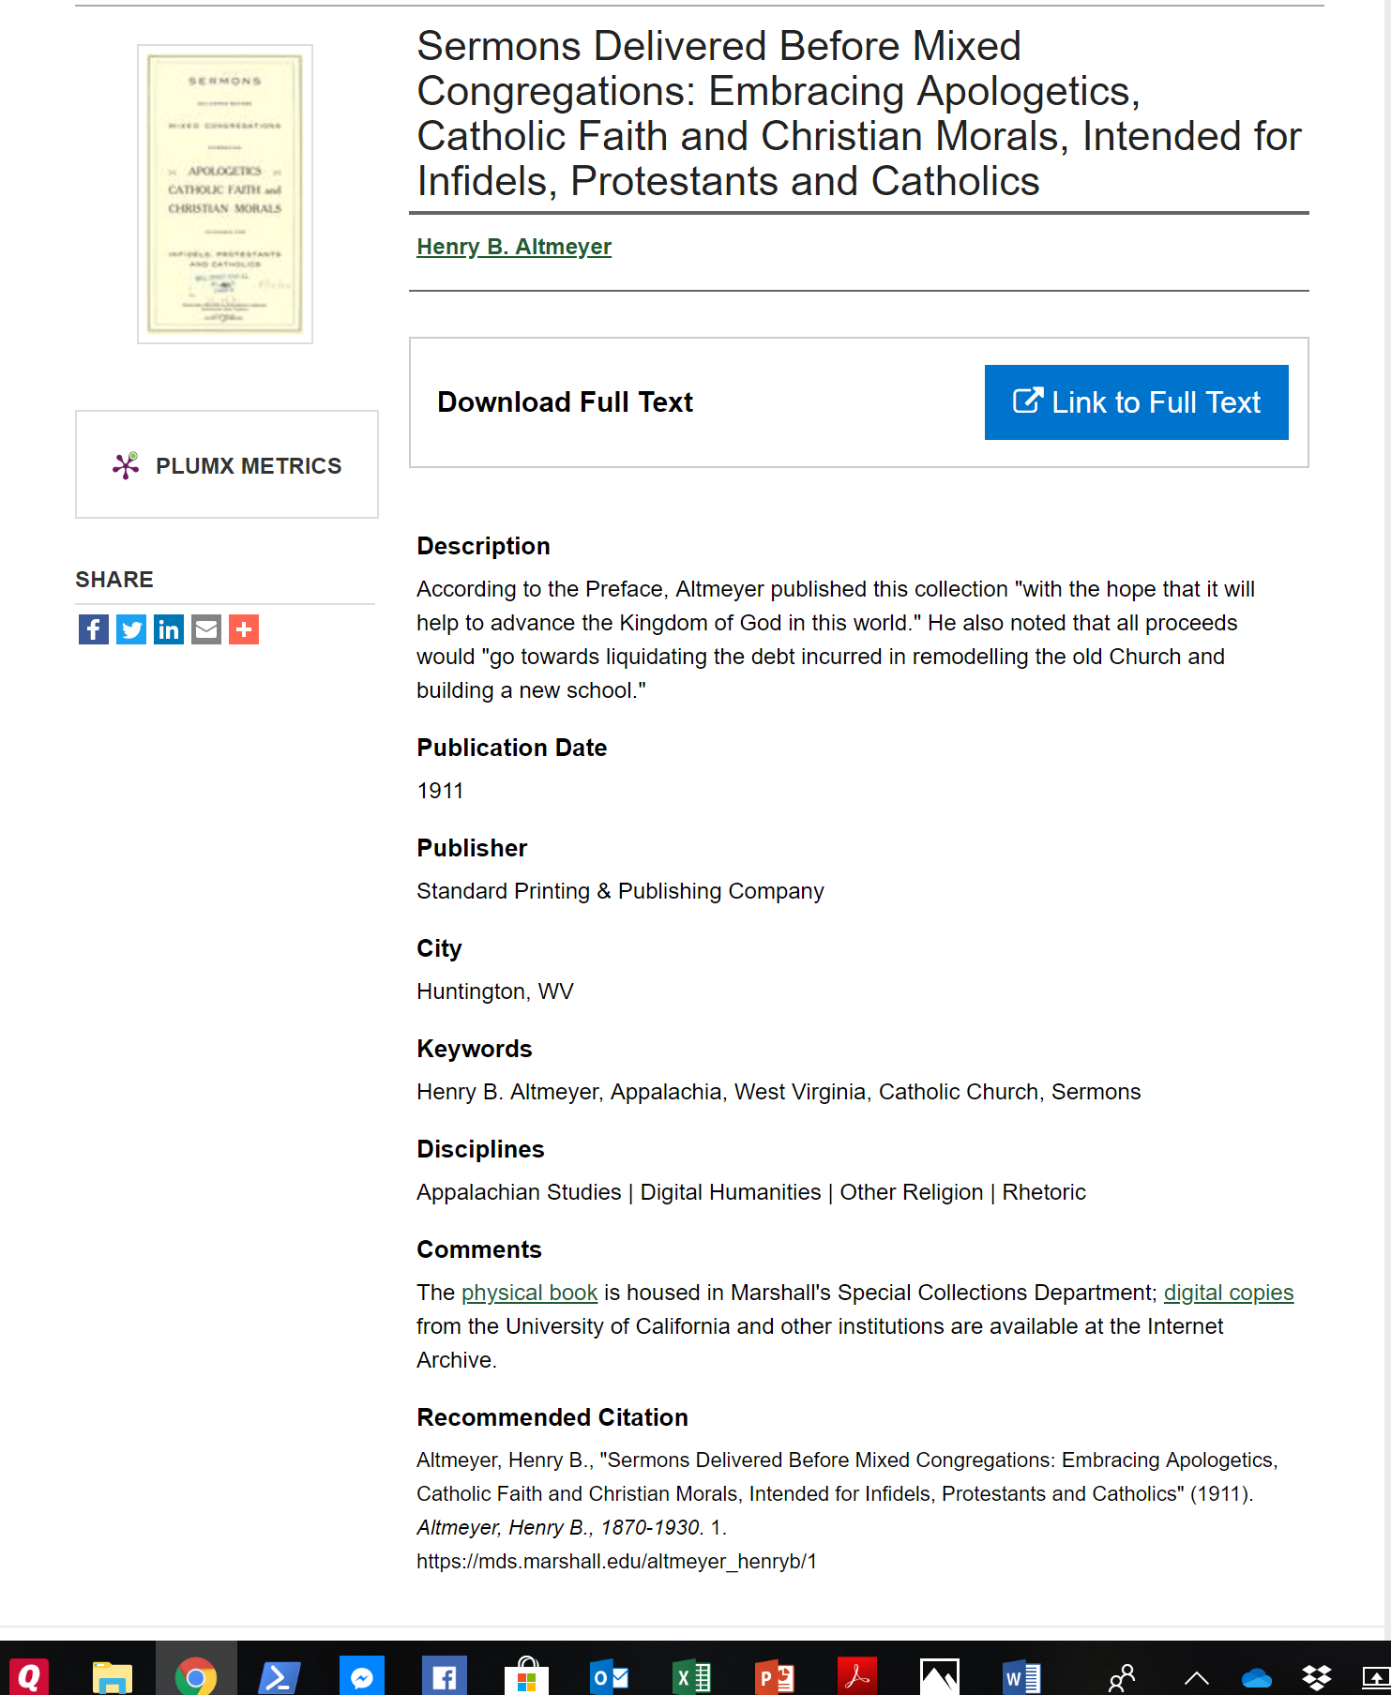
texts
Notes:
Then, when you click on a title, you’ll see some metadata and such, and a link to the text itself. We had to work through some questions along those lines as well:
What if the text is already available online, via Google Books or the Internet Archive? We decided not to duplicate the work involved in scanning and just link out to it instead. Click counts are included in our analytics, so we will still get data on how much the project is getting used. If it’s not already out there, we’ll provide a high-quality searchable PDF.
For the moment, at least, there are no plans for providing plain-text files to be used in computational analysis projects. I’d love for someone to do computational analysis of these sermons, but since this is essentially a 1-man show, there’s just not time to extract plain text from the PDFs and clean it up for use. I also expect scholars would want to do that work themselves, so they could vouch for the quality and integrity of the texts they’re working with.

Slide 13
texts
Notes:
What do we want to do with sermons within collections? The system has the capability of uploading “supplemental files,” such as individual chapters, that would be listed under the main text. We decided not to do that, mainly to keep things simple and also because users could scroll or search to find the one they want.
What about sermons that are not in the public domain? It turns out that there are several copyrighted works in the West Virginia collection to; for the sake of completeness, I definitely want to include them in the project.
We think we have a solution: we won’t upload the full text, but we decided that we could provide the bio sketch, a photo, and the title page and table of contents. In all cases, the metadata for all of our uploads will include a link to the online catalog, so users will know where to go to find the printed text.

Slide 14
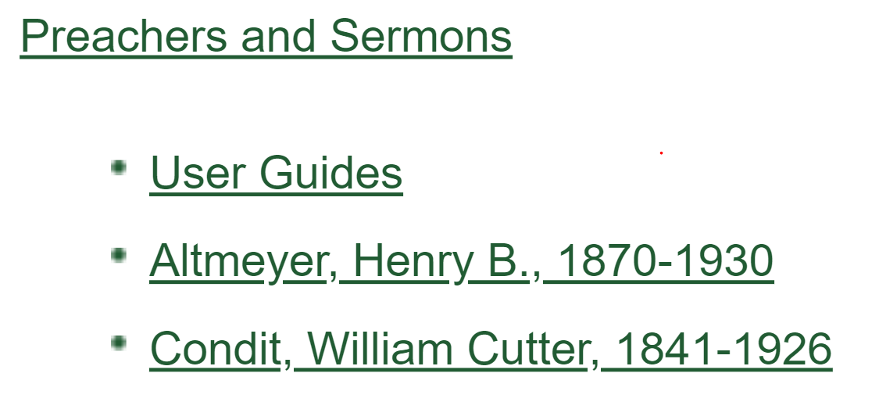
User guides
Notes:
Getting the texts up will be a big step, but it’s not the end of the road. In order to make the project as robust and user-friendly as possible, we want to provide a number of “user guides” as well. We’ve done a lot of talking about what they will look like, but I haven’t made a lot of progress on the documents themselves. I’ll go ahead and show you where we are so far.
The first step was deciding on the phrase itself. The term “finding aid” is fairly standard among librarians, but may not resonate all that much elsewhere. We discussed several alternatives and decided that “user guides” was something that pretty much everyone should be able to relate to.
One of the guides will be a document with a lot of the info I’ve covered in this presentation: the intent and scope of the project, the choices we made about linking to the Internet Archive rather than scanning the books ourselves, and so on.

Slide 15
User guides
Notes:
Next will be several kinds of spreadsheets that users can download, search, and sort. I’m very grateful to one of our catalogers for helping me think through what information should be included, and how it should be presented.
We adopted these basic principles:
The information should be complete enough to meet users’ needs, but simple enough to minimize scrolling, especially left to right.
We will use Library of Congress “name authority” and “subject” headings
We will use the broadest term available (ex: “Catholic Church” instead of “Catholic Church—Clergy”

Slide 16
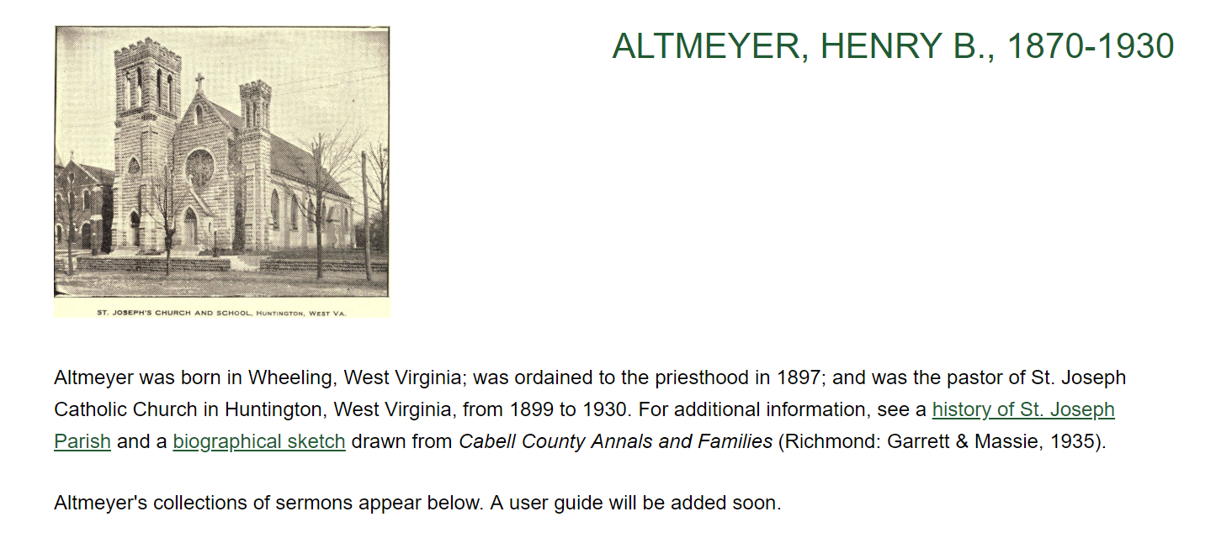
User guides
Name Altmeyer, Henry B., 1870-1930
Denomination Catholic Church
State West Virginia
Time Period Twentieth Century
Notes:
Here’s what that looks like. For the preachers, we’ll provide just these 4 pieces of information. The name will be a hyperlink that will go to that preacher’s page in the collection.

Slide 17
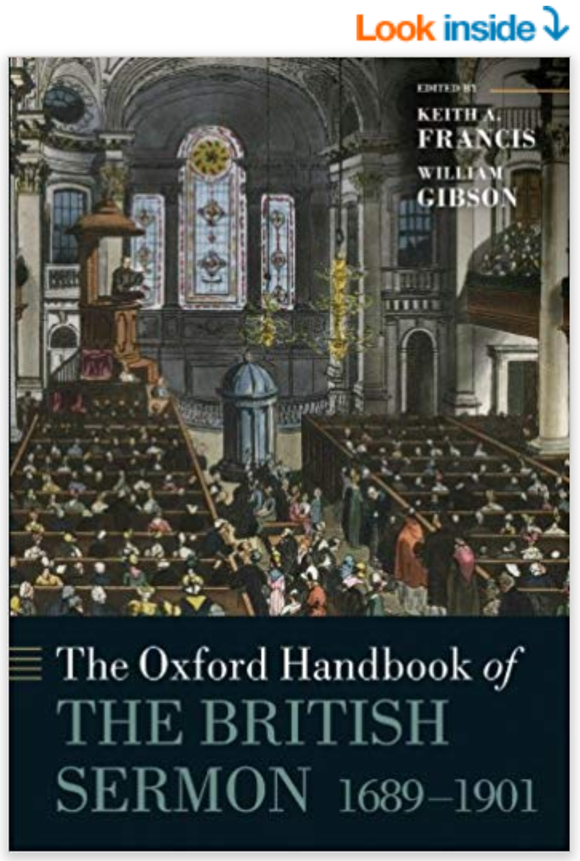
User guides
amazon.com
Notes:
The other spreadsheets will help to meet a longstanding need in sermon studies, and to realize a dream Keith, others, and I have had for a long time.
By “others,” I mainly mean Bob Tennant, who was one of the driving forces in sermon studies until his untimely passing back in 2014.
The dream—Bob’s dream—was this: we’re all familiar with Amazon’s “Look inside” feature. There are untold numbers of sermons and books of sermons out there, and no easy way to tell what they contain. I don’t get a lot of inquiries from preachers and other scholars, but when I do, they are almost always something like this: “I’m looking for sermons on such-and-such a verse,” perhaps with other parameters like denomination or time period added in. “Do you,” they would ask, “have any recommendations for me?”
Every time, I’ve had to give an answer I don’t like to give: “I don’t know.” Not only that, it’s something that, given the current state of affairs, can’t be known.

Slide 18
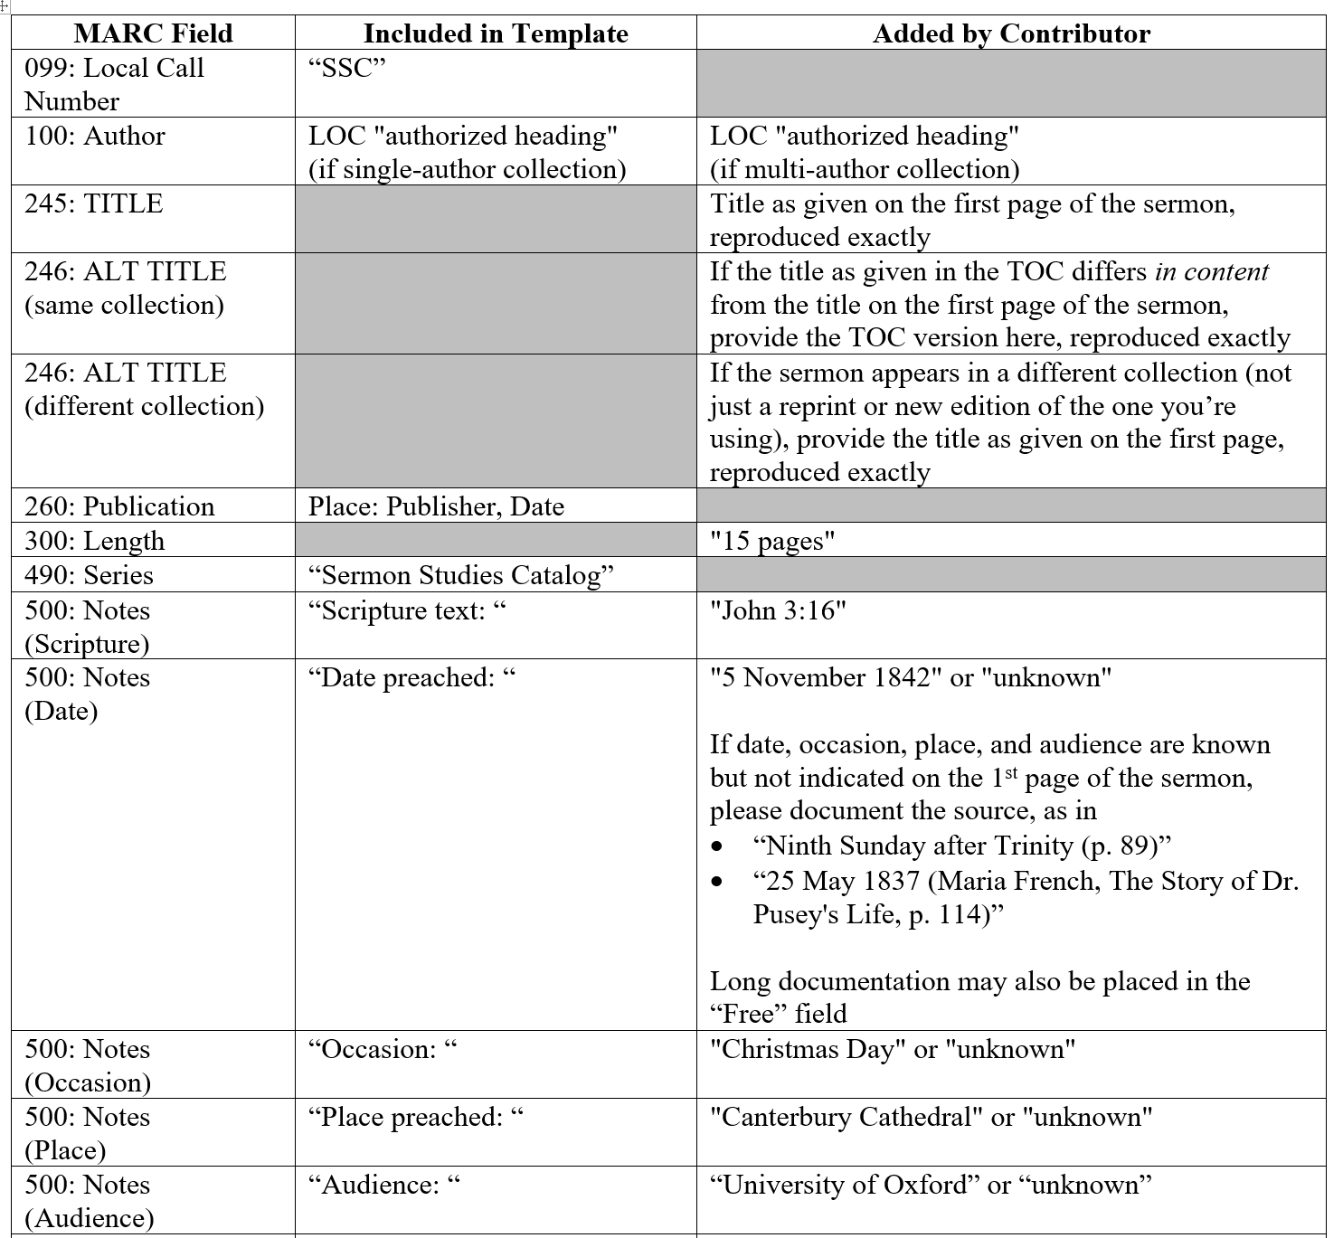
User guides
Notes:
That’s not for lack of trying! About 5 years ago, I sat down with one of our catalogers to work out a record format for sermons within collections. It would have all of the standard categories (author, title, date, etc.), along with fields specifically of interest to sermon scholars (Scripture text, date and place preached, the preacher’s denomination, and so on). Everything would be done according to Machine Readable Cataloging (MARC) standards, and the records would be incorporated into our library’s online catalog.
Nothing ever came of that, mostly because the cataloger didn’t have time to create templates for me, and then review my work before adding the records to the catalog.
So we tried a Plan B, where one of the programmers in IT would create a freestanding catalog for me. We’ve had several design meetings and such, but nothing has panned out, also because of constraints on his time and more pressing obligations.

Slide 19
User guides
Notes:
So we’re trying something new, and I think this will actually work! Instead of providing data to someone else and relying on that person to program and maintain the catalog, we’ll cut out the middleman, as it were, and just upload spreadsheets with the data itself. The spreadsheets will not have all of the information that a full MARC record would have, but they will have the essentials and still follow the “best practices” of academic librarianship.

Slide 20
User guides
Preacher Altmeyer, Henry B., 1870-1930
Sermon Title God and the Soul
Link Sermons and Discourses, pp. 1-6
Scripture Text Not specified
Date Preached Not specified
Place Preached Duquense University
Subject Soul
Denomination Catholic Church
State West Virginia
Time Period Twentieth Century
Notes
Notes:
Here’s what that will look like. If a preacher has more than one sermon, they’ll have a guide of their own, with the categories on the screen. It will have all of the information in the preacher guide, plus the scripture text and other information users will probably find most relevant as they’re looking for specific sermons.

Slide 21
User guides
Notes:
The hyperlinks will go to the preacher’s main page and to the abstract page for the sermon or collection of sermons. From there, users can explore all of the preacher’s works, and either download or link out to the full text.

Slide 22
User guides
Notes:
This information will also be added to a master guide, listing all of the sermons included in the project. As those guides grow, I’ll finally be able to answer “where can I find sermons on X?,” at least within the confines of this effort. Better yet, users can download the spreadsheets and answer the questions for themselves!

Slide 23
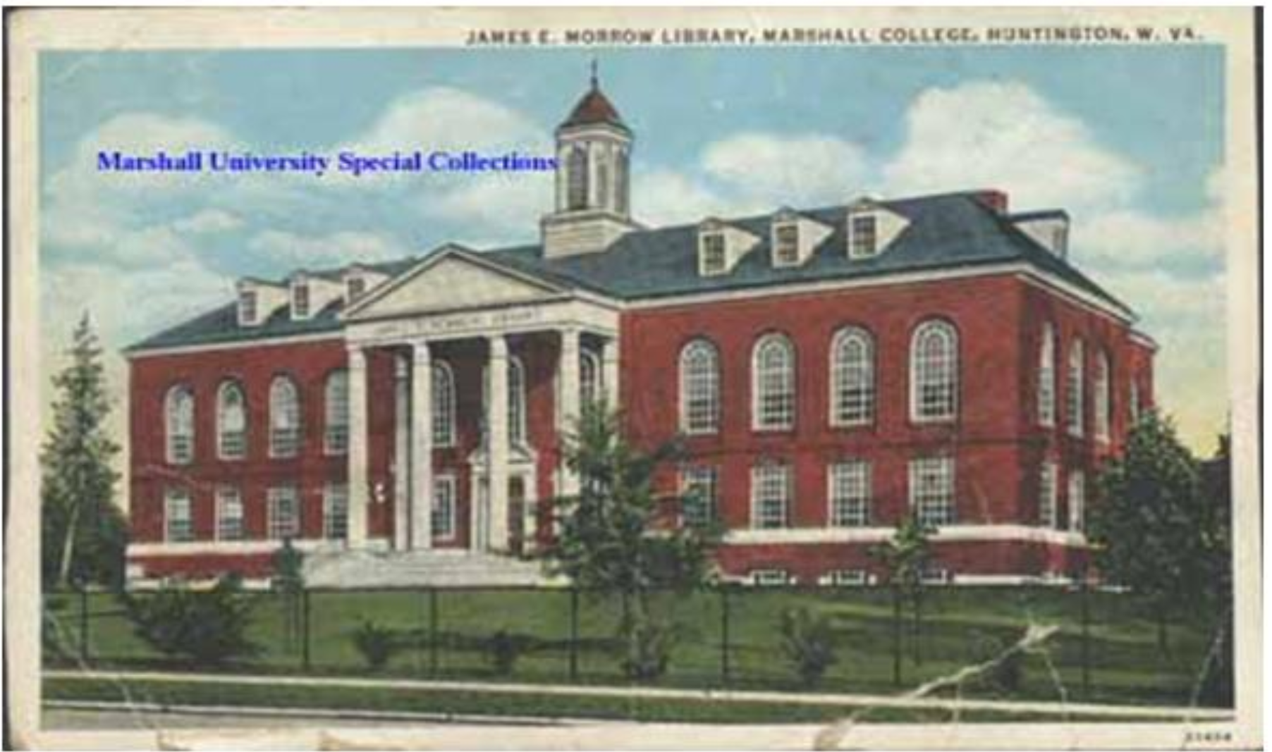
“Big Idea” #2
chrisbaldwin.net
marshall.edu
Notes:
I want to close with my second “big idea.” Someone—it may have been the librarian who made the comment about “best practice”—once remarked that the role of libraries and librarians is changing.
Traditionally, their role has been to take the knowledge produced around the world and make it available to local users.
That’s still the case, of course, but the arrow points the other way now too, as they take knowledge produced locally and make it available around the world.
This project, I’d say, is one example of that. It may be to a lesser extent with the printed texts, which are available in other libraries and may already exist online. It’s certainly the case with the archival material, however, which exists in only one place and requires researchers to travel to Huntington to use. As this project grows, those materials can be used in remote locations, and we’ll have hard data that will show just how far around the globe it goes.
Thank you very much.

Slide 24
DIGITizing sermons in the marshall university libraries

