Slide 1
All Hands On Deck: Making Information Literacy Outreach a Priority
Sabrina Thomas MS, MIRLS

Slide 2
Opening Questions
1. What role does the library have in the Information Age?
2. Do librarians have a civic responsibility in the (dis)Information Age?
Has your library shifted how and to whom it teaches Information Literacy?

Slide 3
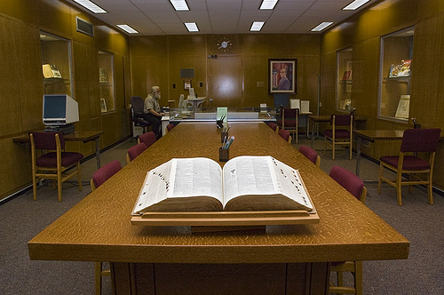
Evolution of ‘Bibliographic Instruction’
Web
Web 2.0
Mobile

Slide 4
Growing Complications & Growing Concerns
Political Polarization
Confirmation Bias
Echo Chambers
Social Media
Consumption of Media
Information Infrastructure
Fake News and Viral Misinformation

Slide 5
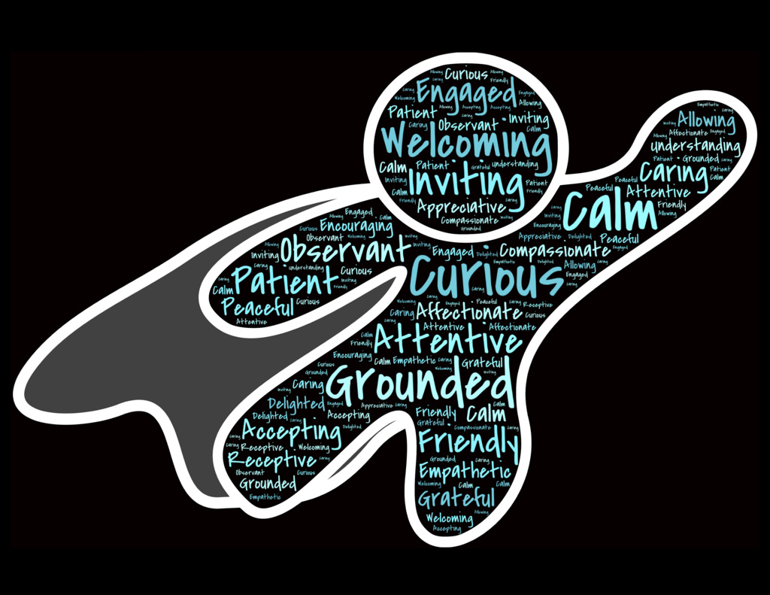
The world needs information literate people now more than ever!
Train the Trainer!
Partner with faculty who train Adjuncts and Teaching Graduate Assistants
Use existing classes and tweak assignments, lesson plans and rubrics
Get out of your box and Comfort Zone! Cabell County 2017 Teacher Institute
Clubs, Social Organizations, and Churches

Slide 6
But Wait!!
I don’t have enough time.
This is outside of the mission of the University and or library.
Will I still be needed?

Slide 7
Where to begin:
Dig into your liaison partnerships!
Ask questions on how information literacy is taught within a discipline.
Ask your faculty friends if they are concerned about fake news and/or viral misinformation.
Get out of your comfort zone!
Volunteer to share your expertise in social clubs and churches.
When asked, say YES!
Academic and Public Librarians UNITE!
Ask who teaches and offer to help.
When asked, say YES!
Enlist the help of your students!
Train students (not just Graduate Assistants) to educate their peers.
Encourage Digital Citizenship

