Slide 1
The Best Things in Life are Free: Open Educational Resources for K-12
© User: OpenSource.com / “Brigham Young University faculty survey seeks to advance open
education through academic libraries” / CC BY, SA, 2.0
Michele Frasier-Robinson
Education & Psychology Librarian
November 2017

Slide 2
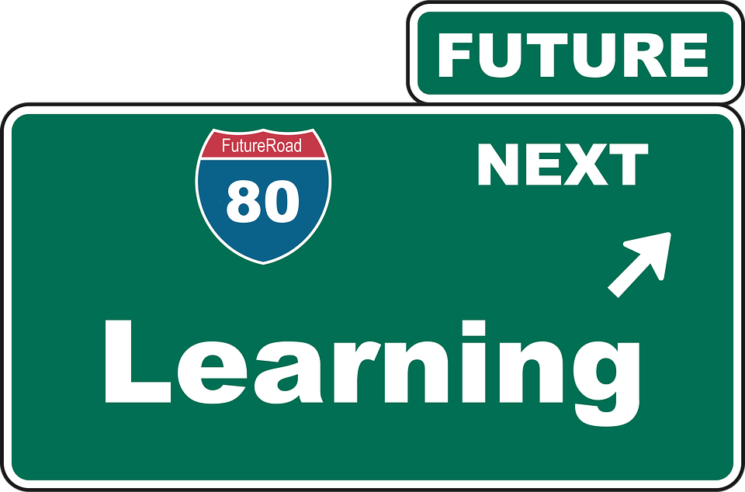
Learning Objectives
1. Understand what Open Educational Resources are
2. Know the benefits of OER
3. Know where to find OER
4. Recognize and understand Creative Commons Licensing
5. Know how to evaluate OER

Slide 3
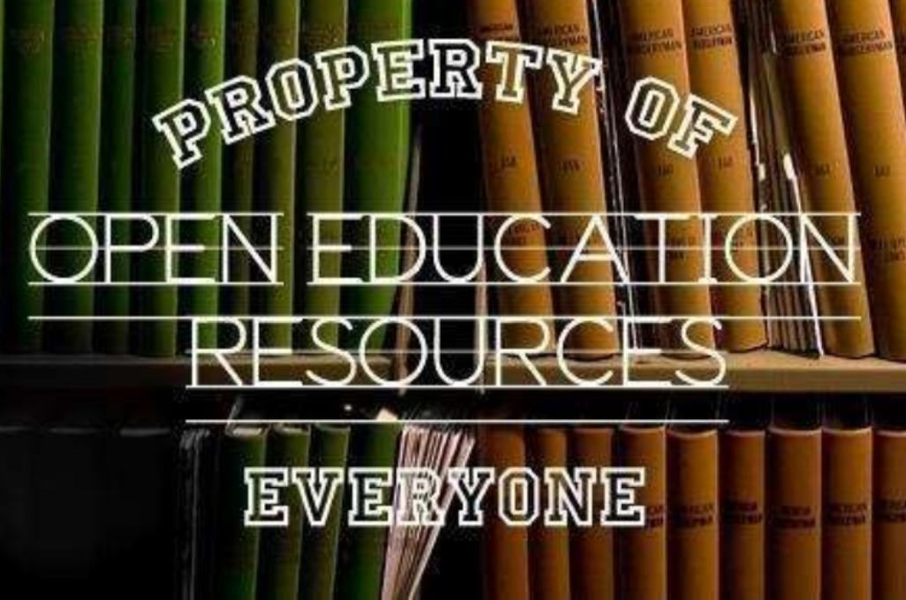
What are Open Educational Resources?
Digitized materials offered freely and openly for educators, students and self-learners to use and re-use for teaching, learning and research.
Open educational resources include
Full courses
Course materials
Textbooks
Streaming videos
Quizzes and Exams
Software
©User: Opensource.com / Beyond Definitions / CC-BY-SA 2.0

Slide 4
Pros & Cons of OER
Pros – OER allow us to:
Maximize budgets. They are available without licensing or royalty fees.
Be creative and adapt instructional resources to the individual needs of students.
Continuously improve teaching materials.
Rapidly disseminate timely information.
Enrich existing traditional instructional materials.
Cons
Not everyone is on board with OER.
Overwhelming amount of resources – beware the rabbit hole!
Some resources are poor quality.
Evaluation takes time.

Slide 5
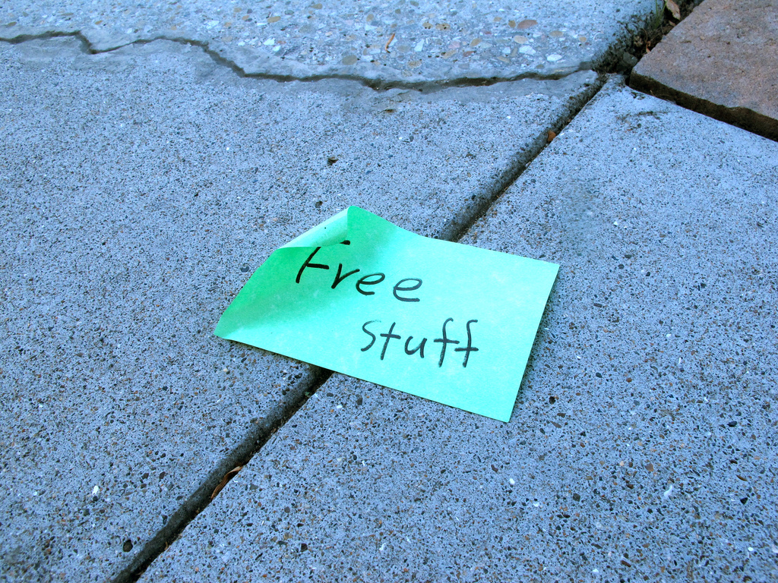
Librarians Should Lead the Way
We are experts at collecting, evaluating, and curating information.
Leverage this free content to promote access and equity.
Become familiar with existing OER sites and make them discoverable.
Develop an understanding of Creative Commons licensing to assist teachers to understand their options when it comes to using OER.
© User: Torbakhopper / “Free Stuff: Castro, San Francisco (2011)” / CC BY 2.0

Slide 6
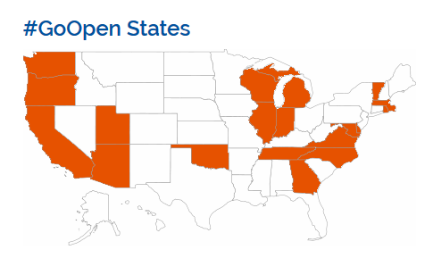
Who’s Using OER in K-12 classrooms?
20 states have launched formal #GoOpen campaigns.
13 states currently maintaining OER repositories.
Top pick: Utah Education Network connects all Utah school districts, schools, and higher education institutions to quality educational resources.

Slide 7
What’s the difference between ‘free’ resources and OER?
Not all free resources are OER!
Key characteristic of OER is the intellectual property license and the freedoms the license grants to share and adapt it.
Free resources that don’t allow reuse, modification, or redistribution without permissions from the copyright holder are not OER
© User: OpenSource / “Open Source Prescription” / CC BY, SA, 2.0

Slide 8
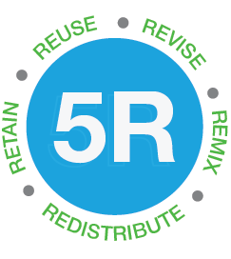
Five Rs of Opennes
David Wiley’s five Rs
Retain-the right to make and own a copy
Reuse-the right to use in a wide range of ways
Revise- the right to adapt, modify, and improve
Remix- the right to combine with other material to create something new
Redistribute- the right to share with others
© David Wiley / Iterating Toward Openness / CC BY

Slide 9
Merlot II Multimedia Educational Resource for Learning and Online Teaching
Cal State’s collection of more than 45,000 resources.
peer-reviewed.
rated by users.
Over 3,000 open textbooks.
Search by topic, audience, CC license, and peer review.
Go to Merlot II

Slide 10
Curriki
Curriculum + Wiki
Open Education Award for Excellence (2017)
Quality materials for teachers, parents and students.
Free account allows use of all materials.
Search collection by subject or by educational level.
Also contains professional development materials.
Spanish language version available
Go to Curriki

Slide 11
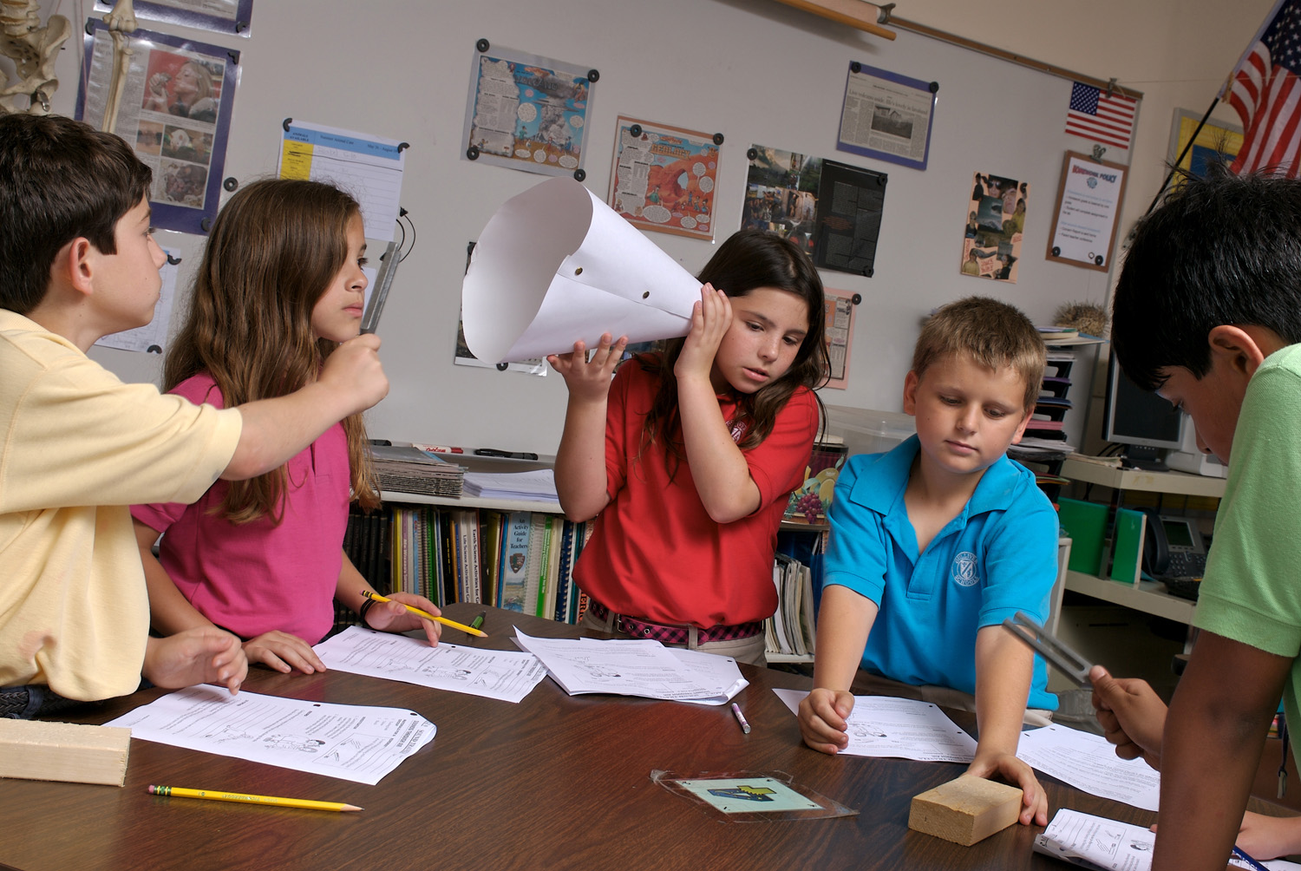
cK-12
Creates / aggregates high quality STEM content.
Over 5,000 math and science concepts and FlexBooks (digital textbooks) for all learning types.
Videos, images, simulations, real world applications, activities, flashcards, study guides, assessments and more.
© Wikimedia Commons / Gulliver Academy / CC BY 2.5

Slide 12
More cK-12
Create account to use free content.
Users create, modify and upload content to CK-12's website.
Create groups and assignments.
Save material to Library.
Correspond with other users in the Café.
Go to cK-12
© Wikimedia Commons / Children at school / CC BY-SA

Slide 13
OER Commons
Search materials by education level, subject, and standard.
Lesson Builder feature allows creation of interactive lessons.
Large collection of lesson plans, worksheets, and activities.
Go to OER Commons
© Wikimedia / “knowledge sharing.” / CC BY-SA

Slide 14
WikiJunior
Free age-appropriate non-fiction books for children from birth to age 12.
Print PDF copies of books.
Books produced by a worldwide community of writers, teachers, and students.
Users can join in and write, edit, and rewrite each module and book to improve its content.
Go to Wikijunior

Slide 15
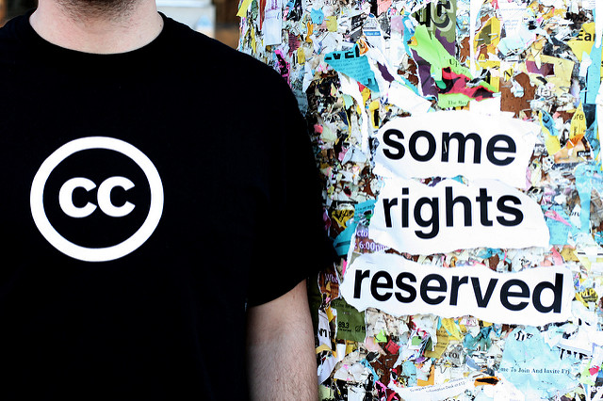
Creative Commons
Many authors of OER use Creative Commons (CC) as their open licensing system of choice.
CC provides free, easy-to-use copyright licenses that give others permission to share and use creative work.
It’s not separate from copyright, but instead is a way of easily sharing your copyrighted work with others.
Traditional copyright = “All rights reserved.”
CC licensing = “Some rights reserved.”
© TilarX / Creative Commons Swag Contest 2007_2 / CC BY

Slide 16
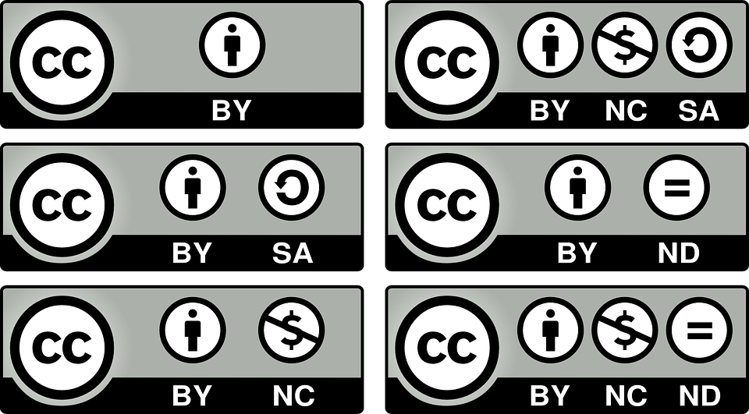
Creative Commons Licensing
CC provides several different licenses for creators to choose from:
CC 0: Public domain
BY: Attribution (most open of all)
SA: Share Alike
NC: Non-commercial
ND: No derivatives

Slide 17
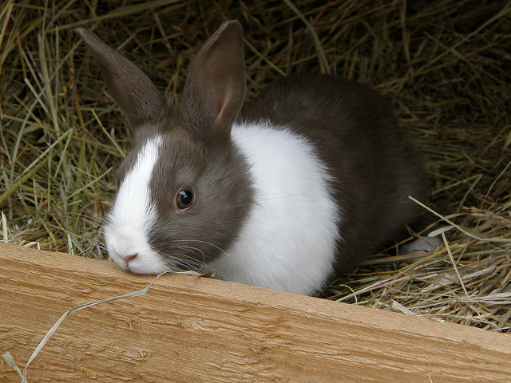
How to Properly Attribute CC Materials
credit the creator
provide the title of the work
provide the URL where the work is hosted
indicate the type of license and provide a link to the license
keep intact any copyright notice associated with the work.
© Manu / little rabbit / CC BY-SA

Slide 18
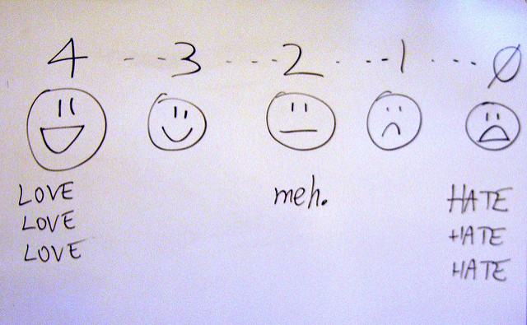
Evaluating Open Educational Resources
Does it cover the content you'd like your students to learn in this course or module?
How can you use the content? Verify the CC license that the resource is under.
What would you like to do with it? Does only a portion of it apply to your class? Would you possibly want to combine this OER with another OER or resource?
Evaluating Open Learning
Evaluation Toolkit Handbook
OER Evaluation Rubric
© billsoPHOTO / Evaluation scale / CC BY-SA

Slide 19
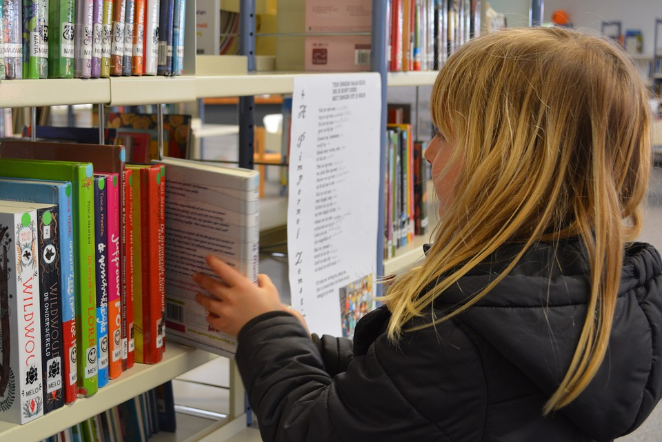
OER Resources by Subject
Reading/Writing/Literature
Freereading.net
Lit2Go – audio books
LibriVox – audio books
OER for Writing
K12 Handhelds – free e-books
Foreign Languages
Center for Open Educational Resources and Language Learning
Social Studies
USHistory.org – free textbooks
OpenEd – homework, videos, lesson plans

Slide 20
More OER Resources by Subject
STEM
Illustrative Mathematics
Algebra2go
PhET
Digital Library for Earth System Education
National Science Digital Library
MIT Blossoms
NASA Education

Slide 21
Image, Music & Sound Effects Sources
Unsplash – all images are CC zero. No attribution necessary
Pixabay - Free photos for commercial and private use – all images CC 0
VisualHunt – search by license type
Flickr – search by license type
MusOpen – download audio clips, sheet music, and music education resources
CCMixter – free audio clips
FreeSound - database of CC licensed sound effects
Google Advance Image Search – narrow your search by usage rights

Slide 22
Further Reading
What the Heck is OER?
OER Handbook for Educators
K12 OpenEd (blog)
State of the States: Open Educational Resources in K-12 Education
#GoOpen Initiative

Slide 23
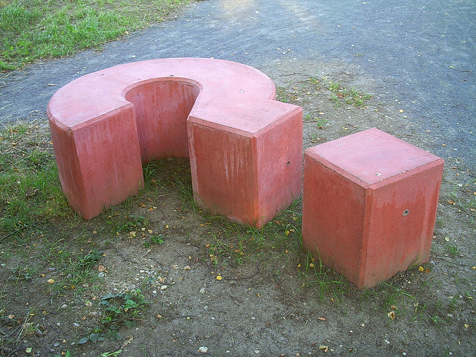
Michele Frasier-Robinson
Education & Psychology Librarian
susan.frasierrobinson@usm.edu
© User: Alexander Henning Drach / Question mark in Esbjerg / CC BY-SA 2.0

