Slide 1
Partnering Literacy with Problem Solving
Audrey Pitonak-Goff, Regional Manager for West Virginia
ReasoningMind www.reasoningmind.org

Slide 2
Literacy and Problem Solving
Clearly define
Assess the current situation
Identify opportunities for partnerships
Share actionable next steps

Slide 3
The Hamburger Problem
Liz is preparing food for 12 people (11 plus herself). She plans to make hamburgers with 4 pounds of meat using 1/5 pound to make each hamburger. Can she make 2 hamburgers for every guest?
Why or why not? Explain your thinking.

Slide 4
Why is problem solving important?

Slide 5
Interconnected Historical Perspective
The ancient Sumerian practice of following and counting stars led to the development of mathematics, which resulted in the need for writing.
Cuneiform symbols contained the first phonetic-based alphabet.
The script was used to record objects and ideas, and advancements later opened the door for tales of Mesopotamian storytellers to be written down.
Harris Brim, Marcia What Every Child Needs to Know about Western Civilization, Brimwood Press, 2006.

Slide 6
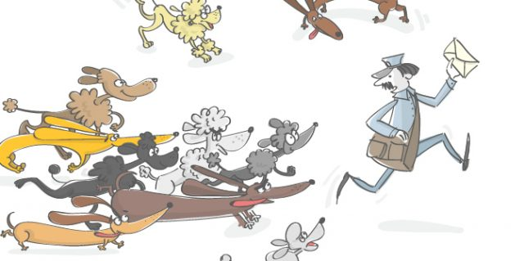
Math Storytelling Day – September 25th
Appreciate ways math enhances our lives
Get children excited about math through stories and games

Slide 7
Research Conclusions
Research shows that math proficiency and problem-solving skills in children 3-5 years old are the single largest predictors for later school success. Mastery of early math skills predicts not only future math achievement, it also predicts future reading and literacy achievement (Duncan et. al.).

Slide 8
Research Conclusions
Researchers have found that children with persistent problems attaining math skills are less likely to graduate from high school or go to college, and that math achievement in adolescents actually predicts labor market success (Duncan & Magnuson, 2011).

Slide 9
Current Situation
How are literacy and problem solving integrated in the educational environment?
Is it working? Is it enough?

Slide 10
What are the missing components?
How can we fill the gaps?

Slide 11
Identify Opportunities for Partnerships
Curriculum and Instruction
Online and In-Person Programs
Children, Parents, and Community

Slide 12
What are next steps?

Slide 13
Questions & Answers

Slide 14
Thank you!

