Slide 1
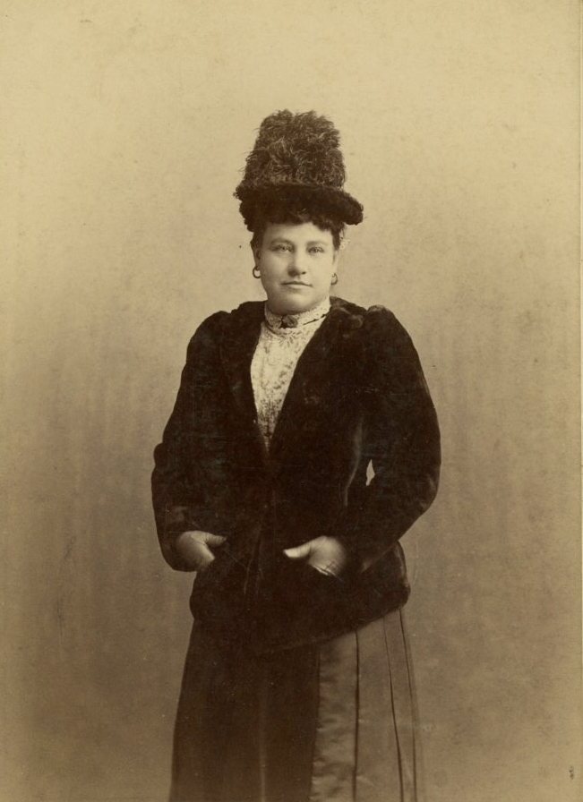
Mrs. Alex. McVeigh Miller
Image courtesy of Greenbrier Historical Society, Lewisburg, WV
Notes:
We can open with this slide on screen through your portion of the talk…

Slide 2
A Dramatic Discovery!
Notes:
Here I will talk about finding our dime novel collection.

Slide 3
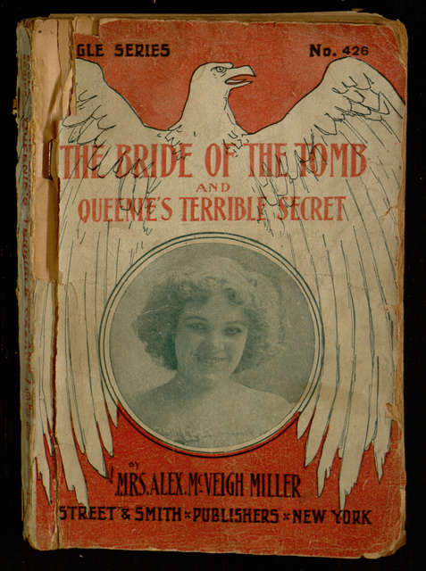
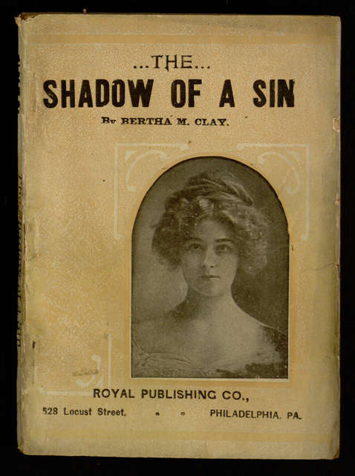
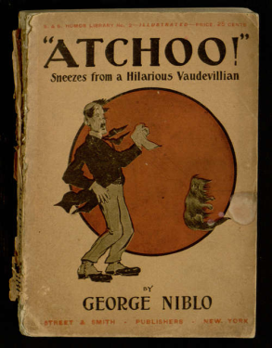
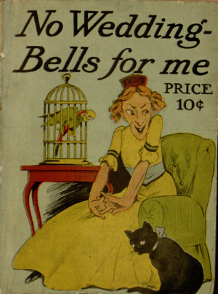
Some Highlights…
Notes:
…and I’ll point out that “Bride of the Tomb” was one of the most eye-catching parts of that original find.

Slide 4
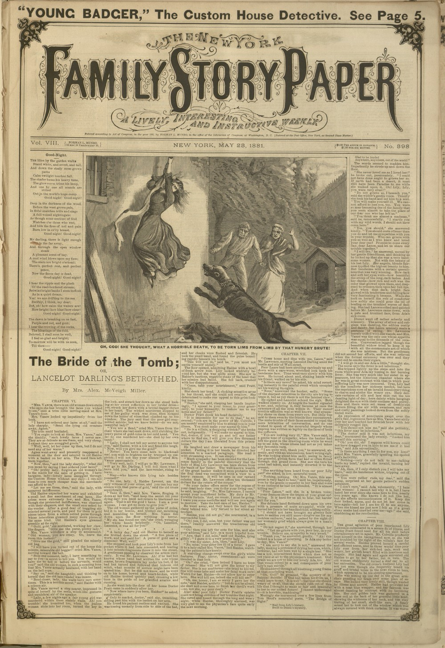
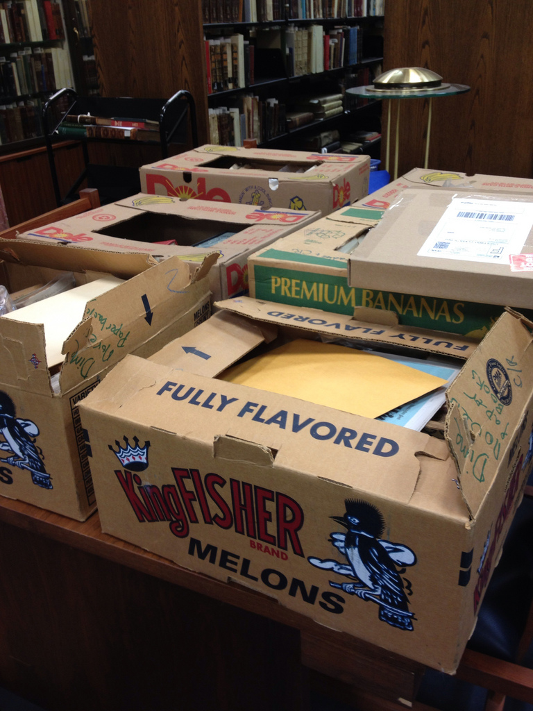
Mountains from Molehills
Notes:
I’ll briefly point out that our small find quickly led to donations and a much larger collection – including a loan of the original serial version of “Bride of the Tomb.”

Slide 5
A Bloom from the Tomb
Digitized images of book: https://digital.library.villanova.edu/Item/vudl:24299
Electronic text of book:
http://www.gutenberg.org/ebooks/42100
Audio reading of book:
https://digital.library.villanova.edu/Item/vudl:384795
Notes:
Here I will talk about how we exposed Bride of the Tomb to the world.

Slide 6
The Groom of the Tomb
Notes:
…and I’ll mention the creation of my book.

Slide 7
…why stop at just one?
Countess Vera; or, The Oath of Vengeance
A Dreadful Temptation; or, A Young Wife's Ambition
Guy Kenmore's Wife
Kathleen's Diamonds; or, She Loved a Handsome Actor
Lancaster's Choice
Laurel Vane; or, The Girls' Conspiracy
Little Golden's Daughter; or, The Dream of a Life Time
Little Nobody
My Pretty Maid; or, Liane Lester
An Old Man's Darling
Pretty Geraldine, the New York Salesgirl; or, Wedded to Her Choice
The Rose and the Lily
The Senator's Bride
The Senator's Favorite
They Looked and Loved; or, Won by Faith
…and many more to come!
Notes:
I’ll highlight some of the other Mrs. Miller titles we’ve released and point out that it’s still just the tip of the iceberg.

Slide 8
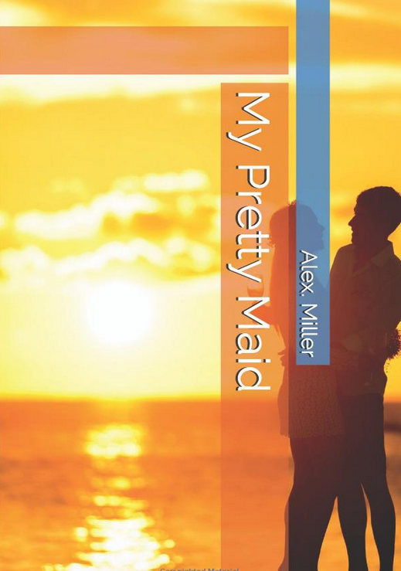
Unexpected Consequences
Notes:
I’ll talk about the odd Amazon covers resulting from harvesting of our texts….

Slide 9
Contact Information
Demian Katz
email: demian.katz@villanova.edu

