Slide 1
Starting the journey without crying
Save the tears for finals week.

Slide 2
Stepping Up The Scholarly Work
What Databases Are
What Databases Are Not
Databases are a collection of snippets of data that make more sense in context.
They grow and evolve overtime
They require decent construction and searching skills
Basic search engine
Intuitive
Static
Indiscriminant

Slide 3
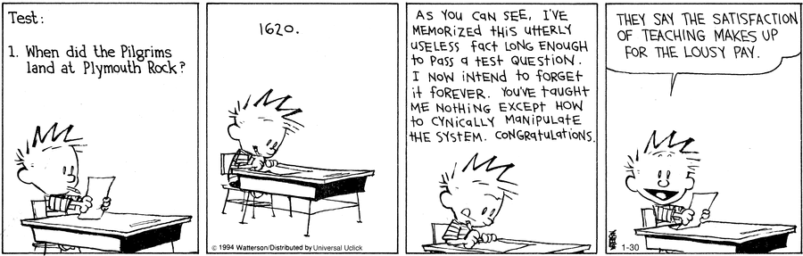
Databases Are Only Scary Until You Know How To Bend Them To Your Will
Credit: Bill Waterson “Calvin & Hobbes”

Slide 4
How To Approach the Databases
  Do not start with a database
  Start with Wikipedia
  Read the article about the general nature of your topic
  Write down a list of some of the jargon you find.
  Use this jargon when you search in the database
Still can’t find anything? Call a librarian.

Slide 5
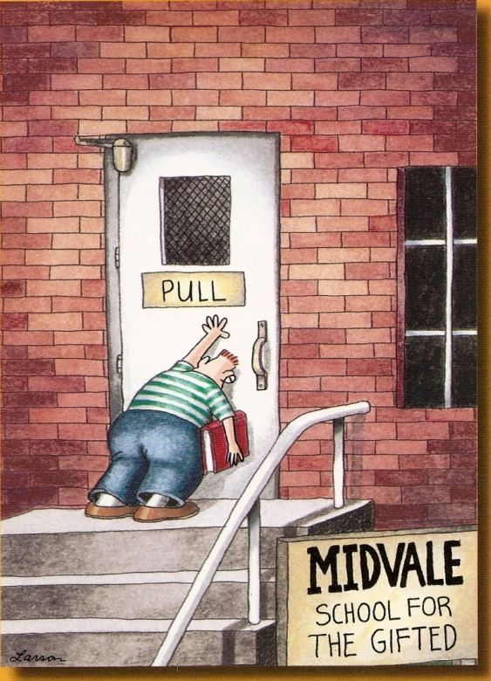
This Is A Lot of Extra Work…
Why in the world am I asking you to do some extra work?
Assignments will only get to be more complex, and learning the basics can only help
We’ll come back to this later
Credit: Gary Larsen “The Far Side”

Slide 6
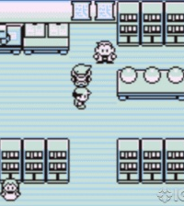
Pick your weapon
Picking your database is a lot like picking your first pokemon
Even if you don’t play Pokemon, it still applies
You can’t have a database that does it all
They each have their specialty
So pick the right specialty for the job
Also, bulbasaur was the best starter option. Just sayin’.

Slide 7
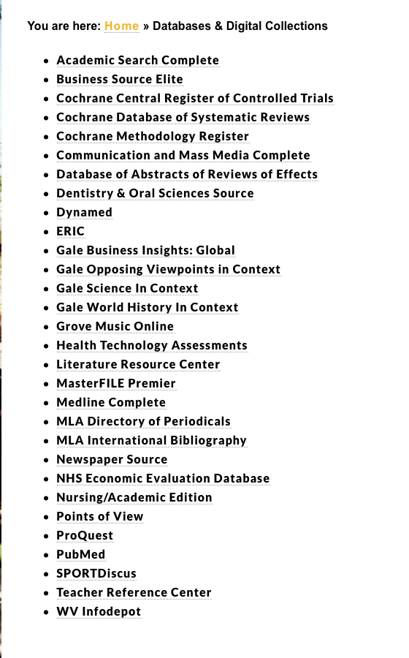
Your weapons of choice
Which option is best will change with different classes
ProQuest is decent with general searches and would be a good starter choice
Visit the list of databases offered to see which ones are closely related to your class

Slide 8



Gotta search ’em all

Slide 9
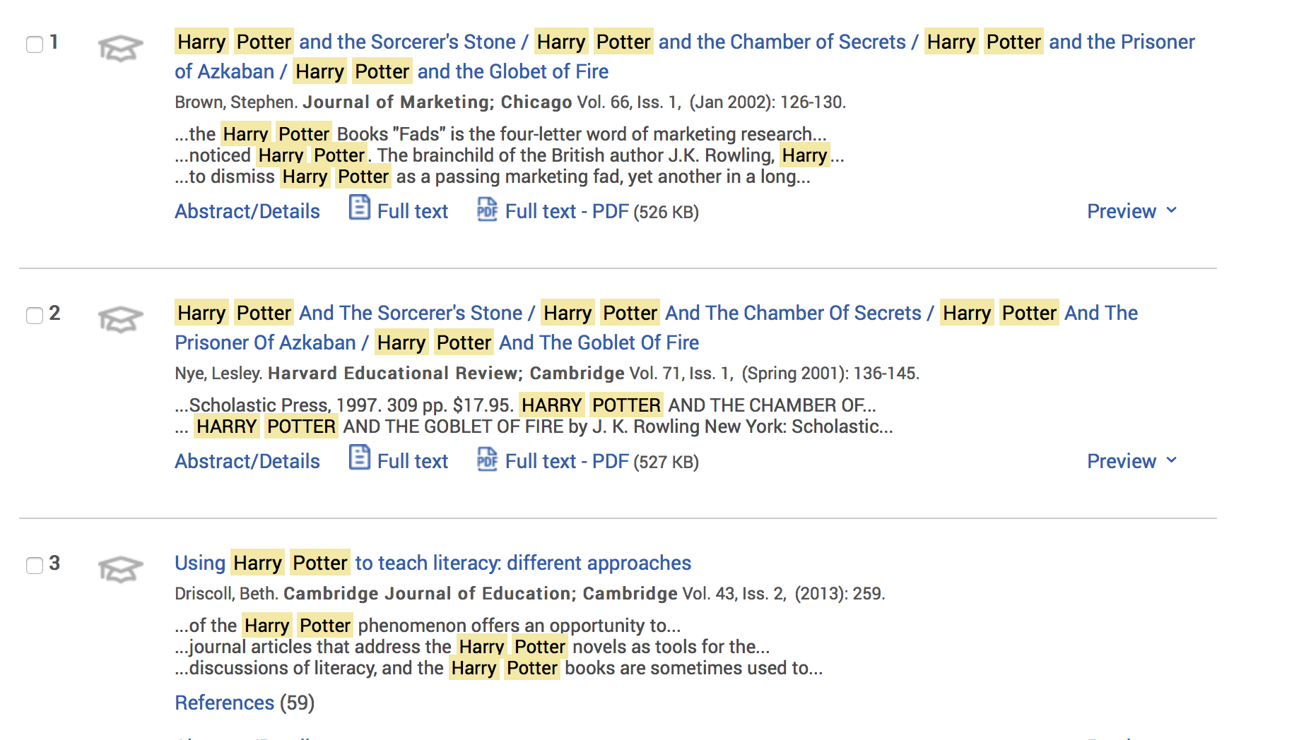
Harry potter search –Proquest

Slide 10
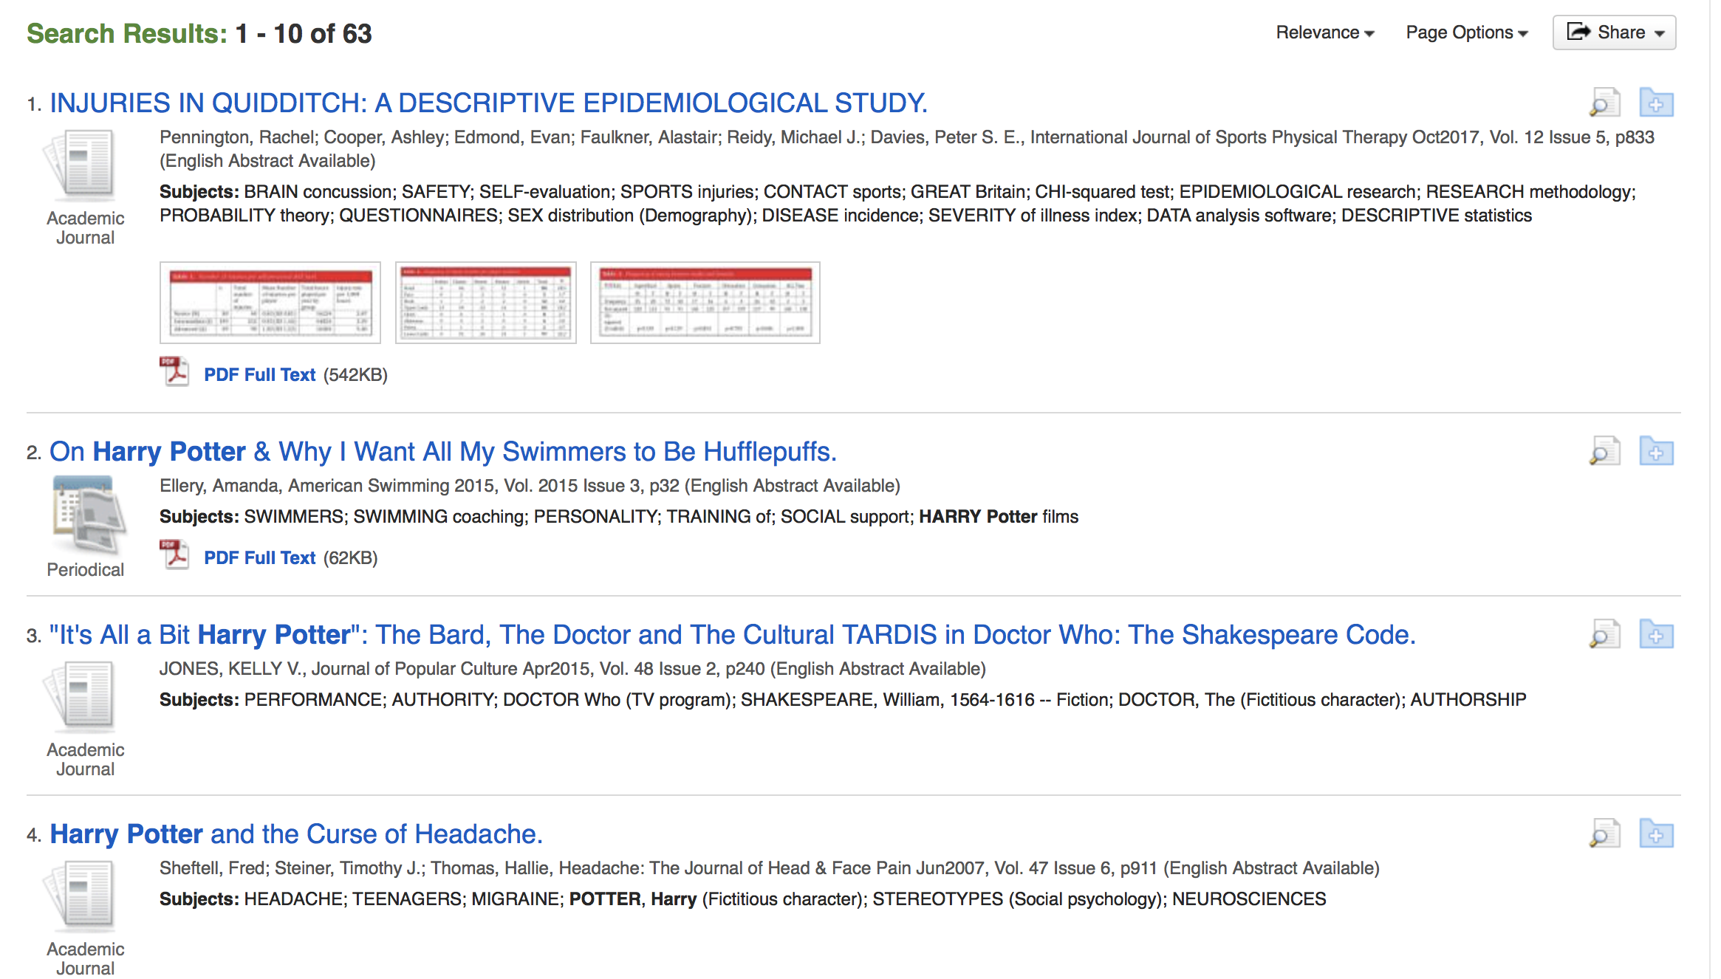
Harry Potter search –Sport Discus

Slide 11
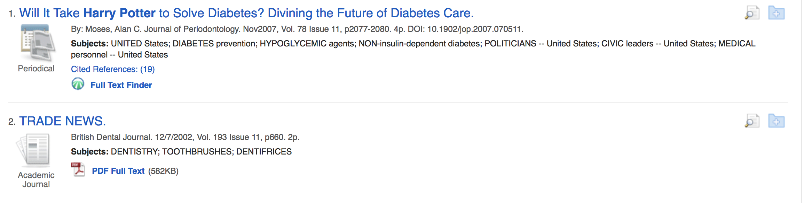
Harry Potter search –Dentistry and Oral Science

Slide 12
Now that you’re ready to search

Slide 13
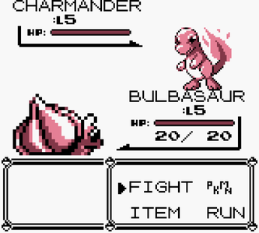
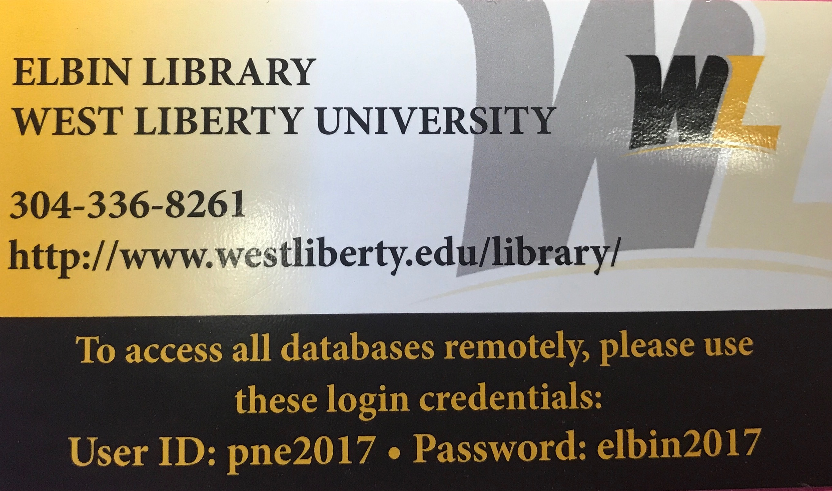
A Wild login appears!
Library Creds uses CONFUSION! It’s super effective!
Bulbasaur hurts itself in its confusion
Library Creds uses SLEEP POWDER
Library Creds misses!
Bulbasaur uses LOGIN
Library Creds FAINTED
Bulbasaur wins!
Library Creds

Slide 14
But seriously…
This card has the credentials for the library databases
Anytime an article requires a login to access, you just use these credentials
Please take a card for your own records
I highly recommend taking a picture in case you find yourself using a different computer

Slide 15
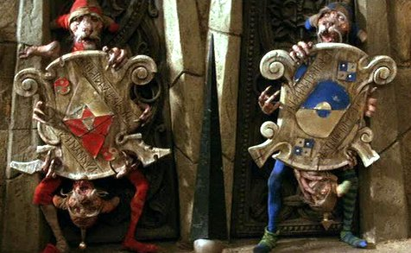
Once you have the right tool, you have to ask the right questions
How you frame your search deeply matters
What jargon you use will definitely affect the outcome
Luckily for you, “certain death” is probably not an option. Probably.

Slide 16
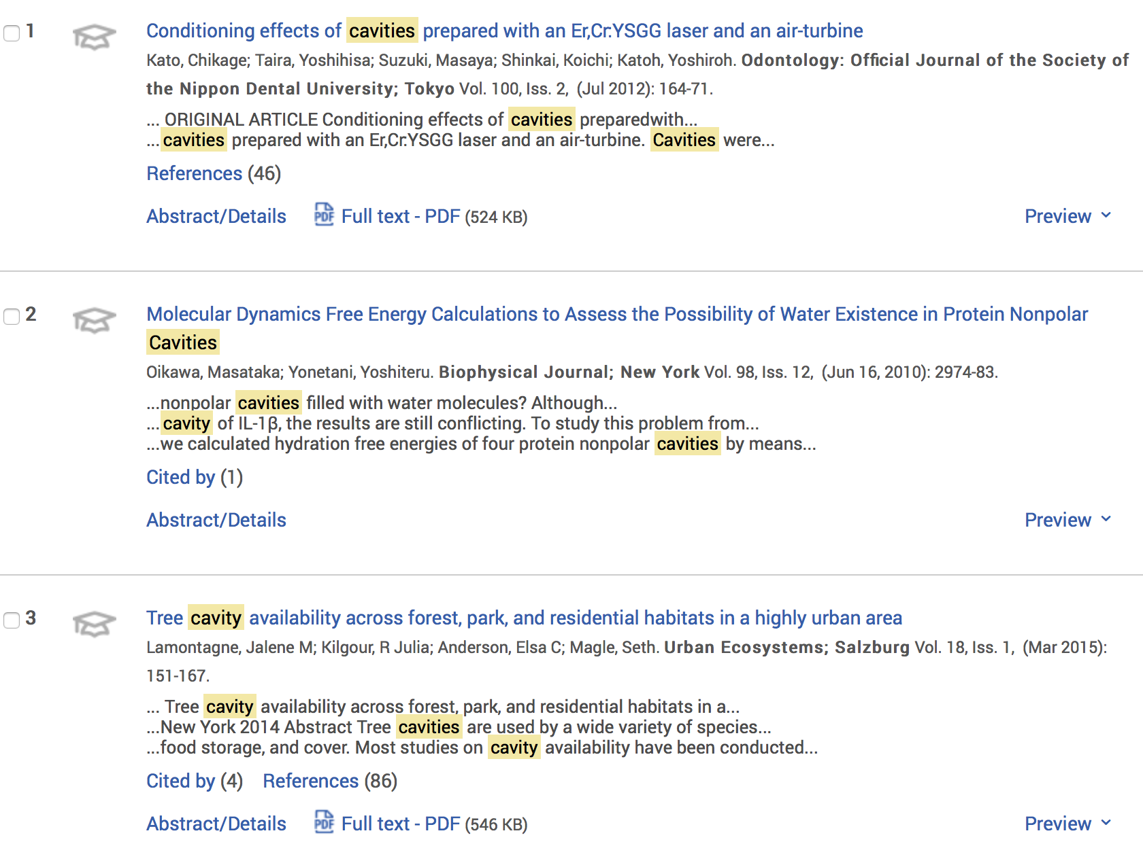
Proquest—cavities

Slide 17
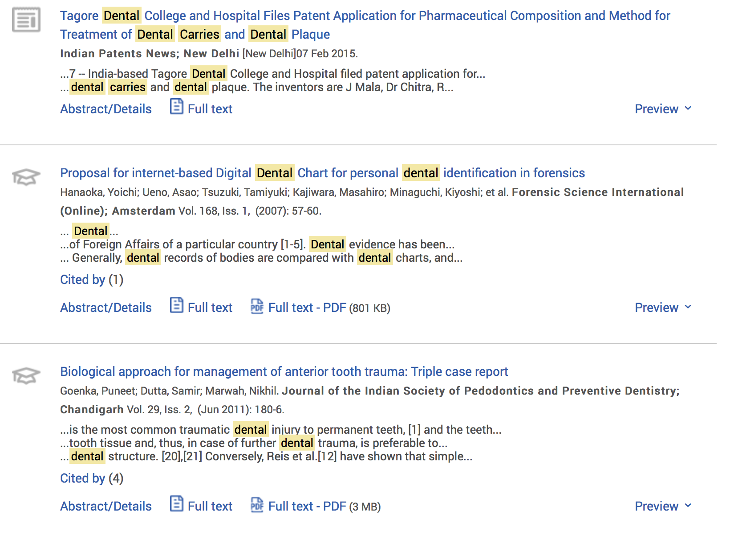
Proquest—Dental Carries

Slide 18
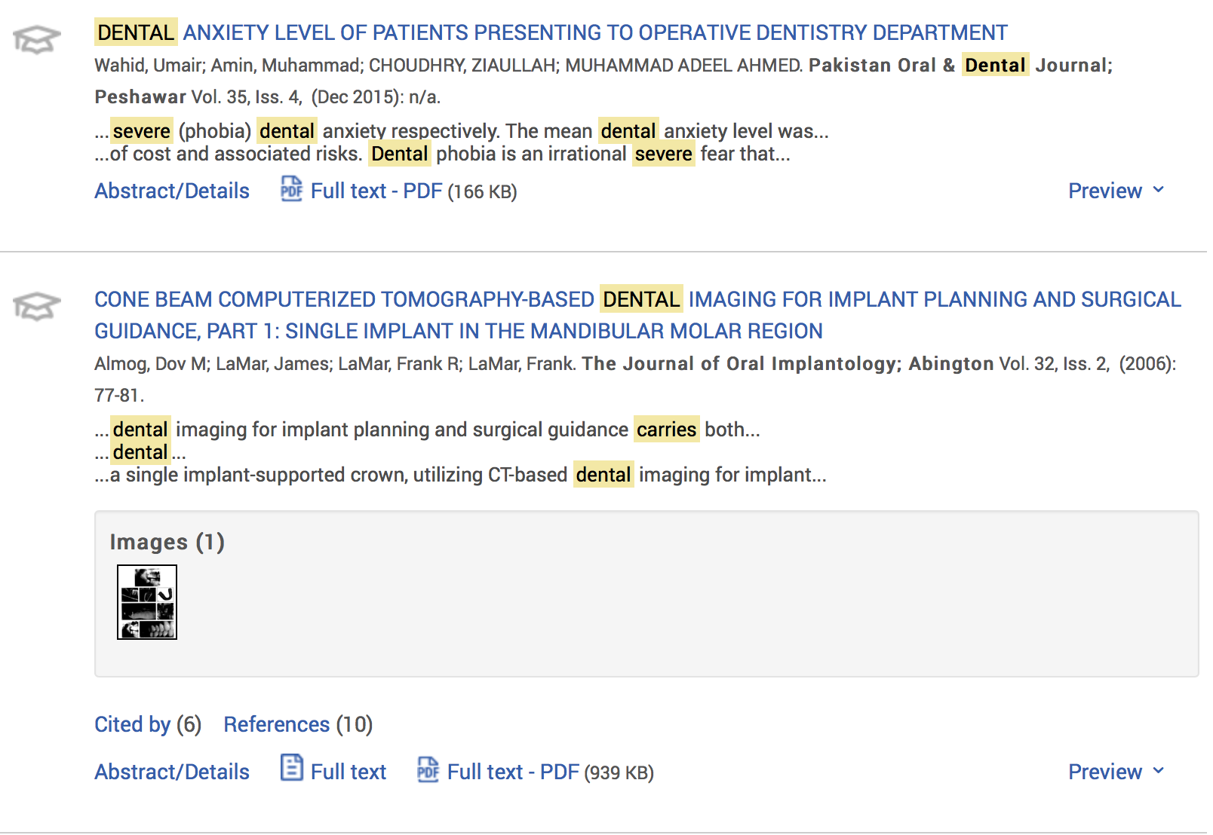
Proquest—Severe dental carries

Slide 19
Use a variety of searches
Play around with vocabulary
Add adjectives
Use jargon
  General information for a general term
  Specific information retrieved with jargon
Use Quotes to refine searches

Slide 20
How to customize your search
For the overachievers in the room

Slide 21
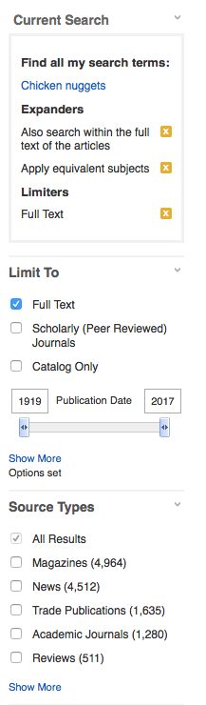
Searches Can Be Customized
Make sure to click “Full Text”
Select “Scholarly (Peer Reviewed) Journals
Make sure the dates are set to current trends
Check “Academic Journals”

Slide 22
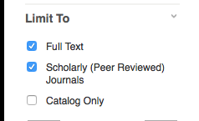

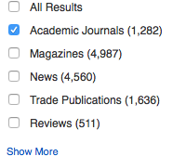
I selected “Scholarly (Peer Reviewed) Journals
I changed the year of publication
I selected “Academic Journals”

Slide 23

Why Can’t I Just Google Things?
Copyright laws
Limited access to journals
Most sources are not considered to be citable

Slide 24
You found some articles. Now what?

Slide 25

Download it!

Slide 26
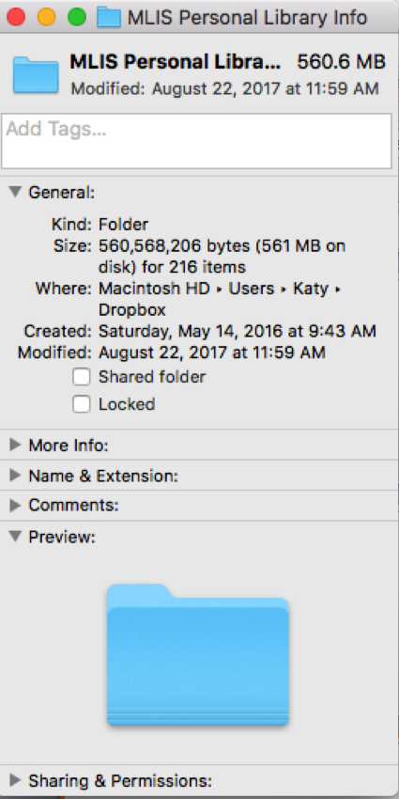
Downloading Content
My personal online library of database articles
Over 200 items available
Helps with future research
Great for studying
Searchable

Slide 27
Some Downloading Software
One Drive
Google Drive
iCloud Drive
Dropbox
Box
Dropl
Evernote
Kindle
Anything that spans devices
My work and personal computers
Can make edits and revisions
Organization abilities
This is why you always select full text

Slide 28
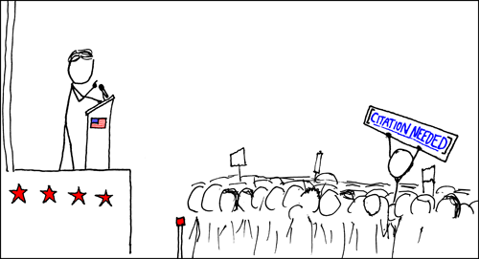
Citations
Cite your sources or face some consequences
Failure to cite is plagiarism
Plagiarism can get you kicked out of school
Use Purdue Owl, or many other online aids, to help you properly cite your sources
Credit: Randal Munroe “XKCD”

Slide 29
Helpful Website
Purdue Owl
  https://owl.english.purdue.edu/owl/section/2/10/
  This is a fantastic resource for all of your citation needs. It goes through several different style guides. It’s easily understood and shows plenty of examples of how to form the proper citation of just about anything.

Slide 30
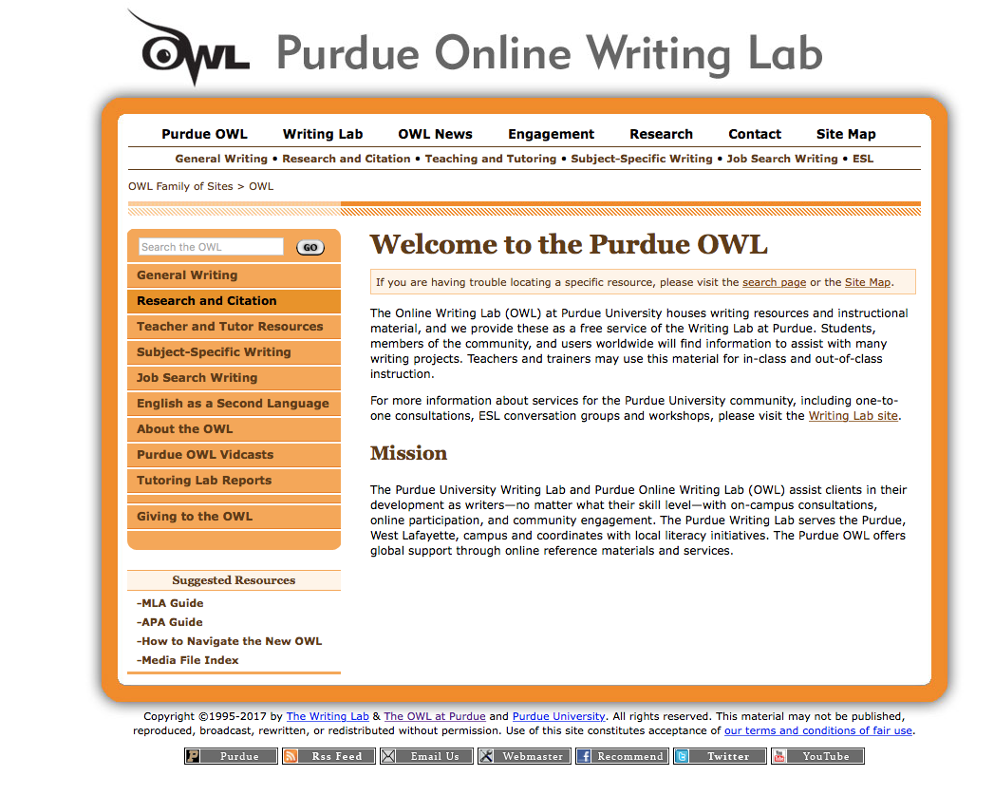
A demonstration

Slide 31
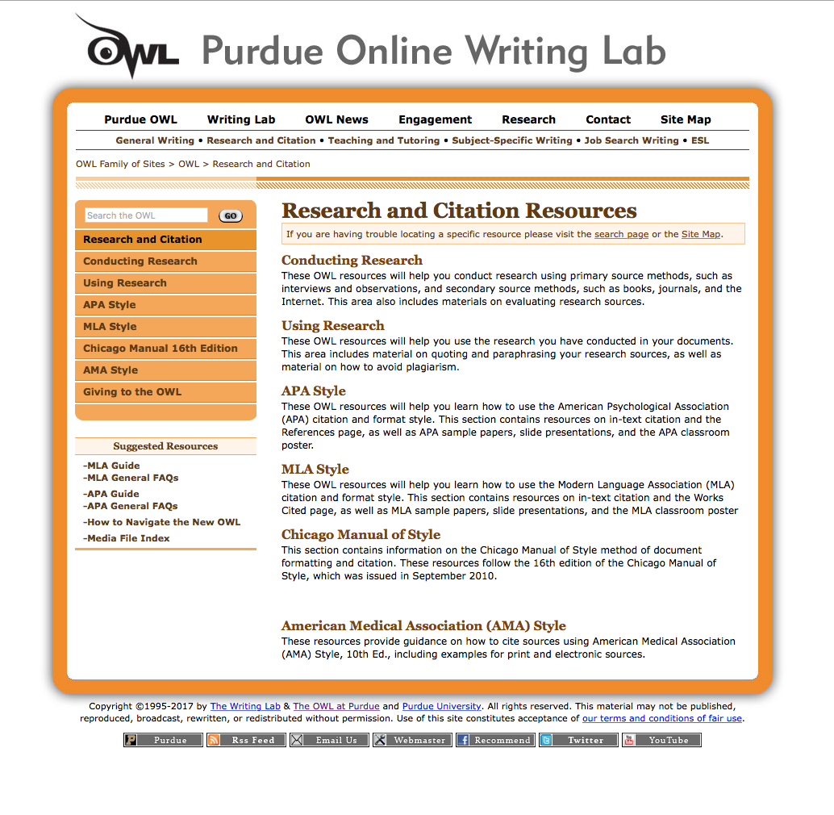

Slide 32
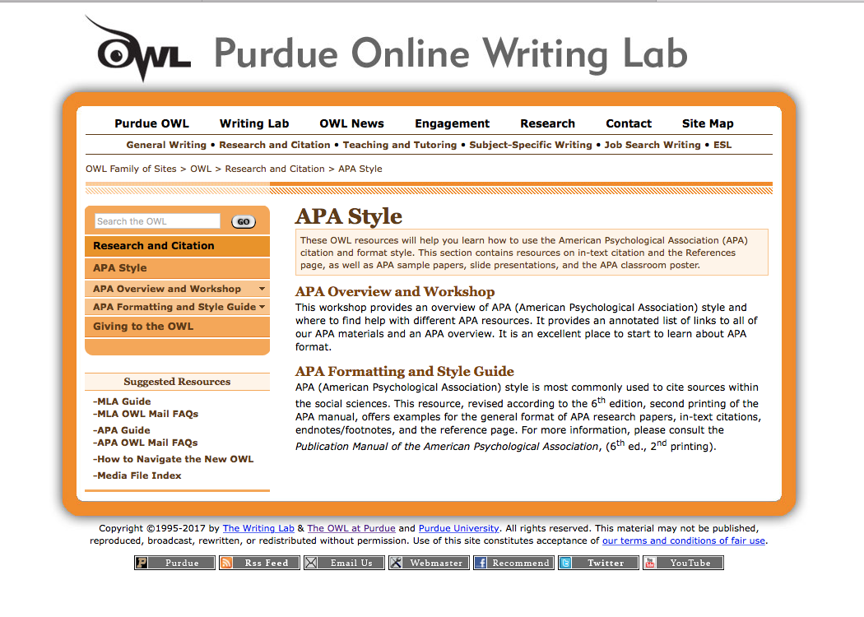

Slide 33
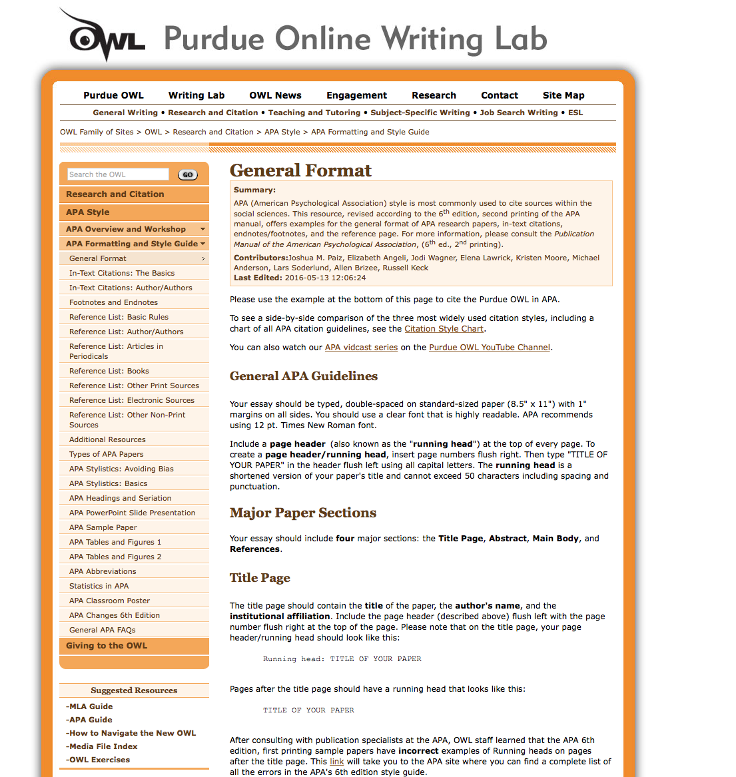

Slide 34
A Few Last Pro Tips
Write down questions that you have about the subject and add them to your paper. It helps with reaching your length and looks like you care about audience concerns.
Go to the writing lab for help with grammar and form.
Come to the library for content and citations.
Don’t use automated citation machines. I’ve been burned before

Slide 35

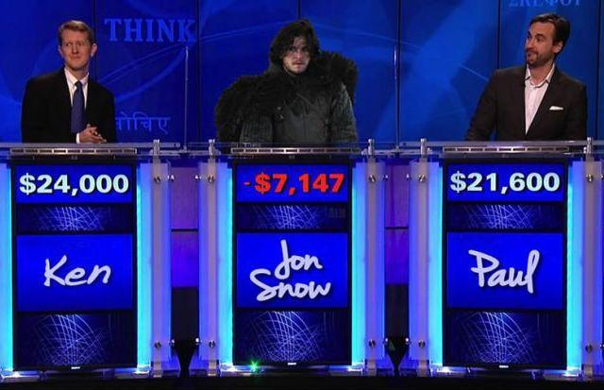
Be a Tyrion Lannister
Not A Jon Snow

Slide 36

Wait, wait! Hold up! What if I need this awesome, totally relevant INFO IN THE FUTURE?
BAM! Download it from the library site: http://westliberty.edu/library

Slide 37
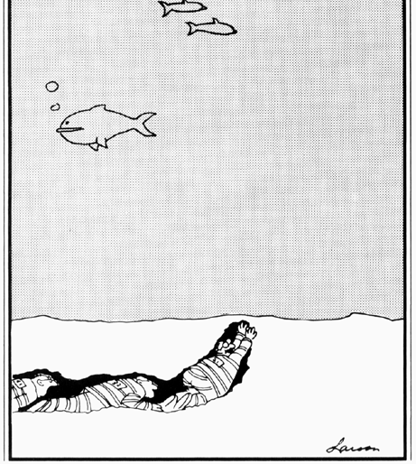
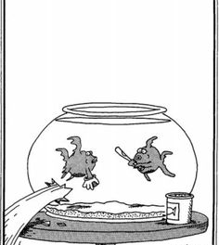
Go to and make me proud
Credit: Gary Larsen “The Far Side”

