Slide 1
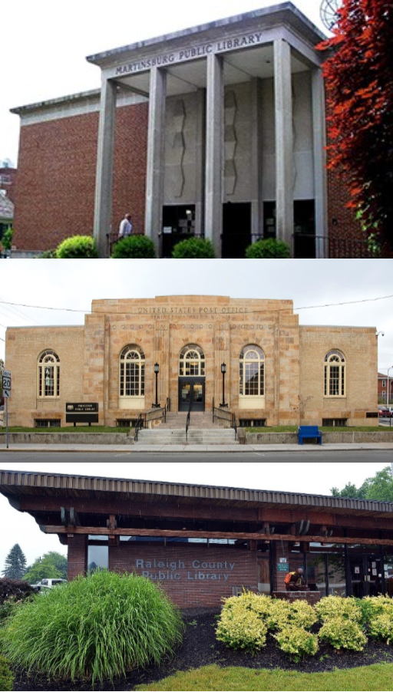
Explore
Discover
Create
FUNDING in WEST VIRGINIA LIBRARIES
WVLA Fall Conference – November 7, 2018

Slide 2
True or False
Every public library in WV is funded the same way.
Total State funding is more than total local funding.
If a local levy fails, state or federal funding will make up the difference..
Every public ibrary 69,505

Slide 3
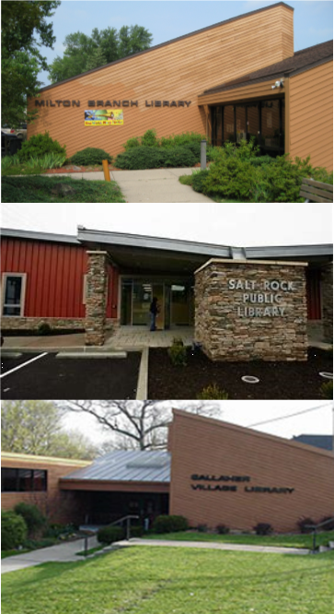
Funding Sources
Local
State
Federal

Slide 4
Local tax-based funding provides less than 50% of the total operating revenue in 48 of the 97 public library systems.

Slide 5
EXCESS LEVIES
No Levy for Libraries | 34 systems
Board of Education | 35 systems
County Commission | 17 systems
Municipality | 11 systems

Slide 6
SPECIAL LAWS
Berkeley County
Cabell County
Hardy County
Harrison County (5 libraries)
Kanawha County PL
Lincoln County
Ohio County
Raleigh County
Upshur County PL
Wood County (2 libraries)
Sistersville PL (Municipal law)

Slide 7
LOCAL NON-TAX FUNDING

Slide 8
STATE FUNDING

Slide 9
FEDERAL FUNDING

Slide 10
CAPITAL FUNDING
Library Facilities Improvement Fund

Slide 11
PERFORMANCE PRECEDES FUNDING

