Slide 1
OERs: How the WVU Libraries are working to change the textbook culture at WVU
Martha C. Yancey, Director of the Evansdale Library
Hilary O. Fredette, Director of Operations and Resource Sharing, Downtown Campus Library

Slide 2
OER Committee History
Organized as a student affordability iniative
1st Committee
Became a member of the Open Textbook Network 2016
Sponsored Open Textbook Review Workshop - 2017/2018
#Textbook Broke Survey 2018 (next slide)
Partnered with Teaching and Learning Commons Summer 2018 to develop a textbook mini-grant

Slide 4
Our work with WVU Faculty (thus far)
Open Textbook Workshop
Offered two times
Textbook Review
2 separate cohorts
Faculty read/review an OTN book
Write a review
Receive a stipend

Slide 5
SUPPORTING
THE ADOPTION OF OPEN EDUCATION RESOURCES AT WVU
Martha C. Yancey, Director of the Evansdale Library
Hilary O. Fredette, Director of Operations and Resource Sharing, Downtown Campus Library

Slide 6
Why Consider OER?
Textbooks are expensive
Faculty have direct control of textbooks and other materials used, and (sometimes) purchased, by students
OER materials are openly available and generally free
OER can help students
WVU Libraries
Notes:
Martha: We’re here to inform you about possibilities in OER and to help explain the problems that students face, financially.

Slide 7
So basically…
In many cases you can achieve the same teaching goals with open materials and there are clear benefits for students

Slide 8
Cost of attendance
Tuition and Fees
Room and Board
Books and Supplies
Personal Expenses
Transportation
WVU Libraries
Notes:
Martha: These are the costs that students need to consider when looking at school Textbooks are not the highest cost leading to these affordability issues – but it is the one cost that we as faculty can impact and it has a special impact on the academic success of students (as we’ll see later)

Slide 9
The average student should budget $1,170 for textbooks and materials in 2016-17 At WVU, it is $900
https://trends.collegeboard.org/sites/default/files/2017-trends-in-college-pricing_1.pdf
WVU Libraries
Notes:
Martha: The College Board recommends that students budget almost $1200 for each academic year. In WV, it’s slightly less.

Slide 10
WVU Libraries
Notes:
Martha: And yet textbook prices are increasing at an astonishing rate.

Slide 11
$27,708
Average debt of students who graduated from a West Virginia college or university in 2015-16
https://ticas.org/posd/map-state-data#
WVU Libraries
Notes:
Martha: The average amount of debt students in WV had when they graduated in 2016. This is an Average!

Slide 12
West Virginia Students Rank #1
77% of students who graduated in 2016 in the state of West Virginia had some debt.
That ranks the state #1 in overall proportion of students who graduate with debt.
https://ticas.org/posd/map-state-data#
WVU Libraries
Notes:
Martha: Unfortunately, one place that WV rates number 1 is in the percent of student who have debt upon graduation. 77% of students in WV graduate owing money. This places us in the number 1 spot.

Slide 13
Coping with the cost of textbooks
Purchase an older edition of the textbook
Delay purchasing a textbook
Never purchase a textbook
Share a textbook with others
Check with the library
WVU Libraries
Notes:
Martha: Here are some of the ways students deal with expensive textbooks.

Slide 14
59%
Students who say they have to wait until they receive their financial aid to purchase a textbook
WVU Libraries
Notes:
Martha: Oftentimes, students want to purchase a textbook but they are delayed by their financial aid situation.

Slide 15
“Starting an Open Educational Resources (OER) Initiative: What You Need to Know. Regina Gong. https://www.slideshare.net/ReginaGong/starting-an-open-educational-resources-oer-initiative-what-you-need-to-know-82212894 CC BY
WVU Libraries
Notes:
Martha: It’s a problem that effects all levels of higher education

Slide 16
Students (from UNCG) talk about the cost of textbooks
WVU Libraries

Slide 17
What can we do to make this easier for students?
Look for OER materials to help students afford course materials
WVU Libraries
Notes:
Hilary

Slide 18
Open Education: what do we mean?
Encompasses resources, tools and practices that are free of legal, financial and technical barriers and can be fully used, shared and adapted in the digital environment. Open Education maximizes the power of the Internet to make education more affordable, accessible and effective.
--SPARC (Scholarly Publishing and Academic Resources Coalition)
WVU Libraries
Notes:
Hilary

Slide 19
“Open Education and Co-creation” Lorna Campbell. https://www.slideshare.net/LornaMCampbell/open-education-and-cocreation-67121598 CC BY
WVU Libraries
Notes:
Hilary

Slide 20
The rate of adoption of OpenStax textbooks among faculty teaching large enrollment courses is now at 16.5%, a rate which rivals that of most commercial textbooks. This is a substantial increase over the rate observed in the previous year (10.8%).
Opening the Textbook: Educational Resources in U.S. Higher Education, 2017, Babson Survey Research Group. www.onlinelearningsurvey.com/oer.html CC BY SA 4.0
WVU Libraries
Notes:
Hilary

Slide 21
OER Myths and Facts
Myth #1: Open simply means free
Fact: Open means the permission to freely download, edit, and share materials to better serve all students
Myth #2: All OER are digital
Fact: OER take many formats, including print, digital, audio, and more
Myth #3: “You get what you pay for”
Fact: OER can be produced to the same quality standards as traditional textbooks
Myth #4: Copyright for OER is complicated
Fact: Open licensing makes OER easy to freely and legally use
Myth #5: OER are not sustainable
Fact: Models are evolving to support the sustainability and continuous improvement of OER
Myth #6: Open textbooks lack ancillaries
Fact: Open textbooks often come with ancillaries, and when they do not, existing OER can provide additional support
Myth #7: My institution is not ready for OER
Fact: Any institution can start with small steps toward OER that make an impact for students
WVU Libraries
Notes:
Hilary

Slide 22
Overview of Copyright
Copyright: Forever Less One Day
WVU Libraries
Notes:
Hilary

Slide 23
Overview of Creative Commons
Wanna Work Together?
WVU Libraries
Notes:
Hilary

Slide 24
Why are we talking about copyright? Aren’t we here to talk about OER?
Most OER materials have Creative Commons licenses
This means they can be used freely and, in many cases, revised
They can be reworked to fit your needs for your class
WVU Libraries
Notes:
Hilary: The advantages of using OER instead of trying to work with copyrighted materials.

Slide 25
Stretching Copyright…
Joseph Donica, assistant professor of English at Bronx Community College, said during a panel at the Modern Language Association convention last week that he embraced OER once he was "over waiting a month for students to buy books, and over clearly just breaking every copyright rule in the book.“
https://www.insidehighered.com/digital-learning/article/2018/01/10/finding-oer-remains-challenging-solutions-abound
WVU Libraries
Notes:
Hilary As you’ve seen from the 2 videos, it’s much easier to provide information to students using creative commons/open resources. So many faculty are trying to help students but they are often circumventing copyright. (Story about faculty at WVU and textbook on the web.)

Slide 26
5Rs: The Powerful Rights of Open
Retain
Make, own, and control your own copy of the content
Reuse
Use the content in its unaltered form
Revise
Adapt, adjust, modify, improve, or alter the content
Remix
Combine the original or revised content with other OER to create something new
Redistribute
Share your copies of the original content, revisions, or remixes with others
Adapted from “Open Education Leadership Summit 2014” Kim Thanos and David Wiley. https://www.slideshare.net/kythanos/opened-leader-summit-effective-oer-projects CC BY
WVU Libraries
Notes:
Hilary

Slide 27
Creative Commons Licenses
CC BY
All CC licenses require that others who use your work in any way must give you credit the way you request, but not in a way that suggests you endorse them or their use. If they want to use your work without giving you credit or for endorsement purposes, they must get your permission first.
CC BY ShareAlike
You let others copy, distribute, display, perform, and modify your work, as long as they distribute any modified work on the same terms. If they want to distribute modified works under other terms, they must get your permission first.
CC BY NonCommercial
You let others copy, distribute, display, perform, and (unless you have chosen NoDerivatives) modify and use your work for any purpose other than commercially unless they get your permission first.
CC BY NoDerivatives
You let others copy, distribute, display and perform only original copies of your work. If they want to modify your work, they must get your permission first.
CC BY NonCommercial ShareAlike
You let others remix, tweak, and build upon your work non-commercially, as long as they credit you and license their new creations under the identical terms.
CC BY NonCommercial NoDerivatives
The most restrictive of the six main licenses. You allow others to download your works and share them with others as long as they credit you, but they can’t change them in any way or use them commercially.
More free
Less free
WVU Libraries
Notes:
Hilary

Slide 28
Copyright vs. Creative Commons/ Open
Openly licensed materials can be used and reused legally in more ways than traditionally copyrighted materials.*
The Creative Commons encourages the sharing of ideas and research
“Traditional” copyright has become more restrictive rather than less
The Creative Commons idea is integral to the growth of the OER movement.
* "An Introduction to Open Educational Resources" Abbey Elder. https://www.youtube.com/watch?v=NtJmakm1-zc&feature=youtu.be CC BY 4.0
WVU Libraries
Notes:
Hilary

Slide 29
“Open education resources (oer)” Rosario Passos. https://www.slideshare.net/rosariopassos/open-education-resources-oer-62722840 CC BY
WVU Libraries
Notes:
Hilary: Link to article cited: https://link.springer.com/article/10.1007/s12528-015-9101-x#enumeration

Slide 30
OER Myth #3: You get what you pay for
Nine peer-reviewed studies
5,201 people surveyed
2,484 faculty
2,717 students

Slide 31
S. Cohen.
WVU Libraries
Notes:
Hilary: Open Textbooks get generally good ratings from faculty reviews.

Slide 32
Looking for OER materials
Some of the sites to find OER textbooks or other materials
Notes:
Martha

Slide 33
Open Textbook Library
WVU Libraries
Notes:
Martha

Slide 34
OpenStax OpenStax textbook projects are developed and peer-reviewed by educators to ensure they are readable and accurate, meet the scope and sequence requirements of each course, are supported by instructor ancillaries, and are available with the latest technology-based learning tools.
WVU Libraries
Notes:
Martha

Slide 35
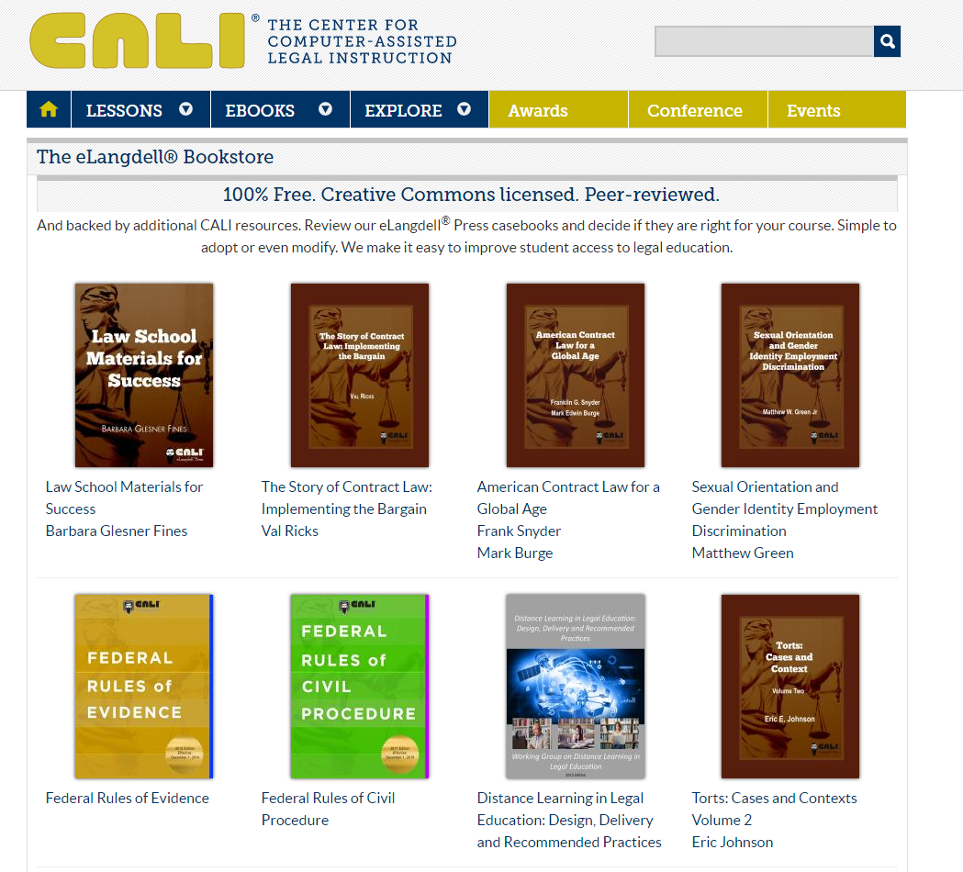
CALI
WVU Libraries
Notes:
Martha

Slide 36
OER Commons

Slide 37
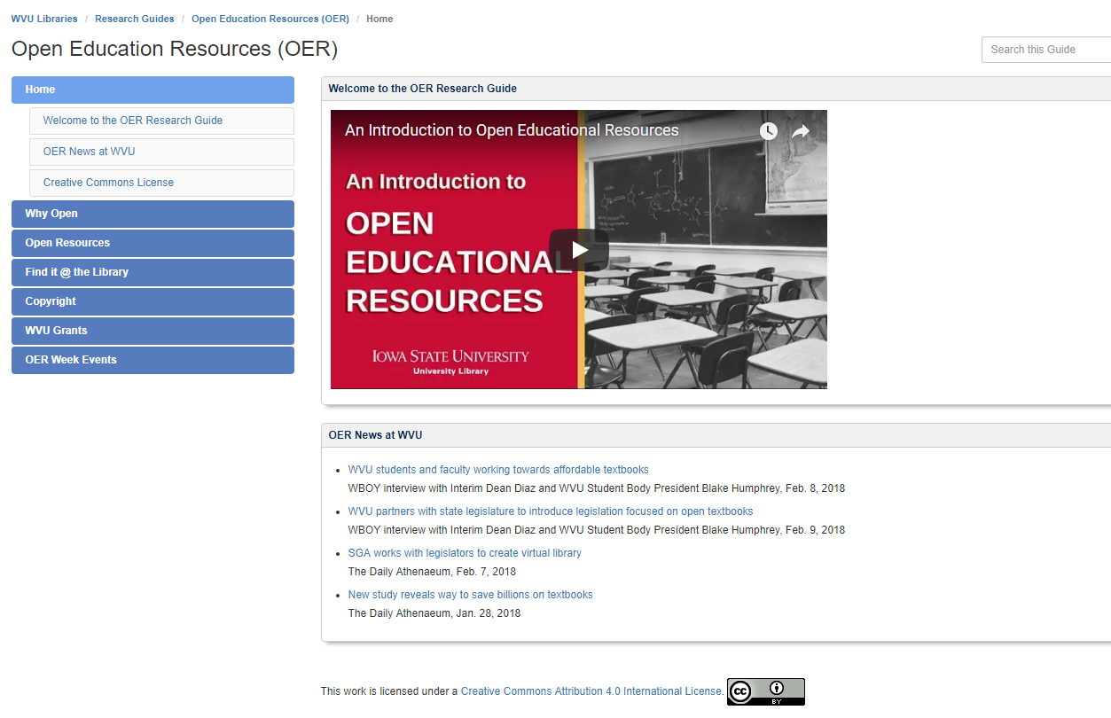
WVU Libraries OER Research Guide

Slide 38
Interested in finding OER materials beyond those mentioned today?
Work with the Liaison Librarian or Subject Specialist for your college or department
Go to “About” from the Libraries homepage
WVU Libraries
Notes:
Martha

Slide 39
WVU faculty are able make their openly accessible research materials available by depositing them with The Research Repository at WVU
A look at downloads from WVU’s Institutional Repository:
The Research Repository at WVU
WVU Libraries
Notes:
Martha

Slide 40
How to submit a review
Go to the Open Textbook Library and look at their materials
Select a book in your subject area
Read the textbook
Submit a review
Earn $200

Slide 41
Future plans for working with faculty
Encourage more OER adoptions
Develop a template for librarians to use to discuss and encourage use of OER when meeting with their departments
Continue to offer OTN Workshop
Continue to offer OTN Review stipends
Offer additional workshops to cover OER in a broader context
Develop an “OER Classroom Award” for faculty who adopt/adapt OER completely

Slide 42
Questions?

