Slide 1
An Overview of
The Open Governmental
Proceedings Act
West Virginia Library Association
Fall Conference
Drew A. Proudfoot, Esquire
Bowles Rice LLP

Slide 2
Open Meetings Act
W.Va. Code § 6-9A-1 et seq.
“Open Governmental Proceedings Act”

Slide 3
Key Provisions of Open Governmental Proceedings Act
(W. Va. Code § 6-9A-1 et seq.)
meeting Notices
Agenda Items
Executive Sessions
Public Involvement
Violations

Slide 4
Open Meetings
1975 – Open Meetings Act approved
Applies to all governing bodies of public agencies
Includes WV Library Commission meetings, committees, sub-committees, etc.

Slide 5
O.M.A.O 2008-18
Is a training workshop a “meeting” and subject to the Open Governmental Proceedings Act?
      ANSWER: YES/ NO
      If quorum of members attending to listen to a presentation and not deliberating or discussing in furtherance of a later official action, then not a “meeting” subject to open meetings law.

Slide 6
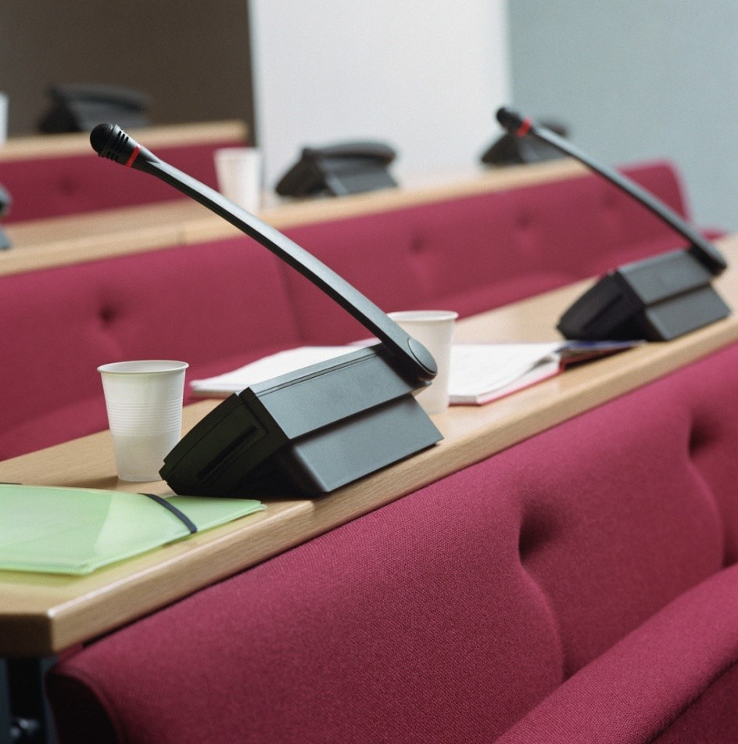
Open Meetings
Compliance requires taking certain actions before, during and after a meeting

Slide 7
Notice and Agenda
  The Open Meetings Act requires advance notice of the date, time, and place of the meeting, and an agenda of matters to be considered.

Slide 8
Meeting Notice
County & municipal agencies – provide reasonable notice
  Regular Meetings – may follow established schedule or 3 business days
  Special Meetings – provide 2 business days

Slide 9
Meeting Agenda
Regular meeting - 3 business days in advance
Special Meeting – 2 business days in advance
Business days do not include the day of the meeting, weekends or legal holidays
Post in public place by close of business on day # 1

Slide 10

Meeting Agenda
List all items requiring official action on the agenda
Official action involves anything requiring a vote of the governing body
        Either at this meeting or a future meeting

Slide 11
Meeting Agenda
Agendas need not be published – only made available
Posting in a public place meets the minimum requirements
Agencies encouraged to post on website

Slide 12
Amending an Agenda
Agenda may be amended up to two (2) business days before the meeting, except for a true emergency.
Amended Agenda must be made available to the public and media in the same manner as the original agenda.

Slide 13
Amending an Agenda
Routine matters that arise after the deadline to amend an agenda must be held over to the next regular meeting, or for a special meeting.
If an agenda is amended due to an emergency, both the meeting agenda and the meeting minutes must explain the facts and circumstances of the emergency.

Slide 14
What is an emergency?
Emergency meeting is any meeting called by a governing body to address an unexpected event requiring immediate attention because of an imminent threat to public health or safety; an imminent threat of damage to public or private property; or an imminent material financial loss or other imminent substantial harm to a public agency, its employees or the members of the public which it serves.

Slide 15
Meeting Procedures
Members may participate by telephone
Members participating by telephone must be able to hear what is said by the members who are physically present
Public present at meeting must be able to hear what is said over the phone

Slide 16
Meeting Procedures
May not vote by secret or written ballot
If participating by telephone, may not vote by text message
Voting must take place by verbal statement or show of hands
No proxy voting allowed

Slide 17
Executive Session

Slide 18
Executive Session
May only go into executive session for a reason permitted by Act – Personnel, matter of competitive negotiation, otherwise privileged matter.
Must be corresponding agenda/action item.
Must have motion to go into executive session identifying exemption.
Majority vote required to convene in executive session.
No action taken while in executive session.

Slide 19
Executive Session
Personnel – most common exemption
Hiring, firing, promoting, transfer, discipline or compensation of an employee
Employee may request open session, if asked to meet in executive session

Slide 20
Executive Session
General personnel matters are not exempt and must be discussed in open meeting
Examples: Across-the-board pay raise; supplemental health insurance; creating new positions

Slide 21

Public Comment
Public comment periods are recommended, but not mandatory
May not require speaker to sign up more than 15 minutes in advance

Slide 22
Public Comment
May set time limits for speakers
If item requires official action, place on agenda for next meeting

Slide 23
Meeting Minutes
Minutes required for all meetings
Who, what, where, and when
Follow agenda
Results of votes

Slide 24
Violations
● Intentional violations are a criminal misdemeanor subject to prosecution by the County Prosecutor

Slide 25
Some Key Opinion’s relating to
Public Agency Board Members
O.M.A.O. 2005-10
        Permits a governing body to “re-do” a meeting when it inadvertently violated the Act in a previous meeting
O.M.A.O. 2000-07 &14
        Gathering of 2 or more members to review and prepare for an upcoming meeting constitutes a meeting subject to the Act, and must be properly noticed and open to the public and press
O.M.A.O. 2009-04
        Executive Sessions (answers to common questions)
Copies and Index of most opinions may be found on the Ethics Commission website: www.ethics.wv.gov

Slide 26
Parliamentary Procedure and Tools for Meeting Management:
A Guide to Effective Meeting
Drew A. Proudfoot, Esq.

Slide 27

Meeting procedure can mean the difference between this...

Slide 28

And this....

Slide 29
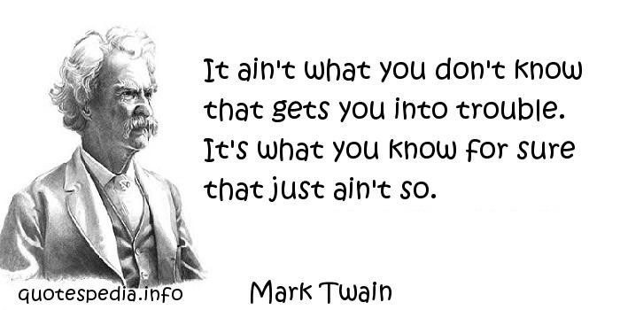
Urban Legends of Parliamentary Procedure

Slide 30
What rules must you follow?
Contract Law
Parliamentary Procedure
Employment Law
WVLC Rules
Open
Governmental Proceedings
Act
Board
Special
Rules

Slide 31
What kind of meeting is it?
Regular Business Meeting
  The most frequently encountered type
  of meeting.
Open Forum Sessions
  Meetings called not for transacting business,
  but for providing opportunity for “public comment.”
Committee Meeting
  Often held for the dual purpose of transacting business and conducting actual work.

Slide 32
What rules must you follow?
Provisions of local, state, and federal law
Rules from a parent organization
Constitution and/or Bylaws
Special rules of order adopted by the Board
Parliamentary authority
(e.g., Robert’s Rules of Order Newly Revised)
Standing rules adopted by the group
Organizational customs
(“We’ve always done it this way…”)
Search in
this direction for answers

Slide 33
Special Rules of Order
These rules are the place to handle many of the procedural issues that a board may face.
Special Rules of Order can be tailored to fit each individual commission, provided that they comply with West Virginia state law.

Slide 34
Special Rules of Order
A board might consider a special rule of order to deal with things like
  A consent calendar
  Handling debate on motions at meetings
  Procedures for allowing members of the public to address the Board
  Allowing input from staff, or requesting input from staff

Slide 35
Regular business meeting agenda
Reading and Approval of the Minutes
Reports of Officers
Reports of Boards and Standing Committees
Reports of Special Committees
Special Orders
General Orders and Unfinished Business
New Business
Good of the Order (optional)

Slide 36
Debate and process of discussing a motion: rights of the chair
The chair HAS the right to:
  Recognize members when they rise to speak
  Decide who to recognize, within certain limits, when more than one person wishes to speak
  Call members out of order and order them to
  be seated if their debates become personal
  attacks or otherwise inappropriate
The chair does NOT have the right to:
  Fail to recognize a person just because s/he disagrees with the person’s position
  Impose limitations on debate in any way
  Determine what issues the group will and
  will not consider at a meeting
During
any business meeting, it
is the chair’s responsibility to keep order.
However, that responsibility does not equal a right to be dictatorial.

Slide 37
General rules and practices for debate and recognition
Who is entitled to be recognized?
The member who made the motion is entitled to speak first if the member so chooses. However, the member does not have the right to speak last.
Debate should alternate between those in favor and
those opposed to a motion.
No member may debate a second time on any motion
until every member who wishes to do so has had an opportunity to speak once.
The person who seconds a motion has no special entitlement to recognition at any time.

Slide 38
General rules and practices for debate and recognition
Rules that Generally Govern Debate
On most debatable motions, every member is entitled to
two debates, each ten minutes in length.
No member is permitted to use language in debate that
is derogatory, slanderous, or that otherwise questions the motives of another member.
A member may not use the name of another member in debate.
Debate must nearly always be confined to the merits of the immediately pending question.
The assembly can limit or stop debate by adopting a motion to Limit Debate or for the Previous Question by a 2/3rds vote.

Slide 39
The Small Board Rules
Robert’s Rules of Order Newly Revised provides some flexibility for small boards of less than a dozen people.
Occasionally, a small board may be better served by taking on some of the characteristics of a committee rather than a deliberative assembly.
The “Small Board Rules” offer this flexibility. See RONR, pp. 487-89.

Slide 40
Small Board Rule 1 –
Recognition
Regular Rule
Small Board Rule
Members obtain recognition by standing, addressing the chair, and waiting to be recognized.
Members remain standing to speak in debate or make motions.
Members may be recognized by simply raising their hands or otherwise signaling to the chair a desire to be recognized.
Members may speak from their seats.

Slide 41
Small Board Rule 2 –
Seconding Motions
Regular Rule
Small Board Rule
Typically, no proposal can be brought before the meeting unless it is moved by one member and seconded by another.
This guarantees that at least two members want the proposal to be considered.
Motions do not require a second.
Members may make motions, and the chair may take a vote on motions, without the need for a second.

Slide 42
Small Board Rule 3 –
Limits on Debate
Regular Rule
Small Board Rule
For most debatable motions, a member may speak only two times on each motion.
There is no limit to the number of times each member may speak in debate.

Slide 43
Small Board Rule 4 –
Informal Discussion
Regular Rule
Small Board Rule
No discussion is allowed in the absence of a motion.
Debate is allowed only on the merits of the motion immediately pending.
The board may engage in informal discussion about a subject in the absence of a motion.
Such a process is often necessary in order for a motion to develop.

Slide 44
Small Board Rule 5 –
Voting without a Motion
Regular Rule
Small Board Rule
The chair puts the question to a vote in the precise way it was offered in a member’s motion.
A motion may be changed only by the amendment process.
Where a proposal is perfectly clear to all members, the chair may take a vote on a proposal without a motion having been made.
However, the required vote thresholds still apply.

Slide 45
Small Board Rule 6 –
The Chair May Sit
Regular Rule
Small Board Rule
The chair presides over the meeting while standing.
Any time the chair addresses a member, takes a vote, or makes a ruling, she or he does so while standing.
The informality allowed by the Small Board Rules permit a chair to remain seated while putting a question to a vote or presiding over debate.

Slide 46
Small Board Rule 7 –
Participation by the Chair
Regular Rule
Small Board Rule
The chair is a neutral presiding officer and does not actively participate in the meeting.
If the chair wishes to speak in debate or make motions, she or he must vacate the chair.
If the chair is a member of the board, she or he may speak in debate, make motions, and vote without leaving the chair.

Slide 47
#1 – “Parliamentary Procedure” and “Robert’s Rules of Order” are the Same.
While this old line is familiar to many, it isn’t quite accurate.
“Parliamentary procedure” refers to the general rules for conducting a business meeting.
“Robert’s Rules of Order” refers to a specific book of rules.

Slide 48
#2 – Adopting Robert’s Rules of Order puts too much restriction on our group.
Understand what Robert’s Rules of Order (“RONR”) actually is and what it is not.
RONR is a set of default rules that guide a group when the group has no rule of its own.
RONR does not, and is not meant to, restrict how the group does its business.

Slide 49
#3 – We can say we follow Robert’s Rules of Order, but we can still do what we want in our own meetings.
This is a half-truth, which makes it one of the most dangerous Urban Legends.
RONR provides a mechanism to suspend certain rules when necessary, but adopting a parliamentary authority creates a contract between the group and its members.

Slide 50
#4 – The President sets the agenda.
Generally speaking, this is false.
Unless there are rules that provide differently, it is up to the group to determine for itself what it will and will not consider at its meetings.
The chair/president has only the authority that the group gives him or her.

Slide 51
#5 – We have to allow the public to attend our meetings.
This is true for public boards.
For public entities, the state Open Governmental Proceedings Act applies.
For regular nonprofit groups, it is perfectly fine to go into executive session for the entire meeting. Not so for a public board.
HOWEVER, the public has no absolute right to participate in the meetings.

Slide 52
#6 – I can just say “I call the question” and the group has to take a vote.
This is always false.
An assembly can order the previous question, which stops debate, but a single person can’t make it happen, not even the chair.
It takes a 2/3 vote to stop debate, or to limit it in any way.

Slide 53
#7 – We need to have all our rules in our bylaws.
The bylaws are the place for structural rules and those that are so important that they should never be suspended.
Other procedural rules can go in a separate body of rules, the Special Rules of Order.
Separation makes the Special Rules suspendable.

Slide 54
#8 – The president can only vote to break a tie.
West Virginia law is very clear that a board president is a member of the board for all purposes, including making motions and voting.
This may be different than what the public (or some board members) is used to seeing in community groups.

Slide 55
#9 – We can’t talk about something that wasn’t on our agenda.
This may or may not be true. It depends on what you mean by “talk about something”.
For entities subject to the Open Governmental Proceedings Act (like county commissions and public boards), prior notice to the public is required prior to taking action on anything. But what about setting the agenda items?
For regular nonprofit entities, this is false.

Slide 56
#10 – We have to present the motion three separate times before we vote.
This rule comes from legislative bodies that follow their own parliamentary procedures.
It may be true for a public board, but that depends on what the action item is and what state law says about it.
No rule of parliamentary procedure prohibits a group from making decisions in a single day.
In fact, parliamentary procedures encourage it.

Slide 57
Drew A. Proudfoot, Esq.
Bowles Rice LLP
125 Granville Square, Suite 400
Morgantown, West Virginia 26501
(304) 285-2566
dproudfoot@bowlesrice.com

Slide 58
We’re here to help. Contact us if we can ever guide you through a problem.
Drew A. Proudfoot
dproudfoot@bowlesrice.com
(304) 285-2566

