Slide 1

Text Sets:
Building Knowledge and Vocabulary

Slide 2

WV Leaders of Literacy
Campaign for Grade-Level Reading
Components
School Readiness
Attendance
Extended Learning
High Quality Instruction
Notes:
Intro Campaign and Session Objectives

Slide 3
The Goal
Increase the number of WV children reading proficiently by the end of third grade
Zip Code Lottery

Slide 4
Five Essential Studies
Hernandez 2011, “Double Jeopardy”
Lesnick et al 2010, “Reading on Grade Level in Third Grade: How Is it Related to High School Performance and College Enrollment?”
Fletcher and Lyon 1998, 74% of 3rd graders who read poorly will still be struggling in 9th grade.
Snow et al 1998, “A person who is not at least a modestly skilled reader by the end of third grade is quite unlikely to graduate from high school.”
Juel 1988, 1st grade reading scores are a “reliable predictor of later reading scores.”
Notes:
Hernandez 2011 from the Annie E. Casey Foundation showed that students that are not reading proficient by third grade are 4 times less likely to graduate from high school on time than students who are reading proficiently in 3rd grade.
These 5 studies all suggest that if you are not reading successfully by at least the third grade your chances of catching up are low. This is both distressing and puzzling. Why would scores so early be such a strong predictor of outcomes later?

Slide 5
Why?
How is it that tests so early can predict results so many years later?
What are we doing in schools that might be perpetuating these trends?
What are we not doing in schools that might be perpetuating these trends?
Why does the gap between struggling and proficient readers increase the longer they are in school?
Notes:
Chart ideas and share out – ideas and brainstorming
Give participants time to think on their own about each of these questions and to discuss or share out. In particular emphasis to them the point implied by the 4th question: the gap grows the longer students are in school.

Slide 6
What are not the causes?
Lack of critical thinking
Failure to know or use comprehension strategies
Failure to master the standards
Notes:
Tell them that we are going to look at some research and illustrations to explore this question more thoroughly, but that it’s worth starting with some common sense.
Lack of critical thinking is not likely to be the issue for at least two reasons:
Third grade reading tests don’t do a terribly good job of testing critical thinking. Mostly they seem to be tests of simple recall or comprehension, yet they are still predicting a wide variety of future outcomes.
Students seem to be able to think critically about a wide variety of topics that interest them. They routinely make inferences, analyze, draw connections and synthesize when talking about their sports, their arts, their social lives. For example, how quickly are students able to infer your moods or predict your behavior based on subtle clues from just a look on your face. But as soon as you put a piece of paper with text in front of them they seem to suddenly lose their ability to think critically.
Failure to know or use comprehension strategies also doesn’t seem like the likely cause.
Comprehension strategies are a lot like critical thinking i.e. making inferences, asking questions, predicting. Again students seem to do these things a lot, just not about material in print.
We have spent at least a decade or more heavily focusing our instruction on comprehension strategies. In fact it’s one of the dominant focus points of American educational practice across the country. And yet it seems not to have had much impact on this problem at all. If comprehension strategies were the problem, our efforts would likely have improved the problem, but so far they haven’t, as evidenced by studies a decade or more apart showing very similar results.
Failure to master the standards is probably not the issue either.
Once again the standards are similar to comprehension strategies are similar to critical thinking.
Moreover, much of this research occurred before most states even had standards. In addition standards have varied widely across states, but these results are remarkably consistent across geography. The advent of nationwide standards-based reform in the 90’s to the 2000’s didn’t seem to change this relationship.

Slide 7
Quick Quiz:
WHICH IS HARDER?

Slide 8
Question 1: Literal Meaning
Low on Bloom’s Taxonomy
Restate the following sentence in your own words:
Notes:
Emphasize that restating or paraphrasing is a very low-level skill that doesn’t require much critical thinking.

Slide 9
“The former render possible theoretical cognition according to principles a priori; the latter in respect of this theoretical cognition only supplies in itself a negative principle (that of mere contrast), but on the other hand it furnishes fundamental propositions which extend the sphere of the determination of the will and are therefore called practical.”
Notes:
Passage taken from pg. 1 of Immanuel Kant’s Critique of Judgment.

Slide 10
Question 2: Synthesis
High on Bloom’s Taxonomy
Read the following passage, then write a letter to the editor defending the moral values the main character displays with regard to animals.
Notes:
Emphasize that this task asks students to do a wide range of critical thinking including, inferring a character’s attitude based on their behavior, generalizing that to a set of moral values, then predicting what such a character might say in defense of those values, thinking about the audience of newspaper editor, and composing a piece of writing that presents an argument. Seems very difficult.

Slide 11
“Where's Papa going with that ax?" said Fern to her mother as they were setting the table for breakfast.
"Out to the hog house," replied Mrs. Arable. "Some pigs were born last night.“
"I don't see why he needs an ax," continued Fern, who was only eight.
Notes:
Passage taken from page 1 of Charlotte’s Web, by E.B. White.

Slide 12
"Well," said her mother, "one of the pigs is a runt. It's very small and weak, and it will never amount to anything. So your father has decided to do away with it.”
"Do away with it?" shrieked Fern. "You mean kill it? Just because it's smaller than the others?"

Slide 13
Which question was easier?
Why?
Would a lesson (or a whole week of lessons) on “finding main idea” or “making inferences” help you to answer question 1?
Notes:
Everyone should recognize that the first question was much harder and that this had something to do with the text, not just the questions being asked. Some may already be hypothesizing that vocabulary or knowledge have a lot to do with why we couldn’t answer the first question. You don’t need to confirm or point this out to them yet. It becomes clear soon.

Slide 14
What are not the causes?
Lack of critical thinking
Failure to know or use comprehension strategies
Failure to master the standards

Slide 15
Everyone knows knowledge plays a role in comprehension, but how big of a role?
Notes:
No one disputes that prior knowledge is important to comprehension, but when students struggle with comprehension, we rarely focus on building knowledge as our primary intervention. Instead we practice comprehension strategies, attempt to build stamina, or simply ask kids to practice.
When many things seems important, knowing how big the impact of each factor is, helps us to choose an area to focus on.

Slide 16
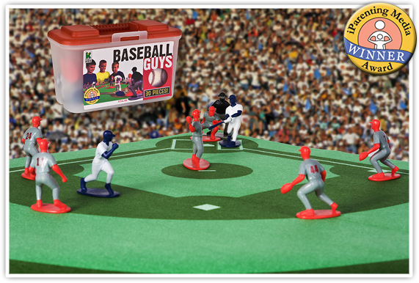
“The Baseball Study,”
Recht & Leslie (1988)
Notes:
Recht and Leslie sought to answer exactly this question, by comparing the relative impact of reading ability to the impact of knowledge of a topic. They had students read a passage about baseball and then tested students comprehension of the passage.
“Effect of Prior Knowledge on Good and Poor Readers‘ Memory of Text” from Journal of Educational Psychology 1988, Vol. SO, No. 1, 16-20
Had 7th and 8th grade students read a short text about baseball and tested them for comprehension using:
Verbal retelling
Reenactment with figurines
Verbal summary
Rating ideas from the story in terms of importance.

Slide 17
“The Baseball Study,”
Recht & Leslie (1988)
Compared reading comprehension for four categories of students:
High reading ability High knowledge of baseball | High reading ability Low knowledge of baseball
Low reading ability High knowledge of baseball | Low reading ability Low knowledge of baseball
Notes:
The students in these 4 groups read a passage about baseball and then took a test of their comprehension. Ask participants to predict what % of questions on a reading comprehension test each category of student would get right. Draw a grid on their paper and put an actual % of predicted questions correct in each quadrant.
Technical Notes:
High reading ability was defined as 70th percentile or higher on a standardized test of reading. Low reading ability was defined as 30th percentile or lower.
High knowledge of baseball was defined as 70th percentile or higher on a test of baseball knowledge. Low baseball ability was defined as 30th percentile or lower.

Slide 18
Notes:
After they predict percentages, show them this slide and give them a minute to take it in. They should notice that the low reading ability students with high knowledge outperformed the high reading ability students with low knowledge. In addition there is little difference between the two high knowledge groups and the two low knowledge groups.
Frequently Asked Questions:
Is this study generalizable? Yes! In fact a European study replicated the finding exactly with students of a totally different background on the topic of soccer. Additional research has shown similar results on a wide variety of other topic and subject areas.
Is the impact here from knowledge or from interest? Knowledge. It’s hard to disentangle these variables, but a separate study using basketball was able to distinguish the two and found that the one that had the major impact was knowledge.
If knowledge is so important does this undermine the value of close reading? No. Close reading teaches students how to gain knowledge from text by attending to it carefully. But, as we will soon discuss, high volume reading of informational text is also necessary to build the base of knowledge and vocabulary necessary to succeed with close reading. This is a BOTH, AND type of question, not an either or.

Slide 19
Findings
Knowledge of the topic had a MUCH bigger impact on comprehension than generalized reading ability did. (pg. 18)
With sufficient prior knowledge, “low ability” students performed similarly to higher ability students. (pg. 19) The difference in their performance was not statistically significant.
Notes:
The second bullet point here has a big implication for student scaffolds. By helping students build their knowledge, “low readers” can perform at levels similar to “high readers.”

Slide 20
A student doesn’t have ONE level.
Each student has MANY LEVELS depending on topic & knowledge.
Notes:
This research is in direct opposition to current instructional practice where we identify a reader by an F & P level, and if you are a level J then you read only level J books. But a level J reader on science passages may be a level T reader on explorers, if they have knowledge of that topic. By letting them read only level J texts we deny them access to more complex text that they could access and learn from on a topic on which they have knowledge.

Slide 21
Vocabulary
Research has shown that when it comes to risk factors for vocabulary development, poverty trumps race, urban vs. rural community, limited English proficiency, and language impairments.
Vocabulary interventions have to be powerful enough to accelerate, not just incrementally advance word learning for students coming from low-income households to narrow the achievement gap.
(Marulis and Neuman, 2011)

Slide 22
Vocabulary
By the time they reach school age, low-income children have heard fewer words than higher-income children.
30,000,000
fewer

Slide 23
Students cannot build knowledge and vocabulary without a high volume of reading.
Most words are learned through reading or being read to.
Building knowledge helps level the playing field for students.

Slide 24
Not all high-volume reading is equally effective!
Research into vocabulary acquisition shows that students acquire vocabulary up to four times faster when they read a series of related texts.
Reading a number of texts within a topic grows knowledge and vocabulary far faster than any other approach.
                (Landauer and Dumais)
Notes:
30 million word Gap - Contrast this to the typical way we do business where we skip around from topic to topic, plants today, tree mammal tomorrow, the colonies the day after. Instead we need to spend time reading several texts within the same topic in order to build knowledge and vocabulary faster. With the huge volume of words and huge bodies of knowledge that students need to learn, we can’t afford to not use the most effective, fastest way to gain this knowledge.
The research referenced here is what led to the creation of the idea of text sets: a thoughtfully sequenced series of texts designed to build knowledge and vocabulary.

Slide 25
Text Sets
Book Baskets
Library of informational texts organized by topic
Each basket is organized from least complex to most complex
Companion Text Sets
Set of related texts that go along with an existing close reading lesson to build additional knowledge about the topic
Include short culminating writing tasks
Expert Packs
Build knowledge to create “experts” on an informational topic
Include an annotated bibliography and text complexity that gradually increases
Offer activities that can be structured in a variety of ways
Research Packs
Build knowledge in preparation for writing about a Next Gen. science topic
Include writing component with scaffolds for teachers and students
Encourage a gradual release of responsibility with whole group, small group, and individual activities

Slide 26

WV Library Commission
Text Set Lending Library - Request Form
Notes:
Local Level Support

Slide 27
Text Set Project Expert Packs
Research Packs
Companion Text Sets

Slide 28

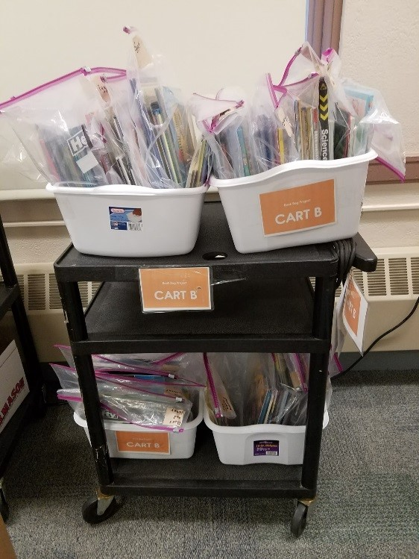
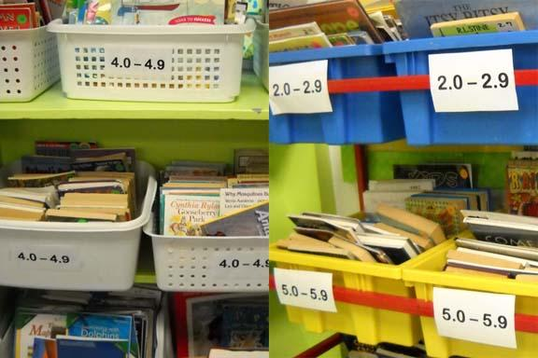
Book Baskets, Libraries, and Book Bags
Notes:
There are many ways in which classroom teachers and school librarians make decisions about how to display and organize texts for independent reading in the classroom. Organizing book baskets, selecting texts to go in student book baggies, and/or setting up shelves in school and classroom libraries are just a few of the many options under consideration.

Slide 29

Time to change the libraries!
Instead of levels-- try TOPICS!
Let’s see what happens to students’ reading engagement, enthusiasm, and motivation when they select books based on what they want to read about, rather than their level!

Slide 30
Getting Started with Book Baskets
Articles
Designing Classroom Libraries that Build Knowledge, Vocabulary, and Engagement
How to Create Book Baskets
Handout
Create a Successful Book Basket
Start a School-Wide Project
Book Basket Project

Slide 31

How to create topically coherent Book Baskets
1. Identify great texts. Sort your existing classroom library into collections of 3 or more texts. Can you group your existing texts by the same conceptually connected topic? Wherever possible, ensure that the texts have similar vocabulary and content. The depth and nuance of the topic will vary based on the grade level and resources)
2. If needed, expand the text set with additional resources. Looking for more free texts to round out your collections? Try:
  Readworks.org
  Newsela.org
  Activelylearn.com
  Commonlit.org
  Getepic.com (free for elementary school teachers and librarians)
  Any additional website that provides clear, readable information on a topic
Notes:
Here are the steps to making your own book baskets. Let’s review the process! (continued on the next slide)

Slide 32
How to create topically coherent Book Baskets
3. Order the texts in sequence. Start with the text that provides the broadest introduction to the topic, and/or is easiest to read. Consider sequencing the remaining texts in a way that builds more understanding -- either from simplest to most complex, or based on the knowledge demands of the subject. One way to think about this is, “Have I provided a resource to help my reader understand an upcoming challenge in the text?” Consider adding websites or videos to round out the set, if the technology in your classroom allows.
4. Label your bins, bags, etc. based on the topic.
5. Introduce the book baskets to your class. Tell your students they will be able to pick the sets they are interested in and become experts on a topic or character.
6. Help students select texts that they are interested in, and monitor their comprehension to ensure that they are able to access the content.
Notes:
You may want to give your teams time to discuss number 5 - what considerations for teaching emerge? What will they have to do differently to introduce independent reading this way?

Slide 33
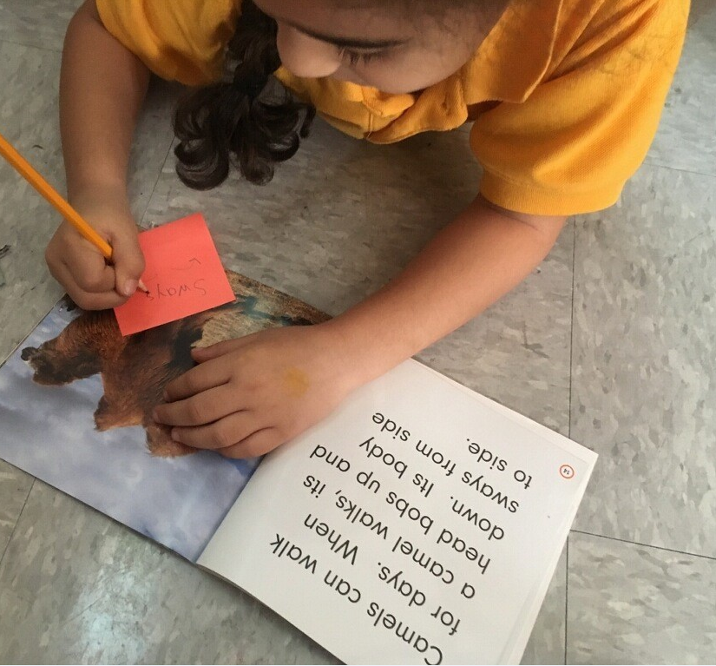
How to create topically coherent Book Baskets
7. Encourage students to read* a full set: in sequential order. This can be done in a variety of ways: independent reading, within small group instruction, or even within a full class if the texts support a concept the class is studying.
8. Ask questions like “What do you want to know about?” and “What have you learned?” instead of “What is your level?”
9. Keep going! Collaborate with your school librarian (if you have one), fellow teachers, and your students, to identify topics and texts for new book baskets.

Slide 34
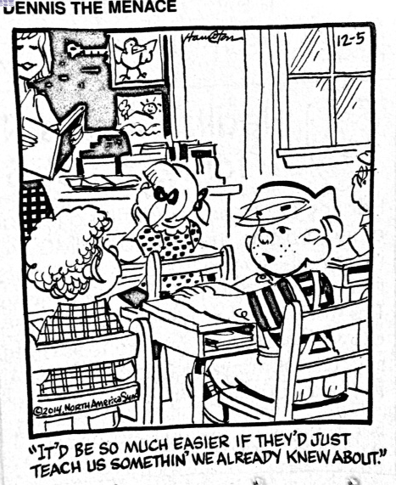
Notes:
Big Idea: We all can relate to this!
Though this is just a comic, this is the idea behind text sets. To take what students already know something about and build on it.

Slide 35



Tracy Komorowski
tbkomorowski@k12.wv.us

