Slide 1
Hey, J-J-Jaded
Surviving Everyday Librarianship
(To viewers who downloaded this from the WVLA/MDS site: Be sure to review this presentation with the “Notes” as there is pertinent information in them. How? Look for “Notes” at the bottom of your screen.)
Notes:
Remember to read the notes for each slide! They will go into more detail.

Slide 2
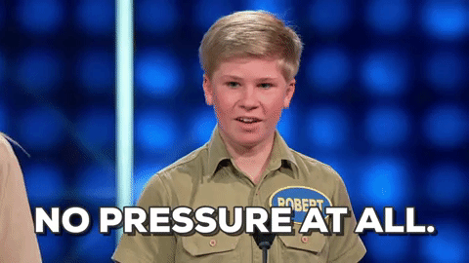
Looking Forward to the next 100 years of innovation in WV Libraries
Envision:
Notes:
(This image is a gif when viewed in presentation mode)

Slide 3
“Yeah, you're so jaded - And I'm the one that jaded you.”
YouTube: https://youtu.be/qbexOeoH5hg
Lyrics: https://www.azlyrics.com/lyrics/aerosmith/jaded.html
Notes:
LOL Areosmith!

Slide 4
Burnout
Why We’re Here
Notes:
Now, as promised, the following slides will have helpful notes.

Slide 5
How it all begins…
“As an individual disengages from work, job burnout is likely to occur.”
Rahim & Cosby, 2016
Notes:
Okay, maybe not this one…

Slide 6
What is burnout?
Feelings of cynicism and detachment
A sense of ineffectiveness and lack of accomplishment
Overwhelming exhaustion
- Maslach and Leiter, 2016
Notes:
2016 article by Maslach and Lieter - they identified three components of burnout.
Exhaustion was assumed to develop first, in response to high demands and overload.
This would precipitate detachment and negative reactions to people and the job (depersonalization or cynicism).
If this continued, then the next stage would be feelings of inadequacy and failure (reduced personal accomplishment or professional inefficacy).
They stated “The significance of this three‐dimensional model is that it clearly places the individual stress experience within a social context and involves the person's conception of both self and others.”

Slide 7
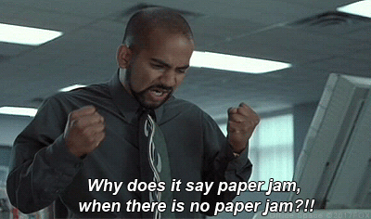
1980’s Foundational Theories
How Burnout Forms:
job stressors
individual strain
defensive coping
- Cherniss, 1980
Notes:
job stressors (an imbalance between work demands and individual resources)
individual strain (an emotional response of exhaustion and anxiety)
defensive coping (changes in attitudes and behavior, such as greater cynicism)

Slide 8
1990’s (still supported)
Burnout arises as a result of persistent threats to available resources.
The loss of resources or even the impending loss of resources may aggravate burnout.
- Hobfoll & Freedy, 1993
Notes:
One theory assumes that burnout arises as a result of persistent threats to available resources.
When individuals perceive that the resources they value are threatened, they strive to maintain those resources.
The loss of resources or even the impending loss of resources may aggravate burnout.

Slide 9
2000’s (still supported)
The greater the mismatch between the person and the job, the greater the likelihood of burnout; conversely, the greater the match, the greater the likelihood of engagement.
- Leiter & Maslach, 2004
Burnout arises when individuals experience incessant job demands and have inadequate resources available to address and to reduce those demands.
- Bakker & Demerouti, 2007

Slide 10
Can you relate?

Slide 11
Why this is bad.
Interpersonal aggression
Lower productivity
Low organizational commitment
Absenteeism
Turnover
Intention to leave job
- Maslach and Leiter, 2016
Notes:
Burnout has been frequently associated with various forms of negative reactions and job withdrawal, including job dissatisfaction, low organizational commitment, absenteeism, intention to leave the job, and turnover. For example, cynicism has been found to be the pivotal aspect of burnout to predict turnover, and burnout mediates the relationship between being bullied in the workplace and the intention to quit the job. On the other hand, for people who stay on the job, burnout leads to lower productivity and impaired quality of work. As burnout diminishes opportunities for positive experiences at work, it is associated with decreased job satisfaction and a reduced commitment to the job or the organization.

Slide 12
Burnout can be… CONTAGIOUS
- Maslach and Leiter, 2016
Notes:
People who are experiencing burnout can have a negative impact on their colleagues, both by causing greater personal conflict and by disrupting job tasks. Thus, burnout can be “contagious” and perpetuate itself through social interactions on the job.

Slide 13
But wait, there’s more!
Stress-related health issues
Exhaustion
Muscle tension
Hypertension
Headaches
Gastrointestinal disorders
- Maslach and Leiter, 2016
Notes:
A ten‐year longitudinal study of industrial workers found burnout to predict subsequent hospital admissions for cardiovascular problems.
Another study found that an increase in burnout reflected an increase in risk for hospital admission for mental health problems, as well as an increase in risk for hospital admissions for cardiovascular problems.
There are also other studies that have provided a more detailed examination of the link between burnout and cardiovascular disease.

Slide 14
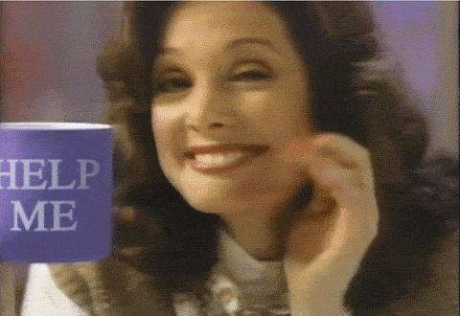
Why we’re really here…
Notes:
But: it’s not all doom and gloom. There are a lot of professions who are aware of the problems occurring in the workplace today that can lead to burnout. So, now that we understand how burnout can occur and the factors that contribute to it, we’re going to try to overcome or avoid it.

Slide 15
Engagement
The Opposite of Burnout
Notes:
I’ve mentioned the term disengagement a few times, and if you’ll remember that introductory slide, one study stated “As an individual disengages from work, job burnout is likely to occur.”
Since the opposite of disengagement is engagement, this concept will play a very important role in overcoming or avoiding burnout.

Slide 16
As opposed to disengagement
Engagement
A state of high energy
Strong involvement
A sense of efficacy
- Maslach and Leiter, 2016
Notes:
- Maslach and Leiter, 2016

Slide 17
Avoiding Burnout
And becoming more engaged
Notes:
So, how do we become more engaged? How do we organically form high energy, how do we stay involved, and where do we find that missing sense of value?

Slide 18
Workplace
Home
Self-care
Strategies
- Maslach and Leiter, 2016
Notes:
On this handout (attached to the end of this presentation), you’ll see the definition at the top, followed by three types of strategies that research shows can be really effective: workplace, home, and self-care.

Slide 19
Fish! Philosophy
Pike Place Fish Market, Seattle: https://youtu.be/onGi6b5BSXQ
1. Choose your attitude
There is always a choice about the way we do our work, even if there is not a choice about the work itself.
We can’t control how other people act, but we can control how we react.
2. Play: take our jobs seriously, but conduct our day in a fun way whenever it doesn’t interfere with work; let things flow efficiently
3. Make their day: find creative ways to engage customers/patrons and respectfully include them
4. Be there: Learn how to be present, fully engaged, inviting.
Condensed: It’s All About Choice: https://youtu.be/zh6kJVxu0gY
“We can either choose to commit, or choose to be in a bummy mood.”
Notes:
The Fish! Philosophy was created by John Christensen, who visited the Pike Place Fish Market in Seattle and noticed the workers there had a lot of energy, provided great customer service, and never seemed to be bothered by their cold, repetitive, hard work. After observing the workers and talking with them, he identified 4 techniques that they were unconsciously using to achieve world-famous status.

Slide 20
Words of Wisdom
“What influences change is control.”
Change You: “Work harder on yourself than on your job.”
Skip Prichard, CEO of OCLC
2018 OCLC Americas Regional Council Conference,
October 25, 2018
https://americanlibrariesmagazine.org/blogs/the-scoop/game-changers-libraries-oclc/
Notes:
Skip Prichard says: ”Change your frame; Change your culture; Change your mindset; Change the narrative; Change you.
Regarding the final point, Prichard said he once received valuable advice. If you work harder on yourself than on your job, he said, you will [in turn] change your potential and have the ability to change your organization. On the flipside, what we need to keep, he said, are our values, principles, purpose, and passion.”

Slide 21
Tough Truths
Are you a perfectionist? Is your burnout self-imposed? You need to stop beating yourself up over the things you can’t realistically accomplish. Instead: Pick three things to do each day, and do them well. *
Everyday is a choice. Your choice. (Fish! Philosophy)
If you don’t like any of these strategies, which are backed up by research, then you need to find a new job, or maybe even a new career. (See: Slide 9)
If you think you’re not the problem: focus on what you can change, not what you can’t change.
* https://www.purewow.com/family/randi-zuckerberg-pick-three?utm_medium=email&utm_source=Money&utm_campaign=32506&utm_content=Money_editorial and https://www.theatlantic.com/health/archive/2018/11/how-perfectionism-can-be-destructive/574837/?utm_source=digg&utm_medium=email

Slide 22
Remember why you’re a librarian
https://acrlog.org/2018/10/18/one-of-todays-lucky-ten-thousand/
Notes:
One: We are [librarians] to teach people the things they don’t already know. If students already knew how to find resources or write citations or even where the classroom is, what would they need me for at the reference desk?
Two: Everyone has to learn a thing before they know it.
FRAME 1
I try not to make fun of people for admitting they don’t know things.
Because for each thing “everyone knows” by the time they’re adults, everyday day there are, on average, 10,000 people in the US hearing about it for the first time.
Fraction who have heard of it at birth = 0%
Fraction who have heard of it by [age] 30 = 100%
US Birth rate = 4,000,000/year
Number hearing about it for the first time = 10,000/day
FRAME 2
If I make fun of people, I train them not to tell me when they have those moments. And I miss out on the fun.
“Diet coke and Mentos thing? What’s that?” “Oh man! Com on, we’re going to the grocery store.”
“Why?” “You’re one of today’s lucky 10,000.”

Slide 23
The End.*
Remember: we are information professionals, and you now you have credible, up-to-date information about the causes and effects of burnout. That means you can take this information to your supervisors/administrators to begin a meaningful conversation about how to overcome burnout if it is happening to you or your team. Your boss can’t fix a problem if they don’t know it exists, so you have to find the courage to start the conversation, and this information will help.
*But not really: the content from handout mentioned previously in this presentation can be found on the remaining slides.

Slide 24
Avoiding Workplace Burnout
Definition
Burnout is a psychological syndrome emerging as a prolonged response to chronic interpersonal stressors on the job. The three key dimensions of this response are an overwhelming exhaustion, feelings of cynicism and detachment from the job, and a sense of ineffectiveness and lack of accomplishment. The significance of this three‐dimensional model is that it clearly places the individual stress experience within a social context and involves the person's conception of both self and others. (Maslach & Leiter, 2016).
Workplace Strategies
Change work patterns: work less, take more breaks, avoid overtime work, balance work/home life
Develop coping skills: cognitive restructuring, conflict resolution, time management
Obtain social support: from colleagues in your workplace and in your profession
Utilize relaxation strategies: meditation, music, uninterrupted reflection time
Promote good health and fitness: get out of your office or building as much as possible
Develop a better self‐understanding: via various self‐analytic techniques, counseling, or therapy

Slide 25
Recovery (Home) Strategies
Self-Care Strategies
Take regular breaks from work – if you have time, use it!
Advocate for better social recognition of the difficult work that is being accomplished
Focus on the positive aspects of life, both at work and home, so that you are not overwhelmed by adversity and misery
Be mindful of psychological wellbeing, via support groups, therapy/counseling, prayer, meditation, or religious services
Fish! Philosophy
Choose your attitude 2. Play 3. Make Their Day 4. Be There
Exercise | Nutrition | Better sleep | Support group | Hobbies / personal interests

Slide 26
References
Awesome burnout article where I got basically all of the information for the handout and my presentation:
Maslach, C., & Leiter, M. P. (2016). Understanding the burnout experience: recent research and its implications for psychiatry. World psychiatry: Official journal of the World Psychiatric Association (WPA), 15(2), 103-11.
Fish! Philosophy:
Lundin, S. C., Paul, H., & Christensen, J. (2014). Fish: A proven way to boost morale and improve results. London: Hodder & Stoughton.
Funny yet insightful blog entry for librarians sick of repetitive tasks:
https://acrlog.org/2018/10/18/one-of-todays-lucky-ten-thousand/

