Slide 1
Making Mental Health a Priority: “Don’t Call Me Crazy,” The Marshall University Mental Health Initiative
Presented by: Kacy Lovelace, Sarah Mollette, and Michelle Alford -Marshall University

Slide 2
Introduction:
Don’t Call Me Crazy

Slide 3
Introduction
Born from the desire to exhibit Marshall University community artwork every year.
Mental Health chosen as our theme to highlight the significant needs of West Virginia for mental health assistance and education.
Art exhibition expanded to include other components as we realized that we could provide multiple forms of help.
Don’t Call Me Crazy
Resiliency through Education
Resiliency through Art
Resiliency through Community
Notes:
(Michelle) Earlier this year, we held our first art exhibition at Drinko Library, “Nevertheless, she Persisted: Marshall University’s Women’s Exhibition.” This theme sought to highlight the disparity between the number of working artists who identify as women and the number of artworks by women present in museums.
The response was incredible, with more than 90 pieces of artwork showcased by 32 unique artists, all women from the Marshall University community. The idea for the art exhibition came from Sabrina Thomas, an instruction and research services librarian at Drinko. Sabrina and I will also be presenting this mental health initiative at the ALA conference in June 2019.
We loved showcasing the art pieces in the library, and the first exhibition was so successful, that we knew that we wanted to repeat the experience, yearly, if possible. While discussing our potential theme for 2019, Sabrina and I landed on mental health. Immediately, we knew that we had an idea that we could, and should, expand beyond an art exhibit; there were so many avenues that we could explore, using our skills as library professionals to provide education and support for those who live with and are touched by mental illness every day. Soon, the “Don’t Call Me Crazy,” mental health initiative blossomed into an extensive collaboration between the MU Libraries, MU Women’s Center, and MU Counseling Center.
(Kacy) According to the West Virginia Department of Health and Human Resources, “The prevalence of poor mental health in West Virginia is significantly higher at 16% than the U.S. prevalence of 11.7%.” In fact, West Virginia ranks number 1 in the United States for self-reported poor mental health. At the same time, “approximately 14.6% of West Virginia adults could not afford needed medical care in the past year.” We looked at this disparity and we saw a need. A need to provide education and campus and community support, in addition to the creative expression that the art exhibition would provide. We arrived at three major components for our initiative: Resiliency through Education, Resiliency through Art, and Resiliency through Community.
(Sarah) This initiative would not have been successful without the hard work and contributions of many people, including: Sabrina Thomas; a primary architect of the initiative as well as art exhibition juror, Melissa Yungbluth; former curator and planner for the art exhibition, Heather Stark; art exhibition juror, Michelle Alford: Library Information Systems Technologist, Leah Tolliver, Women’s Center Coordinator and Tennika Phillips: Mental Health Specialist from the MU Counseling Center who were all responsible for strategic planning and communications, including contacting and confirming the mental health professionals who sat on our discussion panels. After the project began to take shape, Extra Help Librarian Kacy Lovelace was commissioned to create a research guide for the initiative.
From a few months of planning, action, and passion for the potential good that we saw possible, came an initiative that we are incredibly proud of, and one that we believe could be repeated with great success in other academic libraries across West Virginia.
West Virginia Department of Health and Human Services. (2016). West Virginia Behavioral Risk Factor Surveillance System Report 2016, West Virginia Department of Health and Human Services. www.wvdhhr.org/bph/hsc/pubs/brfss/2016/BRFSS2016.pdf

Slide 4
Part 1:
Don’t Call Me Crazy: Resiliency through Education

Slide 5
Resiliency through Education:
Research Guide
Panel Discussions
Recommended Reading
Recommended Workbooks
Notes:
The first component, Resiliency through Education, consists of our research guide, panel discussions with mental health professionals, recommended books and recommended workbooks.

Slide 6
Research Guide
Provide rationale
Collect and organize the various components of the initiative
Provide information about upcoming events, including the art exhibition
Provide resources for self-help and help from the community
http://libguides.marshall.edu/mentalhealth
Notes:
The entire initiative is supported, foremost, by the research guide. The research guide provides rationale for the overall initiative, it provides information about scheduled events, it collects and organizes the various components of the initiative and provides a guide to campus, community, and national mental health resources.

Slide 7
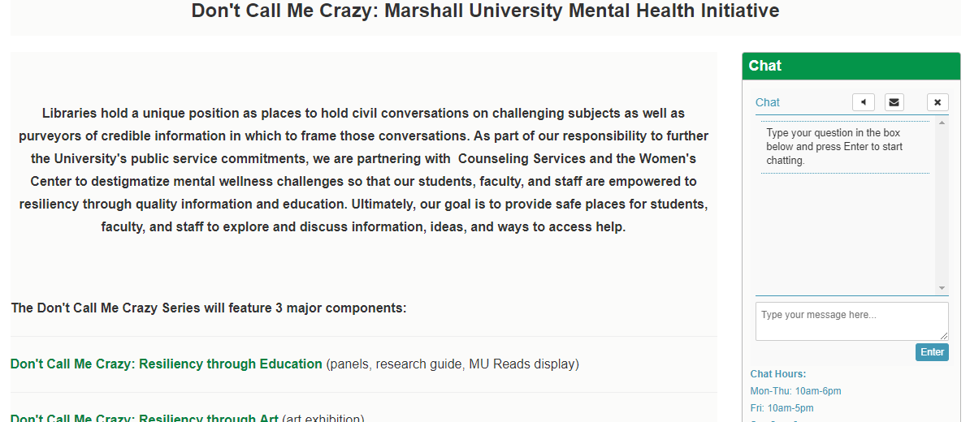
Notes:
Our rationale for the initiative is found on the home page of the research guide: “Libraries hold a unique position as places to hold civil conversations on challenging subjects as well as purveyors of credible information in which to frame those conversations. As part of our responsibility to further the University's public service commitments, we are partnering with Counseling Services and the Women's Center to destigmatize mental wellness challenges so that our students, faculty, and staff are empowered to resiliency through quality information and education. Ultimately, our goal is to provide safe places for students, faculty, and staff to explore and discuss information, ideas, and ways to access help.”
On the home page, the three components are listed as is pertinent information about the mental health discussion panels. Another important component of the research guide is the Ask-a-Librarian chat widget that appears on almost every page of the research guide. It was important to us that students have as many ways to ask for help as possible.

Slide 8
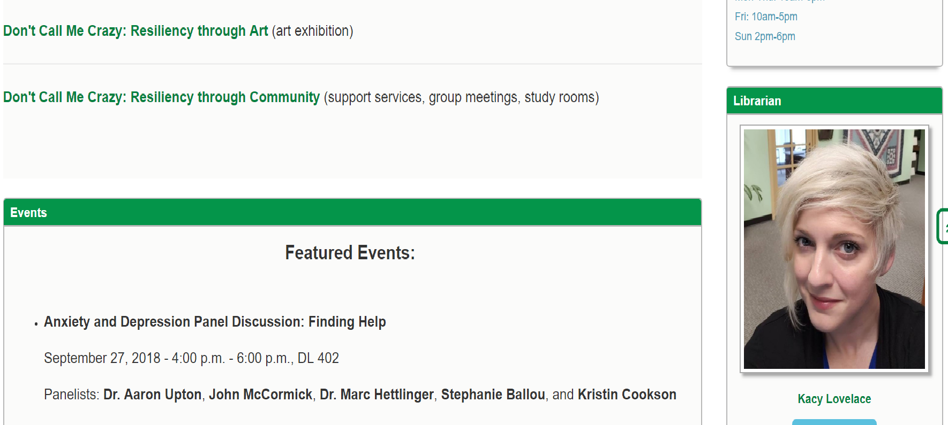
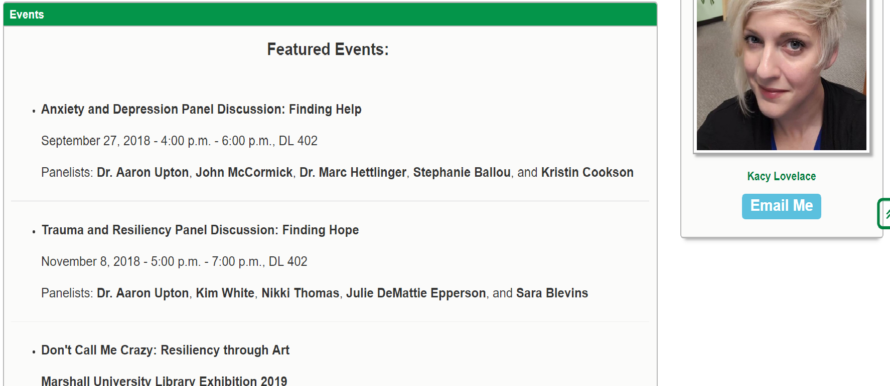

Slide 9
Panel Discussions
Provide in-person information from experts about specific topics in mental health
Allow students, faculty, staff, and community members to get answers to their mental health questions
Live stream via Facebook
Notes:
This takes us to the Resiliency through Education page. Basic information is found about each panel discussion as well as in depth information about the upcoming panel discussion. Currently, in depth information is available for our Trauma and Resiliency Panel Discussion, which takes place tonight, so biographical information is available for each panelist.
The panel discussions provide in-person information from experts about specific topics in mental health, The panel discussions allow students, faculty, staff, and community members the opportunity to ask any questions that they may have about mental health. And while the first panel discussion was not live streamed, the one tonight, and each subsequent panel discussion, will be live streamed.

Slide 10
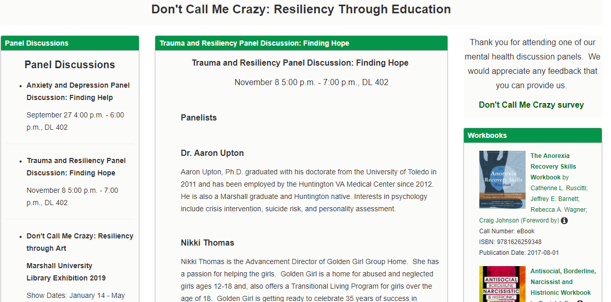
Notes:
There is a lot of information on the Resiliency through Education page, so I’ve divided it between a few slides so that you see the major components, including the recommended reading and workbooks lists. And I will show you the actual research guide in a few minutes as well.

Slide 11
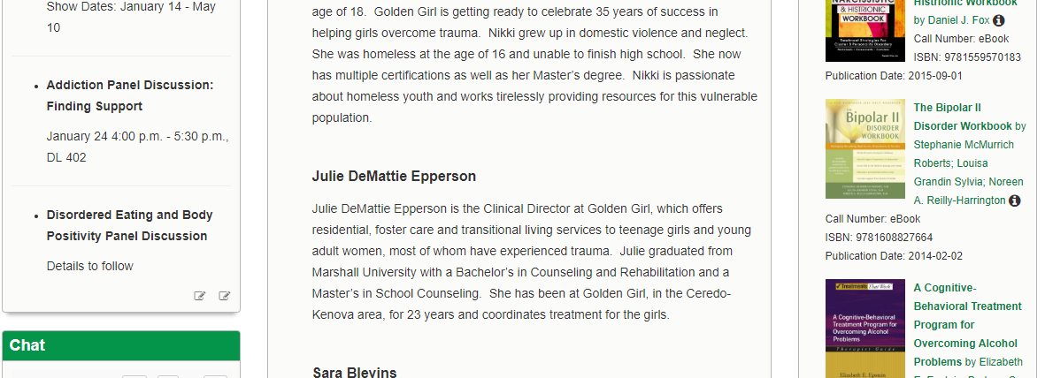

Slide 12
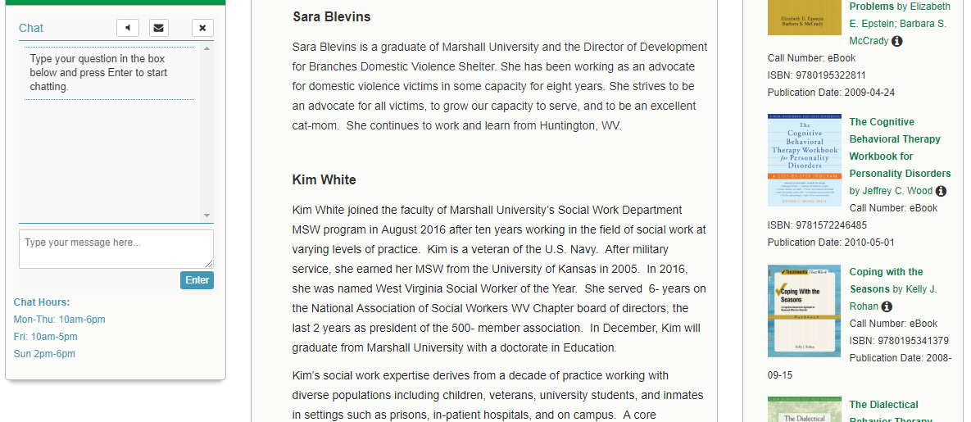

Slide 13
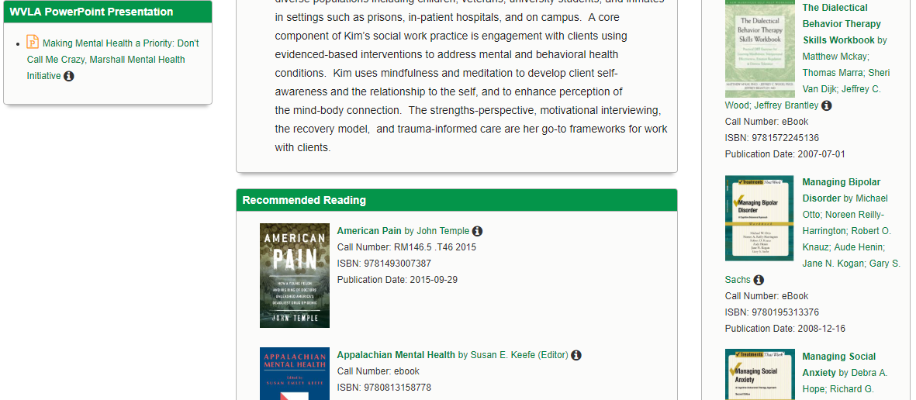

Slide 14
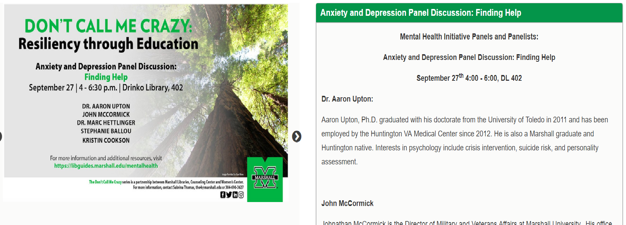
Notes:
After each discussion I will create a separate page with the event information and biographical information of our panelists, photos from the event (and these photos are careful to only include panelists and library faculty and staff), as well as a list of the questions that the event moderator, Sabrina Thomas, asked the panel.
On these two slides, you can see the page that I have created for the first panel discussion that was held on September 27th, “Anxiety and Depression Panel Discussion: Finding Help.” That is the flyer and digital signage that we used to promote the event.

Slide 15
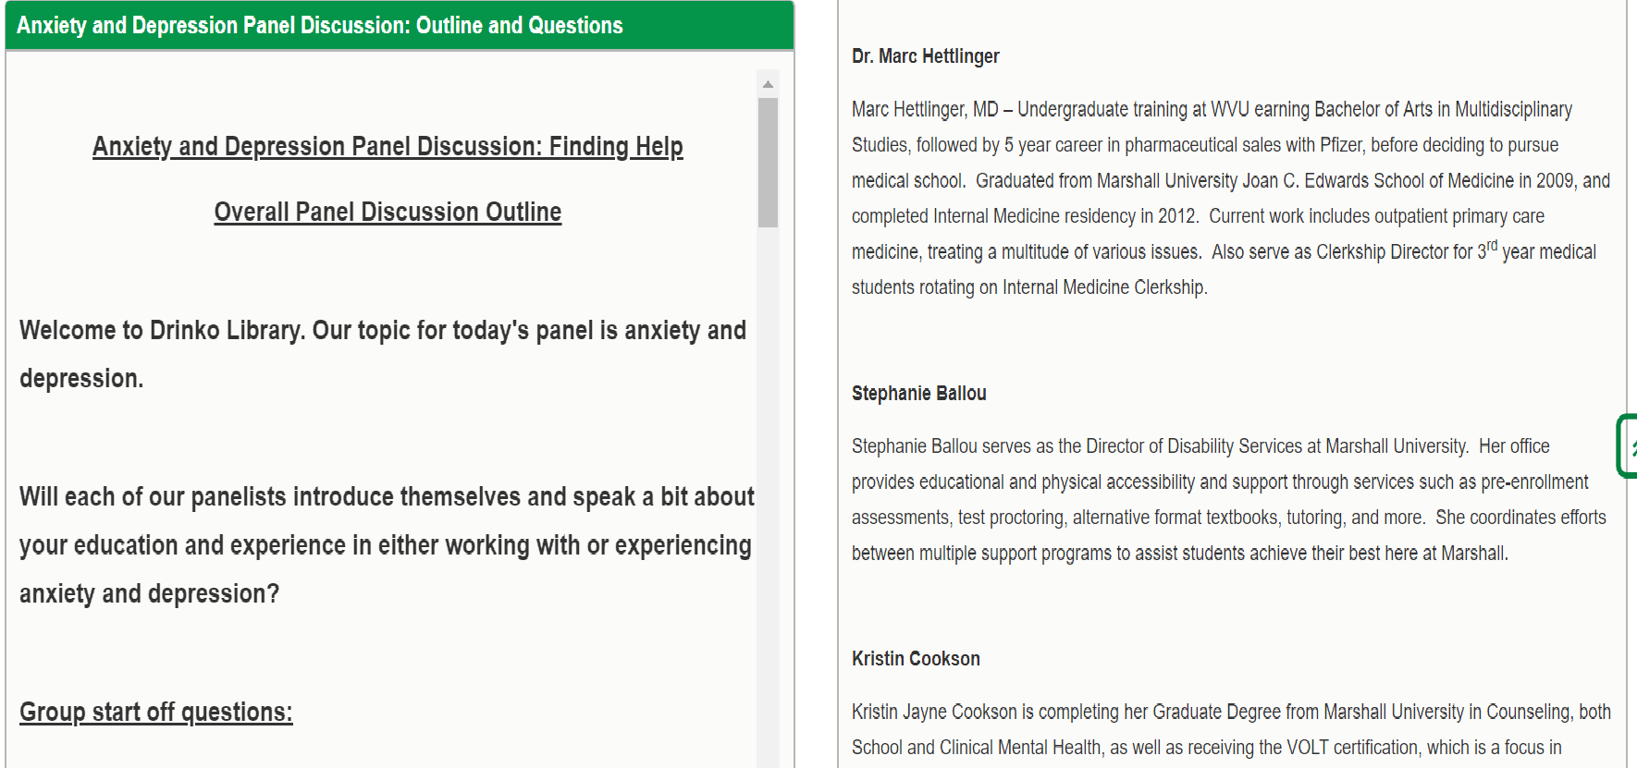

Slide 16
Recommended Reading
Includes books available from MU’s catalog. Those that were not available were added.
Includes reference materials and works of non-fiction, such as Appalachian Mental Health and Mental Health Issues and the University Student.
https://libguides.marshall.edu/mentalhealth
Notes:
So we saw the beginning of the recommended reading list on a previous slide. Many of the titles on this page were compiled by Tennika Phillips from the Counseling Center, with a few supplemental titles added in based on what we had available in the catalog already, including Appalachian Mental Health and Mental Health Issues and the University Student.

Slide 17
Workbooks
Included to allow for self-help
All titles are e-books for immediate access
Cover topics that are the focus of each discussion panel
Notes:
I also discovered that our Ebscohost and ProQuest eBook collections had dozens of self-help workbooks, so these were included for anyone who is hesitant or afraid to reach out for help. The titles cover topics that are the focus of our discussion panels as well as a few others.
I will quickly show you the actual research guide now, and then I will hand things over to Michelle.

Slide 18
Part 2:
Don’t Call Me Crazy:
Resiliency through Art

Slide 19
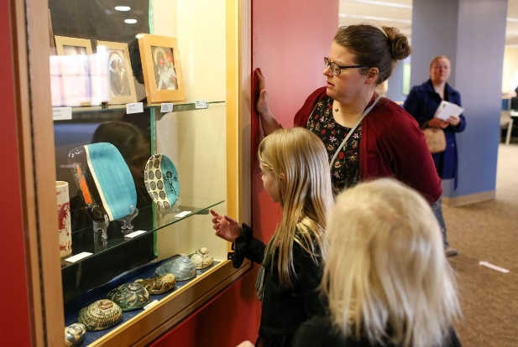
It started with an art exhibition…
Credits
Sabrina Thomas - Coordinator and planner for art exhibition, lead for mental health initiative
Melissa Yungbluth - Former curator and planner for art exhibition
Michelle Alford - Planning committee for mental health initiative
Leah Tolliver - Planning committee for mental health initiative
Tenikka Phillips - Planning committee for mental health initiative
Kacy Lovelace - Creator of research guide
Spring 2018, Nevertheless, She Persisted
Photo credit Sholten Singer/The Herald Dispatch 1/25/18
This photo was taken during the opening for the Nevertheless She Persisted Art Exhibition that ran from Jan.-May 2018 in the Drinko Library.

Slide 20
Opening for Nevertheless, She Persisted
Expanding the Theme
The exhibition brings in approximately 50 guests opening night. Campus and community comments are positive.
Discussion in the student conduct committee has slowed.
Discussion about marketing the Spring exhibition leads to a committee and collaboration with the Women’s Center and the Counselling Center.
Decision is made to add a series of panel discussions targeting specific mental health issues, such as trauma and addiction.
Live streaming
After our first panel we decided to work with our IT department to plan to have the Nov. 8th panel live streamed to our library Facebook feed in order to expand our audience.
02
04
06
2017
Spring 2018
Summer 2018
Fall
2018
Q1
Q2
Q3
Q4
Jan.
Feb.
Mar.
Apr.
May
Jun.
Jul.
Aug.
Sep.
Oct.
Nov.
Dec.
01
03
05
07
Nevertheless she persisted
Don’t Call Me Crazy
Resiliency Through Education
Don’t Call Me Crazy Exhibition
Sabrina Thomas begins work with Melissa Yungbluth to establish Drinko Library’s 1st major art exhibition.
She also works on a student conduct committee to address ways to help students dealing with anxiety and depression.
Planning for a Spring 2019 art exhibition begins. The theme of mental health awareness and resiliency is picked.
The first of the discussion panels goes well, with 6 panellists and 11 attendees.
Our online anonymous question form works out wonderfully.
Opening for the Spring 2019 exhibition set for Jan. 31st 2019.

Slide 21
Areas to improve:
Drop off procedures
Addition of virtual tour to website
Exhibition map/program
Plan for photographers to document the event

Slide 22
Don't Call Me Crazy: Marketing an Initiative
Creative marketing
Study rooms

Slide 23
Part 3:
Don’t Call Me Crazy:
Resiliency through Community
Notes:
I joined Marshall in August of this year, and much of the work for the library’s involvement in this initiative was very much underway.
So, the first thing I have to say about my colleagues is how remarkable it is that they did this with little to no outreach/programming experience, at least not in the formal sense. They had all worked on events previously, including the “Nevertheless, She Persisted” exhibit, but the instinct and passion they have brought to this initiative is what has made it so successful.
I have previous experience as an Outreach Librarian and am currently working on outreach at Marshall, so when Kacy invited me to speak on the community aspect, I knew that it would be easy, mostly because she had already done all of the work in compiling information for the research guide.

Slide 24
Resiliency through Community:
It Takes a Village
Use of SpringShare
Opportunities for Growth
Notes:
So, I’m going to talk to you about a few things today:
Why it’s important for a university library to provide resources for the communities they serve
How we used SpringShare to enrich the sharing of these resources
A few things we’ve learned along the way

Slide 25
It takes a village
Outreach is simply defined as “the extending of services or assistance beyond current or usual limits.” (Merriam Webster).
Goals: be visible and be active
Academic libraries have priorities, and the non-campus community is on that list.
Notes:
For any academic library, there are really two types of communities: on-campus, which includes students, staff, and faculty; and, off-campus, which consists of the local area residents. Whenever the library hosts an event, we try to make it clear that both types of communities are welcome. We don’t charge for admission, and there are often subjects being covered that can benefit all types of attendees.
Admittedly, some of the time, the non-campus community tends to float near the bottom of our priority list, and we may not specifically target our marketing to them, but we hope they see it. However, for the mental health initiative, it was really important that we understand the responsibility that Marshall has to our surrounding area, especially when Huntington is frequently making local and national headlines for all the wrong reasons. We knew that the problems facing our students were problems being faced by people everywhere, so reaching out to the citizens of the tristate was one component of this initiative that we knew we couldn’t ignore.
With these resources and events, we have been able to show the our Marshall community, as well as the Huntington and tristate residents, all the ways in which help is available to them. (NOTE: next slides are screenshots)

Slide 26
Notes:
Obviously, academic libraries differ from public libraries because we have sort of a built-in community of students and faculty. As librarians, we wanted to make sure that our students and event attendees were aware of all the resources available to them.
So the first thing to put on our community page was where they can get help on campus, and in this screenshot you can see we have our campus map next to a list of these resources, which includes the Counselling Center, Wellness Center, Psychology Clinic, Tutoring services. Farther down on this list includes information for Disability Services, Veteran’s Services, Students with Autism Spectrum Disorder, and our walk-in clinic.

Slide 27
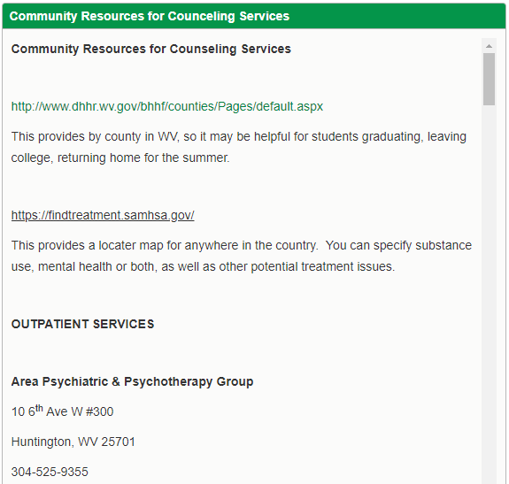
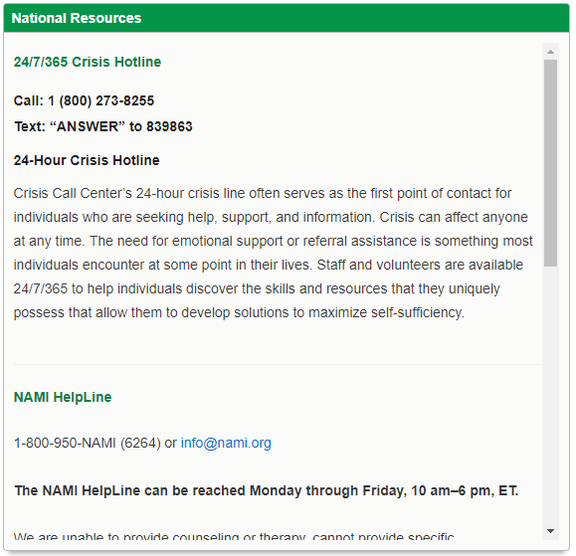
Notes:
Because there was such a strong possibility that community members would find our page after seeing a social media post or attending an event, we wanted to make sure they had the appropriate and credible information to sources available at both local and national levels.
For the local resources, Kacy found information for a Huntington Psychiatric and Psychotherapy group, Goodwill Family Services Counseling, domestic abuse support services, opioid treatment centers, and other community resources for family issues, substance abuse issues, and other behavior therapies.

Slide 28
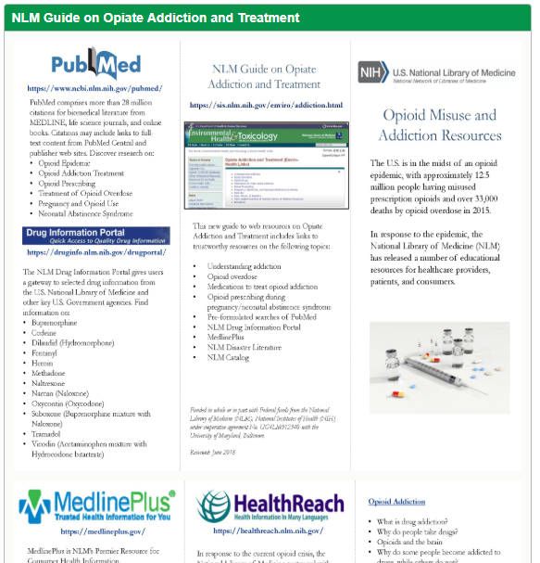
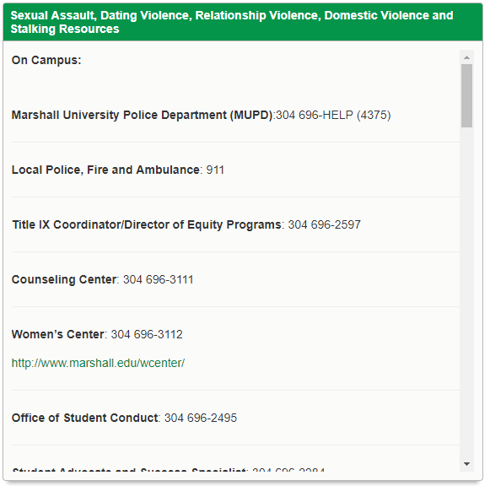
Notes:
Because there is a depressingly large number of adverse things that can impact people, Kacy also listed resources for on-and-off campus help regarding sexual assault, dating/relationship/domestic violence, and stalking.
She also found a really awesome guide from the US National Library of Medicine on opiate addiction and treatment.

Slide 29
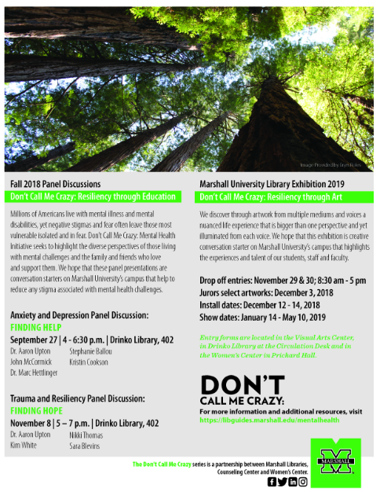
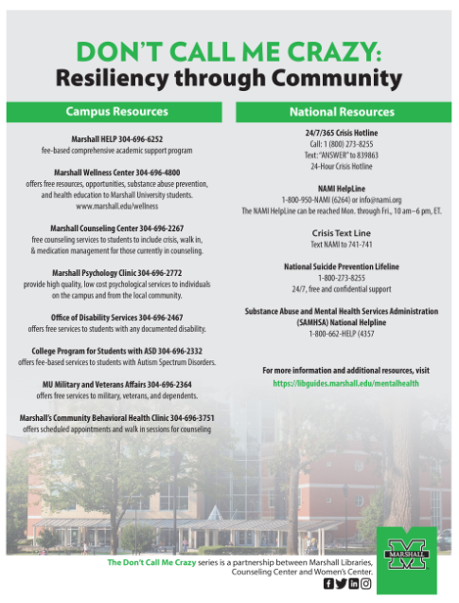
Notes:
We have a really great university communications team that we work with and they created these flyers and informational sheets for us for the events and resources.

Slide 30
Use of SpringShare
Research Guide
Anonymous question submission form
Track number of questions
Provide a safe space
Encourage participation
Notes:
You just saw the Research Guide, and I will say this as a late-comer to the project: it’s very possible that by seeking out and collecting information, we accidentally educated ourselves. At least that’s what happened with me!
But there was another online component to our panel discussions that really turned out to be successful.
How many of you currently have access to SpringShare and/or have used it in the past? I know sometimes I have a love/hate relationship with it, but for this initiative, I feel like their products were really good at meeting our needs. This seems like a weird “#plug” but I swear it’s not.
I’m talking about the LizWizard form option.

Slide 31
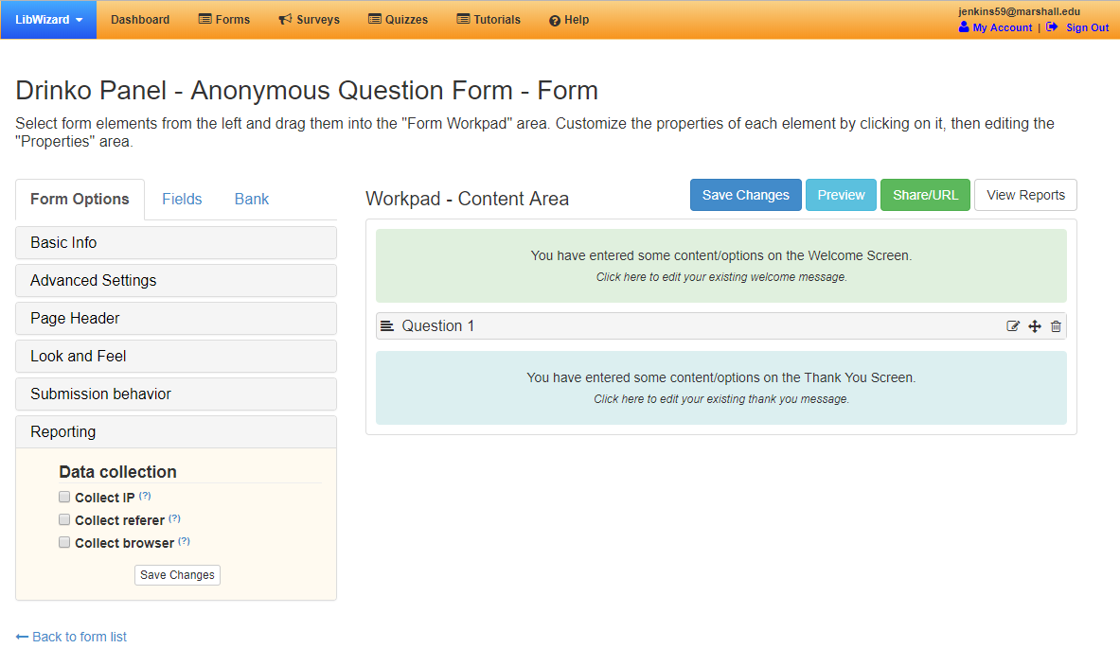
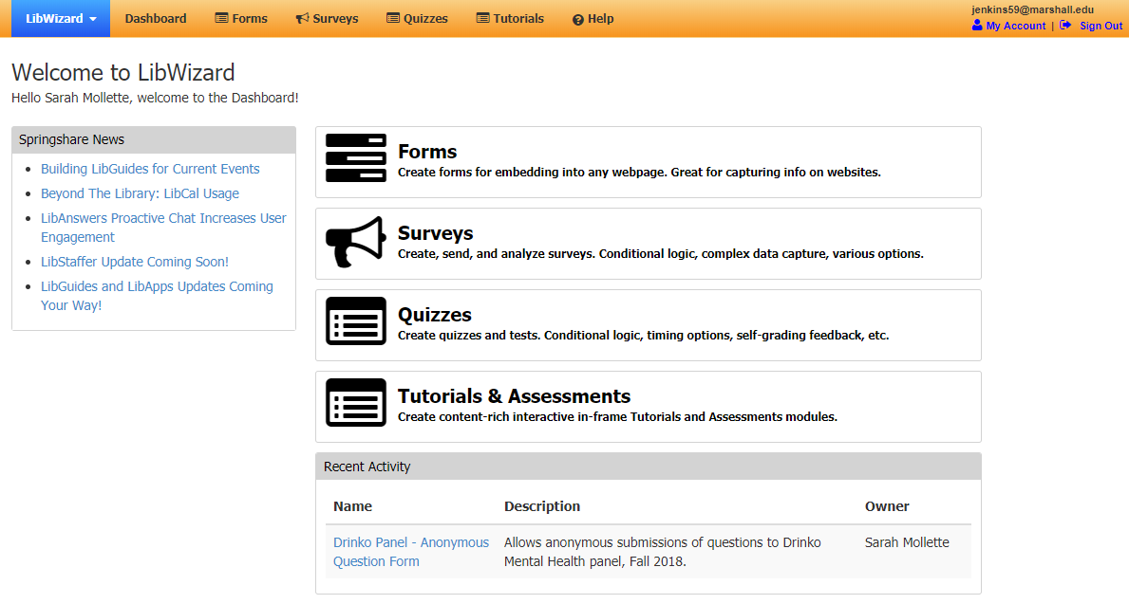
Notes:
One aspect we realized we needed for our panel discussions was the use of an anonymous form so that our event participants could submit questions that they may not necessarily want to ask out loud, for whatever reason. So by using the LibWizard form options in SpringShare, we were able to give those attendees a voice. There are some statistical advantages to this, in that we could simply track the number and nature of the questions asked, but we primarily did this so we could provide a safe space for these participants and allow them to receive the answers and the help that they otherwise may not have received. Based on the number of questions we got this way, I think it’s safe to say that we encouraged a bit more participation than we may have seen without the form.

Slide 32
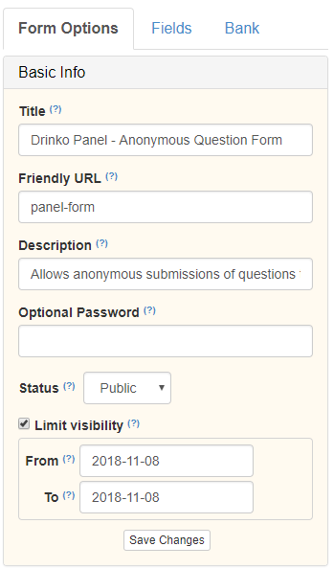
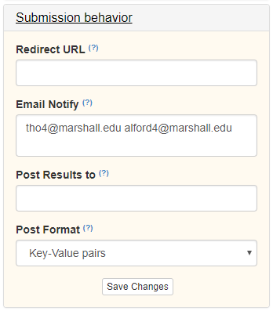
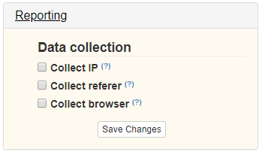
Notes:
These are some of the options available for form behaviors. You can see here that I set rules for how the form notifications went to, and how we did not select any data collection options.

Slide 33
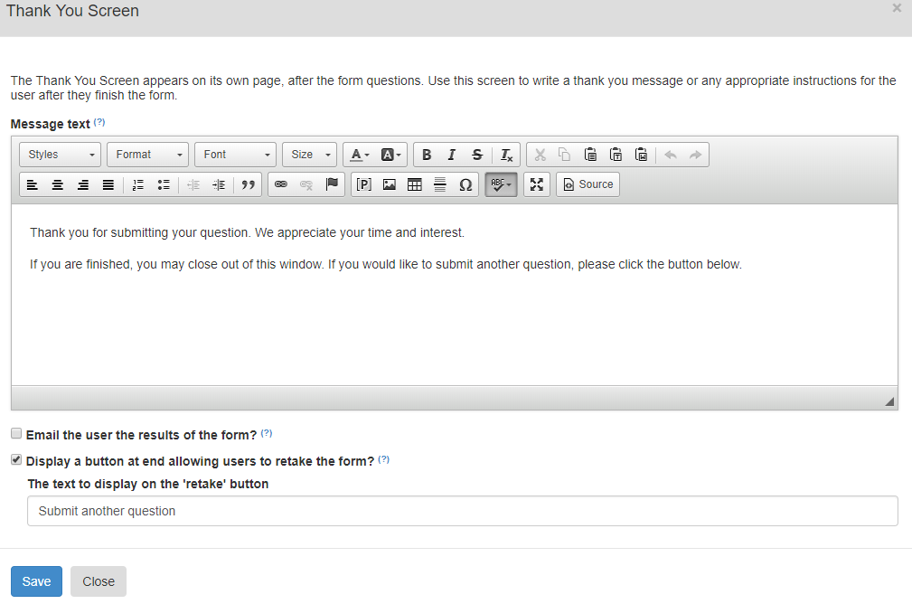
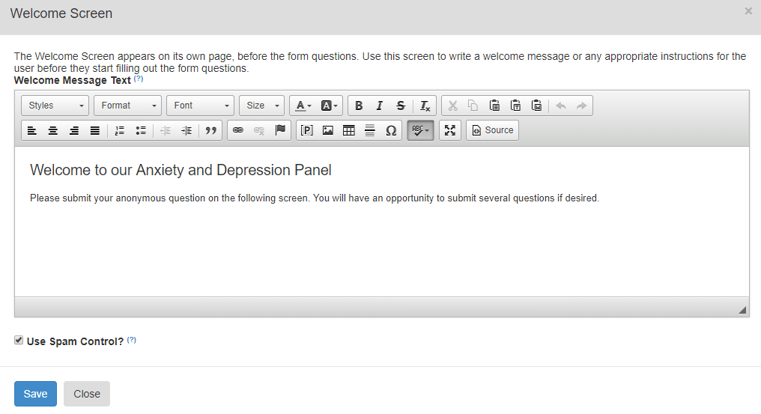
Notes:
These are the two screens people saw when they visited the form URL. We wanted to keep it as simple as possible as far as the welcome text, submission initiation, and we really wanted to make sure they were not limited to only one question.

Slide 35
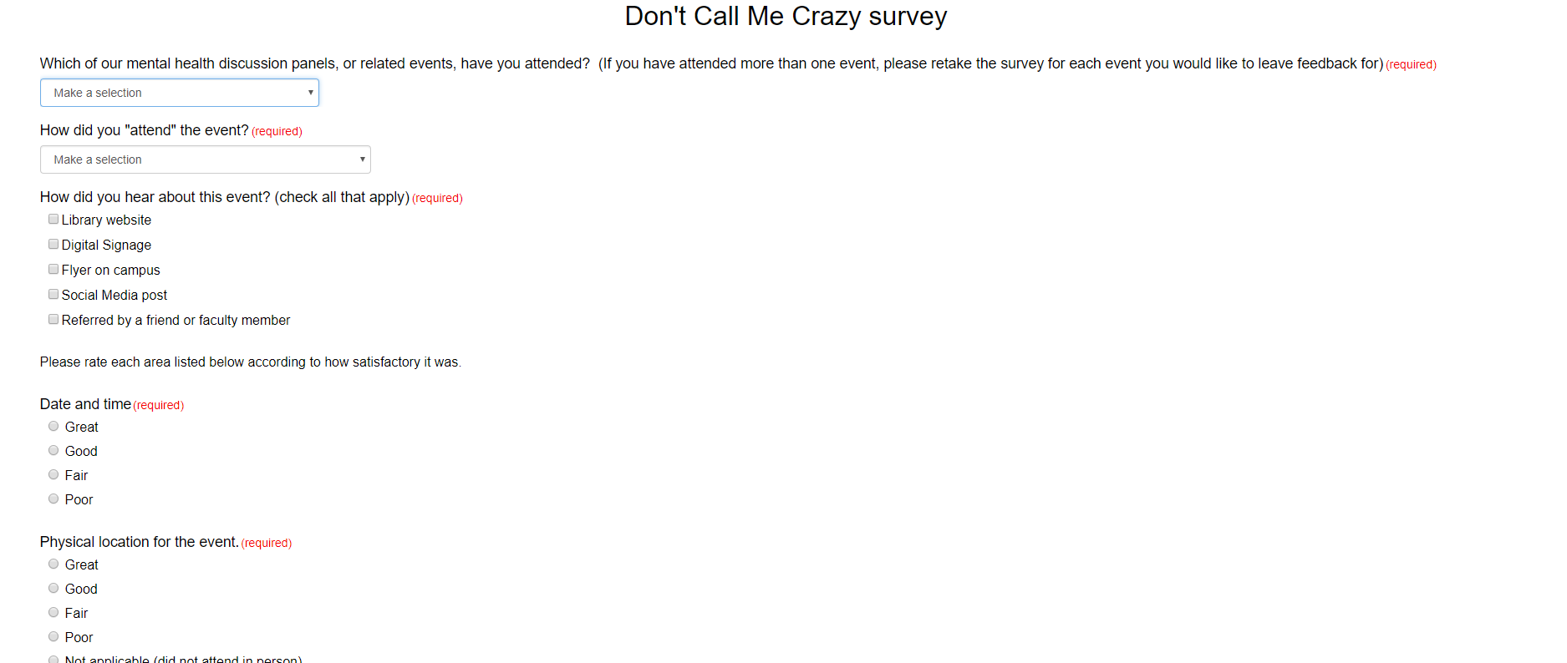

Slide 36
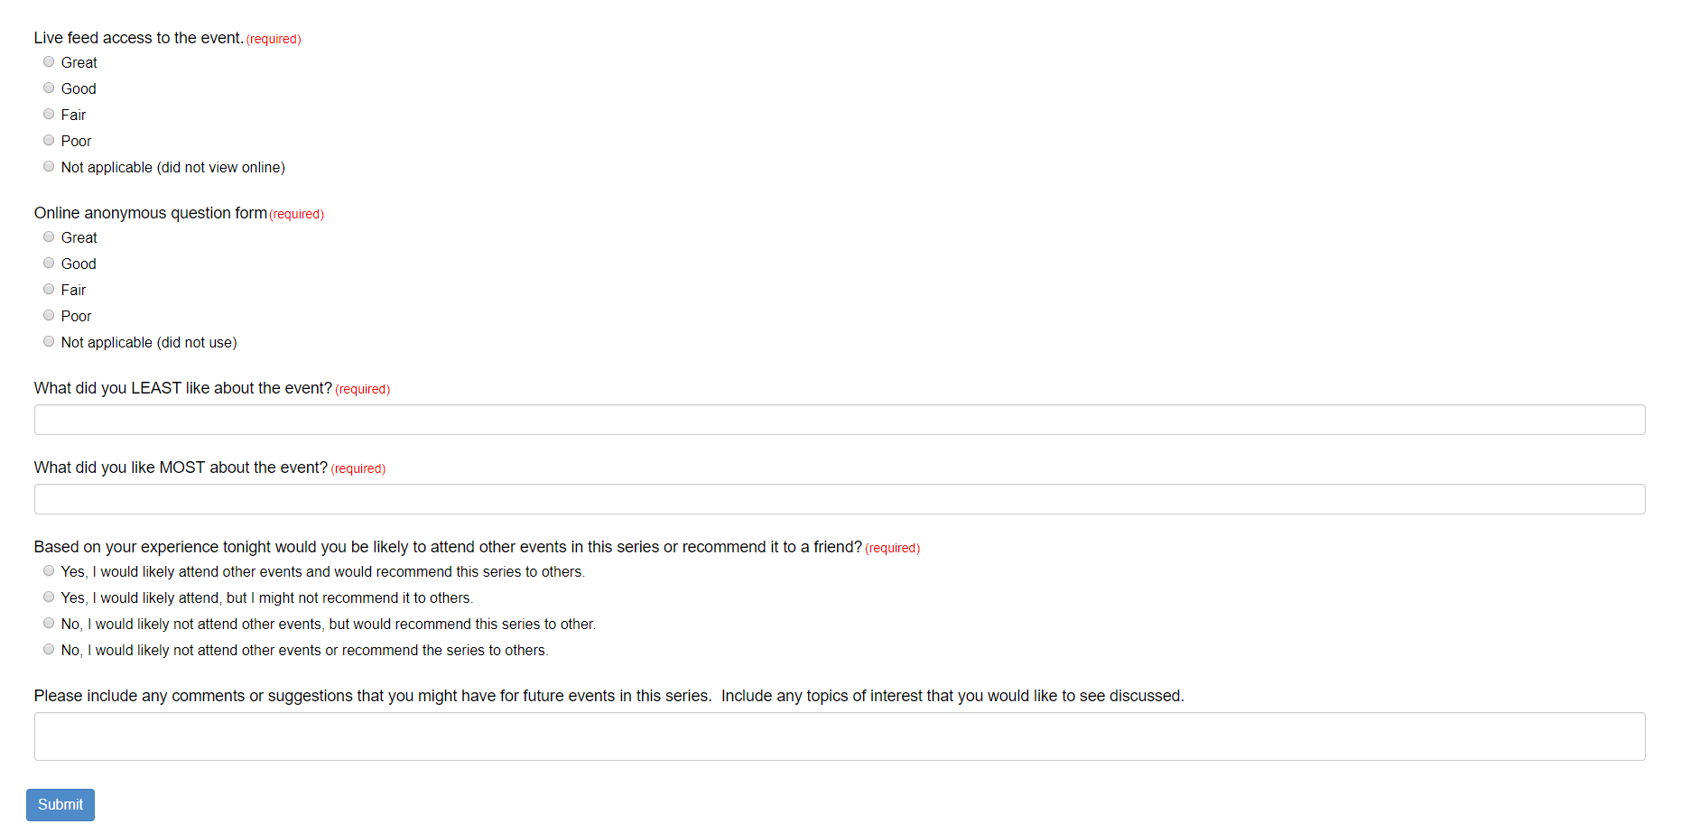

Slide 37
Opportunities for Growth
Connecting with community members (future events) and campus partners (Counseling Center trainings hosted by library)
Asking for feedback
Creating Self-Care library spaces
Notes:
The last component I’m going to talk about today is opportunities for growth.
First, a big part of doing any kind of outreach is making sure that you learn from and adapt to any ideas or problems. Luckily, at least at this mid-way point, I think it’s safe to say that we haven’t really experienced any problems.
Secondly, there’s always the hopeful guarantee that you’ll make connections with your on-campus partners, and I think that my colleagues have done that in leaps and bounds. We are not only involving the people from our MU departments and services in the panel discussions, but we have also started discussions with counseling services to host training sessions in our library. That’s really cool because one huge goal of outreach is simply getting people in the building, and when people can view the library as a place to get help- no matter what type of help that may be- it makes my little outreach heart very happy.
Another example is the formation of one idea for growth that we had just in discussing our content for this presentation: to provide feedback forms to attendees and panelists, which probably seems obvious to many of you but is something I didn’t think of doing before our first event.
Lastly, a few really awesome things that have come out of this process are some ideas that my coworkers have come up with, like finding a space in our library to turn into a sort of self-care or mediation space, which I know is one really huge current trend in all types of libraries today.
That’s all I have about the outreach aspect and the community components of our initiative. I’m going to hand it back to Kacy now to wrap everything up.

Slide 38
Conclusion and Considerations
Considerations
Book display
Interactive map
Live stream of the first panel discussion
Increase research guide use
Notes:
A few pieces of our initiative did not come to fruition for various reasons. We had originally planned to have MU Reads create a mental health book display. This plan was delayed by the success of our “HerdCon” display; HerdCon is our pop culture and entertainment convention that takes place on March 16, 2019 at Marshall University . We do still hope to feature mental health titles as a display in the future.
The interactive map that we had hoped to have created did not manifest.
We wish that we would have streamed the first panel discussion. We quickly remedied this.
We would also like to increase use of the research guide. Currently, the research guide has been viewed 318 times.
So I really liked the way that Sarah has used SpringShare’s LibWizard form option to facilitate our panel discussions, and I wanted to see if there was a way that SpringShare could give me insight into if and when the research guide is being viewed.

Slide 39
Notes:
LibGuides “Guide Tracking,” will let you choose a date range and run a report showing you when each guide is being viewed.
I definitely noticed that the guide is getting the most use in the days preceding our panel discussions, so I hope to investigate ways that I might use this trend to increase views and panel discussion attendance.
Does anyone have any questions? About the initiative? About implementation? We would be happy to discuss any aspect of the project.

Slide 40
References
West Virginia Department of Health and Human Services. (2016). West Virginia Behavioral Risk Factor Surveillance System Report 2016, West Virginia Department of Health and Human Services. www.wvdhhr.org/bph/hsc/pubs/brfss/2016/BRFSS2016.pdf

