Slide 1
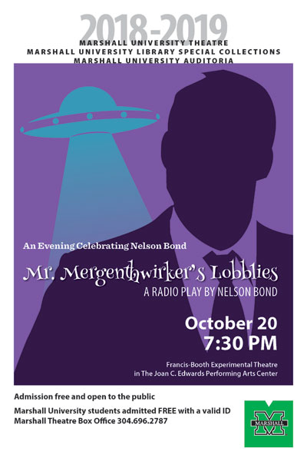
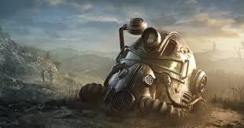
A RADical Proposal:
Coordinating and Organizing Library Outreach
Events / Displays
A Presentation
created by
Lori Thompson
and
Seth Nichols

Slide 2
Introduction:
Marshall Special Collections
Pre-Production and Planning: Pitfalls and Progress
Theming and Branding:
Or How to Look “Cool” to Youngsters
The Big Day:
Is It Over Yet?

Slide 3
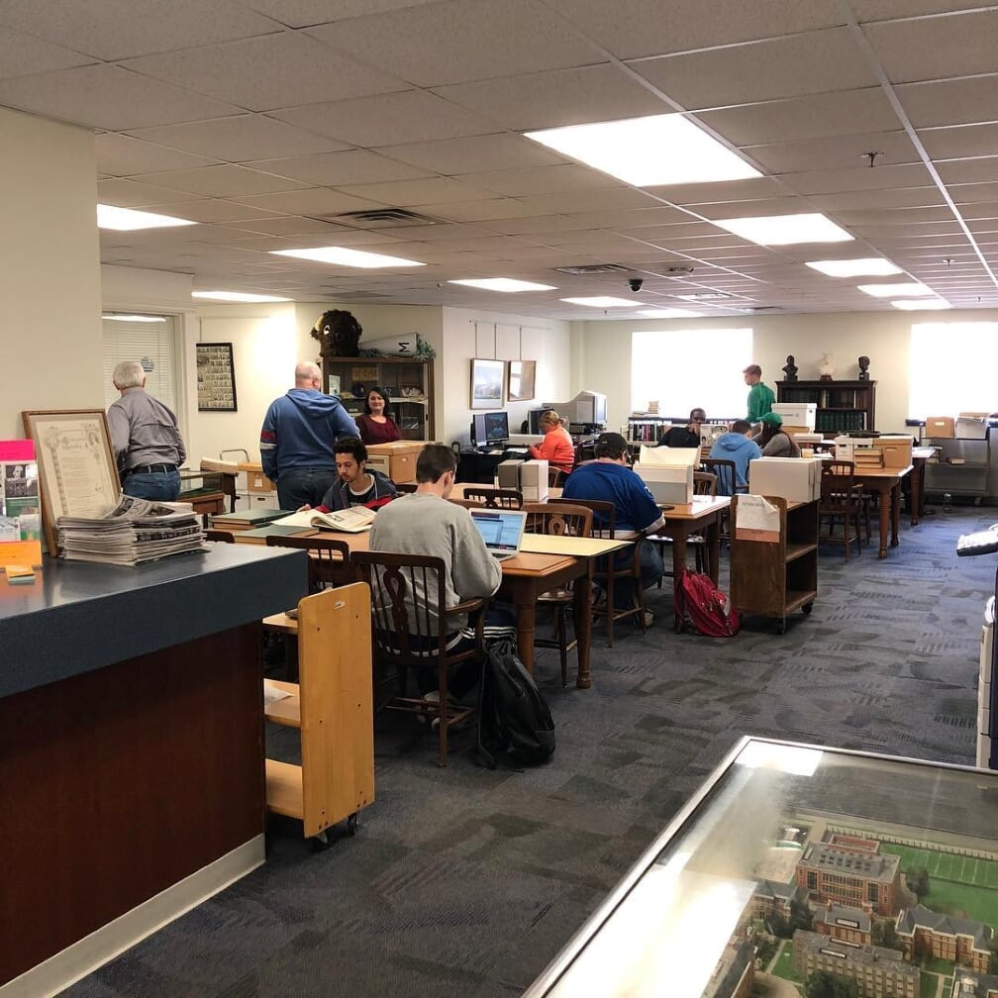
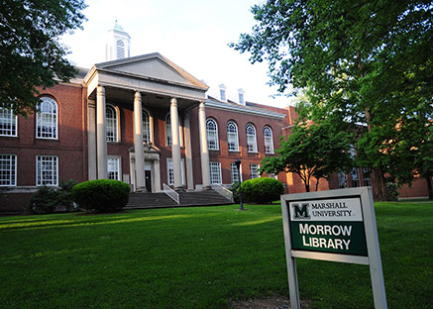
Who Are We?
Special Collections at Marshall University
James E. Morrow Library (NOT Drinko Library, the Original One!)
2nd Floor, Old building
Very niche audience.
Community History
Family History
Marshall History
Introduction

Slide 4
Past Outreach:
Very Limited Outreach.
Donor Based.
Collection Based.
Exclusive. (Invite-Only)
Community Centered.
Formal Setting and Attire.
Academic Events. (such as Presentations)
Examples of Past Outreach:
Huntington Rotary Gala
Matthew A. Reese Dinner
Family History Lock-In
Presentations
History Day at State Legislature
Reese Poster at the Mid-Atlantic Regional Archival Conference
Talks at Other Academic Conferences.
In a 35 year period, absolutely “0” student-based outreach events.
Introduction

Slide 5
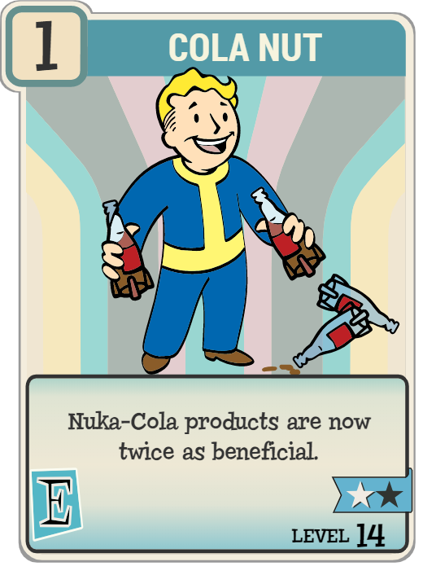
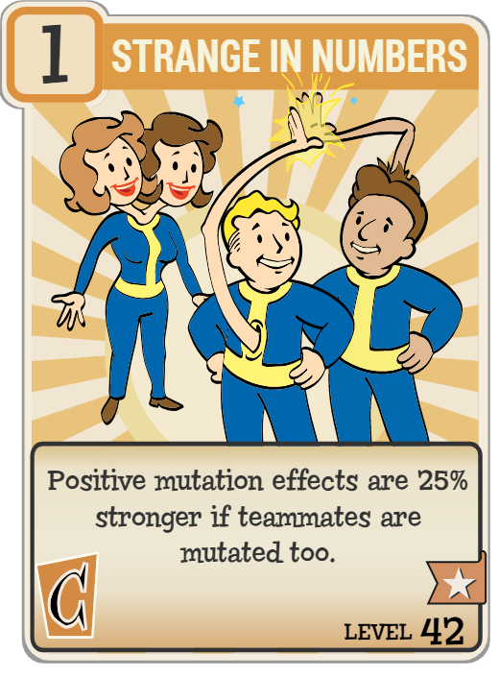
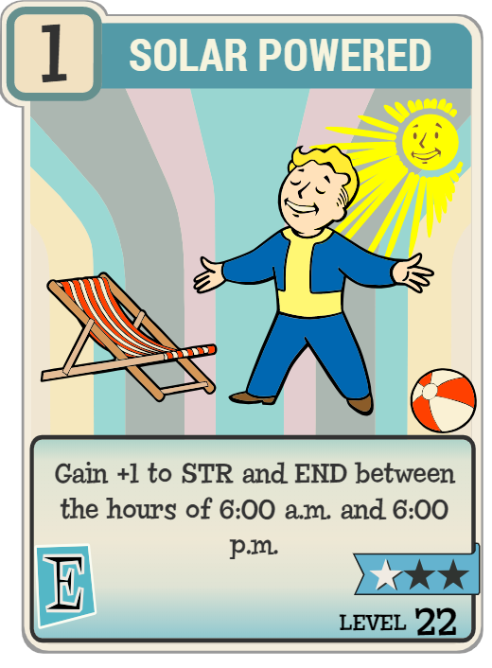
And Then There’s Us…
Introduction

Slide 6
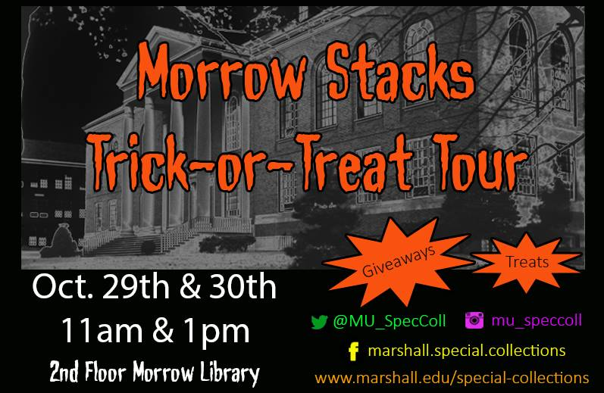
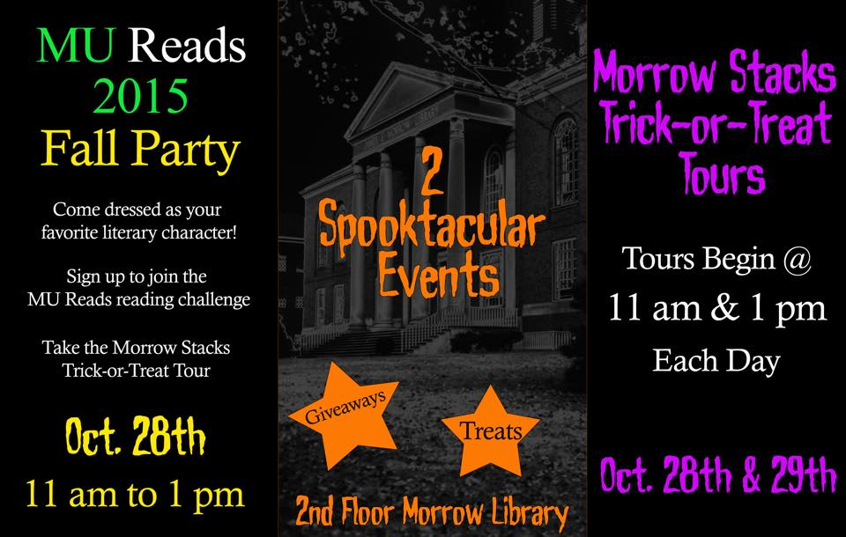
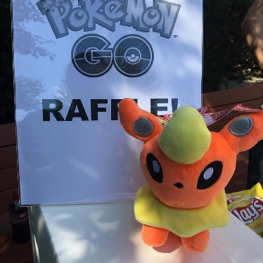
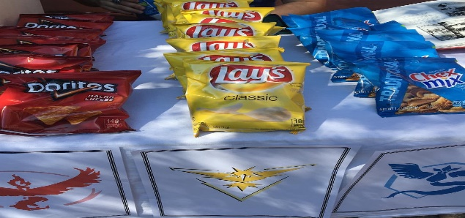
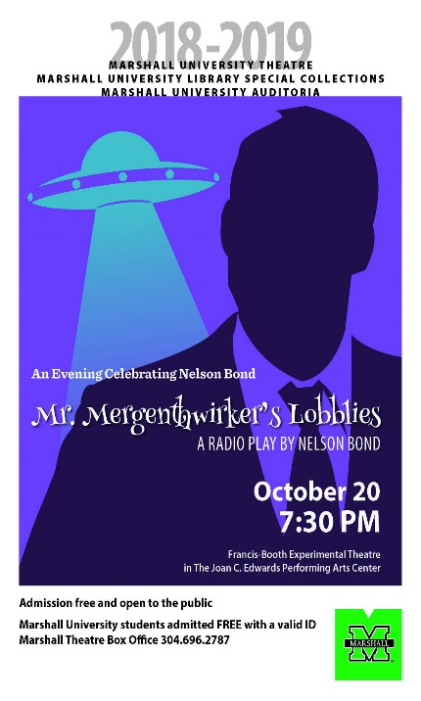
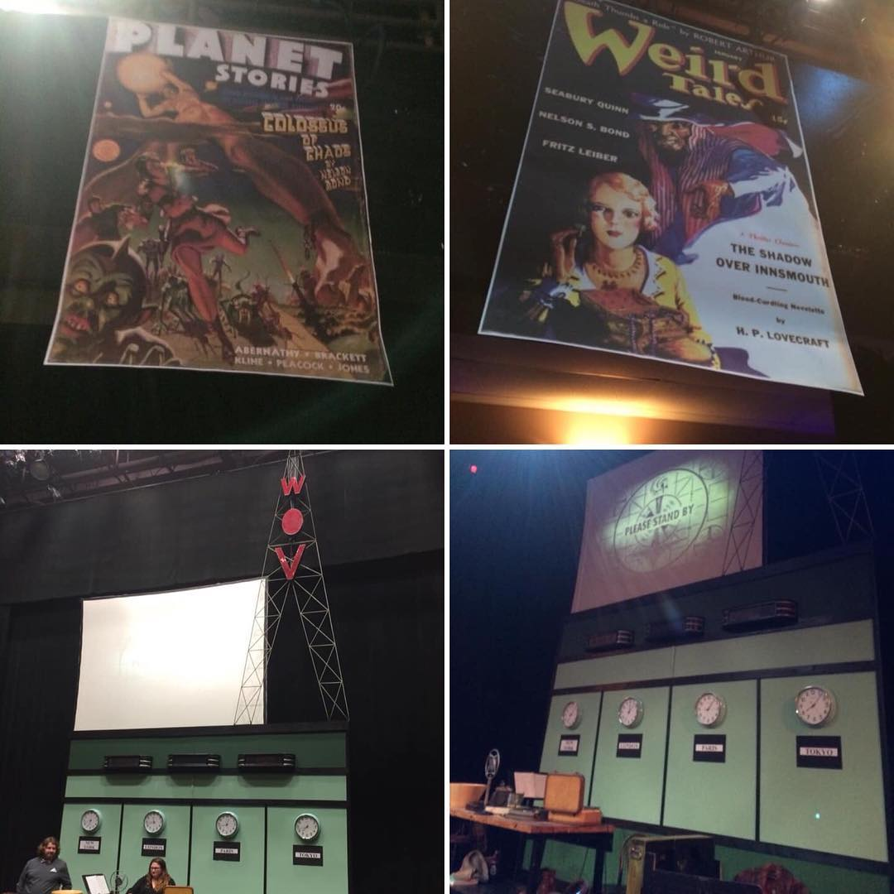
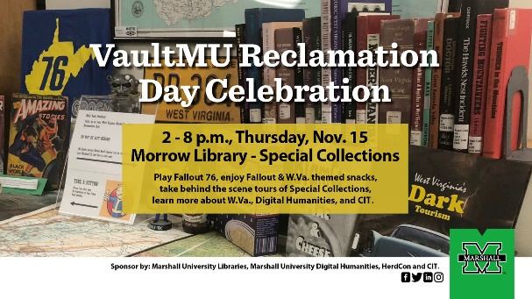
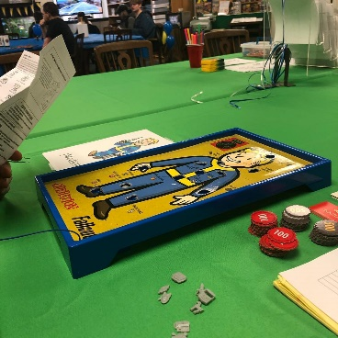
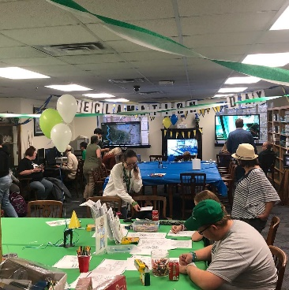
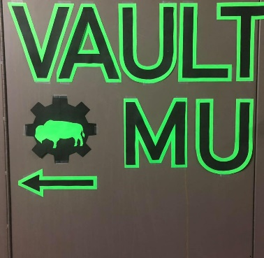
Pokemon Go:
Outside Event
Morrow Stacks
Halloween Tours
Vault MU: Fallout Event
Nelson
Bond
Theatre
Play

Slide 7
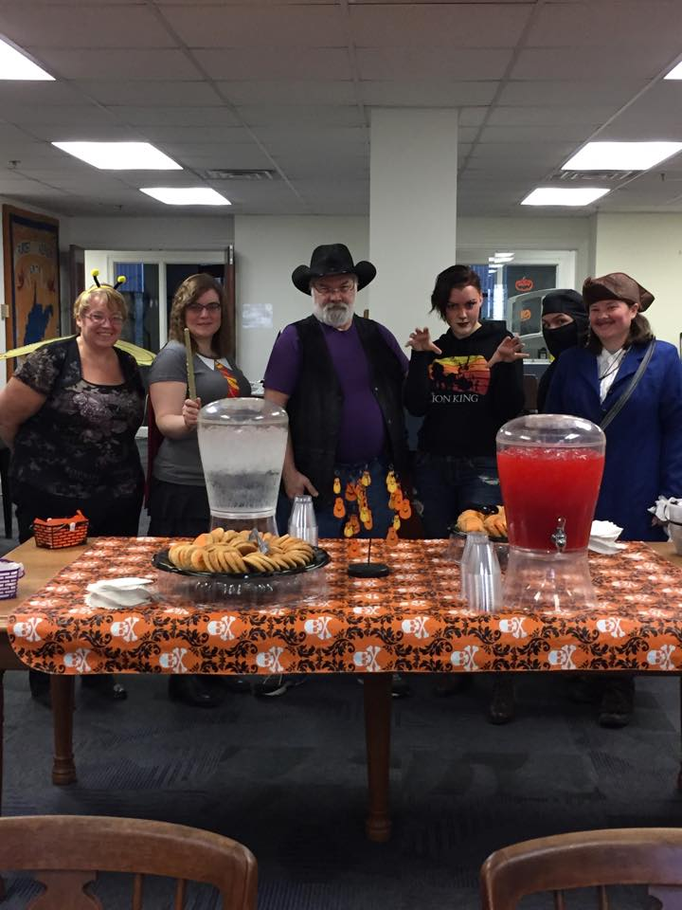
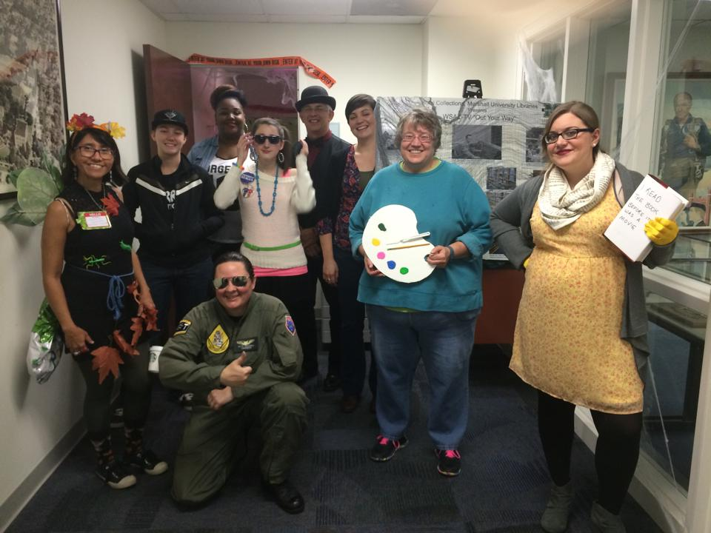
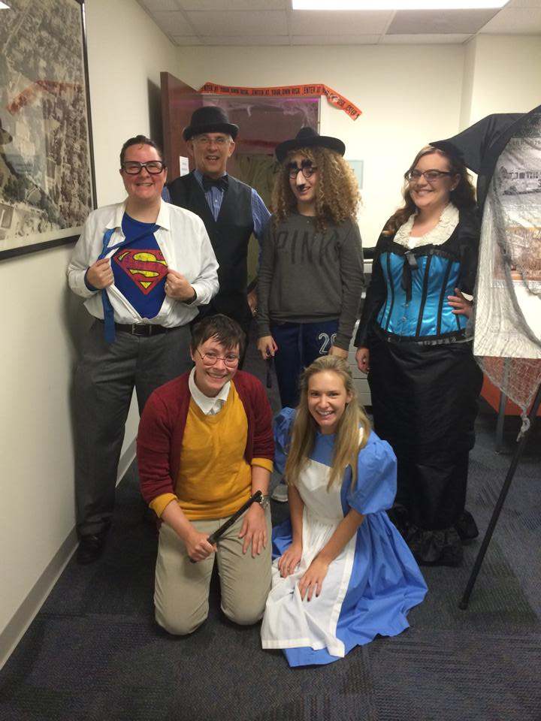
Morrow Stacks Halloween Tours (2014 & 2015)
First attempt at campus outreach.
Guided tour of our Morrow Stacks
(w/added Halloween decorations)
Costumes and some refreshments.
Relaxed, come and go atmosphere.
Social media posting along with giveaways.
Attempt to (de)mystify the Stacks and the Special Collections as a whole.
Introduction

Slide 8
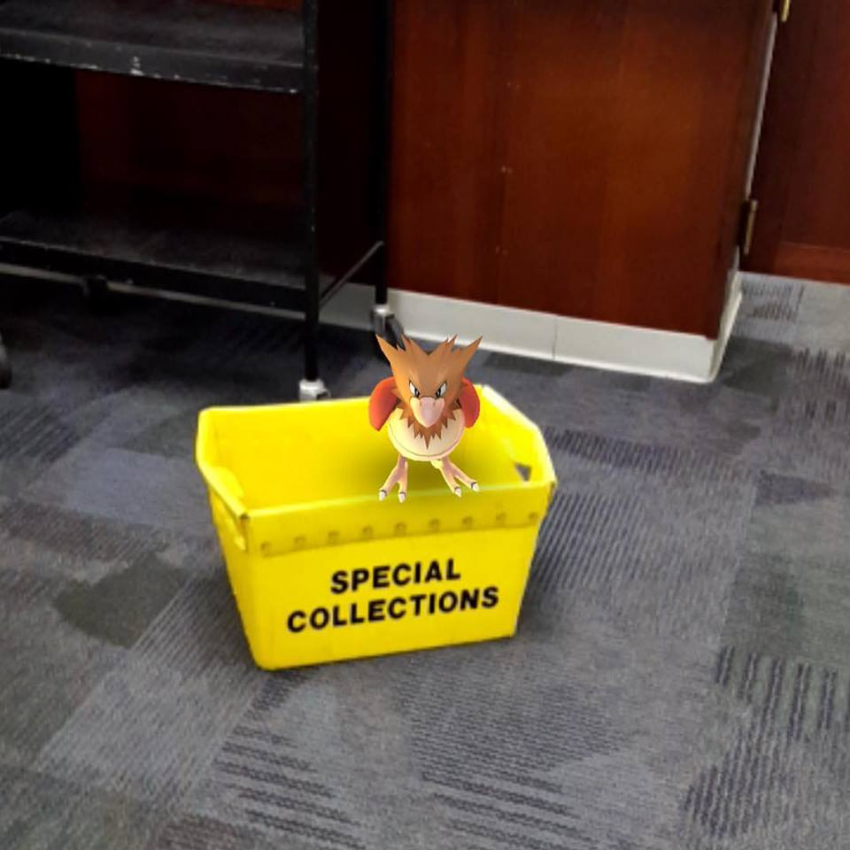
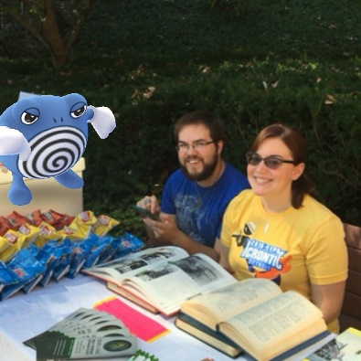
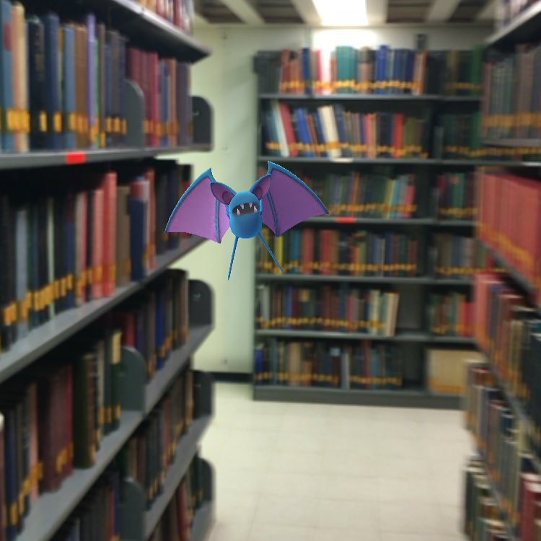
Pokemon Go:
Outside Event (2016)
Very last minute. Quick Preparation.
Low Budget (Refreshments and Giveaway items)
Timely. But on the tail-end of the craze.
Morrow was a PokeStop and a Gym and also we were players ourselves.
Themed and tailored to Pokemon Go players.
Brought it outside for visibility.
Social media posting.
Introduction

Slide 9
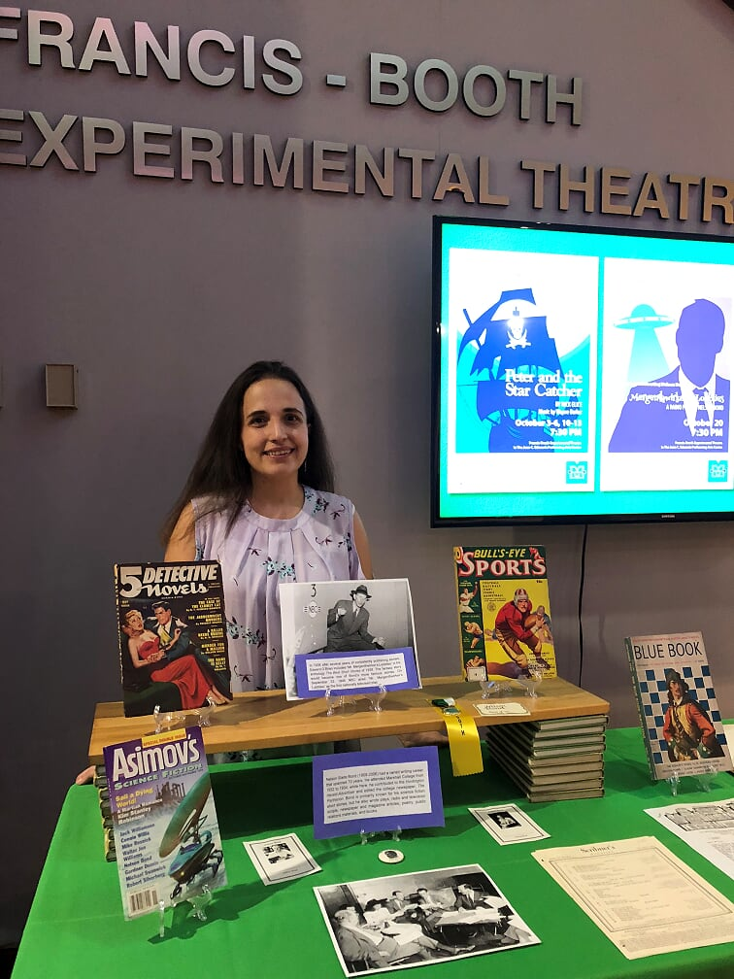
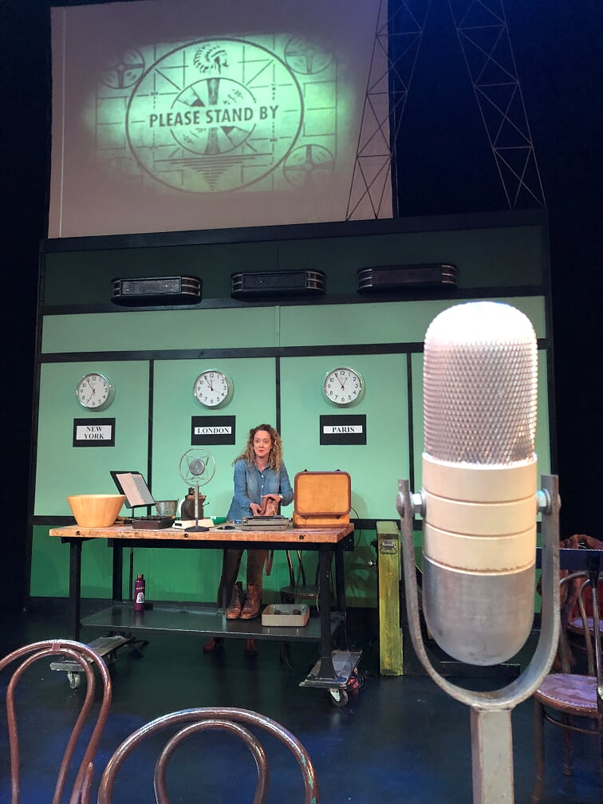
Nelson Bond
Theater Play (2018)
First attempt at interdepartmental collaboration.
Closer in style to older outreach events. Included an exclusive formal dinner with Bond family.
Utilized a lot of our own unique items within the collection to “brand” the event.
Long term planning. Started discussion of a Nelson Bond performance in March 2018.
Social media posting.
Set up a table at the event to showcase those materials.
Introduction

Slide 10
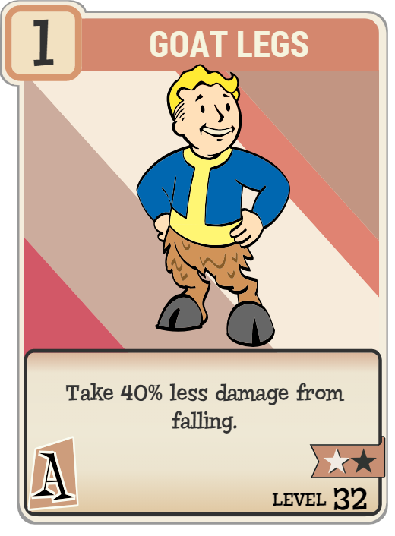
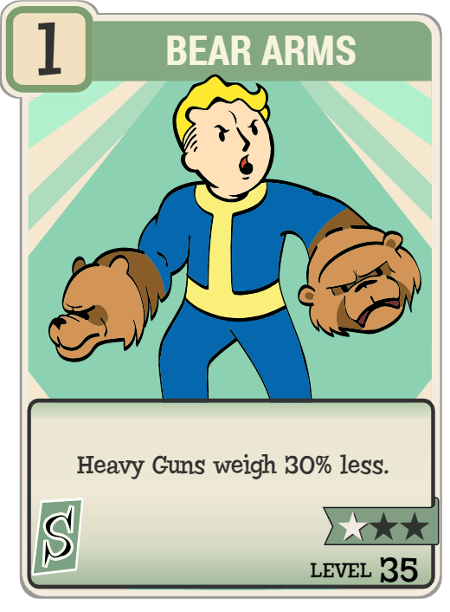
Vault MU:
A Mutation of Ideas
The Event Needed to Be:
Timely Event.
Relaxed, Come and Go Atmosphere.
Themed to Fallout
Clear Branding Associated with Special Collections
Social Media Presence
Introduction

Slide 11
Pre-Production and Planning:
Pitfalls and Progress

Slide 12
The Announcement!
May 30, 2018
Pre-Production and Planning

Slide 13
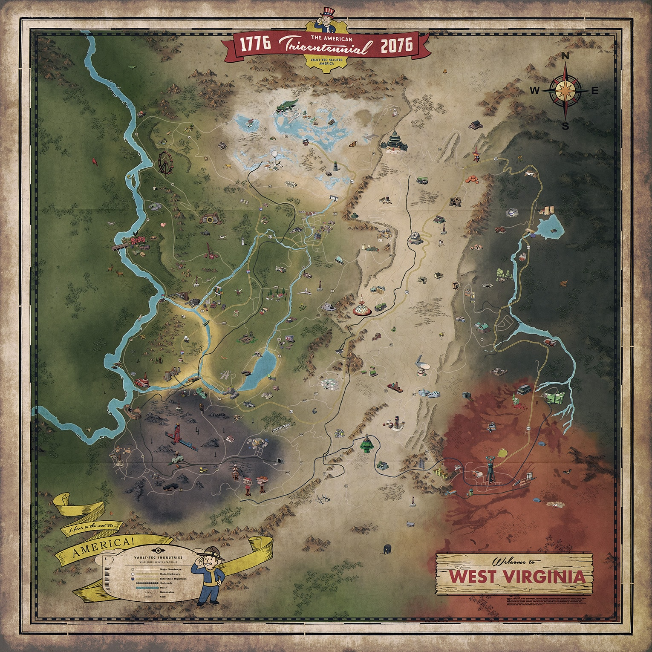
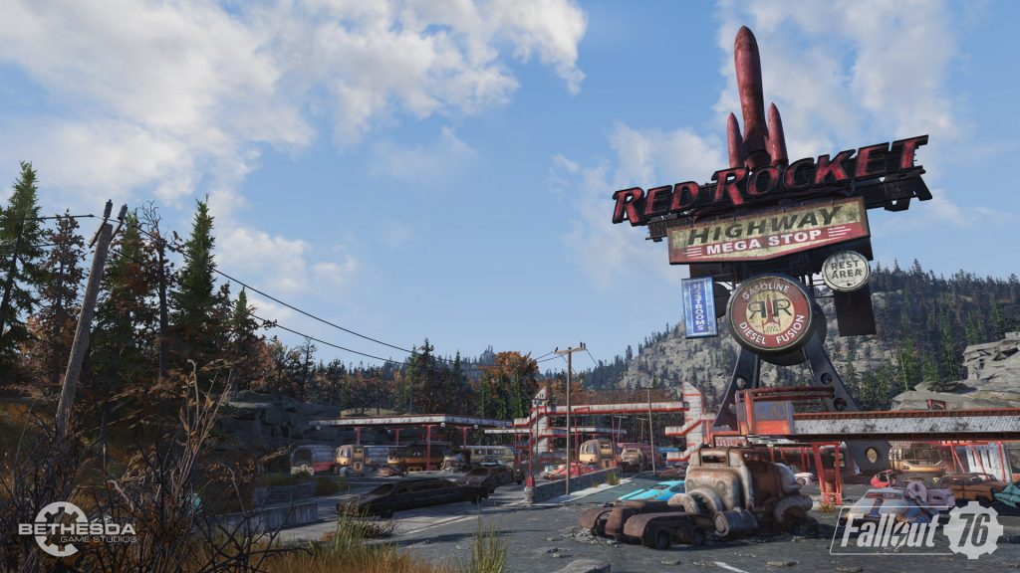
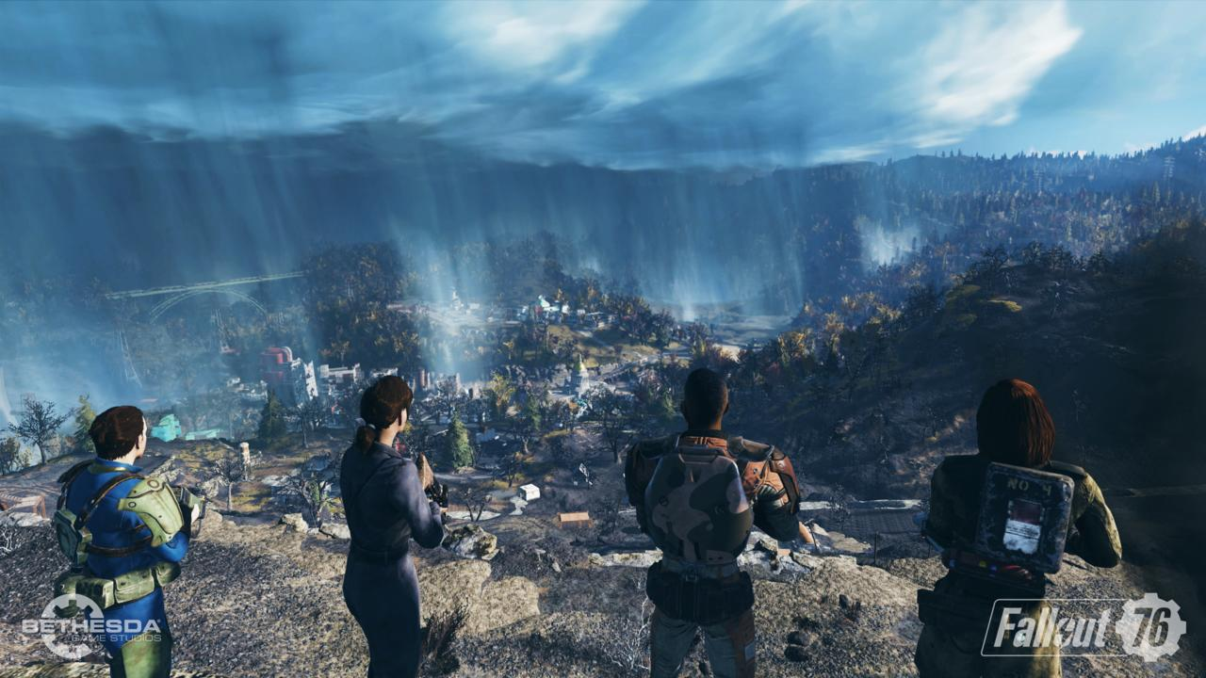
What is Fallout 76?
Fallout franchise originally created by Black Rock Studios in 1997.
Now created by Bethesda Game Studios since 2008.
Set in a fictionalized post-apocalyptic future America.
Retro-1950s aesthetic. (Rockets, atomic power, robot assistants) Think Flash Gordon meets Norman Rockwell rolled up into The Road Warrior.
Most Fallout games take place near a city of the United States. Fallout 76 takes place in all of West Virginia.
Pre-Production and Planning

Slide 14
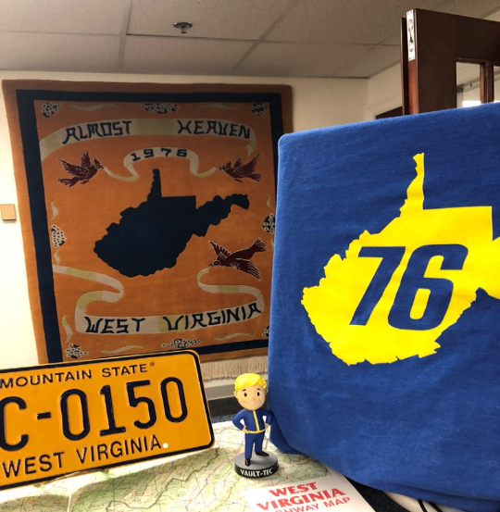
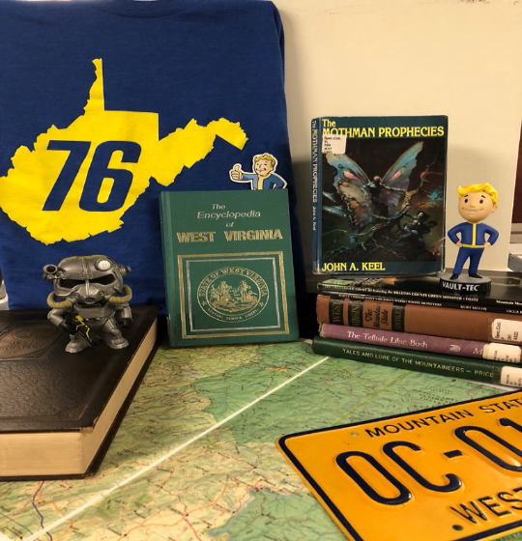
Timeline
May 30, 2018 – First Teaser Trailer, Announcing Fallout 76
June 10, 2018 – Bethesda E3 Conference,
Formal Announcement of Fallout 76
Game is to set in West Virginia.
June – August, 2018 – Lori and Seth discuss and
geek out over the game.
August 13, 2018 – Seth creates a social media display/post in order to tie Special Collections to the new Fallout game.
Pre-Production and Planning

Slide 15
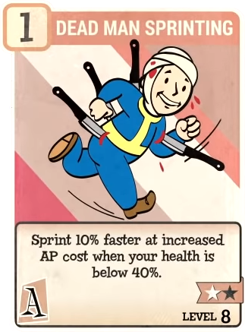
Timeline
August 31, 2018 – The beginnings of formal discussion on a campus-wide event.
September 18, 2018 – We begin preparations for a Special Collections based event that will occur when the game launches.
(as opposed to waiting to January!)
September - October – Planning, Coordinating, and Decorating for the event.
Game releases November 14, 2018!!!
Pre-Production and Planning

Slide 16
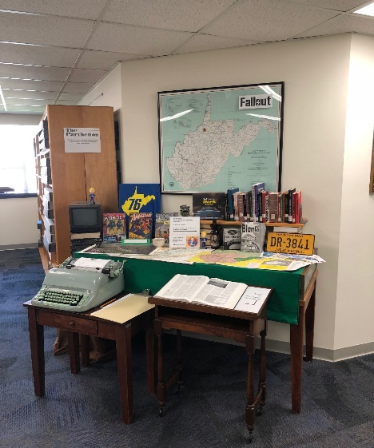
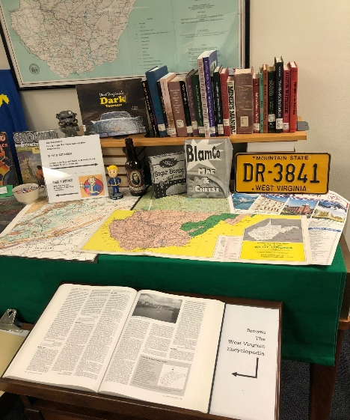
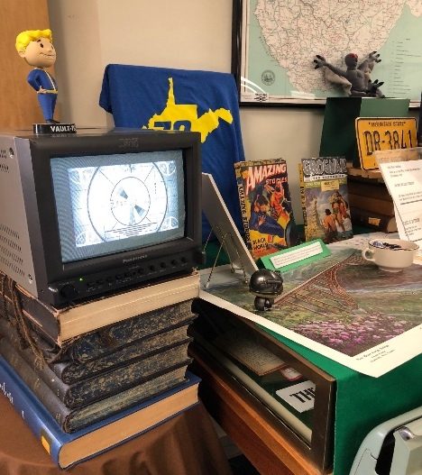
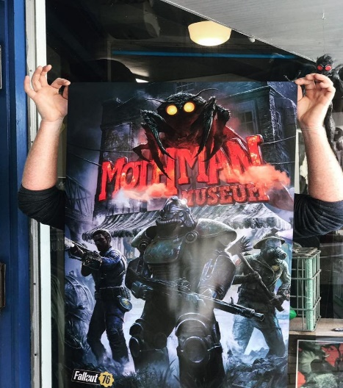
An Event is Born
Our vision changed. Constantly.
We had to receive approval from the administration. Thus we needed to give an outline of our vision.
There were discussions occurring throughout campus.
Who was already planning their own events? (Would we be stepping on toes?)
Would these events overlap?
Was this worth it to the libraries?
Pre-Production and Planning

Slide 17
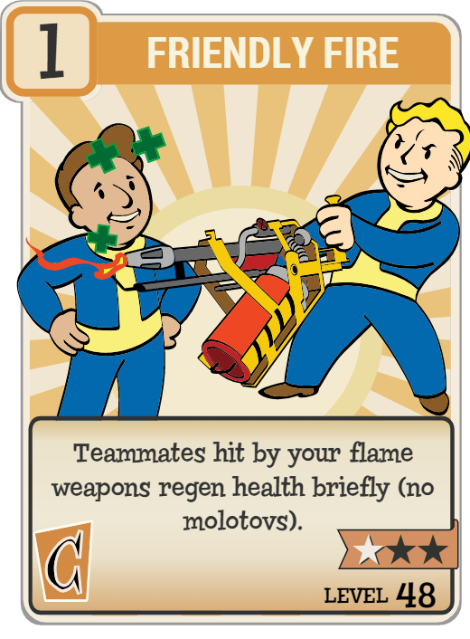
Collaboration
We had a meeting on September 26th
The only meeting.
Groups represented:
Digital Humanities
Drinko Library
Special Collections
HerdCon
Marshall IT
College of Information Technology
Autism Training Center (?)
We mostly communicated through one long email chain.
Different Visions…
Different Agendas…
…And No One Making Decisions.
Pre-Production and Planning

Slide 18
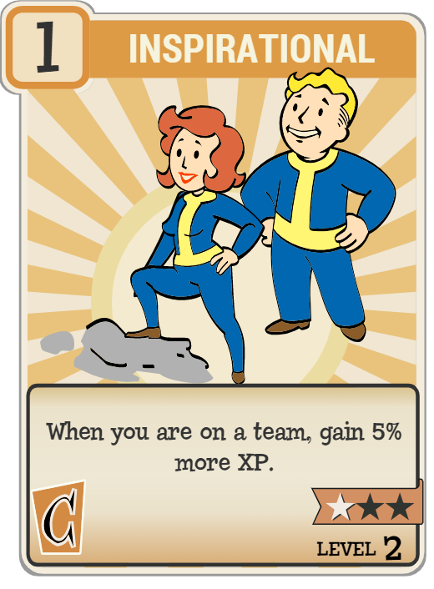
A Leader Will Rise!
Special Collections took charge.
Lori was able to settle factions and laid down a clear outline of the event.
The event would be:
Called VaultMU
An opportunity for students to play the game.
A celebratory party that would show off materials from Special Collections.
Have a reception with refreshments.
A time for each group to “sell” its upcoming event/class/group involvement.
The event would happen the day after launch: Nov. 15 (in consideration of the Plane Crash Memorial)
The event was to be campus affiliated. We were there for students not the community at large.
(This became important later)
These decisions did not fully emerge out of the meeting, but came about through important considerations.
Pre-Production and Planning

Slide 19
Considerations:
Practicality –
Limited Budget
Unknown number of attendants (Free entry)
Unknown state of game (known for “bugs”)
Time constraints (2 months prep)
Tech –
How many game systems / TVs could we get?
Copies of the game
Wireless internet use for each system
Streaming set-up (CIT expectations)
Locations to set-up (outlets)
Tech support for issues
Privacy Concerns –
Sportsmanship / Conduct –
Family friendly atmosphere
Inappropriate comments / rude behavior
Sharing worry
Anger / Rage concerns
No mic set-up
Managing Expectations (Internal / External) –
Playing nice with other events
Campus-based
Outside groups
Sticking to the outline
No pre-events
Providing attendees with accurate expectations of the event.
Pre-Production and Planning

Slide 20
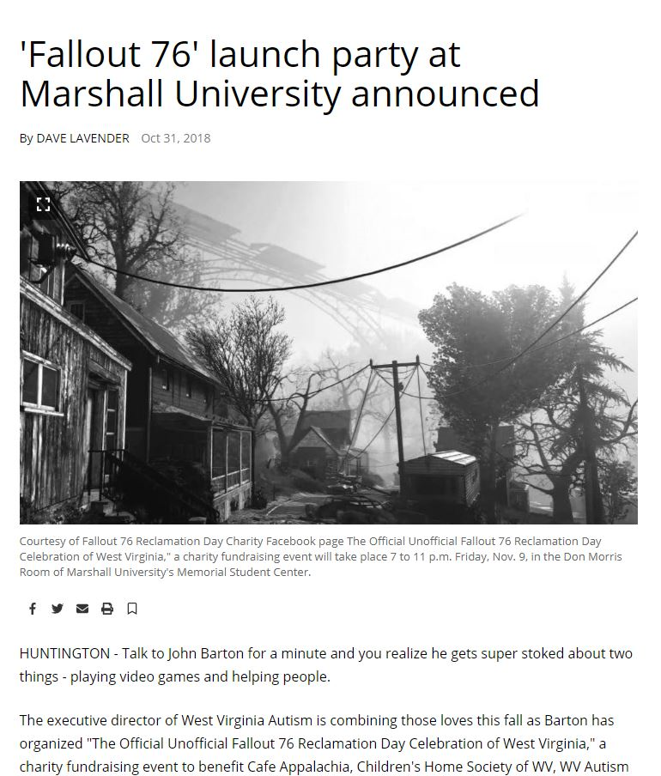
Complications:
Lack of Communication
No idea what others were doing
No discussion about helping with the event
Assigned roles were not completed
Inconsistent Messaging / Other Events
Making ourselves distinct from other events.
#VaultMU
Several flyers for our event
But members wanting to connect to these events.
Attempts to hijack messaging
Expectations
Competing Agendas
Not a springboard for “Your” event.
Lack of Leadership
Budget
More for Less
Get Creative
If you have to have it, you have to pay for it.
Article from the Williamson Daily News
Pre-Production and Planning

Slide 21
Theming and Branding:
Or How to Look “Cool” to Youngsters

Slide 22
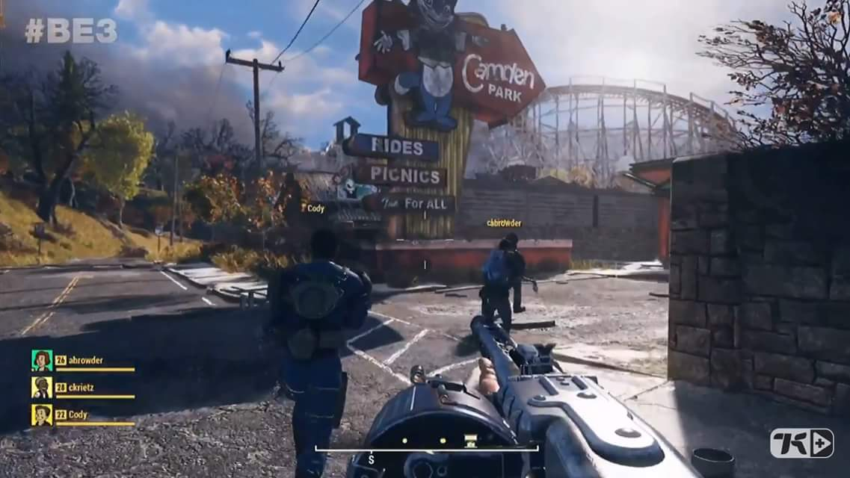
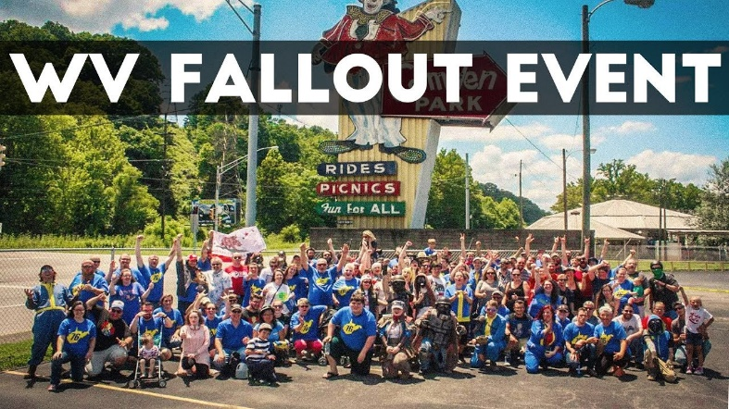
Making Connections
Our primary objective: How to increase student activity in Special Collections.
Why was Fallout perfect for that objective?
Popular game
Set in West Virginia (Most of our material is West Virginia based)
Retro-Future aesthetic (We have lots of materials from the past to fit this theme)
We really were perfectly set up to capitalize on this game, much of our materials mirrored things you could find in the game.
We knew there was a great surge of students interested in Fallout due to the popularity of the display and also meet ups that occurred around places mentioned in the game.
Theming and Branding

Slide 23
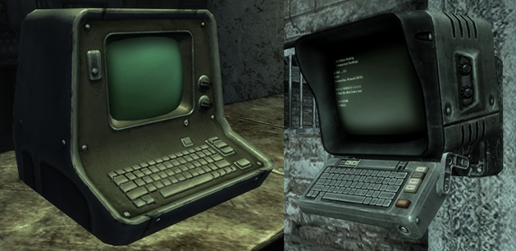
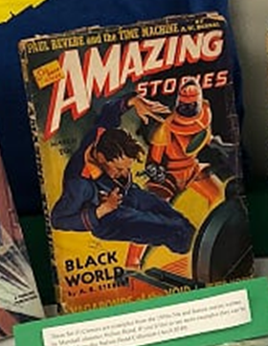
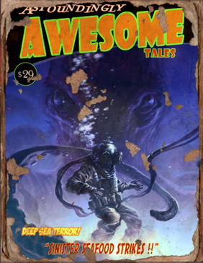
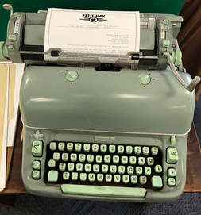
Items in Fallout
Items We Had
Theming and Branding

Slide 24
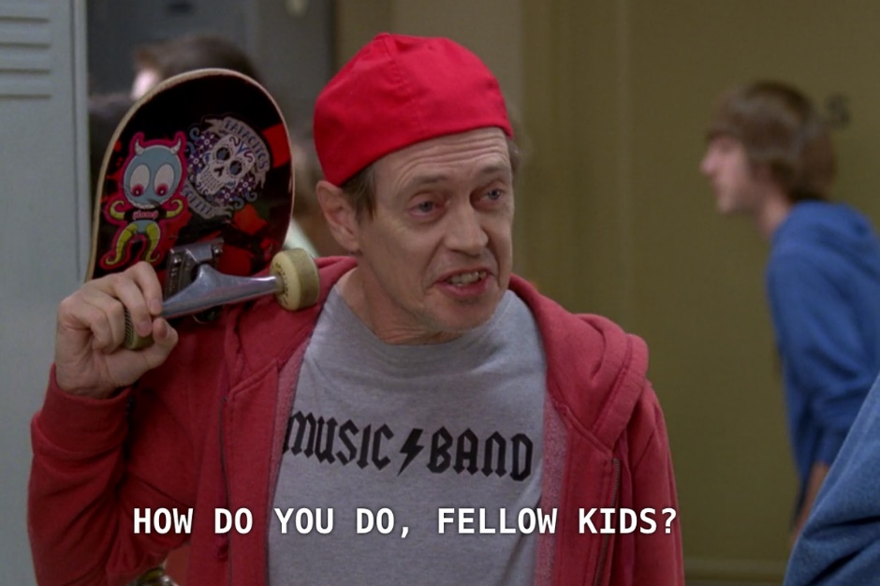
Details Matter
We were lucky in that we both were already fans of the game and had played them.
But as librarians we also have the capability to “find this detailed knowledge.”
Nothing makes fans cringe more than “newbies” trying to be hip.
When planning an event, theming matters immensely and should be a way for you to connect relevant materials to people who are already interested but unaware.
Small details add up and make events memorable: VaultMU
Tailor the situation
to the location
to the event!
Theming and Branding

Slide 25
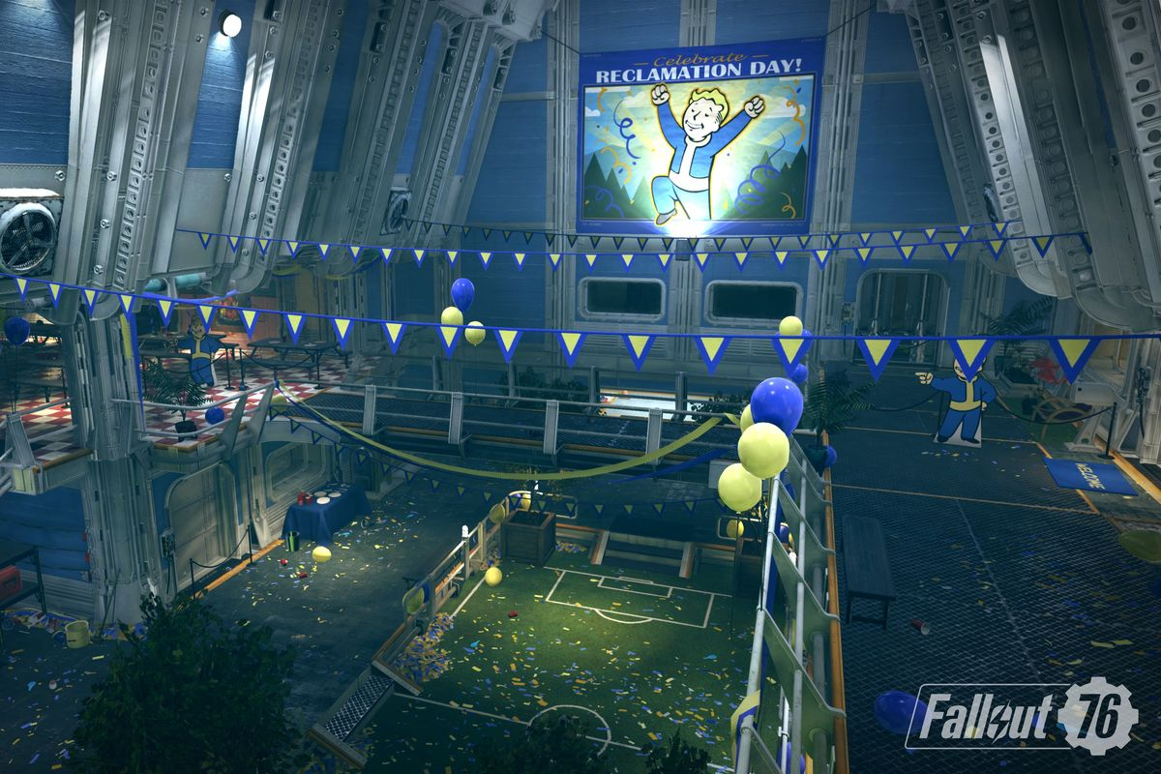
Theming the Décor
Think about what you have to work with. Break it down into components.
Trailer and Screenshots for Fallout 76
Other games in Fallout series
1950s Sci-Fi
American History
Science (Atomic Energy / Radiation)
What’s your budget? How much do you want to devote to decorating your space?
Get Creative.
Signs (Images and Fonts)
Streamers
Balloons
Table cloths
Colors (of the décor)
Layout of your space
Book Displays
Don’t get too mired in details.
Theming and Branding

Slide 26
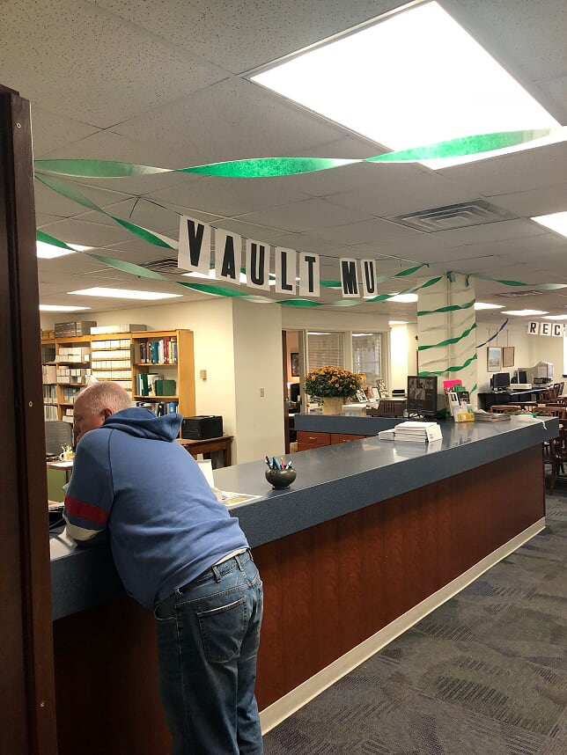
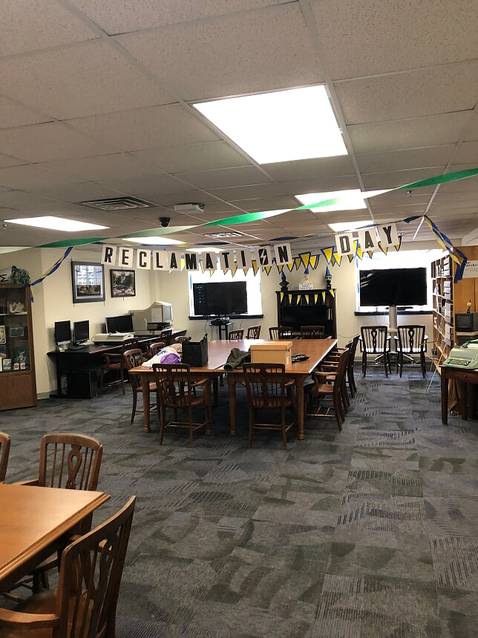
Theming the Décor
Theming and Branding

Slide 27
Theming the Activities
There will be times when people won’t be playing the game. What then?
Other activities:
Brand board games
Coloring Sheets
Reading
Tours of Special Collections
Corn-hole (X)
Green Screen (X)
It’s not just enough to have other activities but how are they themed to the event? The setting?
Reasoning can be stretched, but people appreciate a reason.
Theming and Branding

Slide 28
Crucial Minor Details
Some of the best responses we got from patrons were when they realized we knew a lot and were big fans.
What are some ways you can embellish your event?
Examples:
Vault Acceptance Letters
Typed Letter from Important Character
Signs
Food
Food Descriptions
Don’t forget to talk to your guests about the thing they like!
Theming and Branding

Slide 29
It Pays to Have Sponsors!
Theming and Branding

Slide 30
Branding: How Do You Stand Out
Sometimes you aren’t the only one planning an event.
We had 4 other related events:
Fallout Charity Event – WV Autism Center
College of Education / WV Dept. of Education Fallout panel @ conference in January
Fallout B.E.T.A. Party (Hosted by CIT)
HerdCon used Fallout messaging to promote its convention.
What separates your event from any of there’s? How do you cut through the noise?
Helpful Tips We Learned:
Get creative with your messaging.
A catchy title or “#” can help your event look unique and hip. (#VaultMU)
The earlier the better.
We already started off behind and had a hard time catching. Going through University Communications = Delays.
Market to your target audience.
Go to where your audience pays attention. Whether its social media, local flyers, forums, newspapers, letters, etc.
It is ok, to decide its not worth the effort.
If there are other events that will overshadow you, or you don’t feel there is sufficient “hype” its ok to save your time/energy for another time.
Theming and Branding

Slide 31
Branding: How Do You Stand Out
Theming and Branding

Slide 32
Branding: Timing is Key!
Timing matters not only in prep work, but when the event occurs.
Where other events had to determine how to incorporate the game into their event. The game was the core of our event.
Too early = Messaging not as effective, game not present, focus becomes about non- game aspects, help build the hype.
Too late = Game is present, reaction to the game (for good or ill), hype has moved on, all the time you need to plan / message.
We chose after launch in order for students to be able to access the game.
Consider launch days, movie / book releases, or important dates within the subject you are highlighting (ex. Harry Potter’s birthday). Details matter.
Theming and Branding

Slide 33
The Big Day:
Is it Over Yet?

Slide 34
The Final Week
Last Minute Preparations and Purchases.
Major Marketing Push
Campus Flyers
Social Media
Library Signs
Begin Decorating
(Mindful of Memorial and Daily Library traffic)
Gathering Raffle items and collecting additional refreshments / snacks.
Informing regulars of the specifics behind how the Fallout Event will effect our library. (when, where, what)
Make sure everyone is on the same page! This is it.
You get one shot.
The Big Day

Slide 35
Fallout Fatigue
High Spirits!
Low Energy!
The Big Day

Slide 36
D-Day: Nov. 15th
Overnight: Putting up Streamers / Banners / Signs
Decorating Everything.
Filling up Balloons (Helium Issues)
Moving the Layout of our Reading Room
Setting Up Tech and Stations
Testing the Game. Make sure it runs.
Passing out shirts to volunteers. Going over final plans with VaultMU Staff.
Getting food set up at assigned location.
The Big Day

Slide 37
We Hit A Home Run!
The Big Day

Slide 38
We Hit A Home Run!
The Big Day

Slide 39
Media Coverage
The Big Day

Slide 40
The Big Day

Slide 41
What Worked?
Connecting
with
Students
The Timing
of
the Event
The Messaging
The
Details
The Big Day

Slide 42
What Didn’t Work?
No Written Policies:
(Behavior /Damages)
Communicating with Other Departments / Groups
Sign-In / Sign-Up
Sheets
The
Messaging
Accounting for Everyone at the Event
Accessibility
Lack of Leadership (Early On)
The Big Day

Slide 43
How Do You Prove That You Were Successful?

Slide 44
Takeaways:
Plan Early. Plan Meticulously.
Spend Time Sharing the Vision of your Event.
Communicate Often.
(Pretend Like You Like Each Other)
Details Matter.
Timing is Important.
Capture the Zeitgeist!
Don’t Be Afraid to Take a Chance.
Be Unique. Sell that Uniqueness!
The Big Day

Slide 45
ASK US QUESTIONS! PLEASE!!!!!

